Slide 1
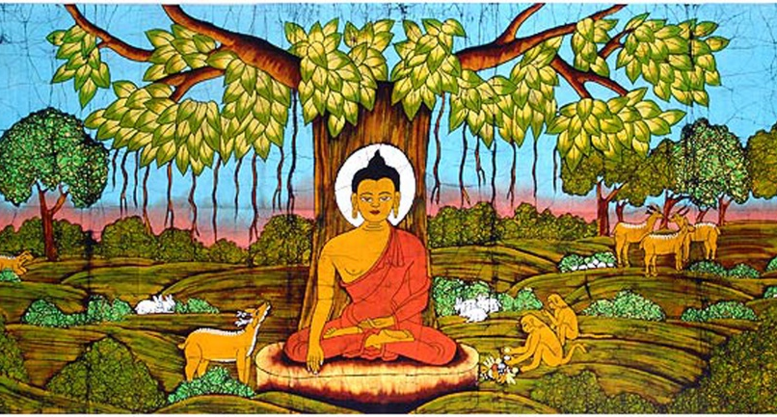
Buddhism and the Environment
HPRS5009/C & HPRS6009/C

Slide 2
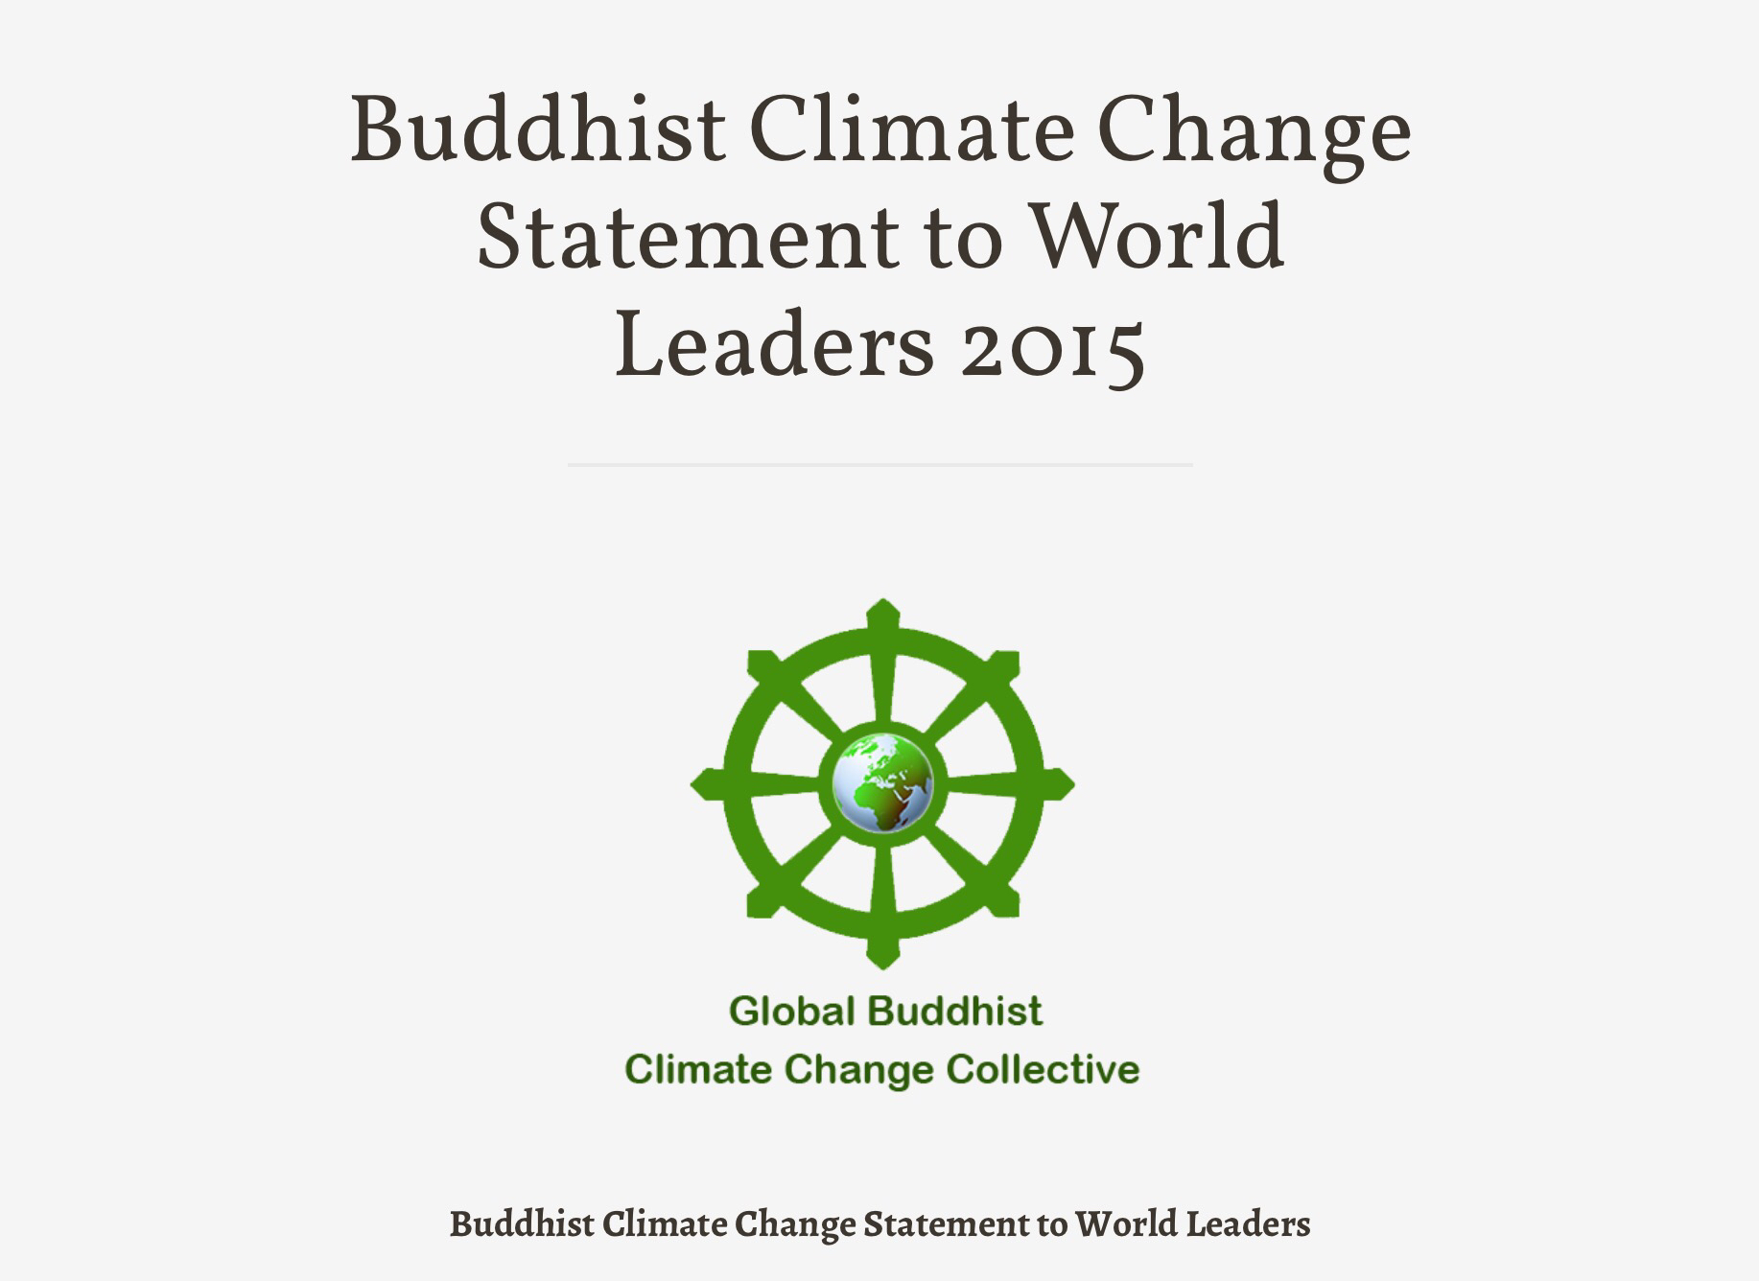
The ‘Greening’ of Buddhism
For a number of decades, Buddhists have been formulating responses to environmental problems.
‘The Time to Act is Now: A Buddhist Declaration on Climate Change’ (14 May 2015)
The ‘Buddhist Climate Change Statement to World Leaders’ (signed ahead of the Paris Conference, 29 Oct 2015).

Slide 3
Buddhism and the Environment
The compatibility of Buddhism and contemporary environmental ethics often taken as self-evident.
‘Ancient Eastern cultures are the source of respect for and religious veneration of the natural world…In the Far East the man-nature relationship was marked by respect, bordering on love, absent in the West.’
– Roderick Nash, Wilderness and the American Mind, pp. 20-21, 192-93

Slide 4
Buddhism and the Environment
However, the claims made on behalf of Buddhism from an ecological perspective have come under fire in recent years (in academic circles, at least!).
Does the idea of ‘Green Buddhism’ (or ‘Eco-Buddhism’) stand up to scrutiny? To what extent can Buddhist teaching and doctrine truly be said to support and foster a concern for issues of environmental care and sustainability?

Slide 5
Early Buddhist Teaching: The ‘Four True Realities’
‘This is the noble truth of suffering: birth is suffering, ageing is suffering, sickness is suffering, dying is suffering, sorrow, grief, pain, unhappiness, and unease are suffering; being united with what is not liked is suffering, separation from what is liked is suffering; not to get what one wants is suffering; in short, the five aggregates of grasping are suffering.
This is the noble truth of the origin of suffering: the thirst for repeated existence which, associated with delight and greed, delights in this and that, namely the thirst for objects of sense desire, the thirst for existence, and the thirst for non-existence.
This is the noble truth of the cessation of suffering: the complete fading away and cessation of this very thirst – its abandoning, relinquishing, releasing, letting go.
This is the noble truth of the way leading to the cessation of suffering: the noble eightfold path, namely right view, right intention, right speech, right action, right livelihood, right effort, right mindfulness, right concentration.’
– Samyutta Nikaya v. 421-2

Slide 6
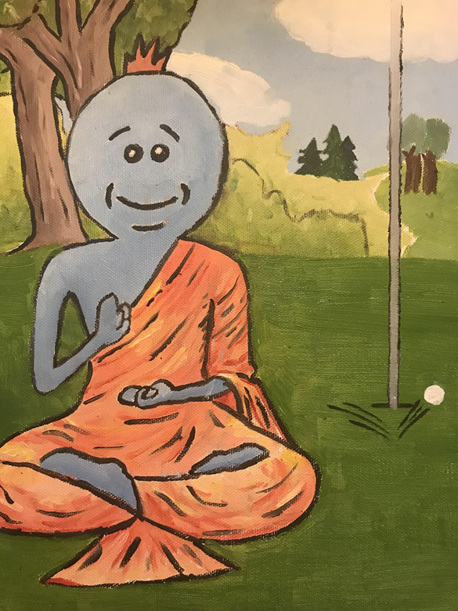
The First True Reality: The Disease
Human existence characterized by dukkha [P].
Our attachment to things that are impermanent (anicca [P]) is a cause of this ‘unsatisfactoriness’.

Slide 7
The Second True Reality: The Cause
The key origin or cause of dukkha is tanha (which leads to ‘grasping’ or ‘attachment’, upadana).
Tanha (‘thirst’) refers to those desires which are constantly on the lookout for gratification.
In order to overcome dukkha, the Buddhist path aims to uproot craving from the psyche altogether.

Slide 8
Conditioned Arising/Dependent Origination
Related to the teaching on the four true realities, particularly the second, is the doctrine of Conditioned Arising or Dependent Origination (patticcasamuppada).
The principle of causality or conditionality – all things, mental and physical, arise and exist due to the presence of certain conditions, and cease once their conditions are removed.
‘That being, this comes to be; from the arising of that, this arises; that being absent, this is not; from the cessation of that, this ceases’ (Samyutta Nikaya ii. 28).

Slide 9
Conditioned Arising/Dependent Origination
‘Conditioned by (1) ignorance are (2) constructing activities, conditioned by constructing activities is (3) consciousness, conditioned by consciousness is (4) the mind-and-body/sentient body, conditioned by the sentient body are (5) the six senses, conditioned by the six senses is (6) sensory stimulation, conditioned by sensory stimulation is (7) feeling, conditioned by feeling is (8) craving, conditioned by craving is (9) grasping, conditioned by grasping is (10) becoming, conditioned by becoming is (11) birth, conditioned by birth is (12) old-age and death – grief, lamentation, pain, sorrow, and despair come into being. Thus is the arising of this whole mass of suffering.’
– Samyutta Nikaya ii. 1-2

Slide 10
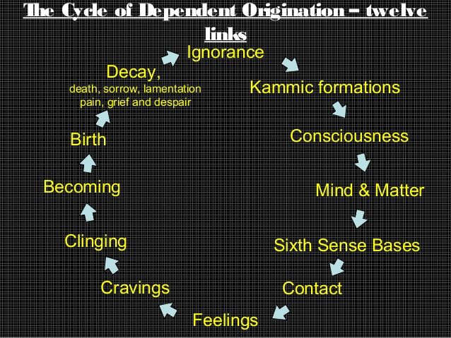

Slide 11
The Third True Reality: The Cure
The ending of thirst and the abandoning of attachment.
When craving and other related causes come to an end, dukkha ceases.
This is Nirvana (Nibbana [P]), the ultimate goal of Buddhism.
Nirvana is only attained when there is total non-attachment and letting go.

Slide 12
Nirvana
Literally ‘blowing out’ or ‘extinguishing’.
‘Nirvana during life’ (a temporary stopping of all conditioned states) defined as the destruction of the ‘fires’ of attachment, hatred and delusion.
Having destroyed all causes of rebirth, a Tathagata (‘One attuned to reality’) cannot be reborn in any way (parinirvana).

Slide 13
The Fourth True Reality: The Medicine
The fourth True Reality concerned with Buddhist practice proper – the practical means for attaining Nirvana.
The Noble Eight-Factored Path is a ‘middle way’ that avoids a life of pursuing either sense-pleasures or harsh asceticism.
This path leads to the cessation of dukkha.

Slide 14
Moral/Ethical Virtue (Sila)
RIGHT SPEECH
  REFRAINING FROM FALSE, DIVISIVE, HURTFUL SPEECH
  REFRAINING FROM IDLE CHATTER
RIGHT ACTION
  REFRANING FROM HARMING LIVING BEINGS
  REFRAINING FROM TAKING WHAT IS NOT GIVEN
  REFRAINING FROM SEXUAL MISCONDUCT
RIGHT LIVELIHOOD: BASED ON RIGHT SPEECH AND ACTION

Slide 15
Meditation/Mental Development (Samadhi)
RIGHT EFFORT
  PREVENTING/ ABANDONING UNWHOLESOME STATES (GREED, HATRED, DELUSION)
  AROUSING/ DEVELOPING WHOLESOME STATES (NON-ATTACHMENT, LOVING KINDNESS, WISDOM)
RIGHT MINDFULNESS
  CONTEMPLATION OF BODY, FEELING, MIND, DHARMA
RIGHT CONCENTRATION

Slide 16
Wisdom (Prajna)
RIGHT VIEW
  SEEING THE FOUR NOBLE TRUTHS
RIGHT INTENTION
  DESIRELESSNESS
  FRIENDLINESS
  COMPASSION

Slide 17
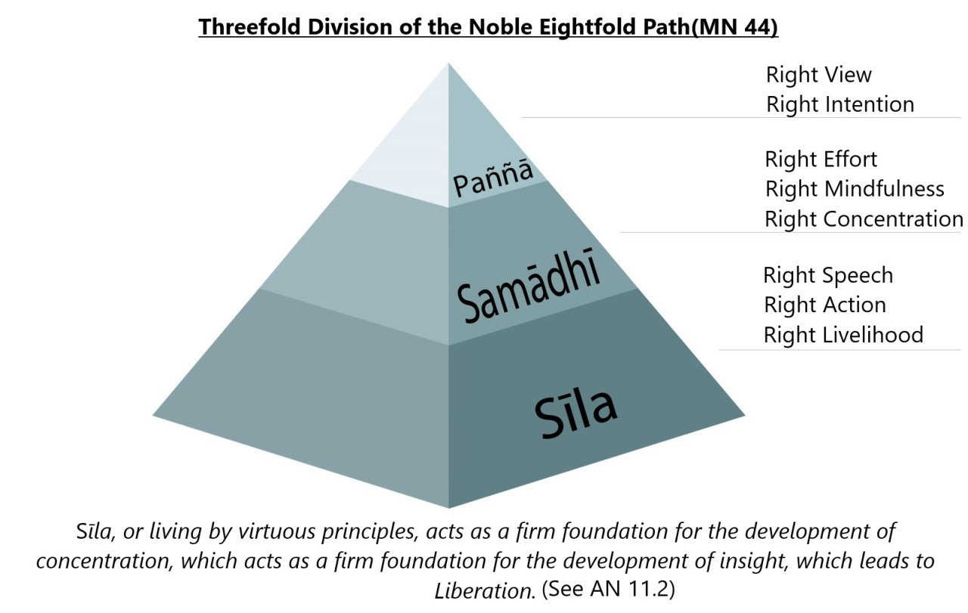

Slide 18
Searching Early Buddhist Teaching for an Environmental Ethic: Right Action
Right Action: includes refraining from harming/killing living beings.
Early Buddhism strongly influenced by the Hindu and Jain principle of ahimsa.
The shared experience of dukkha is the basis for the first of the five precepts.
Concern and compassion for all sentient beings considered to aid in the de-centering of the self and the elimination of ego.

Slide 19
Searching Early Buddhist Teaching for an Environmental Ethic: Right Action
‘In the long course of rebirth there is not one among living beings with form who has not been mother, father, brother, sister, son, or daughter, or some other relative. Being connected with the process of taking birth, one is kin to all wild and domestic animals, birds, and beings born from the womb.’
– Donald Swearer, ‘Principles and Poetry, Places and Stories: The Resources of Buddhist Ecology’, p. 227

Slide 20
Searching Early Buddhist Teaching for an Environmental Ethic: Right Livelihood
Right Livelihood: must be based on Right Speech and Right Action.
Prohibited: trading in slaves, trading in weapons, selling alcohol, selling poisons, and slaughtering animals.
A terrible fate promised by the Buddha to those who hunt deer or slaughter sheep.

Slide 21
Searching Early Buddhist Teaching for an Environmental Ethic: Right View
Right View: seeing things as they truly are, i.e. impermanent, subject to change, and dependently originated.
Nothing exists autonomously. Everything is interdependent.
The Law of mutual causality or interdependence at the forefront of Buddhist environmental thought.
Interbeing (Thich Nhat Hanh): a way to express the dynamic sense of relationship with the earth.

Slide 22
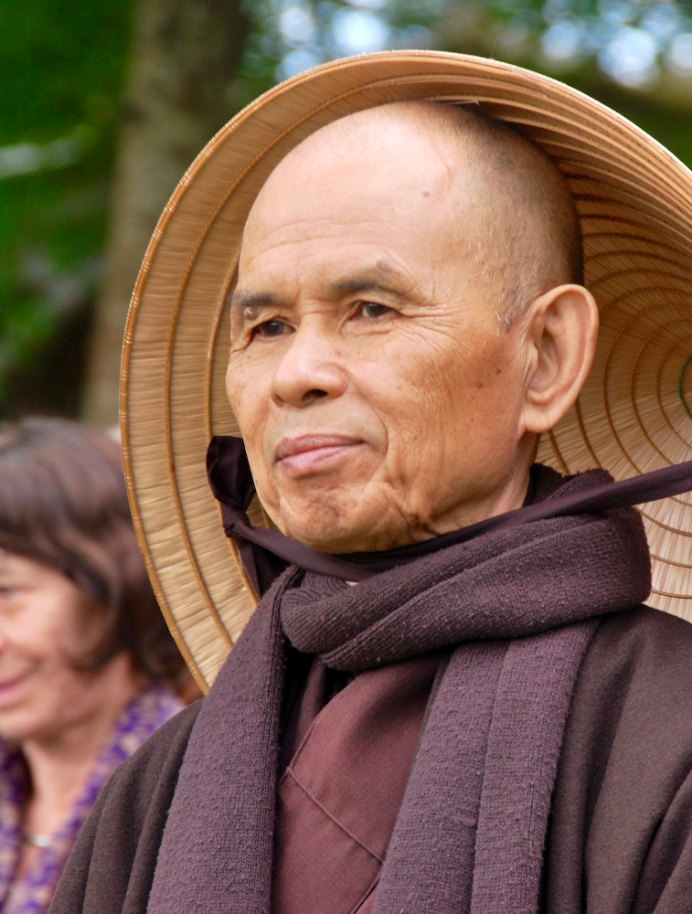
‘Interbeing’
Task: listen to Thich Nhat Hanh’s explanation of ‘interbeing’.
How might this notion feed into a contemporary ecological ethic? Can you identify any potential problems with this concept (from the standpoint of modern environmental ethics)?

Slide 23
Searching Early Buddhist Teaching for an Environmental Ethic: Right View
‘Buddhist environmentalists find in the causal principle of interdependence an ecological vision that integrates all aspects of the ecosphere—particular individuals and general species—in terms of the principle of mutual codependence. Within this cosmological model individual entities are by their very nature relational, thereby undermining the autonomous self over against the “other,” be it human, animal, or vegetable.
Buddhist environmentalists see their worldview as a rejection of hierarchical dominance of one human over another or humans over nature, and as the basis of an ethic of empathetic compassion that respects biodiversity. In the view of the Thai monk, Buddhadasa Bhikkhu, “The entire cosmos is a cooperative. The sun, the moon, and the stars live together as a cooperative. The same is true for humans and animals, trees, and the earth. When we realize that the world is a mutual, interdependent, cooperative enterprise . . . then we can build a noble environment. If our lives are not based on this truth, then we shall perish.”’
– Donald Swearer, ‘Buddhism and Ecology: Challenge and Promise’ (Yale Forum)

Slide 24
Evaluating Early Buddhist ‘Environmentalism’
Is early Buddhist teaching really compatible with contemporary environmental ethics?
Buddhism not a nature religion – the Buddha’s message focused on human liberation from suffering. Care for the environment a distraction from this goal?
The natural world characterized by impermanence and dukkha. Liberation entails leaving the physical world behind.

Slide 25
Evaluating Early Buddhist ‘Environmentalism’
‘The monks and ascetics who developed the concept of dependent origination and its implications saw the phenomenal world as a binding chain, a web of entanglement, not a web of wonderment.’ Early Buddhist texts advocate ‘disengagement from all entanglement in this web.’
– David McMahan, The Making of Buddhist Modernism, pp. 153-54.

Slide 26
Evaluating Early Buddhist ‘Environmentalism’
Dependent origination denies that nature has ‘intrinsic value’, a central tenet of contemporary environmental ethics.
Early Buddhists not motivated to embrace or revere the natural world – the aim is to remove craving and attachment in all forms.
Interdependence undermines any form of ‘centrism’, whether theocentrism, anthropocentrism or ecocentrism.

Slide 27
Evaluating Early Buddhist ‘Environmentalism’
It could be argued, however, that Buddhism does not view nature as ‘bad’ in and of itself – natural phenomena are only considered dukkha in the context of relationship.
‘Such non-attachment does not reject natural (impermanent) things entirely; rather, it means non-attachment in the sense of not grasping after natural phenomena as if they were permanent, the elimination of egoful clinging to things that aims to aggrandize the self.’
– John Holder, ‘A Suffering (But Not Irreparable) Nature’, p. 122

Slide 28
Evaluating Early Buddhist ‘Environmentalism’
Early Buddhists may not have held a romantic view of nature, but that is not to say that they viewed it as intrinsically bad!
‘In short, early Buddhism promotes a middle way as regards the valuation of the natural world’ – Holder, p. 124
‘The ultimate analysis and evaluation of existence in early Buddhism does not motivate efforts for preserving nature, not to mention restoring it, nor efforts for transforming or subjugating it by means of technology.’
– Lambert Schmithausen, ‘The Early Buddhist Tradition and Ecological Ethics’, Journal of Buddhist Ethics 4 (1997), p. 11

Slide 29
Mahayana Developments
Mahayana (‘the Great Vehicle’): an umbrella term for a broad range of traditions/schools that began to develop around the turn of the era.
Emphasizes that the true nirvana is attained at Buddahood (i.e. via path of the bodhisattva).

Slide 30
Mahayana Developments
The bodhisattva chooses to stay on in samsara in order to perfect the spiritual qualities necessary to becoming a fully-awakened Buddha (for the sake of helping suffering beings).
Compassion emphasized as the motivating factor for the whole bodhisattva path.
The physical world not a place from which to be liberated but a place in which enlightened beings seek to be reborn for the sake of helping all suffering beings.

Slide 31
The Bodhisattva Vow
‘The Lord said: Here, Subhuti, someone who has set out in the vehicle of a Bodhisattva should produce a thought in this manner: “As many beings as there are in the universe of beings, comprehended under the term ‘beings’ – egg-born, born from a womb, moisture-born, or miraculously born; with or without form; with perception, without perception, and with neither perception nor nonperception – as far as any conceivable form of beings is conceived: all these I must lead to Nirvana, into that Realm of Nirvana which leaves nothing behind.”’
– from the Diamond Sutra (Vajracchedikā Prajñāpāramitā Sūtra)

Slide 32

Searching Mahayana Teaching for an Environmental Ethic: The Ideal of Compassion
Ecosattvas
BUT it is not uncommon for Zen masters and other Buddhist teachers to encourage students to defer social activism until they have eliminated ego.

Slide 33
Searching Mahayana Teaching for an Environmental Ethic: Emptiness (Śūnyatā)
‘Form is emptiness, emptiness is form’ (The Heart Sutra).
All phenomena are ‘empty’ of ‘own-being’ or independent existence (see Dependent Origination). Emptiness NOT equal to nothingness.
To say that something is ‘empty’ is to say that it is ‘full of the cosmos’.
‘Temporarily freed of the delusion of an absolute self, one experiences the vast realm of causes and conditions that determine the many forms and events of the universe. In this sense , one is not separate from the mountain, the waterfall, the whale. An experience of unity with the natural world can generate a dramatic shift in orientation to the Other, whether in human or nonhuman form’ – Stephanie Kaza, Green Buddhism, p. 18.

Slide 34


Slide 35
Searching Mahayana Teaching for an Environmental Ethic: Buddha-Nature
The notion of a universal Buddha-nature developed by the T’ien T’ai school (8th century) – both sentient and non-sentient beings seen as capable of achieving enlightenment.
‘The Buddhahood of grasses and trees’.
No agreement on the connotation and scope of this construct.

Slide 36
Searching Mahayana Teaching for an Environmental Ethic: Buddha-Nature
‘It is in Buddha-nature that all existences, animate and inanimate, are unified and harmonized. All organisms seek to maintain this unity in terms of their own karma. To wilfully take life, therefore, means to disrupt and this inherent wholeness and to blunt feelings of reverence and compassion arising from our Buddha mind.’
– Phillip Kapleau, To Cherish All Life: A Buddhist Case for Becoming Vegetarian, p. 19.

Slide 37
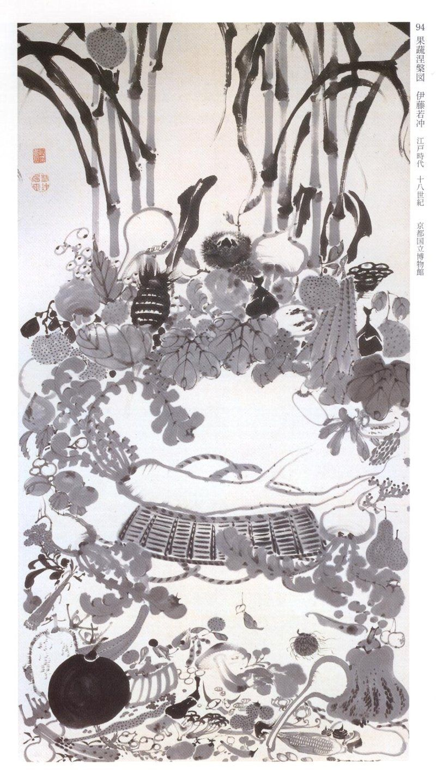
Itō Jakuchū – Yasai Nehan (Vegetable Nirvana), c. 1792

Slide 38
Evaluating the Ecological Worth of Mahayana Teaching
Pure Lands: ideal domains created by the appropriate Buddha, e.g. Amitabha’s Land of Bliss (Sukhavati).
Pure Land Buddhism emphasizes rebirth in these regions of purity and bliss – extremely easy to hear and practice the dhamma in Pure Lands.
Does the notion of Pure Lands de-value earth?

Slide 39
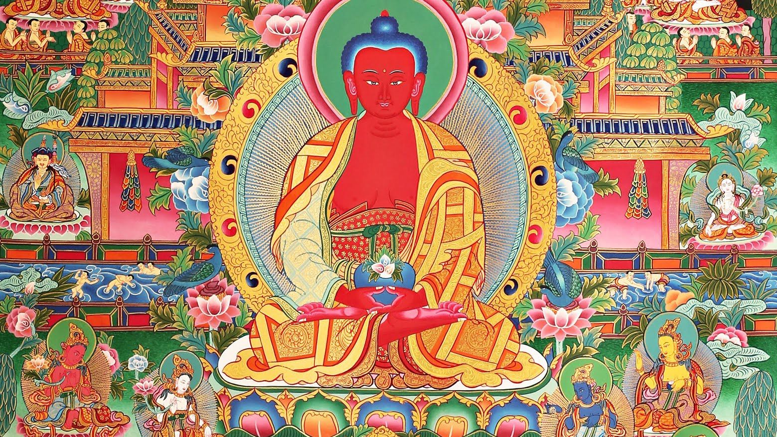
Sukhāvatī (The Pure Land of Amitābha)

Slide 40
Conclusion: The Ecological Value of Buddhist Thought
Task: read the concluding section to John Holder’s article, ‘A Suffering (But Not Irreparable Nature): Environmental Ethics from the Perspective of Early Buddhism’.
Do you agree with Holder that an ecological ethic emerges from the thought of early Buddhism? If so, what are the distinctive features of this ethic? What might later Buddhist traditions be able to contribute to a Buddhist response to environmental concerns?

