Slide 1
Module Title: Professional Career Development within H&SC
Module Number: LCHS 4009 (LON)
Assignment No: ASSIGNMENT 1
Student Name: Oyinkansola Jacobs
Student ID : 2439186
Lecturer’s Name: Amitave Banik
Student Topic: TeamWork in Health and Social care

Slide 2
Acknowledge use of AI
No form of AI was used in this presentation / slides

Slide 3

Introduction
Team work according to the Cambridge Dictionary “Teamwork is the process of working collaboratively with a group of people to achieve a goal”
Source https://fuzeinteriors.co.nz/office-design-effective-teamwork/

Slide 4

Definition of Teamwork
Working in teams entails a group of experts collaborating and supporting one another to reach a common goal. In health and social care, different professionals (such as nurses, doctors, social workers, and care assistants) communicate, share information, and coordinate their duties to provide safe and person-centred care to service users.
For example, clinicians may collaborate to assess a patient's needs, arrange therapy, and monitor progress to ensure the individual receives the best possible care.

Slide 5
INVOLVEMENT IN DAY TO DAY PRACTICE
In everyday health and social care practice, collaboration entails communicating, sharing duties, and coordinating care to fulfil the requirements of service users.
According to (Scarlett 2026) This includes frequent communication among team members, attendance at meetings or handovers, providing information on a patient's status, and collaborating to plan and review care.
Staff, for example, may discuss patient progress during shift handovers, participate in multidisciplinary team meetings, and record information in shared care records to ensure that all experts involved understand the patient's needs and treatment plan.
Notes:
Remove where I learnt the skill and reduce words

Slide 6


How teamwork supports Safe and Effective Care.
Improves communication among specialists, reducing misconceptions and medical errors.
Allows personnel to disseminate information rapidly and detect potential threats or changes in a patient's condition earlier.
Encourages coordinated care, in which several clinicians collaborate to plan and provide therapy safely.
How teamwork ensures good quality outcomes for service users
Combines the skills of many professions to produce more effective care plans.
Multidisciplinary collaboration can reduce adverse events while increasing patient satisfaction and recovery.
Strong cooperation is associated with improved clinical outcomes and higher-quality healthcare services.

Slide 7


Service Users / Patients
Teamwork increases safety because staff exchange critical information regarding the patient's status. (WHO, 2010)
Teamwork also leads to better coordination and comprehensive care from various providers. (NHS England, 2023).
For example, if a nurse detects a patient's condition deteriorating, she notifies the doctor and other team members right once, allowing for speedier treatment and avoiding problems. (WHO, 2010)
Staff and Colleagues
Improves communication and avoids misconceptions among professionals. (WHO, 2010)
Allows employees to share tasks and support one another.
Encourages learning from coworkers with varying talents and experiences. (NHS England, 2023).

Slide 8
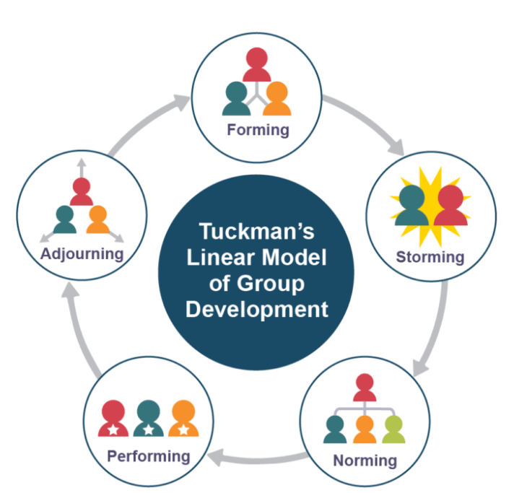
Tuckman’s Team Development Model
The model used is the Tuckman's Team Development Model and it describes how teams evolve and become more effective as members learn to collaborate over time. According to the paradigm, when a group of people first meets, they do not work as a powerful team right away. Instead, kids go through a series of stages to create relationships, roles, trust, and communication skills.
This model explains how collaboration develops when individuals learn to cooperate, manage disagreements, and work toward a common objective. It is widely utilised in the workplace, including health and social care settings, to better understand how teams can collaborate and be more productive.

Slide 9
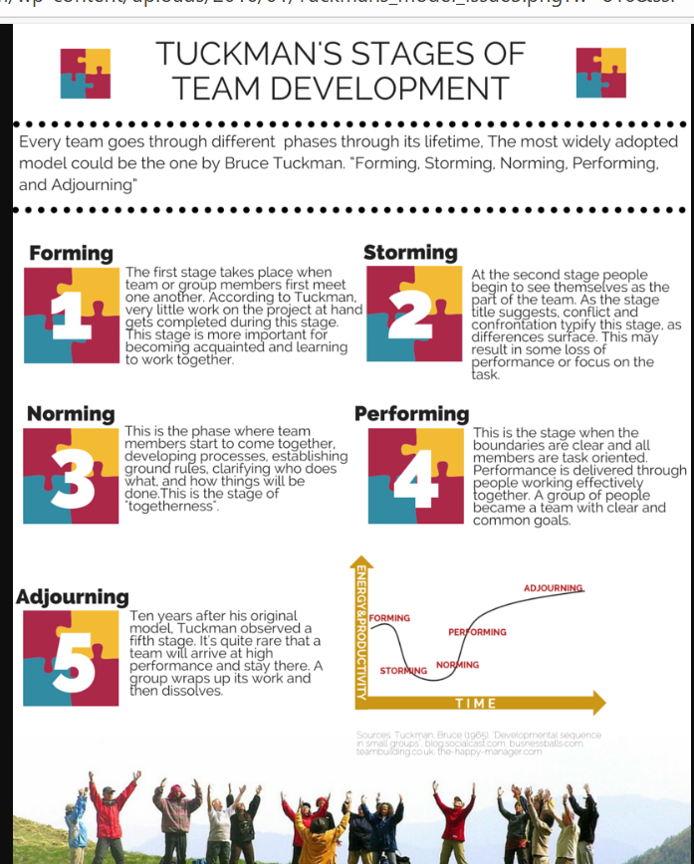
Key stages
Forming - Team members meet, learn about their roles, and begin to develop relationships.
Storming - Differences in beliefs or working habits can lead to conflict as members adjust.
Norming - The team begins to cooperate, set rules, and collaborate more effectively.
Performing - The team works well together, communicates clearly, and is focused on reaching its objectives.
Adjourning - The crew finishes its work and disbands.
(Clayton M, 2020)
Source:-Clayton, M. (2020). The Tuckman Model -https://www.youtube.com/watch?v=-nlMJcTAz_g

Slide 10

How does this model help professionals understand or use teamwork as a skill in practice?
Tuckman's team development model teaches professionals how teams grow and enhance their ability to collaborate. The concept demonstrates that teams progress through various stages before becoming fully effective. Understanding these stages enables professionals to handle conflict, increase communication, and foster team trust.
In health and social care settings, this helps professionals realise that conflicts or unclear duties are common when teams first establish. Understanding the model encourages professionals to assist one another, clarify duties, and collaborate so that the team may operate efficiently and offer safe, coordinated care to service consumers.

Slide 11

Applying teamwork as a skill in practice
Job Function and Setting
A nurse working in a hospital ward (for example, under the National Health Service)
Situation
A patient's condition abruptly deteriorates (e.g., low oxygen levels and breathing difficulties).
How would teamwork be applied
Speak with medical professionals and healthcare assistants promptly.
Clearly communicate observations (symptoms, vital signs).
Cooperate to provide emergency care (such as oxygen and monitoring).

Slide 12

Applying Teamwork as a skill in practice
How Teamwork Directs Your Behavior in practice
Promotes attentive listening and straightforward communication.
Ensures that roles of who does what are understood.
Encourages teamwork and prompt decision-making.
Effect on Healthcare
Patient experience: The patient feels reassured and supported.
Safety and quality: A quicker reaction lowers the possibility of issues.
Results: Better recuperation and a lower risk of severe injury.

Slide 13

How does this skill support my future career?
Why I Think Teamwork Is Important
Employability
• Demonstrates my ability to collaborate effectively.
• Developed as a result of my customer service background.
• Appreciated by organizations such as the National Health Service.
Future career as a nurse
• Assists me in delivering efficient, safe care.
• Encourages collaboration with various experts.
Reflection
Strength
• Based on my experience, I'm good at listening and helping people.
Growth
I want to get more comfortable speaking up, particularly at the University of Wales.

Slide 14
Conclusion
For care to be safe, efficient, and person-centered, teamwork is crucial.
Enhances professional communication and lowers errors
Promotes improved decision-making and coordination• Promotes better results and experiences for clients
Tuckman's Team Development Model clarifies how groups grow and function well.
Equips professionals for actual practice in environments like the National Health Service

Slide 15
Reference list
Cambridge Dictionary (2019). TEAMWORK | meaning in the Cambridge English Dictionary. [online] Cambridge Dictionary. Available at: https://dictionary.cambridge.org/dictionary/english/teamwork.
Clayton, M. (2020). The Tuckman Model - Tuckman Team Development Model. YouTube. Available at: https://www.youtube.com/watch?v=-nlMJcTAz_g.
Costello, M., Rusell, K. and Coventry, T. (2021). Examining the Average Scores of Nursing Teamwork Subscales in an Acute Private Medical Ward. BMC Nursing, [online] 20(1), pp.1–10. doi:https://doi.org/10.1186/s12912-021-00609-z.
Epstein, N.E. (2014). Multidisciplinary in-hospital Teams Improve Patient outcomes: a Review. Surgical Neurology International, [online] 5(8), p.295. doi:https://doi.org/10.4103/2152-7806.139612.
Gillian (2024). 10. The importance of teamwork in health and social care - UK School of Management. [online] UK School of Management. Available at: https://blog.uksm.org.uk/2024/09/30/10-the-importance-of-teamwork-in-health-and-social-care/.
Leonard, M., Graham, S. and Bonacum, D. (2004). The Human Factor: The Critical Importance of Effective Teamwork and Communication in Providing Safe Care. [online] Quality & safety in health care. Available at: https://pubmed.ncbi.nlm.nih.gov/15465961/.

Slide 16
Morgan, M. (2025). The Role of Teamwork in Delivering Effective Health and Social Care Services. [online] Academy for Health & Fitness. Available at: https://uk.hfonline.org/the-role-of-teamwork-in-delivering-effective-health-and-social-care-services/.
NHS England (2023a). NHS England. [online] England.nhs.uk. Available at: https://www.england.nhs.uk/.
NHS England (2023b). NHS England» Safety culture. [online] www.england.nhs.uk. Available at: https://www.england.nhs.uk/patient-safety/patient-safety-culture/safety-culture/.
O’Daniel, M. and Rosenstein, A.H. (2008). Professional Communication and Team Collaboration. [online] Nih.gov. Available at: https://www.ncbi.nlm.nih.gov/books/NBK2637/?.
Rosen, M.A. (2020). Teamwork in healthcare: Key Discoveries Enabling safer, high-quality care. American Psychologist, [online] 73(4), pp.433–450. doi:https://doi.org/10.1037/amp0000298.
Scarlett, A. (2026). Teamwork in Health and Social Care | Royal Open College. [online] Royal Open College. Available at: https://royalopencollege.org/blog/health-and-social-care/teamwork-in-health-and-social-care/.
Wavebreakmedia Ltd (2015). Team of doctors working together on patients file. [online] Dreamstime. Available at: https://www.dreamstime.com/stock-photo-team-doctors-working-together-patients-file-medical-office-image53850244 [Accessed 9 Mar. 2026].
World Health Organization (2010). Framework for action on interprofessional education & collaborative practice. [online] World Health Organization. Available at: https://www.who.int/publications/i/item/framework-for-action-on-interprofessional-education-collaborative-practice.

