Slide 1
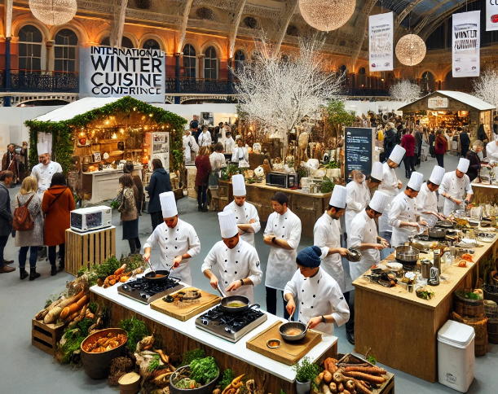
International Meetings Management for the Hotel Industry
BMIH6007
By 2126298
Roxana Jurj
Lecturer: Kathryn Flynn

Slide 2

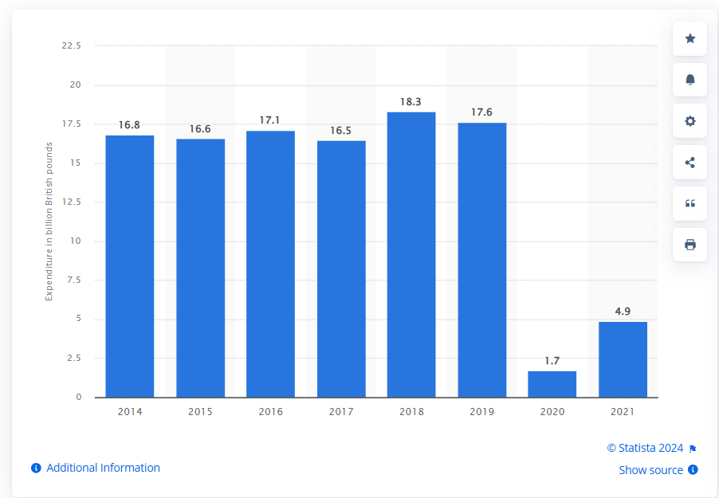
Introduction
Winter culinary trends are discussed at the International Winter Cuisine Conference with chefs, restaurateurs, and food business executives.
Demonstrations and expert discussions cover sustainable food sourcing, inventive winter meals, and seasonal eating (Fox et al., 2014).
Corporate travel and the hospitality industry benefit from MICE (Meetings, Incentives, Conferences, and Exhibitions).
Business events benefit the UK economy, as attendees spent £4.9 billion in 2021 (Statista, 2023).
Post-pandemic conferences like this promote eco-friendly and innovative hotel strategies.
The event's winter cuisine focus matches increased demand for seasonal cuisines and distinctive dining experiences.
It promotes culinary collaboration and information sharing through MICE (Vargas et al., 2021).
Statista (2023). Expenditure on business events in the UK 2021.

Slide 3
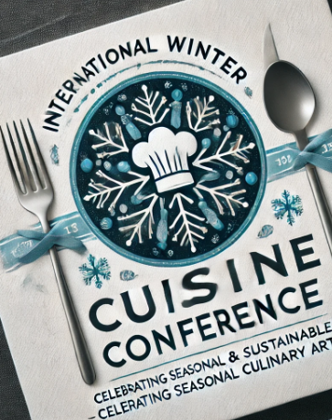
Event description
Skilled chefs collaborate at the International Winter Food Conference to promote seasonal foods, sustainability, and winter operations' environmental impact (Caraher and Coveney, 2016).
Live demos of winter products like hearty meats, root vegetables, and festive spices coincide with sustainable food trends.
Sustainable winter procurement, waste reduction, and supply chain efficiency are covered in expert seminars (Hall and Gossling, 2016).
The conference targets chefs, restaurateurs, and food professionals who set trends, find new suppliers, and improve cooking (Chatzipavlou et al., 2024).
Winter meals that meet consumer demand for comfort foods distinguish the event from other culinary festivals (O'Toole, 2011).
Birmingham's NEC, with its wide venues and easy access, has hosted successful culinary shows including the BBC Good Food Show Winter (NEC Group, 2024).

Slide 4

Marketing factors
Customers choose sustainable, seasonal food, making the International Winter Cuisine Conference popular (Beersbeer, 2018).
Studies demonstrate food festivals, culinary demos, and gourmet events attract professionals and foodies, growing the worldwide food and beverage business (Beersbeer, 2018).
Comfort food and seasonal specialities are popular in winter-themed eating, which emphasises eco-friendly techniques and local sourcing (Caraher and Coveney, 2016).
This conference focusses on winter cuisine and sustainability, unlike the Skills for Chefs Conference and BBC Good Food Show Winter .
Winter foodies could be reached by culinary journals, food bloggers, and influencers promoting seasonal, sustainable cuisine.
Social media, targeted email marketing, and winter tourism destination partnerships will boost worldwide promotion and attract local and international players (Jin, Lee and Lee, 2013).

Slide 5
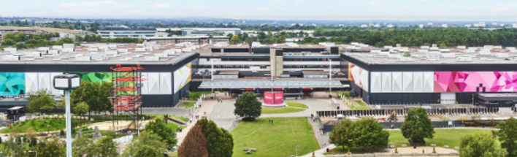
The operational side
Exhibition World. (2023). Birmingham NEC reports its biggest year for new events.
With 20 connected halls that can hold 100,000 people, Birmingham's NEC is appropriate for the International Winter Cuisine Conference (The NEC, 2023).
Experience with big food events like the BBC Good Food Show Winter makes the NEC suitable for gourmet demos and tastings.
With its closeness to Birmingham International Airport, the NEC is suitable for domestic and international access, food and live demo facilities, and accessibility.
Audio-visual technicians, culinary experts, and taster catering teams are needed for a successful event (Dowson and Bassett, 2015).
Live broadcasting is handled by technology workers, and winter cuisine experts boost learning.
Hilton and Crowne Plaza hotels offer extensive accommodation, good road and rail links to UK cities and health permits maintain UK safety requirements.

Slide 6

Sustainable and Cultural Considerations
Use of seasonal, local foods will promote sustainability and reduce food transportation impacts at the conference (Lee and Slcum, 2015).
Chefs promote local, fresh ingredients to reduce carbon emissions.
Chefs from diverse origins will demonstrate winter dishes from different places to promote intercultural contact.
Eastern European stews and Scandinavian root vegetables will inspire learners to use winter ingredients creatively in modern cuisine.
Recycle, compost, use biodegradable packaging, and cut trip emissions via virtual attendance (Page and Connell, 2012).
The event promotes sustainable packaging and low-use plastics, following environmental best practises.
Harris, C. (2023). Pioneering sustainability: A blueprint for businesses
in the 21st century.

Slide 7
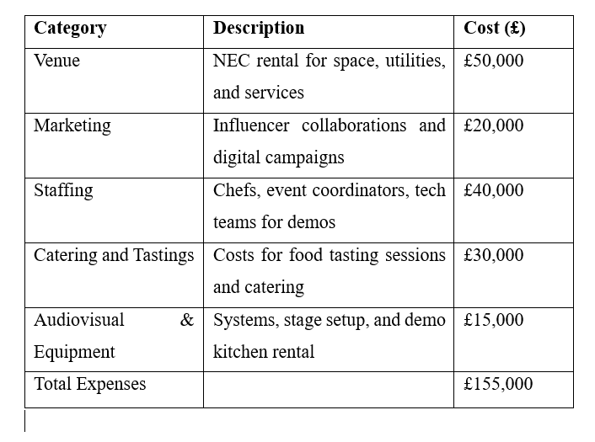
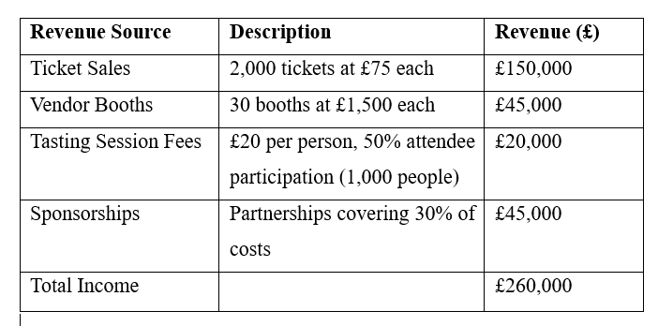
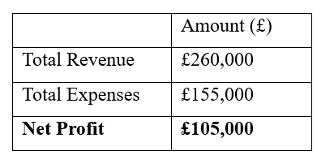
Financial forecasts

Slide 8
Conclusion
Well-planned and cost-effective.
Strong market base due to demand for gourmet events and sustainable, winter-themed cuisine.
Birmingham's NEC's logistical capabilities benefit both local and foreign guests.
Unique experience with sustainable methods, cultural diversity, and seasonal foods.
Expected surplus due to scheduled sales exceeding costs.
Promotes culinary innovation and sustainability.

Slide 9
References
Beersbeer, S., 2018. Food tourism and regional development. Networks, products and trajectories.
Caraher, M. and Coveney, J. eds., 2016. Food poverty and insecurity: International food inequalities. Cham: Springer.
Chatzipavlou, M., Karayiannis, D., Chaloulakou, S., Georgakopoulou, E. and Poulia, K.A., 2024. Implementation of sustainable food service systems in hospitals to achieve current sustainability goals: A scoping review. Clinical Nutrition ESPEN.
Dowson, R. and Bassett, D., 2015. Event planning and Management: A practical handbook for pr and events professionals. Kogan Page Publishers.
Fox, D., Gouthro, M.B., Morakabati, Y. and Brackstone, J., 2014. Doing events research: From theory to practice. Routledge.
Hall, C.M. and Gössling, S., 2016. Food tourism and regional development. Networks, products and trajectories.
Jin, N., Lee, H. and Lee, S., 2013. Event quality, perceived value, destination image, and behavioral intention of sports events: The case of the IAAF World Championship, Daegu, 2011. Asia Pacific Journal of Tourism Research, 18(8), pp.849-864.
Lee, S.S. and Slocum, S., 2015, January. Understanding the role of local food in the meeting industry: An exploratory study of meeting planners' perception of local food in sustainable meeting planning. In Journal of Convention & Event Tourism (Vol. 16, No. 1, pp. 45-60). Routledge.
NEC GROUP (2024). Good Food Show Winter. [online] Available at: https://www.thenec.co.uk/whats-on/good-food-show-winter/ [Accessed 7 Oct. 2024].
O’Toole, W. (2011) Events feasibility and development: from strategy to operations. Elsevier: Oxford
Page, S.J. and Connell, J., 2012. The Routledge handbook of events. London: Routledge.
Statista (2023). Expenditure on business events in the UK 2021. [online] Statista. Available at: https://www.statista.com/statistics/621831/business-event-market-value-delegate-spend-united-kingdom-uk/.
THE NEC (n.d.). Home. [online] Available at: https://www.thenec.co.uk/. / [Accessed 7 Oct. 2024].
The NEC (2023). Our Halls. [online] Available at: https://www.thenec.co.uk/organisers/our-halls/ [Accessed 1 Nov. 2024].
‌Vargas, A.M., de Moura, A.P., Deliza, R. and Cunha, L.M. (2021). The Role of Local Seasonal Foods in Enhancing Sustainable Food Consumption: A Systematic Literature Review. Foods, [online] 10(9), p.2206. doi:https://doi.org/10.3390/foods10092206.

Slide 10
Thank you!

