Slide 1
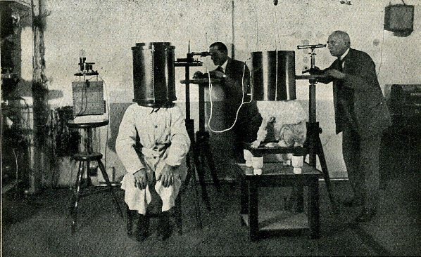
Experimental Methods & Behavioural Research
Part 2
http://www.weirdexperiments.com/Experiment_1_farb.jpg
Andy Coard UWTSD Lampeter
Notes:
Karl Krall (far right) researching telepathy between man and dog

Slide 2
Aims of the Presentation
Part 1 (Last session)
To examine practical and ethical issues associated with applying the scientific method to the study of human behaviour
Part 2 (Today’s session)
To consider different experimental designs used for controlling participant variables
(Ideally, the only relevant difference between groups of participants will be due to the effects of the Independent Variable)

Slide 3
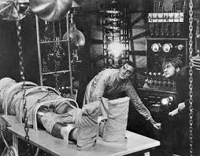
How the Scientific Method Works
(The Underlying Rationale)
http://dimanagul.files.wordpress.com/2012/10/movfrankenstein.jpg

Slide 4



Requirements of a Good Experiment
Needs to be replicable (and so falsifiable)
Needs to have validity
Ability to generalise the findings
(sampling technique will be important)
(What is the difference between reliability & validity?)

Slide 5
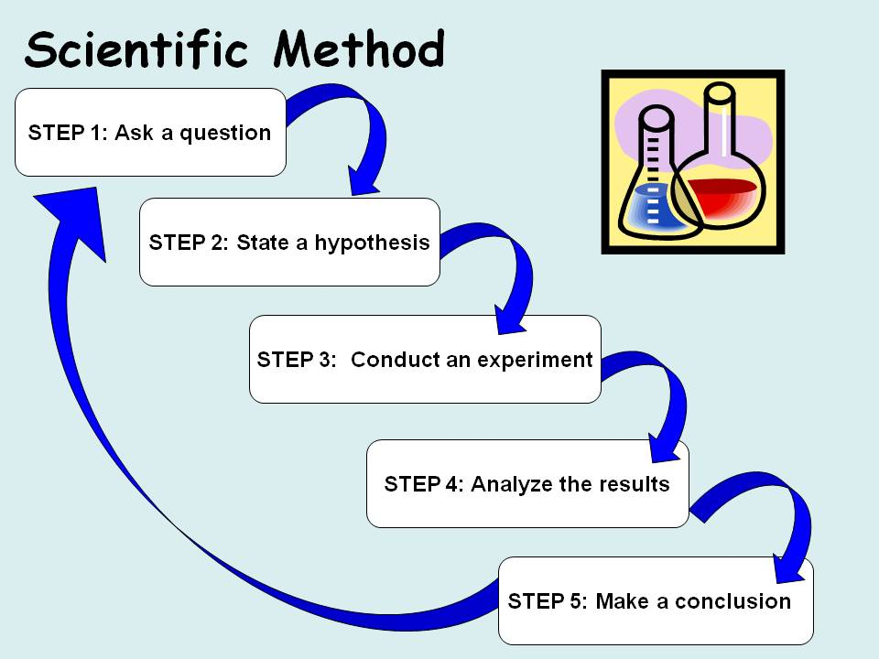

The Scientific Method
The Process;
Notes:
*
http://science-fair-coach.com/wp-content/uploads/2011/10/Slide3.jpg

Slide 6
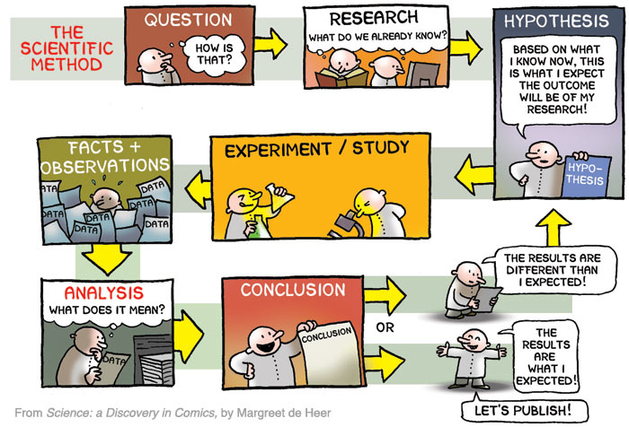
Stages of the Scientific Method
http://nbmpub.com/blog/wp-content/uploads/2013/05/method1.jpg

Slide 7
Summary of the Scientific Method

Slide 8
What Constitutes an Experiment?
A scientific experiment aims to demonstrate cause and effect relationships between specific variables
An experiment deliberately manipulates one variable to see its influence on another
The variable being manipulated is the independent variable (IV) and the one being influenced is the dependent variable (DV)

Slide 9
The Scientific Method
The independent variable (IV) and dependent variable (DV) are implicitly stated within the prediction, or experimental hypothesis
The Independent
Variable
Influences
Change in the
Dependent
Variable

Slide 10
What Do Experimental Hypotheses Look Like?
Males create longer passwords than females
Cyclists in groups will have faster lap times than lone cyclists
People are more likely to come to a risky decision in a group than when making decisions alone
(See if you can identify possible IV’s & DV’s for the above examples)
Notes:
Note: the examples given here are all one-tailed hypotheses since they predict the direction of the expected difference between the experimental conditions, rather than simply predicting that there will be a difference (in which case the hypothesis would be two-tailed).

Slide 11
Experimental Methods Used in Behavioural Research

Slide 12
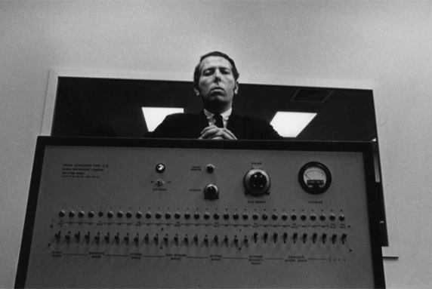


Laboratory Experiments
(e.g. Milgram’s Studies of Obedience)
Field Studies;
Natural Experiments
(e.g. Saint Helena Study)
Naturalistic Experiments
(e.g. Lost Letter Technique)
http://images.mentalfloss.com/sites/default/files/styles/article_640x430/public/stanley-milgram.png
http://i.huffpost.com/gen/1362683/images/o-LETTER-WINDSHIELD-CAR-facebook.jpg
http://slawomirgrochowski.pl/wp-content/uploads/2013/09/books.jpg

Slide 13
Laboratory Experiment
Advantages
Tight control of variables
In some cases artificiality is not problematic
Can establish cause and effect
Disadvantages
Tight control may limit range of behaviour
Artificiality issues – may distort behaviour
Do findings generalise to real world?
(Issues of ecological validity)

Slide 14
Natural Experiment
(Not a true experiment as IV is not manipulated and variables are not controlled – sometimes called a quasi-experiment)
Advantages
Disadvantages
Takes advantage of naturally occurring circumstances
Reduced ethical issues?
Ecological validity
Greater generalisability?
Lack of control over variables
Participants may be unaware they are part of an investigation

Slide 15
Naturalistic Experiment
(Ability to manipulate variables in a real world setting)
Advantages
Disadvantages
Ability to manipulate IV
Ecological validity - real world setting
Greater generalisability?
Lacking tight control of variables
Ethics - Participants likely to be unaware part of an investigation (issues of consent, deception, debriefing etc.)

Slide 16
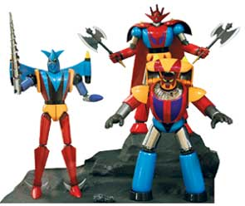
Different Types of Experimental Design
(Controlling Participant Variables)
Participants have different skill sets & abilities
http://www.nationmultimedia.com/2008/02/15/entertainment/images/30065544-01.jpg
Independent Measures
(Different participants serving in each group)
Repeated Measures
(Each person participates in all conditions)
Matched Pairs
(Participants matched for relevant variables)

Slide 17

Independent measures
(Different Participants Serving in Each Group)
Advantages
Disadvantages
Like Matched Pairs can be used when not possible to use Repeated Measures design
Quick and easy to run
The least successful method for controlling participant variables – this is not a problem if sample is large enough

Slide 18

Repeated Measures
(Each Person Participates in all Conditions of Experiment)
Advantages
Disadvantages
Offers the best control for participant variables
Generates a lot of data
Not always suitable
(E.g. single solution problems)
Order Effects
E.g. boredom, practice, fatigue
(need for counterbalancing)

Slide 19
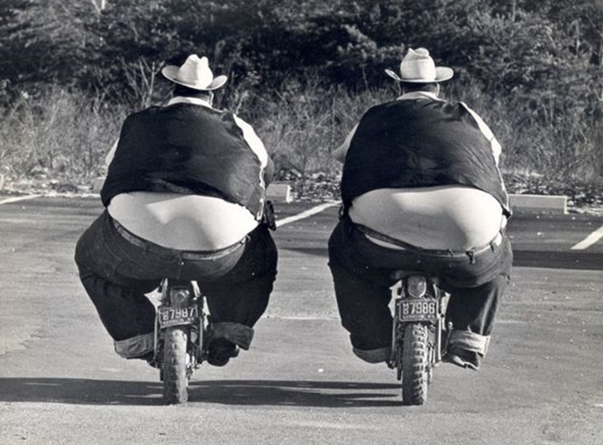
Matched Pairs
(Participants Are Matched for Variables Relevant to the Study)
Advantages
Disadvantages
Useful when not possible to use Repeated Measures
Although attempts to combine advantages of the other two designs, can never be sure that all the variables important to the outcome have been matched for
Process of matching can be very time consuming
https://s-media-cache-ak0.pinimg.com/564x/c2/9d/06/c29d06eadc6e74520e7a6d7ad315e51a.jpg

Slide 20
Summing Up
With careful design, it is possible to apply the scientific method to the study of human behaviour
Scientific research improves both prediction and understanding of human behaviour
We cannot predict behaviour with certainty, but we can make statements about how individuals and groups are likely to behave under given circumstances

Slide 21
Finally:
Be aware that applying the experimental method to the study of behaviour has its critics – there is an ideological position which takes a greater qualitative stance, as opposed to a quantitative one.
Common sense would dictate choosing the appropriate method for the research in question, not being tied to one approach exclusively.

Slide 22
References
Bernard, H. R. 2006 Research Methods in Anthropology: Qualitative and Quantitative Approaches. Oxford: Alta Mira Press.
Coolican, H. 1994 Research Methods and Statistics in Psychology. London: Hodder & Stoughton.

Slide 23

The End
http://i.imgur.com/m3fh5S9.jpg

