Slide 1
Certificate of higher education skills for the​ health and social care
LCHS4010: Psychology in health and social care​
​
Student number: 2420336​
Student name: Leanne Jarvis​
​
Tutor details: Helen parsons
​
Module leader: dr Azora Hurd​
​
Portfolio – Presentation​
Submission date: Monday 23rd march 2026

Slide 2
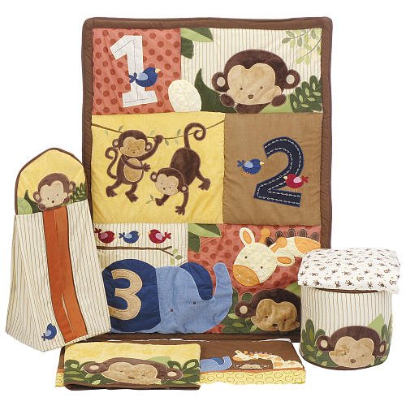
Introduction:
Today I'll present a support plan for Amira, a three-year-old child who recently joined our nursery. Amira shows anxiety when separated from her carers, has limited verbal communication, and struggles to engage in group play. My goal is to explain her developmental needs using attachment theory, and show how this framework guides evidence based stratergies to support her emotional, social, cognitive, and pysical wellbeign.

Slide 3
This theory was developed by john Bowlby (1969) and expanded by Mary Ainsworth (1978).
Focuses on the emotional bond between a child and their caregiver.
Strong evidence base for guiding early years practice and transitions.
Links to emotional regulation and social competence.
The chosen theory:
Attachment theory JOHN BOWLBY explains that infants form an emotional bond to a primary caregiver that functions as a "secure base" for exploration and a source of comfort in times of stress (bowlby, 1969).. Early caregiver sensitivity and responsiveness shape the child's internal working models of self and others (expectations about whether others will be available and supportive), and these models influence emotional regulation, social Behaviour, and responses to separation across early childhood.
This theory directly addresses the child caregiver relationship, separation behaviours, social Engagement and early emotional regulation- precisely the domains where Amira is showing challenges (anxiety at drop off, limited verbal communication, difficulty in group play). Attachment theory also has a strong evidence base and has informed tested interventions to increase caregiver sensitivity and child security.

Slide 4
APPLYING ATTACHMENT THEOARY EXPLAINING CURRENT BEHAVIOUR AND NEEDS:
Amira's distress is caused when her carers leave, this suggest she may be experiencing separation anxiety, which Bowlby described as a natural response to separation from the primary attachment figure. Since recently joining the nursery her attachments to her carers is strong and she has not yet formed a secure attachment with any nursery practitioners. Amira is seeking reassurance that she is safe and her carers will return. Practitioners should offer consistent comfort, maintain predictable routines, and gradually increase Amira's confidence in the setting through a key person approach- a consistent adult who becomes her secondary attachment figure.
Amira's limited speech may be influenced by anxiety and unfamiliarity rather than a developmental delay. To help Amira practitioners can use non-verbal reassurance (e.g. smiling, gestures, soft tone) to help reassure Amira. Building trust will encourage her to communicate more freely over time.
Amira finds it difficult engaging in group play, according to Bowlby securely attached children are more confident in social setting because they have internalised a sense of safety and trust. Amira's reluctance to join group play indicates she has noy yet developed this confidence in the new environment. Practitioners should begin with one to one play with Amira's key person, then introduce small group activities. Encouraging cooperative play through familiar, low pressure activities (e.g. building blocks, sensory play) will help her develop social confidence.
By applying Bowlby's theory, the nursery can focus on building secure attachments through consistency, sensitivity and emotional arrangement. Once Amira feels safe, she will be more open to exploring her environment, developing language, and engaging with others.

Slide 5
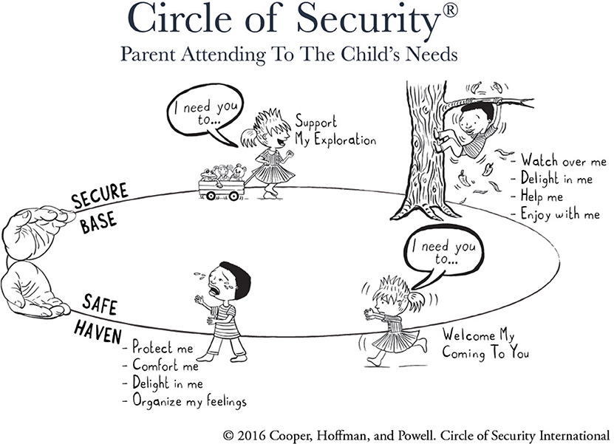
These are some key concepts of john bowlby theory:
Secure base/safe haven-care giver provides comfort and permission to explore.
Internal working model-mental representation of self/others formed from early interactions.
Caregiver sensitivity-the care givers ability to recognise and respond appropriately to child signals a major predictor of attachment security.
Separation anxiety how a child reacts to caregiver departures/returns often used to classify attachment style (ainsworth's strange situation.)
Applying attachment theory:
Attachment theory suggests Amira's separation distress and social withdrawal are best addressed by strengthening predictable, sensitive adult-child relationships in the nursery and at home, while recognising temperament and other factors that may moderate her responses (ainsworth et al, 1978).
ThePhoto by PhotoAuthor is licensed under CCYYSA.

Slide 6
Biological & Enviromental influences:
Biological (nature) factors
Temperament: innate differences (e.g., Behavioural inhibition, sensory sensitivity) influence how strongly a child reacts to strangers and separation and how readily they approach peers. Temperament is relatively stable and interacts with caregiving (mountain, 2017).
Neurobiological regulation: early stress and caregiving quality influence physiological stress systems (e.g., HPA axis) and emotion-regulation neural circuits; interventions that increase caregiver sensitivity can alter Behavioural markers. (ABC intervention research documents changes in biobehavioural markers following treatment.)
Environmental (nurture) factors
Caregiver sensitivity & routines: parental responsiveness, predictability of care and quality of parent–nursery communication strongly shape attachment security and Behaviour.
Recent life events / transitions: a recent move, family stress, or loss may trigger separation anxiety or regressions.
Nursery environment & staff consistency: consistent key persons, predictable routines and sensitive responding foster security and exploratory play.
Interaction (nature × nurture): temperament can moderate sensitivity effects — e.g., a child with high inhibition needs especially predictable and sensitive caregiving to feel secure. The best approach addresses both intrinsic child differences and the caregiving environment.

Slide 7


Critical evaluation of attachment theory:
Strengths:
Strong research evidence.
Practical Guidance for early years.
Supports emotional wellbeing.
ThePhoto by PhotoAuthor is licensed under CCYYSA.
Limitations:
Doesn’t explain all behaviours (E.G language delays).
Cultural variation in attachment expression.
Early versions of the theory focused heavily on the mother-child bond, neglecting the roe of fathers, extended family, or community support (bowlby, 1969).
ThePhoto by PhotoAuthor is licensed under CCYYSA.

Slide 8
Biological (nature) factors:
Temperament: innate differences (e.g., behavioural inhibition, sensory sensitivity) influence how strongly a child reacts to strangers and separation and how readily they approach peers. Temperament is relatively stable and interacts with caregiving.
Neurobiological regulation: early stress and caregiving quality influence physiological stress systems (e.g., HPA axis) and emotion-regulation neural circuits; interventions that increase caregiver sensitivity can alter behavioural markers. (ABC intervention research documents changes in biobehavioural markers following treatment.)
Environmental (nurture) factors:
Caregiver sensitivity & routines: parental responsiveness, predictability of care and quality of parent–nursery communication strongly shape attachment security and behaviour.
Recent life events / transitions: a recent move, family stress, or loss may trigger separation anxiety or regressions.
Nursery environment & staff consistency: consistent key persons, predictable routines and sensitive responding foster security and exploratory play.
Interaction (nature × nurture): temperament can moderate sensitivity effects — e.g., a child with high inhibition needs especially predictable and sensitive caregiving to feel secure. The best approach addresses both intrinsic child differences and the caregiving environment.

Slide 9
5. Critical evaluation — usefulness and limitations of Attachment Theory for Amira’s plan
Usefulness
Highly relevant: directly addresses separation, comfort-seeking and the carer–child relationship — the core issues with Amira.
Actionable: leads to practical, testable interventions (key person, sensitivity training, structured transitions) with a solid evidence base (meta-analyses and RCTs showing that interventions to improve caregiver sensitivity increase attachment security).
Integrative: can be combined with other frameworks (Vygotsky for language/social scaffolding; behavioural strategies for anxiety) to form a comprehensive plan.
Limitations / cautions
Not a full explanation of all behaviours. Attachment theory emphasises caregiver relationships but doesn’t fully explain language delays, neurodevelopmental conditions (e.g., autism spectrum) or medical causes of social withdrawal — these must be considered and ruled out where appropriate.
Cultural variation: attachment patterns and parenting practices vary across cultures; some behaviours labelled “insecure” in one context may not have the same meaning elsewhere. Practitioners must be culturally sensitive.
Risk of over-pathologising normal development: separation anxiety is developmentally normal for many 2–3 year olds; the focus should be on supportive interventions rather than assuming pathology. NHS guidance emphasises that many toddlers outgrow separation anxiety, though it still warrants support if severe.
Measurement and classification limits: Ainsworth’s Strange Situation is a research tool for 12–20 month olds; its direct application to a 3-year-old in a natural nursery setting is limited. Use observational records and multi-informant reports rather than attempting a formal Strange Situation in the nursery.
Conclusion of critical appraisal: Attachment theory is a powerful, evidence-based framework for understanding and addressing Amira’s separation anxiety and social withdrawal in the nursery, but it should be applied alongside developmental screening, cultural sensitivity, and complementary approaches (language scaffolding, behaviourally informed exposure strategies, and, if needed, specialist assessment).

Slide 10


Action list for nursery staff:
Identify and introduce a consistent key person for Amira.
Co-design a short drop off script with parents and trial for one week.
Provide Amira with a transistional object from home (with Parents agreement.
Begin short, supported one to one play sessions daily (10-15mins) with the key person focused on following Amiras lead and language modelling.
Train staff briefly (one 60min session) on sensitive responding and how to follow a child's lead.
Record daily observations on separation reaction intensity, play attempts, and verbal initiations, review fortnightly with the nursery SENCO and parents.
If no improvement after 4-6weeks, consider referral to early help to discuss caregiver focused interventions with parents.

Slide 11
Evidence base- strongest supporting evidence:
Evidence shows that caregiver semsitivity interventions effectively increase attachment security in early childhood.
Targeted, brief attachment interventions have randomized-trial evidence for improving caregiver sensitivity and child outcomes also shows measurable biobehavioural benefits.
Circle of security approaches are widely used in early years context and are the subject of trials and implementation research.
NHS and early years guidance note that separation anixety is developmentally common uo to the age of 3years but benefits from predictable routines and sensitive transitions.

Slide 12
Conclusion:
In conclusion with Bowlby's attachment theory, this helps us to see Amira's behaviour not as problematic but a insight into her anxiety and communication of her need for safety and connection. Amira's anxiety and withdrawn behaviour can be understood as part of her adjustment process to a new Environment. Through sensitive and consistent care, the nursery can help to develop a secure attachment, which will in turn enhance her emotional security, confidence, and engagement in play and learning.

Slide 13
References:
Ainsworth, M.D.S., Blehar, M.C., Waters, E. and Wall, S. (1978) Patterns of attachment: A psychological study of the strange situation. Hillsdale, NJ: Lawrence Erlbaum.
Available at: https://psycnet.apa.org/record/1979-02842-000
Accessed: 29 March 2026.
Bakermans-Kranenburg, M.J., van IJzendoorn, M.H. and Juffer, F. (2003) Less is more: Meta-analyses of sensitivity and attachment interventions in early childhood. Child Development, 74(3), pp. 597–615.
Available at: https://doi.org/10.1111/1467-8624.00571
Accessed: 29 March 2026
Cassidy, J. (2013) Contributions of attachment theory and research: A framework for future research, translation, and policy. Annual Review of Psychology, 64, pp. 579–605.
Available at: https://doi.org/10.1146/annurev-psych-113011-143754
Accessed: 29 March 2026.
Circle of Security International (2017–2020) Circle of Security Parenting and classroom approaches: Research overview and implementation resources.
Available at: https://www.circleofsecurityinternational.com
Accessed: 29 March 2026.
Dozier, M., Bernard, K. et al. (2017) Attachment and biobehavioral catch-up: Addressing the needs of infants and toddlers exposed to adversity. Journal of Consulting and Clinical Psychology.
Available at: https://www.ncbi.nlm.nih.gov/pmc/
Accessed: 29 March 2026.
Mountain, G. (2017) Sensitivity and attachment interventions in early childhood: A review. Early Childhood Research Quarterly.
Available at: https://www.sciencedirect.com
NHS (2021) Separation anxiety.
Available at: https://www.nhs.uk/conditions/baby/separation-anxiety/

