Slide 1


Slide 2

Introduction

Slide 3
Rationale
During a stage in my life I have experienced first-hand the implications of harassment and stalking. The experience has provided me with a substantial understanding of the procedures involved. However, this information was not made available.
Stalking and harassment consists of the perpetrators having an obsession and fixation with their victim and it can often lead from small incidents such as the victim receiving unwanted communications and escalate to more serious crimes such as rape and murder. It is typically misunderstood, and it is often not acknowledged as a crime by the justice system until it becomes severe or is too late and there have been serious consequences. It is a serious crime and can destroy lives of its victims while the perpetrators live a happy carefree life.
During an investigation into various procedures and other case studies it has been made clear that many victims of harassment and stalking are left vulnerable and they have nowhere to turn due to lack of awareness about charities and helplines available.
During further investigations, it is suggested that the police force currently lack the resources and adequate training to deal with victims of stalking and harassment.

Slide 4
Aims & Objectives
The aim of this consultancy project is to help promote awareness of harassment and stalking to ensure that victims know where to turn to and what to do in this situation. The following three objectives have been identified to raise awareness:
•Research the magnitude of unreported incidents
•Help promote awareness by running events
•Collaborate with the local police forces to help them understand harassment and stalking and the implications on its victims

Slide 5
Video
https://youtu.be/zgStJPksRVc
(Warwickshire police 2019)

Slide 6
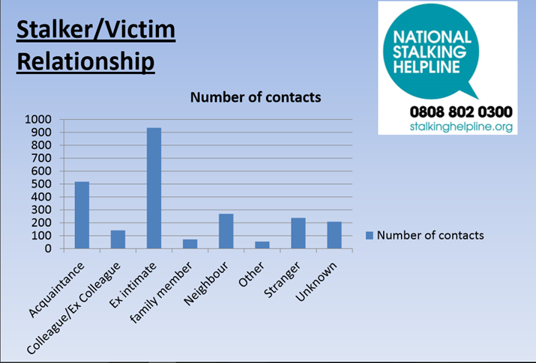
Statistics
.

Slide 7
Methodology
Conduct my background research
Once the requirements have been established research will be conducted to determine suitable premises to host small events.
After each event is completed an evaluation will be conducted on how to further improve the event and how to further promote awareness of stalking and harassment.

Slide 8
Measurements of success
To measurement of success would be determined by the increased number of people at the event.
Positive and constructive feedback from guests and Victim focus officer.
Rate of discussions between Victim focus officer and guests.

Slide 9
Educational Aspects
Multiple events to help boost awareness of stalking and harassment.
By conducting further research into stalking and harassment statistics it would provide a more thorough understanding of the problems that occur on a wider scale and how to better tackle the problem.
Ultimately conducting research prior to running an event is a fundamental requirement to ensure the success of the event.
By conducting questionnaires and speaking with the relevant authorities it makes it possible to understand what people want and need and what support these organizations can provide to aid in the success of the events that I will be conducting.
Ultimately by the project is designed to provide a strong understanding and experience of organizing and running events.

