Slide 1
PRACTICE-BASED RESEARCH
Assessment Workshop-
How to write the research introduction & conclusion section
Created by: Dr Aishat Bakre
Modified by: Dr Zeno Leung

Slide 2
Aims of the Session
To understand
How to write a good Introduction
How to write a good conclusion

Slide 3
Writing a Good Introduction
After the title, the introduction is the next thing your audience will read, so it is vital to begin strongly.
The introduction is your opportunity to show readers and reviewers why your research topic is worth reading about and why your paper warrants their attention.
The introduction serves multiple purposes.

Slide 4
Purpose of a Good Introduction
It presents the background to your study, introduces your topic and aims, and gives an overview of the paper.
A good introduction will provide a solid foundation and encourage readers to continue reading on to the main parts of your paper.

Slide 5
Tips for writing an effective introduction
Start broadly and then narrow down
Cite thoroughly but not excessively
Avoid giving too many citations for one point
State your research aims and importance
State your research objectives/questions
Keep it short, don't bury your readers in detail

Slide 6
Start broadly and then narrow down
In the first paragraph, briefly describe the broad research area and then narrow down to your particular focus.
This will help position your research topic within the broader field, making the work accessible to a broader audience, not just to specialists in your field.

Slide 7
Cite thoroughly but not excessively
Once you have narrowed your focus to the specific topic of your study, you should thoroughly cover the most recent and most relevant literature pertaining to your study.
Your review of the literature should be complete, but not overly long—remember, you are not writing a review article.
If you find that your introduction is too long or overflowing with citations, one possible solution is to cite systematic review articles, rather than all the individual articles that have already been summarised in the review.

Slide 8
Avoid giving too many citations for one point
Consider the following sentence: "Many studies have found a significant association between X and Y [4-15]."
This sentence cites too many studies at once. Although references [4-15] might provide a good overview of the topic, this sentence does not provide enough context or explanation for these past studies.
If all of these references are worth citing, they should be discussed in greater specificity.
For example, "A significant association has been found between X and Y in men [4-7], women [8-11], and children [12-15]."

Slide 9
State your research aims and importance
Say what you want to achieve and why your reader should be interested in finding out whether you achieve it.
That is you need to clearly show the importance of the topic
The basic structure can be as simple as "We aim to do X, which is important because it will lead to Y."

Slide 10
State your research objectives/questions
For research in formal sciences or exploratory research, you could consider stating a research question:
"In this study, we examine the following research question: Is X related to Y?" Note that the research question does not always have to be stated in the interrogative form (with a question mark); instead, you can put the question into a declarative sentence: "In this study, we investigate whether X is related to Y."
Research questions are effective because they help give shape to the project and serve as "signpost phrases" that guide readers through your project smoothly.

Slide 11
Keep it short
Try to avoid an overly long introduction.
A good target is 500 to 1000 words, although checking the project brief will provide the clearest guidance.
Giving an overview of the report / paper will be a good idea

Slide 12
In summary: Introduction
When you begin drafting a paper, the introduction should be one of the first things you plan.
The introduction serves as the roadmap for your paper; by clearly stating the study's background, aims, and hypothesis/research question,
The introduction can guide you as you write the rest of the paper.
It is such an important section—setting the scene for everything that follows—that many authors write the methods, results, and discussion sections in full before completing the introduction.

Slide 13

Writing a Conclusion
Notes:
Abstract
https://www.youtube.com/watch?v=lbCh94nJqIo
How to Write a Conclusion for a Dissertation | Scribbr 🎓 - YouTube

Slide 14
Writing a Conclusion
Writing a conclusion for your research paper can be difficult.
Concluding paragraphs should be clear and sum up what you have presented in your research without sounding redundant.
An effective concluding paragraph can also add impact to what you have presented in your paper.

Slide 15
Importance of writing a conclusion for your research paper
Including a conclusion in your research paper can be important to remind your readers of the strength and impact of your argument.
Concluding statements in your paper can also help to refocus the reader's attention to the most important points and supporting evidence of your arguments or position that you presented in your research.
Conclusions can also serve to recommend future work: continuing/further research, creating new ideas to resolve an issue you highlighted in your paper or offering new approaches to a topic.

Slide 16
Tips for writing an effective conclusion
When writing your conclusion, you can consider the steps below to help you get started:
Restate your research topic.
Restate the research question.
Summarise the main points.
State the significance of results.
Conclude your thoughts.

Slide 17
Restate your research topic
Your first step when writing your conclusion should be to restate your research topic. Typically, one sentence can be enough to restate the topic clearly, and you will want to explain why your topic is important. This part of your conclusion should be clear and concise and state only the most important information. Here is an example:
"The increase in water pollution since 2010 has contributed to the decrease in aquatic wildlife as well as the increase in unsafe drinking water."

Slide 18
Restate the research question
“Next, restate the thesis of your research paper. You can do this by revising your original thesis that you presented in the introduction of your paper. The thesis statement in your conclusion should be worded differently than what you wrote in your introduction. This element can also be effectively written in one sentence”. Here is an example:
"Clean water is imperative to maintaining ecological balance and protecting the public's health."

Slide 19
Summarize the main points
Next, you can sum up the main points of your research paper. It's helpful to read through your paper a second time to pick out only the most relevant facts and arguments.
You shouldn't need to include any more information than the main arguments or facts that you presented in your paper. The purpose of summarising the key points is to remind the reader of the importance of the research topic. Here is an example to help illustrate how to do this:
"With the increase in sugar farming, more and more pollutants are entering our freshwater supplies. This increase in pollution has contributed to massive decreases in marine life, fish die-off, increased respiratory illness in neighbourhood populations and has contributed to the shortage of clean drinking water."

Slide 20
State the significance of results
After discussing the main points of your argument, you should connect these results and state their significance. For instance, after stating the main points you made in your argument, you might discuss how the impacts of your topic affect a specific outcome.
Likewise, you might present the results of studies or other findings that can help add emphasis to how you present the significance of your information. Here is an example:
"Ecologists and marine biologists are continuing to measure the water quality, and researchers are continuing to find ways to combat the pollution run-off from commercial farms. In the future, the EPA hopes this research will lead to a decrease in the pollutant concentration in our freshwater systems."

Slide 21
Conclude your thoughts
As you finish up your conclusion, you might create a call to action or pose an idea that gets your readers thinking further about your argument.
You might also use this sentence to address any questions that were left unanswered in the body paragraphs of your paper. Here is an example:
"If we cannot combat the ill effects that commercial farming has on our clean water, our freshwater ecosystems and drinking water supplies will surely diminish. More research and innovation are needed to maintain our clean water while still supporting the agricultural needs of our economy."

Slide 22
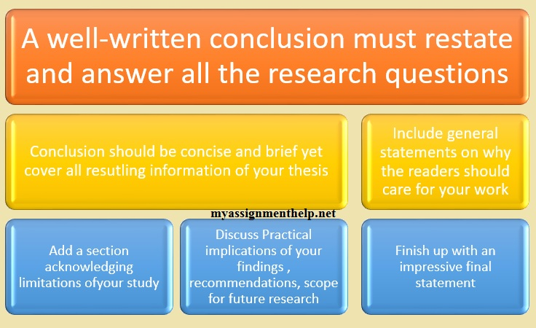
In summary: Conclusion

