Slide 1
BMLW4010
2405110
Tayleigh Western
Insanity And Automatism

Slide 2
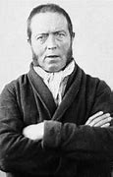
What Is Insanity
'insanity is a legal term pertaining to a defendant's ability to determine right from wrong when a crime is committed.' (Ryan Howes,2009)
M'Naghten Rule - 'To establish a defense on the ground of insanity, it must be clearly proved that at the time of committing the act the party accused was laboring under such a defect of reason, from disease of the mind, as not to know the nature and quality of the act he was doing, or as not to know that what he was doing was wrong.'
Notes:
What is insanity? 'insanity is a legal term pertaining to a defendant's ability to determine right from wrong when a crime is committed.' (Ryan Howes,2009). Also known as the “right-wrong” test, the M’Naghten Rule is a legal standard used to determine whether a defendant can be excused from criminal liability by reason of insanity. To establish a defense on the ground of insanity, it must be clearly proved that at the time of committing the act the party accused was laboring under such a defect of reason, from disease of the mind, as not to know the nature and quality of the act he was doing, or as not to know that what he was doing was wrong

Slide 3
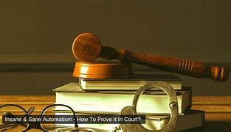
What Is Automatism
'Automatism, in a legal setting, is the involuntary performance of action without that person making the conscious decision to act.'
“We believe the reason for this is it is easy to say the accident was unexpected and unforeseeable, therefore the party had no control, in a way similar to the definition of automatism,” (Philip,2023)
Notes:
How do the courts deal with a defence of automatism? This argument has been raised by a number of insurers in an attempt to protect their clients from responsibility, but rarely has this defence succeeded.
“We believe the reason for this is it is easy to say the accident was unexpected and unforeseeable, therefore the party had no control, in a way similar to the definition of automatism,” Philip said. This argument has been raised by a number of insurers in an attempt to protect their clients from responsibility, but rarely has this defence succeeded. For instance, if a driver has failed to take prescribed medication as recommended or drove contrary to the medical advice he has received which then leads to a medical episode occurring, or if there were warning signs which he or she has failed to respond to but simply continued driving, that person could carry some responsibility for the collision.

Slide 4
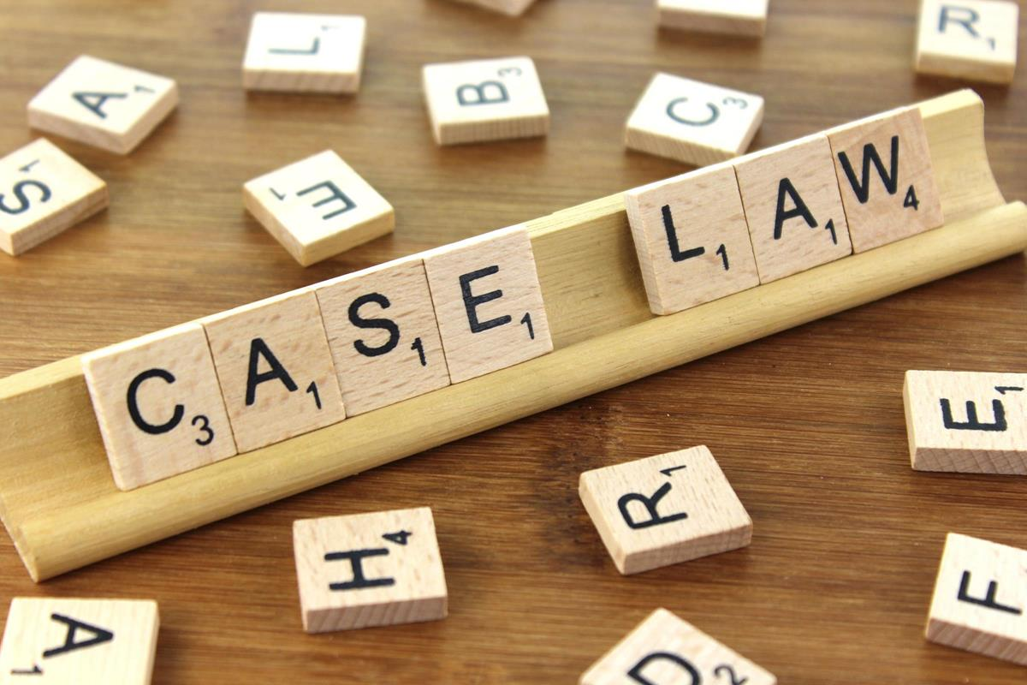
Key case law
A key case law is a legal decision that has a significant impact on how the law is interpreted and enforced. These cases often involve pivotal rulings that set legal precedents, which guide future court decisions in similar cases.
Insanity case law: M'Naghten Rule (1843). ' Daniel M’Naghten took a pistol and shot Edward Drummond, who he believed to the British Prime Minister Robert Pell, wounding him fatally. Drummond died five days later and M’Naghten was charged with his murder. He pleaded not guilty by reason of insanity.'
Automatism case law: Broome v Perkins [1987] . 'the defendant had driven erratically while suffering from hypo-glycaemia (low blood sugar level caused by an excess of insulin in the bloodstream) but was convicted of driving without due care and attention because of evidence that from time to time, he had exercised conscious control over his car, veering away from other vehicles to avoid a collision, braking violently, and so on.'
Notes:
A key case law is a legal decision that has a significant impact on how the law is interpreted and enforced. These cases often involve pivotal rulings that set legal precedents, which guide future court decisions in similar cases.

Slide 5

Issues With Insanity And Automatism
The issue with insanity. There are many issues with insanity such as the stigma, balancing between punishment and treatment and false pleas.
The issues with automatism. An issue with automatism is deciding if the defendant was truly involuntary, the burden of truth, the risk of having abuse and the impacting of scenting.
'The defense of automatism is so closely related to that of insanity that it would make no sense to attempt to reform one without the other.'
Notes:
Various bodies have reviewed the law and recommended reform but the substance of the defence has remained unchanged, and so the faults persist. There is now a greater recognition of the difficulties the criminal justice system faces in dealing with people with mental illness and learning disabilities and there is a growing pressure for reform.

Slide 6

Advantages of the defenses of insanity and automatism
The advantages of insanity:
Uploads justice principles
Promotes medical treatment
Safeguards public safety
Reduces prison overcrowding
Acknowledges mental health importance
The advantages of automatism:
Involuntary actions
Safeguard against punishing innocence
Acknowledgment of mental health and physical health issues
Protection of vulnerable individuals.
Notes:
There are many advantages to insanoty such as:

Slide 7
Reform suggestions
Reforming suggestions for insanity: 'English law’s insanity defense has been subjected to sustained and cogent criticism. It is outdated in its understanding of psychiatry and was devised for trial procedures that are unrecognizable to those familiar with modern day practice.' (David Ormerod,Mark Dsouza,2022)
Royal Commission on Capital Punishment 1953
'The Commission found the M’Naghten Rules were inadequate and needed to be changed.
The Commission criticized the test for responsibility and scope of the rules recommended that mental deficiency be considered a factor.
The suggestions were not implemented the introduction of the partial defense of diminished responsibility addressed some of the criticisms.'

Slide 8
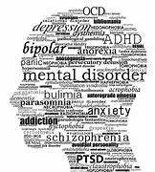
Reform suggestions
Reform suggestions of automatism: 'Suggestions are made for approaches to assessment and medicolegal reporting.' (Cambridge University,2018)
A reform suggestion is 'assesment critiera' for deciding if a person was in an automatic state at the time of when the offence took place, this would include medical evaluations and psychological assessments also.
Another reform suggestion is 'public awareness' to increase the public awareness about automatism to reduce the stigma and the misunderstanding about individuals who have experienced this including a more informed society.

Slide 9
Research timeline
What is Insanity – Thursday 17TH of October 2024
What Is Automatism – Saturday 19th of October 2024
Key Case Law – Wednesday 23rd of October 2024
Issues With Insanity And Automatism – Thursday 24th of October 2024
Advantages of the defenses of insanity and automatism – Saturday 26th of October 2024
Refrom suggestions insanity – Sunday 27th of October 2024
Refrom suggestions automatism – Tuesday 29th of October 2024

Slide 10
The Definition of Insanity | Psychology Today
M'Naghten Rule | Law Library | Digital Exhibits
What is a defence of Automatism and how do we counter that? - Minster Law
Automatism Cases | Law Teacher
Insanity and Automatism - Ministry of Justice - Citizen Space
20 Pros and Cons of Insanity Defense | Ablison bits of law | Criminal | Defences | Insanity: Evaluation & Reform

