Slide 1


Assaults
Notes:
Learners who have successfully completed this lesson will be able to:
Understand legislation relating to the ascending scales of assaults and all Offences Against the Person (including common assault, battery, ABH, GBH and GBH with intent).
Identify and discuss the defences to the above offences.
Apply knowledge to differentiate between all offences against the person.
Apply knowledge and discuss how these offences can become ‘racially’ or ‘religiously’ aggravated.
This needs to be changed – it is almost impossible to assess understanding. Think about what you are actually going to get the students to do in order to assess them on the legislation.

Slide 2

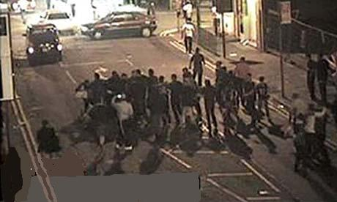
Homicide
G.B.H
Sect 18
OAP Act
1861
G.B.H
Sect 20
OAP Act
1861
A.B.H
Sect 47
OAP Act
1861
Murder
Common
Assault
Sect 39 CJA
1988
Manslaughter
The scale of Assaults
Notes:
Historically the Offences Against The Person Act 1861 provided magistrates with the opportunity to imprison or fine anyone committing the common law offences of assault or battery.
The same statute provided the offences of Assault occasioning actual bodily harm (ABH), GBH and GBH with intent.
Assault and battery remained a common law offence until they became summary offences by S39 Criminal Justice Act 1988.
CPS decide on how to charge a defendant depending on the level of injury. In general, if there are no serious injuries then the offence charged will be common assault.
Common Assaults: The most minor form of assault
ABH: Where actual harm is caused, normally refers to physical injury.
Assault Police: Provided we are acting in the execution of our duty.
More Serious Assaults: Section 20 G.B.H or Section 18 causing G.B.H with Intent.
Homicide: Murder and Manslaughter

Slide 3
Section 39 Criminal Justice Act 1988
There are two offences under S.39 CJA:
COMMON ASSAULT
OR
ASSAULT BY BEATING (Battery)
Notes:
Under Sec 39 Criminal Justice Act 1988 there are two possible offences:
Common assault – to understand common assault, we must first understand what is meant by the word “Assault” (see next slide)
Assault by beating – to understand this, we must first understand what is meant by “Battery” (see next slide)
Although any injury can be classified as actual bodily harm, the appropriate charge will generally be contrary to section 39 where the injuries amount to no more than transient or trifling, for example;
grazes; scratches;
abrasions; minor bruising;
swellings; reddening of the skin;
superficial cuts; or a "black eye".
Assault and battery remained a common law offence until they became summary offences by S39 Criminal Justice Act 1988.
Common Assault – Triable summarily only– Maximum penalty
6 months imprisonment and/or fine on conviction.

Slide 4
Definition of Assault
Any act which a person
intentionally or
recklessly
causes another person to apprehend
immediate
and unlawful personal violence
Notes:
The word “Assault” must be considered first
There is no legal definition of assault, however this definition has been referred to in a court of law: R v Brown 1993
Any act – The act could be words in a letter, or a telephone call including threatening silences
No contact is required
Intentionally – Explained on next slide
Recklessly – Explained on next slide
Causes another person to apprehend – The action of the suspect leave the victim in no doubt of what he is about to face.
To apprehend is to anticipate or fear a certain act or consequence.
Apprehension can come from words, silence or conduct.
Immediate – Not necessary instantaneous but within a minute or two e.g. if a threat is made from outside a house to a victim inside a house, it would take a few moments before it could be carried out.
A future or conditional threat is not an assault. e.g. “I’ll punch your lights out next week”
Unlawful – A person who threatens another by shaking their fist at them or using some other threatening gesture commits an assault if they put the other in fear of immediate unlawful personal violence. It is the act of putting someone in fear rather than the injury that must be intended.
A “conditional threat” will not constitute an assault – e.g. a conditional threat would be a person saying to another “I’d chin you if there wasn’t a copper over there”
Personal violence – The person should fear a violent act being committed against him.
Words alone can constitute an offence, however other criminal offences could be possibly be considered such as Section 4, 4A or 5 Public Order Act

Slide 5
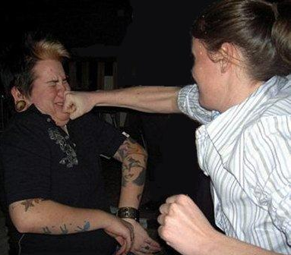
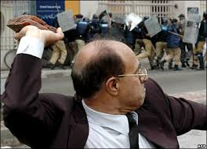
Intentionally
Recklessly
Notes:
Intentionally – means a deliberate or purposeful act.
The suspect deliberately acts in a way that is calculated to leave the victim in no doubt that he will be subjected to personal violence.
The suspect purposely takes part in some kind of conduct which applies unlawful force on another person.
Eg: a person approaches someone and punches them in the face. It is intentionally applied force.
Recklessly is described as being aware of the existence of risk but nonetheless had gone on and taken it. (R V Cunningham 1957)
The person foresaw that the consequence of their conduct might be the application of unlawful force against another person, but they continued anyway.
Eg: a group of people throwing pebbles in a busy street are reckless as to whether the pedestrians may suffer personal violence.

Slide 6
Common Assaults by Beating
Definition of Battery
A person is guilty of battery if they
intentionally or recklessly
apply unlawful force
on another person
Notes:
Battery is a common assault by beating
Intentionally – The suspect purposely takes part in some kind of conduct which applies unlawful force on another person.
If two persons are imitating a fight scene from a film, they both may fear immediate force but they do not assault each other because they do not intend to use immediate unlawful force.
Recklessly – The suspect foresaw that the consequence of their conduct might be the application of unlawful force against another person, but continued, e.g. if a group of people throwing pebbles in a busy street are reckless as to whether the pedestrians may suffer personal violence.
Apply – to make contact with the victim
Unlawful force – Force can be applied in many ways, it involves contact but only the slightest degree of force is required. Force can be applied DIRECTLY
e.g. A applies force to B or INDIRECTLY e.g. A applies force to B who knocks into C (thereby applying force to C)
It can include a simple punch or kick, a blow with a stick or the throwing of a stone at someone. Technically mere touching is a battery
On another – the force can be applied indirectly e.g. a suspect punches a man carrying a baby, causing him to drop the baby. Force is applied to the baby.
The difference between an assault and a battery, in simple terms is that an assault is when someone makes another think they are going to be violently harmed immediately whereas a battery is the actual physical contact or harm being done.
Offences of assault reported to the police tend to involve both an assault and a battery

Slide 7
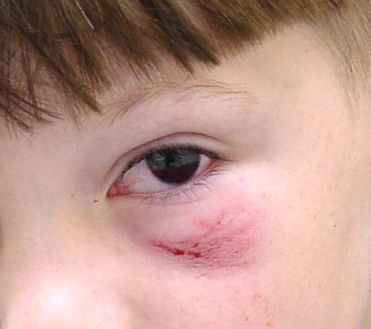
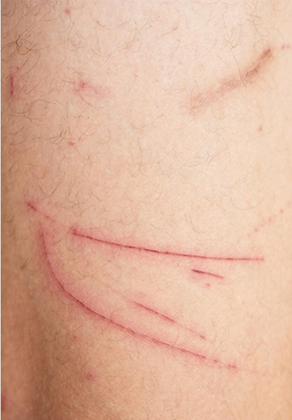
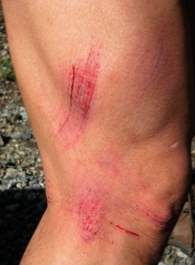
Examples of Injuries Consistent with Battery
Notes:
Injuries consistent with battery
Minor bruising or swelling e.g. black eye
grazes; scratches; abrasions; swellings; reddening of the skin; superficial cuts;

Slide 8
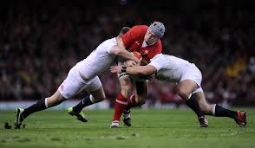
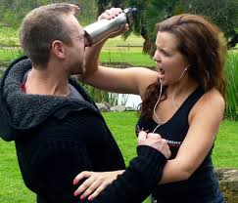
Defences
Consent
Self-Defence
Notes:
General Defences relating to Assault
There are several defences to offences relating to assault, such as consent or the lawful application of force, & actions used to prevent crime to effect a lawful arrest.
Consent – Being tattooed, having a piercing, or medical operation, lawful sports.
Consent cannot be given to an assault that inflicts bodily harm of a substantial nature (other than surgical operations and similar activities). A willing victim of sado-masochism cannot consent to being assaulted (see R v Brown 1993) but a more flexible view can be taken to, for example, some body mutilation in limited and non-aggressive circumstances, (see R v Wilson 1996) Much depends on individual circumstances.
This defence covers participation in all lawful sports which might result in injury due to their very nature, including boxing (under the Queensberry rules), soccer, rugby etc. Properly conducted sports are considered to be for the public good and therefore any assaults and batteries which take place during the course of the contest within the rules are lawful and the opposing players are taken to have given their consent to the injuries which they might suffer during the course of the match or contest. Any injury caused by a player acting outside the rules of the sport will be an assault, and criminal proceedings should be considered.
Sports such as boxing and rugby are contact sports and as such participants consent to the injuries they may receive while engaged in the sport and abiding by its rules.
However, if the rules are broken and the injuries are caused as a consequence, then this defence no longer exists
Consent does not include being reckless as to whether consent was given e.g. knowing an injury might occur and taking the risk anyway
Implied consent eg. walking in crowded streets and being bumped into
There are occasions when a police officer needs to draw attention to their presence in order to seek to ask questions or to warn or to advise a member of the public. A hand placed on a shoulder or arm could amount to an assault or battery, but it seems the courts are willing to accept that it is not an assault simply to tap on the shoulder or to take an arm. Of course, this could equally apply to any other member of the public acting in similar circumstances. These circumstances are of course distinct from arrest where reasonable force can be used.
Self Defence:
A person may defend themselves or close relative, in some cases this may include property.
Self defence will not cover situations where assailants run after the person who has ceased the initial attack and then assaulted them.
The term ‘self-defence’ is not defined by law and therefore it is a question of fact for the courts to decide.
A court will apply a two-part test to self-defence:
That the individual believes that he/she was acting in self-defence
That the individual believes that the force used was reasonable in the circumstances

Slide 9
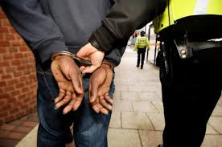
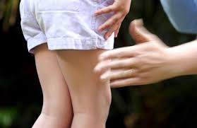
Defences
Execution of Lawful Right or Duty
Reasonable
Chastisement
Notes:
Lawful right or duty
The police are not above the law and must carry out their duties exercising reasonable force.
For use of reasonable force by any person see S3 Criminal Law Act 1967.
For constables powers to use reasonable force see Section 117 PACE
Consideration will be made as to what was reasonable in the circumstances.
Reasonable Chastisement could be a defence to a common assault only - but not section 47, 18 & 20 Offences Against the Person Act 1861.
Following the enactment of S58 Children Act 2004, a parent no longer has the legal right to inflict moderate and reasonable physical punishment on their children (reasonable chastisement). The position is the same for someone who is 'in loco parentis ', meaning 'in the place of a parent'. This can include a teacher, youth leader, baby sitter, etc.
Although this legal right has been removed, Parliament has decided not to make such punishment by a parent an absolute offence. Instead, the issue would only arise in cases where there has been a charge of 'common assault' under S39 Criminal Justice Act 1988. Only in this instance can the excuse of 'reasonable chastisement' be used as a defence to the charge.

Slide 10
Actual Bodily Harm (ABH)
A person is guilty of an offence if he intentionally or recklessly uses unlawful force on another, thereby occasioning him actual bodily harm
  Section 47 Offences Against The Person Act 1861
Notes:
The main factor which distinguishes common assault by beating from ABH is the degree of injury.
Bodily harm – includes any hurt or injury calculated to interfere with the health or comfort of the victim. Such injury or hurt need not be permanent but must be more than merely transient. (lasting for only a short time)
The injury must be real and must be able to be seen and felt by the victim.
Intention or recklessness are the same for ABH as they are for common assault by beating, it only needs to be proved the assault was intended or carried out recklessly.
Triable either way offence
Summary Offence – Up to 6 months imprisonment/ and or fine
Indictable Offence – Up to 5years or 7 years if racially aggravated

Slide 11
Actual Bodily Harm (ABH)
Actual Bodily Harm means;
‘any hurt or injury calculated to
interfere with a persons health or
comfort and includes physical harm or
shock & mental injury’
Notes:
This definition is from case law R v Chan-Fook (1994)
Harm can be permanent or temporary.
Harm includes both physical harm and shock or mental injury. It can include a loss of consciousness.

Slide 12
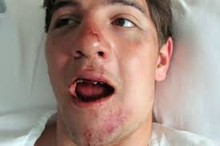
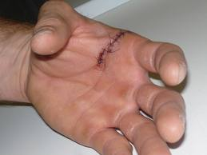
Examples of Actual Bodily Harm
Notes:
Examples of ABH injuries:
Loss or breaking of a tooth.
Temporary loss of sensory functions.
Extensive of multiple bruising.
Minor fractures and cuts requiring stitches
These injuries may need not be visible or permanent, e.g. minor fractures such as a broken nose, bruising or abrasions.
Actual bodily harm has been held to include shock , psychiatric (i.e. mental) injury , a momentary loss of consciousness and there is even a stated case, DPP v Smith 2006, the deliberate cutting of a person's hair was found to be ABH
However it does not include mere emotions such as fear, distress or panic.

Slide 13
Grievous Bodily Harm (ABH)
Whosoever shall unlawfully and maliciously
wound or inflict any grievous bodily harm
upon any other person
either with or without any weapon or instrument
shall be guilty of an offence
Section 20 O.A.P.A. 1861
Notes:
Grievous Bodily Harm is ‘really serious harm’ but may not be permanent.
Examples:
injury resulting in permanent disability or loss of sensory function
Visible disfigurement
Broken limbs
Substantial blood loss – requiring a blood transfusion
Injury resulting in lengthy treatment or incapacity
Psychiatric injury
Fractured skull
Broken cheek bone, jaw or ribs
The suspect must know that the actions would result in some kind of jury , but does not necessarily have to foresee the degree of the injury.
The injuries can be caused either with or without a weapon
Unlawfully – (as per the definition of common assault) means ‘without lawful justification’ Could be lawful if someone is acting in self defence or a police officer acting with reasonable force
Maliciously – includes intentionally or recklessly - the defendant must realise that there is a risk of some harm being caused to the victim. E.g. passing on a sexual transmitted infection, the suspect would foresee that the victim might contract the infection through sexual activity, but go on to take the risk anyway.
It is only necessary to prove that the suspect FORESAW a RISK of SOME HARM and went on to use force against the victim regardless
It is not necessary to prove that the suspect foresaw the EXTENT of the actual harm caused as a result – which may have been far more severe than anticipated
Example: JONES approached LEWIS and punches him to the face. LEWIS falls backwards and hits his head – fracturing his skull.
Wounding - is the breaking of the whole skin e.g. a cut which goes right through all the layers of the skin whether externally or internally.
Inflict - there does not need to be an physical contact and it must be shown that the behaviour of the defendant brought about the resulting harm – a person jumping from a window because of the threats made. There is a link between the suspects actions and the victims injuries.
Section 20: Triable either way. On indictment - 5 years' imprisonment and/or a fine. Summarily - 6 months' imprisonment and/or a fine.

Slide 14
Grievous Bodily Harm (ABH)
Whosoever shall unlawfully and maliciously,
by any means whatsoever:
wound or cause any grievous bodily harm
to any person
with INTENT to do some grievous bodily harm
to any person
or with intent to resist or prevent
the lawful apprehension or
detainer of any person
shall be guilty of an offence
Section 18 O.A.P.A. 1861
Notes:
This is a crime of specific intent
Unlawfully – means ‘without lawful justification’ Could be lawful if someone is acting in self defence or a police officer acting with reasonable force
Maliciously - includes intentionally or recklessly. It means the defendant must realise that there is a risk of some harm being caused to the victim. E.g. passing on a sexual transmitted infection, the suspect would foresee that the victim might contract the infection through sexual activity, but go on to take the risk anyway.
By any means whatsoever – harm can be produced in any way but a connection between the means and the harm must be proved.
Wound - the breaking of the whole skin e.g. a cut which goes right through all the layers of the skin whether externally or internally.
Cause – is to make something happen it is a wider term than inflict.
Intent – there requires a specific intent to wound or cause GBH. This is sometimes difficult to prove, although some obvious examples are
a weapon is used
repeated or planned attacks
deliberate selection of a weapon or article adapted to cause injury – breaking a glass before an attack
prior threats
Resist lawful apprehension – 2 elements are needed
the arrest is lawful
the person knows arrest is being made
eg. if a suspect pushes a store detective who is trying to arrest them and causes them serious injury (as a result of the push) the offence has been committed
Detainer – is anyone acting in the detention of the suspect ire store detective, police, customs officer etc
Triable on indictment only. Life Imprisonment (max)

Slide 15
 | S.20 | s.18
Category | Either Way Offence | Indictable Only
Crown Court | 5 Years Imprisonment | Life Imprisonment
Magistrates Court | 6 Months and/ or fine | N/A
Racially / Religiously Aggravated | Crown Court: 7 years Imprisonment and / or Fine Magistrates Court: 6 Months and / or fine | N/A

Slide 16
Assault Police
It is an offence for any person to:
assault or resist a police officer or any
person assisting the officer
in the lawful execution of his duty
Section 89(1) Police Act 1996
Notes:
Assault – this is similar to Common Assault by beating, the results of which are minor or no perceived injuries. If the injuries amount to actual or grievous bodily harm then this would be the preferable charge.
Resist – implies a degree or physical confrontation or struggle
Any person assisting – this could mean anyone, including colleagues, police staff (PCSOs) and members of the public.
Lawful execution of his/her duty – it is not enough to simply be on duty. An officer must be in lawful execution of that duty and acting within their powers. For example, if a police officer makes an unlawful arrest, then neither he nor anyone assisting them would be protected by this offence.
Assisting private person to eject trespasser would not fall within this offence as trespass is a civil offence.
There is a stated case to support this:
An officer who went to a call of a recent burglary where it was thought the suspect had made off, entered the premises. On entering the offender ran out pushing over the officer. The offender was charged with assault police but was not convicted – officer not in lawful execution - no power of entry
Summary offence
6 months maximum and/or fine

Slide 17
Obstruct Police
It is an offence for any person:
to wilfully obstruct a police officer or any
person assisting the officer
in the lawful execution of his duty
Section 89(2) Police Act 1996
Notes:
Wilfully Obstructing - means making it more difficult for an officer to carry out his or her duty.
This does not need to be in the bodily form, such as standing in an officers way. It can be caused by omitting to do something e.g. Providing misleading information would meet the criteria.
For example:
Door-staff deliberately misleading the police by stating an offender had run off down the street when he was actually hiding in the managers office.
Obstruction could also be committed by drivers flashing their headlights warning other road users of a speed trap.
This offence also applies to persons assisting a PC (e.g. a PCSO)
Some extreme forms of obstruction may amount to more serious offences such as perverting the course of justice.
Summary offence
1 month maximum and/or fine on conviction

Slide 18
Assault with Intent to resist Arrest
It is an offence to:
assault any person
With intent to resist or prevent
the lawful apprehension or detainer
of himself or of any other person
Section 38 Offences Against Person Act 1861
Notes:
Assault any person – this could therefore include anybody, e.g. a store detective, security officer, customs officer or court representative
Resist or prevent the lawful apprehension or detainer – the arrest MUST be a lawful one.
A detainer is anybody who is acting in the detention of a suspect, including a store detective, a customs officer or court representative
Himself or any other person – the assault need not be committed by the person who is being detained or arrested. For example, it could be the suspect’s friend who is being detained or arrested.
If the suspect believes that the arrest is unlawful, it is still an offence. This would include a belief that the arrested person was innocent.
Summary offence
2 years maximum and/or fine on conviction

Slide 19
Assaults on Emergency Workers (Offences) Act 2018
This Act provides that when the offence of
common assault or battery
is committed against an
emergency worker,
acting in the exercise of his functions as such a worker, the offence shall be triable either way and as such, carry a higher penalty.
Notes:
November 2018
An Act to make provision about offences when perpetrated against emergency workers, and persons assisting such workers; to make certain offences aggravated when perpetrated against such workers in the exercise of their duty; and for connected purposes
Emergency worker means -
(a) a constable;
(b) a person (other than a constable) who has the powers of a constable or is otherwise employed for police purposes or is engaged to provide services for police purposes;
(c) a National Crime Agency officer;
(d) a prison officer;
(e) a person (other than a prison officer) employed or engaged to carry out functions in a custodial institution of a corresponding kind to those carried out by a prison officer;
(f) a prisoner custody officer, so far as relating to the exercise of escort functions;
(g) a custody officer, so far as relating to the exercise of escort functions;
(h) a person employed for the purposes of providing, or engaged to provide, fire services or fire and rescue services;
(i) a person employed for the purposes of providing, or engaged to provide, search services or rescue services (or both);
(j) a person employed for the purposes of providing, or engaged to provide -
(i) NHS health services, or
(ii) services in the support of the provision of NHS health services,
and whose general activities in doing so involve face to face interaction with individuals receiving the services or with other members of the public.
3(2) It is immaterial for the purposes of subsection (1) whether the employment or engagement is paid or unpaid.
3(3) In this section -
custodial institution means any of the following -
(a) a prison;
(b) a young offender institution, secure training centre, secure college or remand centre;
(c) a removal centre, a short-term holding facility or pre-departure accommodation, as defined by section 147 of the Immigration and Asylum Act 1999;
(d) services custody premises, as defined by section 300(7) of the Armed Forces Act 2006;
custody officer
has the meaning given by section 12(3) of the Criminal Justice and Public Order Act 1994;
escort functions -
(a) in the case of a prisoner custody officer, means the functions specified in section 80(1) of the Criminal Justice Act 1991;
(b) in the case of a custody officer, means the functions specified in paragraph 1 of Schedule 1 to the Criminal Justice and Public Order Act 1994;
NHS health services
means any kind of health services provided as part of the health service continued under section 1(1) of the National Health Service Act 2006 and under section 1(1) of the National Health Service (Wales) Act 2006;
prisoner custody officer
has the meaning given by section 89(1) of the Criminal Justice Act 1991

Slide 20
Racially or Religiously Aggravated
S.29 Crime & Disorder Act 1998 takes existing offences and sets out circumstances in which those existing offences become racially or religiously aggravated.
  Assaults
  Common assault/battery s.39 CJA 1988
  ABH s47
  wounding or GBH s20
  Note: s18 GBH with intent is not covered as it already carries
  a maximum prison sentence
Notes:
The ‘aggravated’ form of the offence carries a higher maximum penalty than the ordinary form of the offence
Racially & Religiously aggravated offences shall be covered in another lesson

Slide 21

Who Wants To Be A Crime-Buster?
Notes:
The ‘aggravated’ form of the offence carries a higher maximum penalty than the ordinary form of the offence
Racially & Religiously aggravated offences shall be covered in another lesson

Slide 22
Q1 = Has a common assault taken place here?
Smith sees Pratt in the street and says to her, “Bring back my DVD by tomorrow or I will come around and break your legs”
^{A} Yes, Smith has committed a Common Assault on Pratt.
^{B} Yes, as he has made threats to Pratt.
^{C} No, there is no immediate threat of violence towards Pratt
^{D} No, Smith has committed Threats to Kill.

Slide 23

C – No, there is no immediate threat of violence towards Pratt

Slide 24
Q2 = Jones the school bully threatens Hill, another 13-yr-old boy in the school yard. Jones does not mean to hurt Hill in any way but begins to shove him in the chest. Hill loses footing and subsequently falls, lacerating his arm in the process. Is Jones guilty of an offence?
^{A} No, the injury was sustained as a result of the fall.
^{B} Yes, assault occasioning Actual Bodily Harm (ABH)
^{C} No, he could have not foreseen the circs when he was pushed
^{D} Yes, common assault

Slide 25
^{B} – Yes, assault occasioning ABH

Slide 26
Q3 = Smith is threatened by a youth armed with a bicycle chain. He is not intimidated and easily disarms the youth, but before the youth has a chance to run away, Smith gives him a severe beating, resulting in the youth having multiple bruises, cuts and swelling to his face. Can Smith claim this assault is justified?
^{A} Yes, this was clearly self defence
^{B Yes,} because the youth was in possession of a weapon
^{C} No, an assault of this nature can never be justified.
^{D} No, the injuries were caused after the youth was disarmed

Slide 27
^{D} - No, the injuries were caused after the youth was disarmed

Slide 28
Q4 = Sykes is involved in an argument with a group of men in a crowded pub. During the argument, he removes his belt and starts swinging it around his head. As a result of this, his friend, Roberts, is struck by the belt, causing a deep laceration to his face. Sykes did not intend to injure Roberts, but bares no remorse. Is Sykes guilty of an offence?
^{A} Yes, Sykes is reckless in his actions
^{B Yes,} Sykes intended to cause injury with the belt
^{C} No, as Sykes did not intend to injure Roberts
^{D} No, as Roberts was not threatened first

Slide 29
^{A} – Yes, Sykes was reckless in his actions

Slide 30
Q5 = Jones has extreme views against religion and is annoyed by persons from his local church handing out leaflets in the town centre. One afternoon, Jones throws a glass bottle with considerable force at one of the congregation, aiming at the persons face. The bottle smashes and the injury causes the person to lose sight in their left eye. What offence would you consider for Jones in these circumstances?
^{A} Section 18 GBH
^{B} Section 47 ABH
^{C} Racially Aggravated Assault
^{D Section} 20 GBH

Slide 31
^{A} – Section 18 GBH
(Jones’ actions intended to inflict serious injury)

Slide 32


