Slide 1
Metaphysics and Epistemology
(HPPH5037/HPPH6037)
Vuthy Hastings

Slide 2
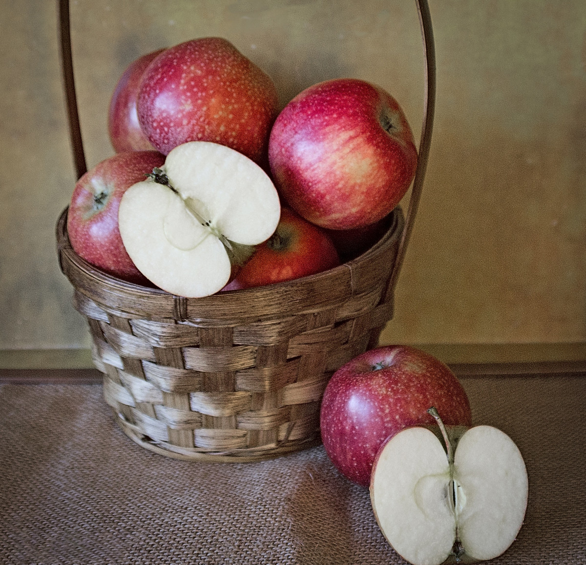

Does redness exist independently of particular red things?
‘The chief philosophical problem here is posed by sameness of type. Two different things, different particulars, can be of the same type’ (D.M. Armstrong, Universals: An Opinionated Introduction, 1989, p. 2)
This Photo by Unknown Author is licensed under CC BY
This Photo by Unknown Author is licensed under CC BY

Slide 3
Universals & particulars
Particulars: “A substance – that which is called a substance most strictly, primarily, and most of all – is that which is neither said of a subject nor in a subject, e.g. The individual man or the individual horse” (Aristotle, Categories 2a11–15, in The Complete Works of Aristotle: The Revised Oxford Translation, Vol. 1, ed. J. Barnes, 1984)
Universals: ‘the universal is common, since that is called universal which naturally belongs to more than one thing’ (Aristotle, Metaphysics 1038b8–10, in The Complete Works of Aristotle: The Revised Oxford Translation, Vol. 2, ed. J. Barnes, Princeton University Press, 1984)
Statement: ‘A definite or clear expression of something in speech or writing’ (Oxford University Press, “Statement,” Oxford Languages, via Google Dictionary, n.d.)
Proposition: The meaning or content expressed by a declarative sentence (adapted from King, J., Soames, S., & Speaks, J., “Propositions,” Stanford Encyclopedia of Philosophy, Introduction, 2023)
Level | Example | What it represents
Statement | This apple is red | A sentence that can be true or false
Proposition | The apple has the property of redness | The meaning/content of the statement
Predicate | is red | Attributes a property to the subject
Predicate: ‘Is part of a sentence or clause containing a verb that makes a statement about the subject’ (Oxford University Press, “Predicate,” Oxford Languages, via Google Dictionary, n.d.)

Slide 4
Parmenides
‘One path is: That Being doth be, and Non-being is not’
‘Th’other path is: That Being is not, and Non-being must be’
‘For thou never canst know what is not (for none can conceive it)’
(Parmenides, Fragment, “On Truth,” p. 4)
‘Never it was or shall be; but the ALL simultaneously now is, one continuous one’ (Parmenides, On Nature, “On Truth,” p. 6, in The Fragments of Parmenides, trans. Thomas Davidson, St. Louis: E. P. Gray, 1870)
‘Surely thou shalt not separate Being from clinging to Being,
Nor shalt thou find it scattered at all through the All of the cosmos,
Nor yet gather together’
(Parmenides, Fragment, “On Truth,” p. 6)

Slide 5
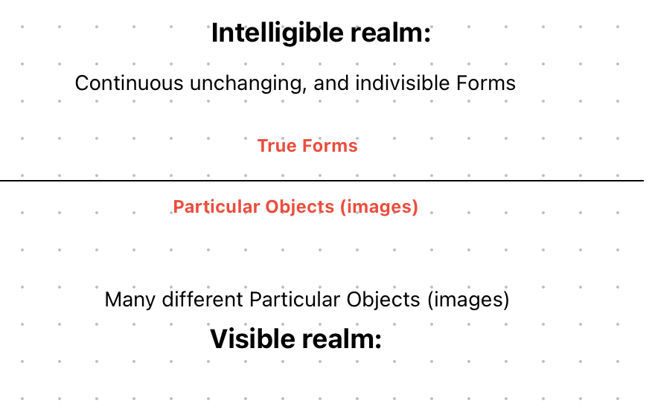
Platonic realism
(the Theory of forms)
‘It always is and neither comes to be, neither waxes nor wanes’ nor passes away
(Plato, Symposium 211a-b, in Plato: Complete Works, ed. John M. Cooper & D. S. Hutchinson, Indianapolis: Hackett Publishing Company, 1997)
The visible realm consists of ‘images those very things of which images were made in’
(Plato, Republic 511a-b, 1997)
‘It is like a line divided into two unequal sections.13 Then divide each section—namely, that of the visible and that of the intelligible’
(Plato, Republic 509b–c, in Plato: Complete Works, ed. John M. Cooper & D. S. Hutchinson, Indianapolis: Hackett Publishing Company, 1997)
‘nothing else makes it beautiful other than the presence of, or the sharing in, or however you may describe its relationship to that Beautiful’
(Plato, Phaedo 100c–d, in Plato: Complete Works, ed. John M. Cooper & D. S. Hutchinson, Indianapolis: Hackett Publishing Company, 1999)

Slide 6
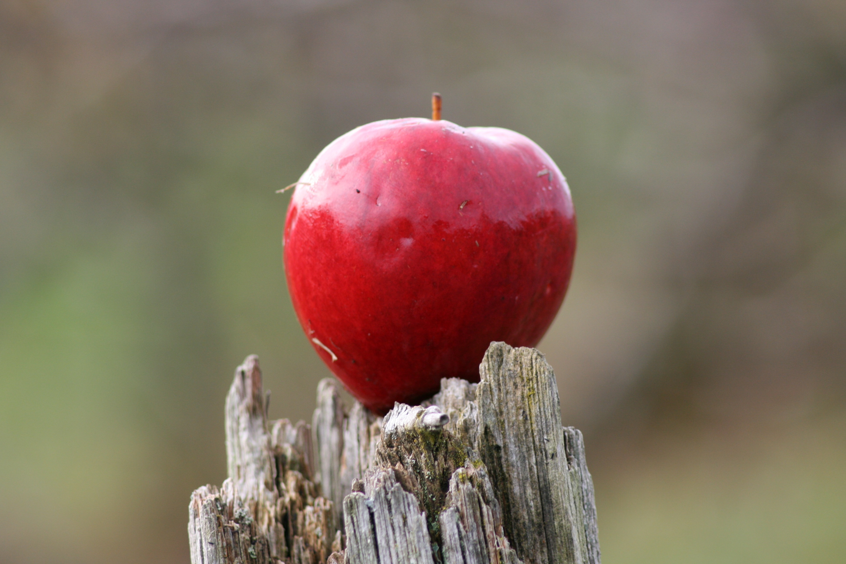
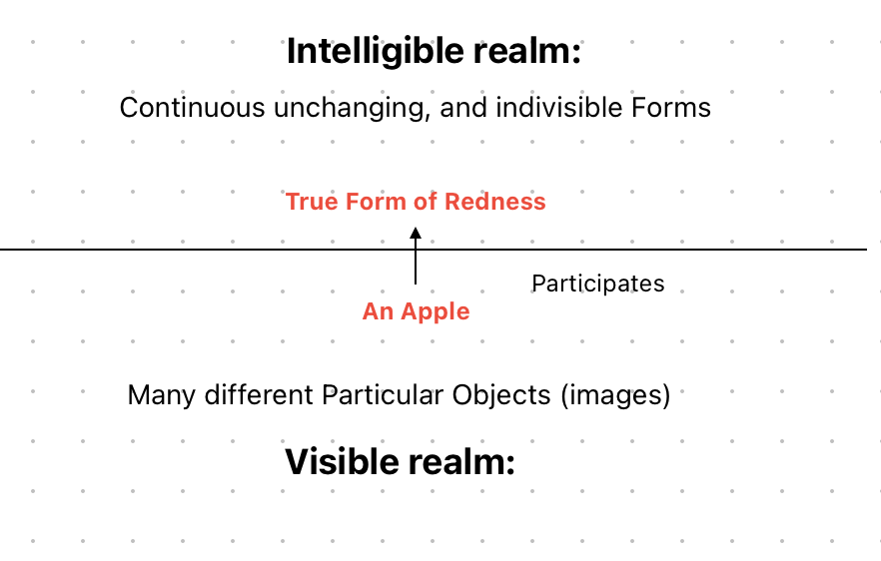
This apple is red
This Photo by Unknown Author is licensed under CC BY
Part | Example | Parmenides | Plato
Subject | This apple | Multiplicity problem | Particular
Predicate | Is Red | Change impossible | Refers to the Form of Redness
Proposition | This apple is red | Hard to explain | The apple participates in the form

Slide 7
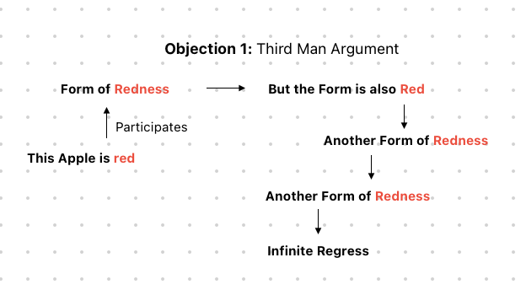
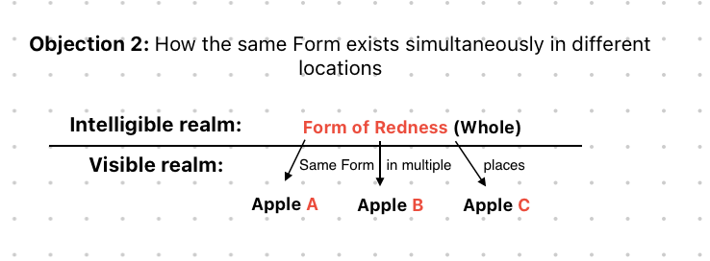
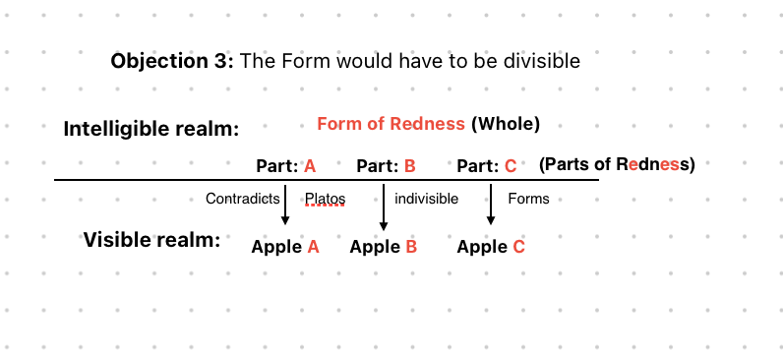
Response to plato
‘whenever some number of things seem to you to be large, perhaps there seems to be some one character, the same as you look at them all, and from that you conclude that the large is one’
(Plato, Parmenides 132a, in Plato: Complete Works, ed. John M. Cooper & D. S. Hutchinson, Indianapolis: Hackett Publishing Company, 1997)
‘So does each thing that gets a share get as its share the form as a whole or a part of it? ‘
(Plato, Parmenides 131a, 1997)
‘Are not the things that always remain the same and in the same state most likely not to be composite, whereas those that vary from one time to another and are never the same are composite?;
(Plato, Phaedo 78c, 1997)

Slide 8
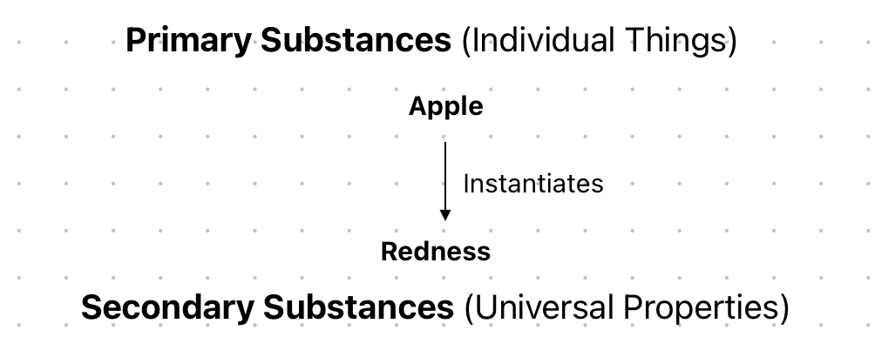
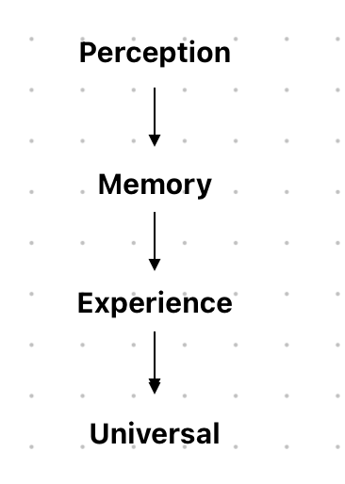
Aristotelian realism
Rejecting separate Forms: To say that the Forms are patterns and that other things participate in them is to use empty words and poetical metaphors (Aristotle, Metaphysics, 991a20)
Multiple entities: They make the Forms equal in number to the things that exist.
Primary Substance: ‘A substance – that which is called a substance most strictly, primarily, and most of all – is that which is neither said of a subject nor in a subject, e.g. The individual man or the individual horse’ (Aristotle, Categories 2a11–15)
Secondary Substance: Universals: ‘the universal is common, since that is called universal which naturally belongs to more than one thing’ (Aristotle, Metaphysics 1038b8–10)
‘From memory experience is produced in men; for many memories of the same thing produce finally the capacity for a single experience’ (Aristotle, Metaphysics 980b25)

Slide 9
This apple is red
Part | Example | Parmenides | Plato | Aristotle
Subject | This apple | Multiplicity problem | Particular | Primary Substance
Predicate | Is Red | Change impossible | Refers to the Form of Redness | Secondary Substance
Proposition | This apple is red | Hard to explain | The apple participates in the form | The apple instantiates redness
This Photo by Unknown Author is licensed under CC BY

Slide 10
nominalism
“All theories of universals maintain that there are multiply instantiable properties, entities that are simultaneously instantiated by many different, spatially separated particu- lars. There need be no such thing according to the Trope Nominalist. In addition, Trope Nominalists find evidence of particularized properties in common sense “
Markosian, “A Problem about Universals,” p. 238, in Crane & Farkas (eds.), Metaphysics: A Guide and Anthology, 2004
Part | Example | Class Nominalism | Resemblance Nominalism
Subject | This apple | Particular object | Particular object
Predicate | is red | Refers to membership in the class of red things | Refers to resemblance with other red objects
Relevant respect | Colour | Object belongs to the group of objects labelled red | Object resembles other objects in colour
Proposition | This apple is red | The apple belongs to the class of red objects | The apple resembles other red objects in colour
“Natural classes¹ are identified with classes of individuals where certain relations of resemblance hold between the individuals.”
(Armstrong, Theories of natural classes III, pg15, 1989)
“Class Nominalism² is the view that for a thing to be of a certain type is nothing more than for it to be a member of a certain class.”
(Armstrong, Class Nominalism II, pg. 8, 1989)
Notes:
Footnote Bertrand Russell

Slide 11
conclusion
Part | Example | Class Nominalism | Resemblance Nominalism
Subject | This apple | Particular object | Particular object
Predicate | is red | Refers to membership in the class of red things | Refers to resemblance with other red objects
Relevant respect | Colour | Object belongs to the group of objects labelled red | Object resembles other objects in colour
Proposition | This apple is red | The apple belongs to the class of red objects | The apple resembles other red objects in colour
Part | Example | Parmenides | Plato | Aristotle
Subject | This apple | Multiplicity problem | Particular | Primary Substance
Predicate | Is Red | Change impossible | Refers to the Form of Redness | Secondary Substance
Proposition | This apple is red | Hard to explain | The apple participates in the form | The apple instantiates redness

Slide 12
Bibliography
Books:
Aristotle. (1984). The Complete Works of Aristotle: The Revised Oxford Translation (Vol. 1). (J. Barnes, Ed.) Princeton, NJ: Princeton University Press.
Aristotle. (1984). The Complete Works of Aristotle: The Revised Oxford Translation (Vol. 2). (J. Barnes, Ed.) Princeton, NJ: Princeton University Press.
Armstrong, D. (1989). Universals: An Opinionated Introduction. Boulder, CO: Westview Press.
Carroll, J. W., & Markosian, N. (2010). An Introduction to Metaphysics. Cambridge: Cambridge University Press.
King, J., Soames, S., & Speaks, J. (2023, September (revision) 29). Propositions. Retrieved March 2026, from Stanford Encyclopedia of Philosophy: https://plato.stanford.edu/entries/propositions/
Oxford University Press. (n.d.). Predicate. Retrieved March 2026, from Oxford Learner’s Dictionaries: https://www.google.com/search?q=proposition+definition
Oxford University Press. (n.d.). Statement. Retrieved March 2026, from Oxford Languages (via Google Dictionary) : https://www.google.com/search?q=statement+definition
Parmenides. (1870). The Fragments of Parmenides. (T. Davidson, Ed.) St. Louis, MO: E. P. Gray.
Plato. (1997). Plato: Complete Works. (J. M. Cooper, & D. S. Hutchinson, Eds.) Indianapolis, IN: Hackett Publishing Company.
Russell, B. (1912). The Problems of Philosophy. New York: Henry Holt And Company.
Images/figures:
Hastings, V. (2026). Allergory of the Cave. Presentation figure. Independent work, Carmarthern.
Hastings, V. (2026). Aristotle Explanation Diagram. Presentation figure. Independent work, Carmarthern.
Hastings, V. (2026). Aristotles Perception Diagram. Presentation figure. Independent work, Carmarthern.
Hastings, V. (2026). Objection 1. Presentation figure. Independent work, Carmarthern.
Hastings, V. (2026). Objection 2. Presentation figure. Independent work, Carmarthern.
Hastings, V. (2026). Objection 3. Presentation figure. Independent Work, Carmarthern.
Hastings, V. (2026). Platos Participation. Presentation figure. Independent Work, Carmarthern.

