Slide 1
BA Leadership & Management Skills for the Workplace
Module: BMSW5101
Developing Workplace Critical Thinking
Week1

Slide 2


Aim
To Develop a Critical approach to workplace thinking, based on established theoretical models.

Slide 3
Module Objectives
At the end of the module the learner will be able to:
Distinguish and Analyse the difference between beliefs, attitudes and values within a workplace context
Critically assess their own beliefs, attitudes and value systems and their impact on workplace behaviour
Apply the critical assessment of an appropriate management theory

Slide 4
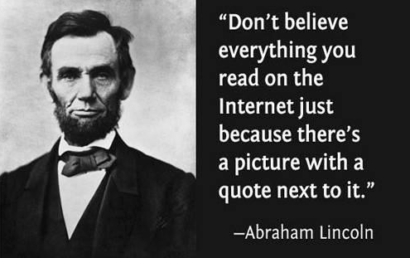
Introduction
BMSW5101
Assessment
Critical Thinking

Slide 5
Assessments
Task 1 Poster Presentation
Create a Poster presentation in a group (4/5) using a workplace example, critically analysing how organisations demonstrate their values, beliefs and attitudes towards sustainability. Apply critical thinking models to show how the organisation implements these values and its impact on success of the organisation and sustainable greener future.
The Poster presentation is to be presented with each group member contributing 5 minutes to the presentation (20minutes per group). Speaker notes (1000 words) will be uploaded to Turnit Link and will be used for marking your assessment by 8/11/21 by 3pm.
Speaker notes submitted 8/11/21.Posters to be presented week commencing 8/11/21.

Slide 6
Task 2 Report
The student will produce an individual 2500 word formal report which is to consider the critical analysis of classical management theories relevant to the organisational example and critically assess the impact of these theories on the implementation of the beliefs, and values of the organisation. Critically evaluate the impact on its employees as well as on the wider society in terms of future sustainability and impact on the environment. Finally how would you align your personal Values, attitudes and Beliefs with the organisational example used in your report?
Ensure the report is structured as a formal report and ‘Harvard’ referencing is used
Your Report should be submitted to Turnitin by 10/12/21

Slide 7
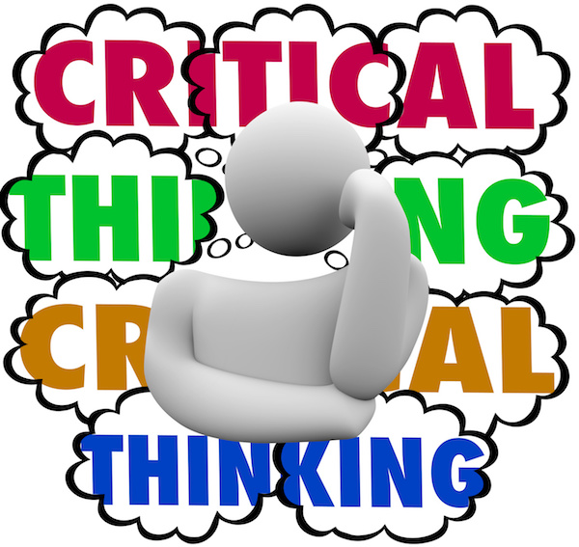
Notes:
What do you think critical thinking is?
Does not mean to criticise in a negative manner, rather its about questioning the information and opinions by understanding the topic in different
It means not taking what you hear or read at face value, but using your critical faculties to weigh up the evidence, and considering the implications and conclusions of what the writer is saying.
Critical thinking applies analytical skills and will be explored in great detail in this module. Critical and analytical thinking should be applied at all points in academic study - from selecting information, reading, writing, speaking and listening. Of these, learning to read and evaluate information critically is perhaps the most important skill, which if acquired can then be applied to other areas.

Slide 8
Critical thinking
Recognize & switch off emotions
Collect & Use information & Data
Avoid Thinking errors
Notes:
Focusing on facts – getting angry/ impulsive behaviour/ defensive
Avoid premature conclusions
What don’t I know about the situation
Looking for patterns, logical connections
Looking at all possible soloutions

Slide 9
What is critical thinking?
A cognitive activity, associated with using the mind. Learning to think in a critically analytical and evaluative ways means using mental processes such as
Attention
Categorisation
Selection
Judgement
(Cottrell, 2011)
Notes:
Critical thinking is also linked very closely to evaluating skills which means –
Paying attention to details/ evidence/ sources/ authenticity/ reliability etc
Categorisation – level of importance- based on what its being researched for
Selection – based on relevance to the research
Judgement – based on weighing up all the evidence based on all the factors mentioned previously and coming to your own sound judgement which you should be able to justify. Here you decide the strengths and weakness of text. This is based on specific criteria.

Slide 10
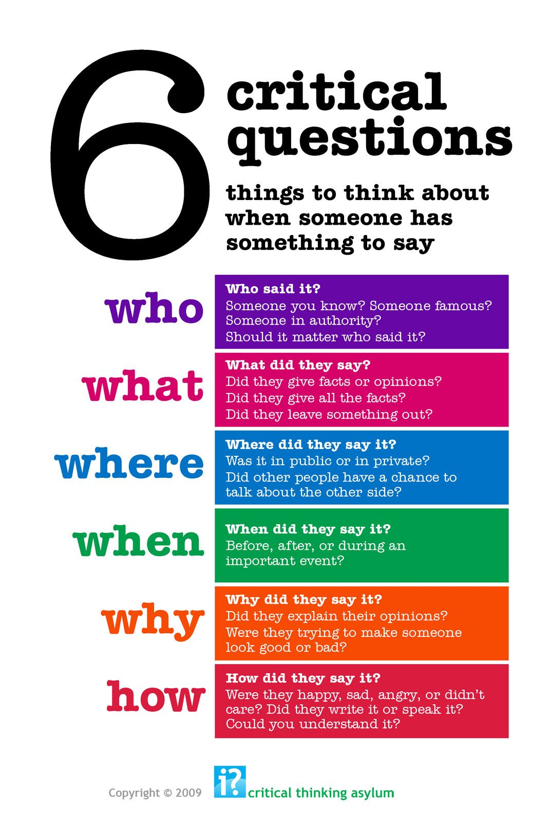
What is Critical Thinking?
Notes:
Who – who said it – Some one who has authority on the subject? Scholar/ academic/ expert in the field example – with current pandemic whose authority do we believe when it comes to taking health warnings?
What – the content – facts? Opinions?
Where- the platform they are using, many politicians use social media as their platform of communication.. Is it an appropriate means to convey message?
When – how dated is it? How current is it?
Why – what's the motive? Are they influencing us for a gain?
How – the tone of the content- is it persuasive, does it require a change in behaviour/ attitudes?

Slide 11
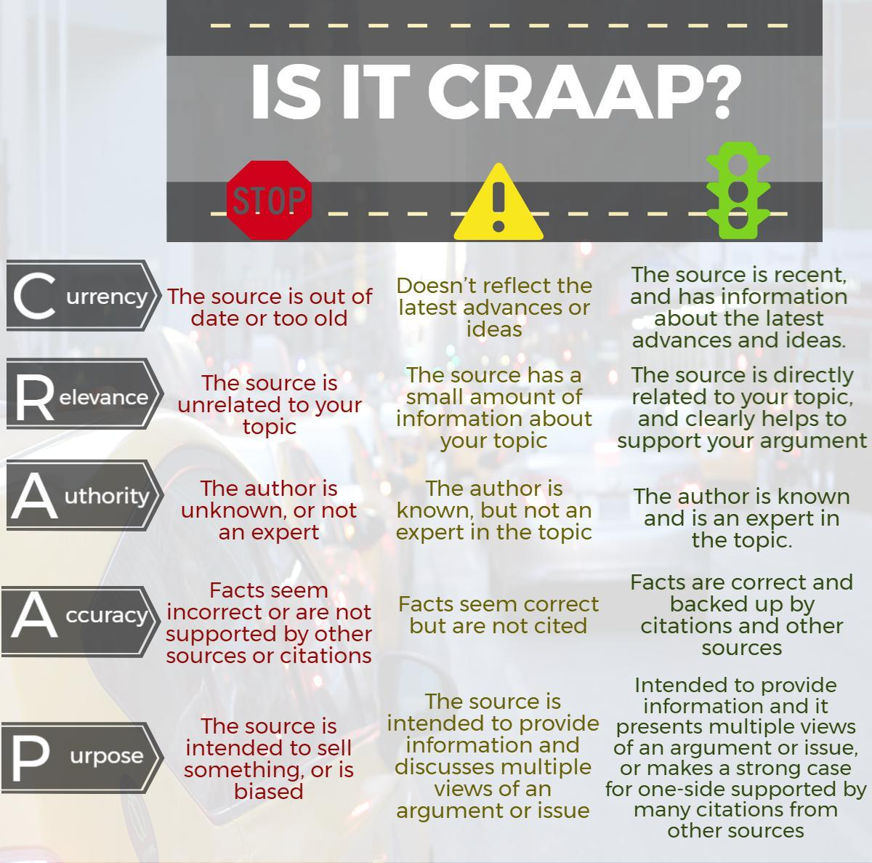
CRAAP test
Notes:
Currency – date, is it latest information or outdated
Relevance – to the topic directly linked or not
Authority – experts, is this person known on this topic
Accuracy – facts? Supported by other sources, cited?
Purpose – why is it created? Source of information? Providing an argument? Is it one sided?

Slide 12
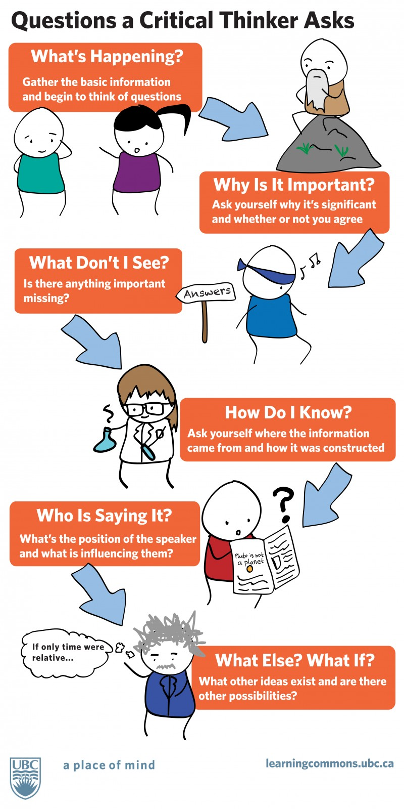
Gather information
Why is it important
Are we missing any information
Source of information
What is the position of the person saying it?
Are there any other opinions out there?
Notes:
They key to critical thinking is the ability to pose challenging and provocative questions to yourself. To think critically is to delve deeper into those hidden layers of meaning and dissect the message in a comprehensive way by asking relevant questions.
As we are living in an age where we have an overflow of information, it is vital to swift through the information, critically and evaluate particular sources using these questions

Slide 13
Critical Thinking is being :
“Be wary and ask questions about why the information says what it says”
“Looking at what something does/how it works and how does it achieve this. What if it was built another way/used different elements”
‘It’s not enough to just use the research, you have to analyse it and present your point of view”
Notes:
Critical thinking is the attempt to ask and answer questions systematically. This means asking the most useful questions in the most productive sequence . Instead of accepting ‘at face value’ what you read or hear, critical thinkers look for evidence and for good reasons before believing something to be true. This is at the heart of what it means to be a scientist, researcher, scholar or professional in any field. Whatever you are studying, critical thinking is the key to learning and to making progress

Slide 14
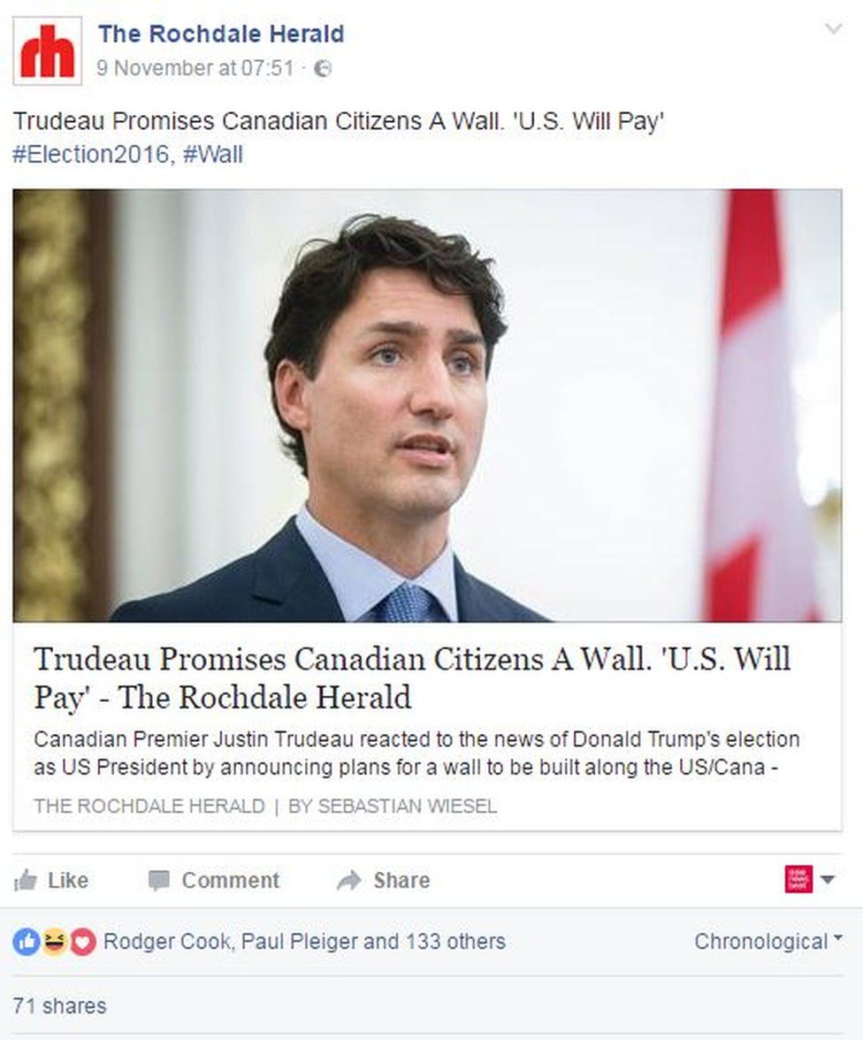
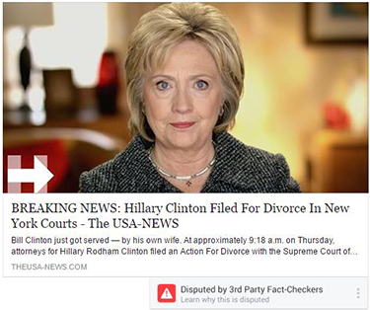

Example: taking things at face values - Fake News/Interpretation
Newspapers can choose which areas of the research to highlight/ What is their source/ Who wrote the article/ purpose

Slide 15
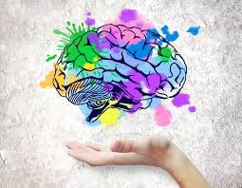
Critical Thinking
Setting out actively to understand what is really going on using reasoning, evaluating, and thinking carefully about the process of thinking itself.

Slide 16
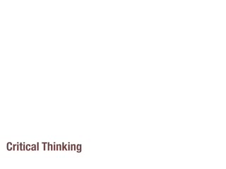
Critical Thinking by QualiaSoup

Slide 17

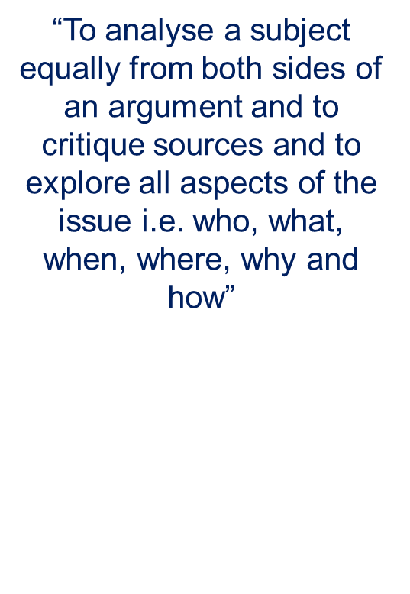
“To understand something fully in different contexts when you argue for and against the case from your own perspective”
“Evaluating things and looking outside the box and look at things from a different angles”
Notes:
The common question words: what, who, where, when, how,
and why will help you to get started; along with the phrases:
what if, what next, and so what. Attempting to answer these
questions systematically helps fulfil three vital functions for any
serious study – description, analysis and evaluation

Slide 18
Describe ... To define clearly what you are talking about, say
exactly what is involved, where it takes place, or under what
circumstances. Fulfilling this function helps you to introduce a
topic. More complex description will become analysis.
Analyse ... To examine and explain how parts fit into a whole;
give reasons; compare and contrast different elements; show
Critical thinking, your understanding of relationships. In this way analysis forms
the main part of any in-depth study.
Evaluate ... To judge the success or failure of something, its
implications and/ or value. Evaluations lead us to conclusions or
recommendations and are usually found at the end of a piece of
academic work, a paper, chapter or other text.

Slide 19
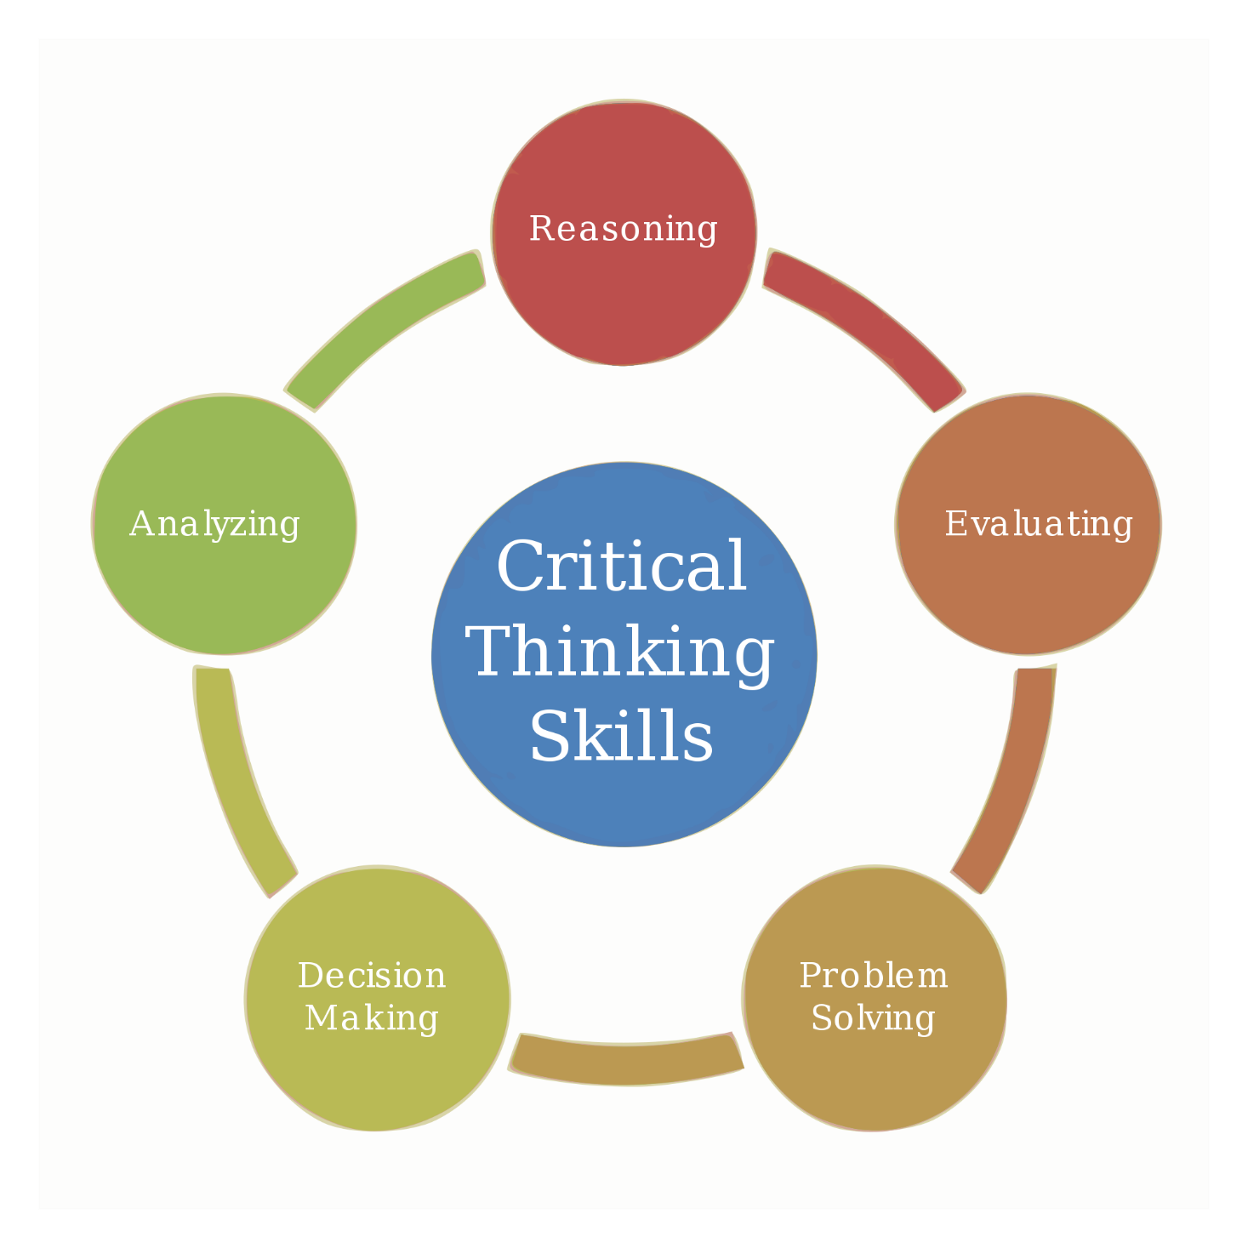
Notes:
Critical thinking is a cognitive activity (conscious mental activity) associated with using mind reasoning . Learning to think critically analytically examining and explaining reasons and evaluating to judge success or failure or implications and ways processing with attention, categorisation, selection being applied and hence being able to solve problems and ensure decision making is done based on sound judgement.

Slide 20
Critical thinking is
A process involving skills and attitudes
Identifying other people’s arguments and conclusions
Evaluating the evidence of alternative points of view
Being able to read between the lines and seeing false and unfair assumptions
Recognise techniques to make certain positions and false logic and persuasive devises
Reflecting on issues
Drawing conclusions justifiable
Synthesise information
Present own structured clear view to convince others

Slide 21
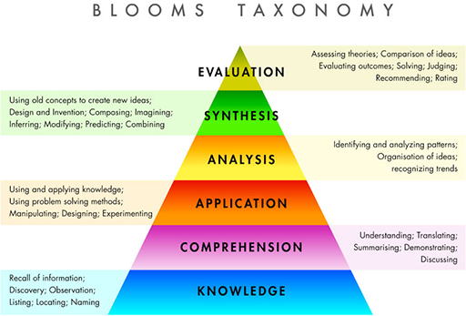
Notes:
Bloom’s Taxonomy was created by Benjamin Bloom in 1956, published as a kind of classification of learning outcomes and objectives that has, in the more than half-century since, been used for everything from framing digital tasks and evaluating apps to writing questions and assessments

Slide 22
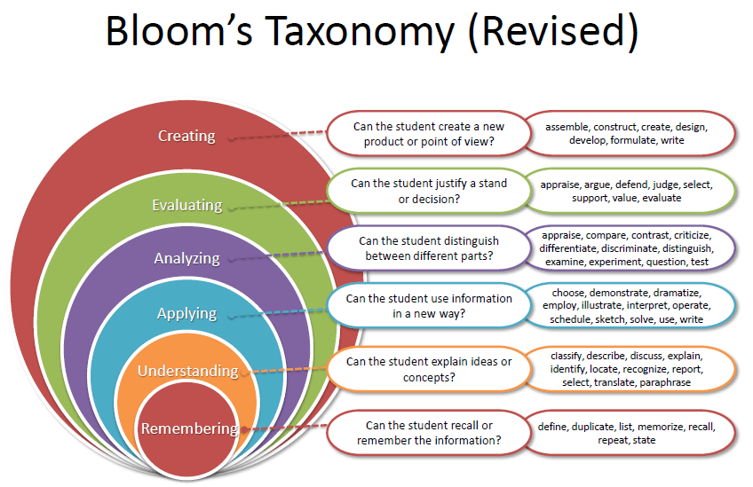
Notes:
The original sequence of cognitive skills was Knowledge, Comprehension, Application, Analysis, Synthesis, and Evaluation. The framework was revised in 2001 by Lorin Anderson and David Krathwohl, yielding the revised Bloom’s Taxonomy. (You can read more here.) The most significant change was the removal of ‘Synthesis’ and the addition of ‘Creation’ as the highest-level of Bloom’s Taxonomy. And being at the highest level, the implication is that it’s the most complex or demanding cognitive skill–or at least represents a kind of pinnacle for cognitive tasks

Slide 23
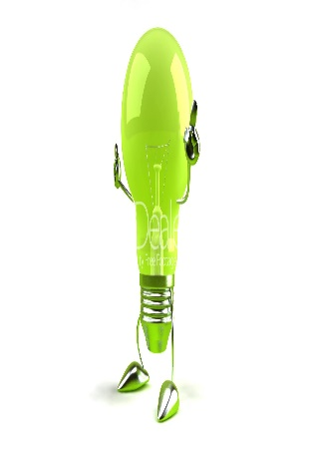

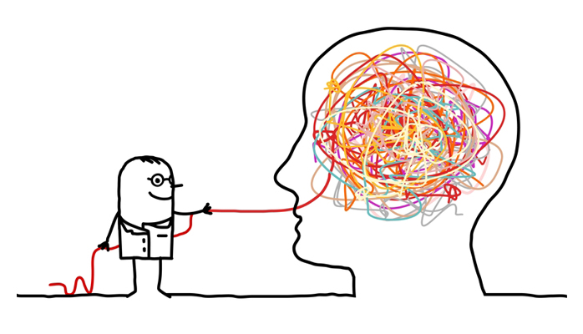
Critical thinkers
Quick Thinking
Respond to unexpected prompt fluidly and flawlessly
Creative thinking
Allow the potential to be submerged
Analytical thinking
Employ tools to solve problems logically
Notes:
Quick thinking - Speed in itself is necessary but not sufficient it must be supplemented with creative and or analytical. Practice being quick on ones feet
Creative thinking – creative thinkers are able to leave behind logical answers and instead of trying to force a square peg through a round hole be willing to explore different approaches. Many people declare they are not but truth is we are all potentially creative and need to strip away layers of self doubt and rediscover our creative side
Logical/ analytical – scientific approach, defining the problem, generating solutions selecting most suitable and then implementing, evaluating and making adjustments where needed – results oriented action.
We need to develop all three skills to be comprehensive in critical thinking

Slide 24
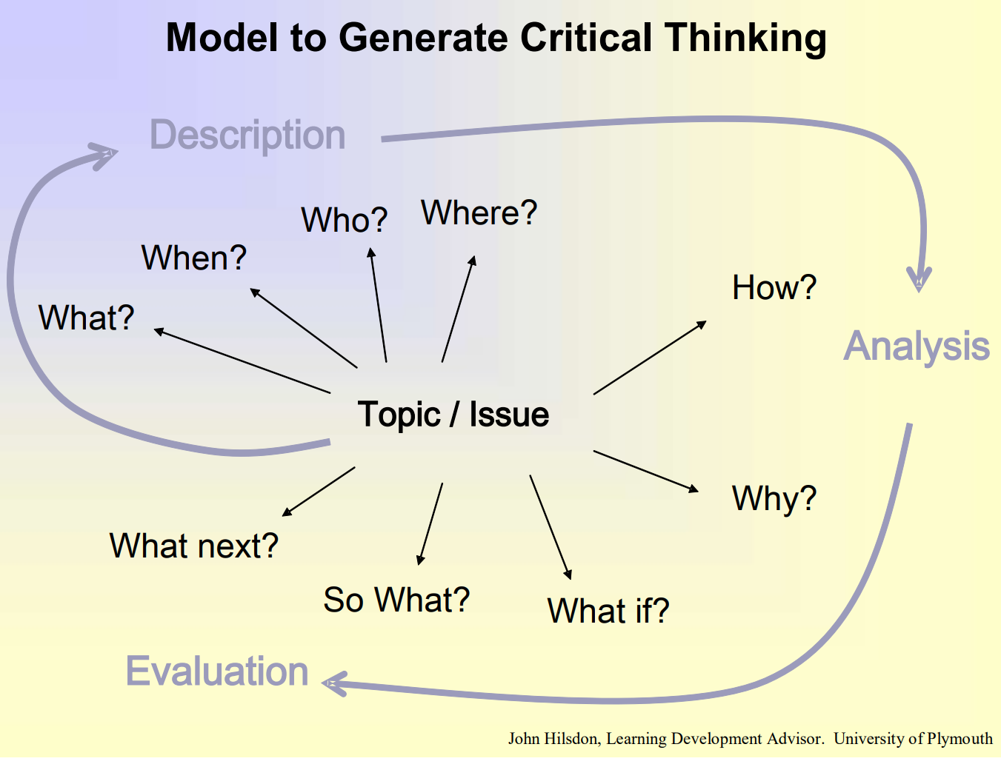
Notes:
So the model to start one to critically think is to asking the right questions in a systematic way, this will develop a coherent structure by using the key functions
Description – the what/when/who and where will give us descriptive information,
What – introduction to the to the issues
Who, when and where - these provide the context/ the background useful for the introduction
Analysis – to begin the analysis and start to examine and explain we need to look at how. How requires consideration looking at procedures/ processed attempting to from descriptive into analytical side
why? Moves deeper into analysis? begins to look at reason/ explanations or causes moving into further research to analyse further
Evaluation –is where we are forming our judgement and identifying the implications/ actions and so we look at what if? And so what? And what's next?

Slide 25
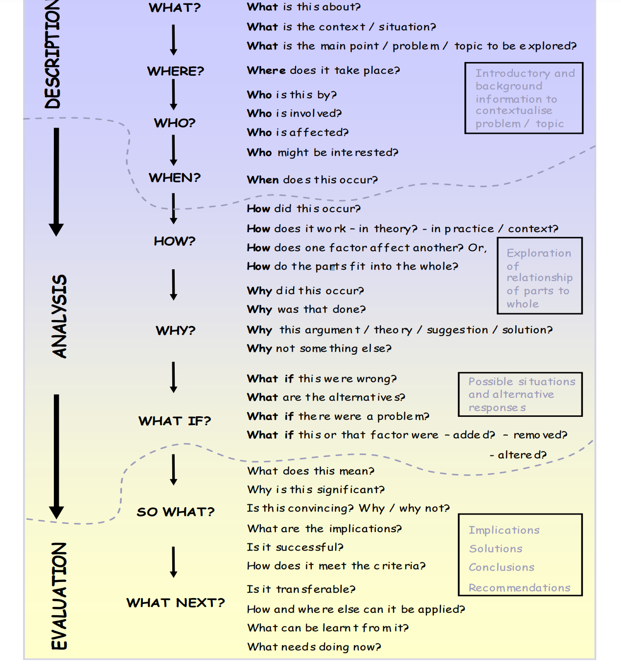
Notes:
Linear Model
Description – what is about? Context? Main points?
Where – does it take place?
Who – who is involved? Effected? Might be interested?
When did it occur?
Analysis when we look to explore in relation to the whole problem How – question how did it occur? Or how does it work? Beginning to move form descriptive into understanding.
Why? Looking for solution, why it happens?
And looking for alternatives by moving towards evaluation and asking what ifs
Evaluation- the implications/ conclusions and recommendations – so what does it show? Why does this matter
What makes it successful?
And finally what does it mean for us.. What's next? How can we take this information and use it to benefit us?

Slide 26
Homework
Watch the critical thinking videos – you tube link provided
Read the article Critical thinking with Plymouth University

