Slide 1
Shaping Cultures
Rhiannon Akers, February 2024

Slide 2
Recap of last week
How to motivate and engage employees:
  Benefits of employee engagement
  How to build an engaged and motivated workforce
  The importance of aligning people strategy

Slide 3
Today’s learning outcomes
  Defining wellbeing
  The importance of wellbeing
  Wellbeing strategies
  Employee Voice

Slide 4
Definition of wellbeing
Overall quality of work experienced by the individual in the work-place.
Fisher likens wellbeing to ‘happiness’, manifesting in positive attitusdes, good moods and emotions.
Grant et al identified 3 main dimensions – psychological, physical, social.
Notes:
Fisher – happiness linked to high levels of job satisfaction, employee engagement and affective organisational commitment.

Slide 5
Grant et al – 3 dimensions
Psychological – happiness and the subjective, positive experiences individuals have in the workplace.
Physical – aspects of stress, injuries and diseases, the provision of healthcare services as part of an EAP for example.
Social - quality of peer and hierarchical relationships in the workplace.

Slide 6
World Health Organisation (WHO)
Health is ‘a state of complete physical, mental and social wellbeing and not merely the absence of disease and infirmity’.
Clear overlaps between health and wellbeing.
Department of Health argue there is a 2-way relationship between wellbeing and health, both influencing each other.

Slide 7
Why so important?
On average we spent an estimated one-third of our lives at work. Difficulties in achieving equilibrium between work and home lives has created a culture of employees putting their jobs before their personal lives.
Caicedo et al found workplace stressors such as organisational change, staff shortages and poor relationships with managers/colleagues may have a negative effect on overall health and wellbeing, reducing productivity and organisational effectiveness.

Slide 8
Why so important?
3 benefits for increased focus on employee wellbeing:
Better employee morale and engagement.
A healthier and more inclusive culture.
Better work-life balance.
All of the above positively impact performance.
Notes:
Promoting and supporting employee wellbeing is at the heart of our purpose to champion better work and working lives because an effective workplace wellbeing programme can deliver mutual benefit to people, organisations, economies and communities. Healthy workplaces help people to flourish and reach their potential. This means creating an environment that actively promotes a state of contentment, benefiting both employees and the organisation.
Investing in employee wellbeing can lead to increased resilience, better employee engagement, reduced sickness absence and higher performance and productivity. However, wellbeing initiatives often fall short of their potential because they stand alone, isolated from the everyday business. To gain real benefit, employee wellbeing priorities must be integrated throughout an organisation, embedded in its culture, leadership and people management.
The people profession is in a unique position to drive forward this agenda, to convince senior managers to make it a priority, and ensure that line managers are confident and capable to support their team’s wellbeing.

Slide 9
What can organisations do?
Cooper and Suff confirmed organisations need to become more conscious of the complexities of people’s lives.
Organisations can provide individuals with key emotional support from managers.
Evidence suggest this will decrease burnout and negative effects of other health issues.
Leads to valued employees and retention of knowledge.

Slide 10
More than a monthly wellbeing session
Autonomy
Safety
Flexibility
Inclusivity
Skill development
Security
Connection
Integration
Recognition
Notes:
Adam Morris
CEO BelievePerform & Director PlanetK2 Group
2mo
People don't want another monthly wellbeing session which they are too busy to attend. The true impact of wellbeing within organisations has become lost. Workplace wellbeing is too often associated with reactive activities or events rather than it being seen as the foundation for a culture. People don't ask for more yoga, more resilience, more healthy snacks or another wellbeing talk. People want to feel as though their needs are being met. They want to be part of a culture where they have a sense of purpose and belonging. They want to be part of a culture where there are opportunities for growth and development. Part of a culture where they are recognised and rewarded for their energy, actions and behaviours. Part of culture where wellbeing is integrated within the design of work. We are failing people within the workplace by not treating wellbeing as a key element in an organisations strategic approach.

Slide 11
Who is responsible?
People professionals
Senior managers
Line managers
Occupational health
Employees
Notes:
People professionals
People professionals have a lead role to play in steering the health and wellbeing agenda in organisations. They need to ensure that senior managers regard it as a priority and integrate wellbeing practices into the organisation’s day-to-day operations.
They need to communicate the benefits of a healthy workplace to line managers, who are typically responsible for implementing people management and wellbeing policies. They need to work closely with all areas of the business and provide practical guidance to ensure that policies and practices are implemented consistently and with compassion.
Senior managers
Lack of senior management commitment to wellbeing can be a major barrier to implementation. Senior managers are crucial role models, and line managers and employees are more likely to engage with health and wellbeing interventions if they see senior leaders actively participating in them. Senior managers have the authority and influence to ensure that wellbeing is a strategic priority embedded in the organisation’s day-to-day operations and culture.
Line managers
Much of the day-to-day responsibility for managing employees’ health and wellbeing falls on line managers. This includes spotting early warning signs of stress, making supportive adjustments at work, and nurturing positive relationships.
Yet our surveys consistently show that ‘poor management style’ is a main cause of work-related stress. In our 2022 Health and wellbeing at work survey, around a quarter (26%) of respondents blamed management style for work-related stress. Managers are important role models in fostering healthy behaviour at work, and this finding shows how harmful the impact can be if managers aren’t equipped with the competence and confidence to go about their people management role in the right way.
Managers also need to understand the impact their management style has on employees and the wider organisational culture at work.
Our guidance for managers on preventing and reducing stress at work outlines the key steps they should take.
Occupational health
Occupational health (OH) is a specialist branch of medicine focused on health in the workplace. For this reason, OH practitioners should work closely with people professionals and those responsible for health, wellbeing and safety in a workplace.
Employees
Employees also have a responsibility for looking after their own health and wellbeing, and will only benefit from wellbeing initiatives if they participate in the initiatives on offer and take care of their health and wellbeing outside work as well. Employers can encourage employees’ involvement by communicating how staff can access the support and benefits available to them. It’s also important that the organisation seeks employee feedback about its current offering so it can learn how to shape existing initiatives and plan new ones.

Slide 12
Activity
Many organisations are promoting health and wellbeing in the workplace, but it’s not always taken seriously enough, more can be done to facilitate a healthy workplace.
Consider the wellbeing strategy of an organisation you are familiar with and its effectiveness. How can it be improved?

Slide 13
CIPD – Health and Wellbeing at work (2023)
Key findings
Slightly more have a stand-alone wellbeing strategy, but focus from senior leaders is waning
Mental health remains the most common focus of health and wellbeing activity
COVID-19 continues to have some impact
Employee assistance programmes continue to be the most common wellbeing benefit offered
Little change to wellbeing budgets
Lack of line manager skills and confidence is the top challenge
Investing in wellbeing to boost employee engagement is the top opportunity
Notes:
Health and wellbeing at work | CIPD

Slide 14
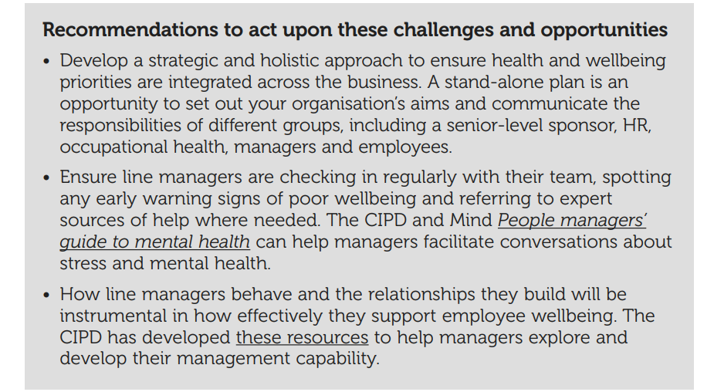

Slide 15
Holistic approach
Line managers have the ongoing guidance needed to support their teams, so they can have sensitive conversations with individuals and signpost to expert help where needed. All employees should be encouraged to have a good self-care routine including a healthy approach to diet and sleep.
Employers need to look beyond absence statistics to understand the underlying factors, such as unmanageable workloads, that are driving unhealthy working practices and influencing people’s wellbeing.
Notes:
This leads us nicely into Employee Voice.
Research shows that effective worker voice can lead to positive outcomes for both individuals and organisations. Participating in decisions is important for people's wellbeing and motivation, as it provides a way to improve work experience and overall job quality. Employers can benefit from higher productivity and innovation, and reduced workplace conflict and absenteeism.

Slide 16
Employee Voice
Individual and collective channels.
Directly and indirectly through employee reps and trade unions.
Effective voice should involve complementary channels and be supported by leaders.
Two-way communication important, managers should listen and act on employee voice.
Notes:
CIPD (2019) found one to one meetings with a manager to be the most common voice channel, followed by team meetings and employee surveys. This supports the notion that leaders and line managers have a vital role to play in employee voice, which in turn will improve employee engagement.

Slide 17
Importance of Employee Voice
Fundamental right, allows employees to express themselves and is integral to good work.
Helps to improve the effectiveness and performance of an organisation by allowing employees to suggest improvements.
Voice is also an important part of employee wellbeing and is positively linked to job satisfaction.
What about employee silence? What are the risks?
Notes:
CIPD research on voice showed that employees’ involvement in decision-making is significantly and positively linked to job satisfaction. CIPD’s case study research offers an in-depth look at how organisations have developed their employee voice channels.
Lack of employee voice can negatively impact levels of engagement amongst employees in terms of wellbeing, commitment and innovation (CIPD, NO DATE).
Employee silence
When individuals choose not to speak up on matters of importance to them, despite having something to say, this is known as employee silence. Employees are unlikely to speak up if they believe the costs of doing so outweigh the benefits – for example, if they feel that their position in the organisation would be threatened. Power dynamics influence people’s willingness to speak up, particularly on information which challenges the status quo or could be judged negatively by a more senior colleague.
CIPD research found that a quarter of employees report high levels of silence. It is important for all employees to feel safe to express their voice, particularly where some employee groups are underrepresented. Leaders, line managers and people professionals should champion the use of voice channels, so that businesses hear from a diverse range of employees.

Slide 18
Changing nature of voice and influence
Decline in trade union representation but collective voice still considered key in terms of employee engagement.
Rising inflation likely to increase the use of collective voice.
Social technology.
Corporate governance.
Notes:
Social technology
The increase in remote and home working has provided new ways for people to have a voice at work. Employees are now more familiar with mobile devices, employee apps and digital meeting platforms such as Microsoft Teams and Zoom, meaning voice is not limited to in-person, office based mechanisms.
Organisational intranets also allow employees to communicate at a much flatter level, without hierarchical barriers meaning employees can express their views to senior leaders directly and more regularly. These virtual networks allow workers some control over issues discussed, as well as informal networking with colleagues.
Corporate governance
The UK government’s corporate governance reform requires listed companies to ensure that employees’ interests are better represented at board level. One of the recommended options is to include an employee representative on the board. This is normal practice across Europe, but there’s no one-size-fits-all approach. In our response to the government, we and the High Pay Centre welcomed raising awareness of employees’ interests at board level, but acknowledge that there’s no single solution to creating meaningful employee voice. Read more on corporate governance.

Slide 19
Creating a ‘speak up’ culture
Whistleblowing (Public Interest Disclosure Act 1998)
Policies should make clear that the employer will identify and remedy any wrongdoing, employees should inform their line manager straight away (or possibly senior manager in a serious case), employer will treat concerns in confidence and individual won’t be penalised.
Other complaints should be handled appropriately through a grievance policy.
Notes:
Personal complaints such as harassment or discrimination are not usually treated as whistleblowing and should be handled according to the organisation’s grievance policy. It’s preferable to deal with whistleblowing separately because the level of risk to the organisation and to the worker will generally be significantly greater in whistleblowing cases than in other grievance matters.
A climate of open communication, supported by a clear procedure for dealing with concerns, will help reduce the risk of accusations of misconduct and illegalities, and ensure that concerns are dealt with speedily and effectively.

Slide 20
Today’s learning outcomes
  Defining wellbeing
  The importance of wellbeing
  Wellbeing strategies
  Employee Voice

