Slide 1

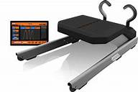
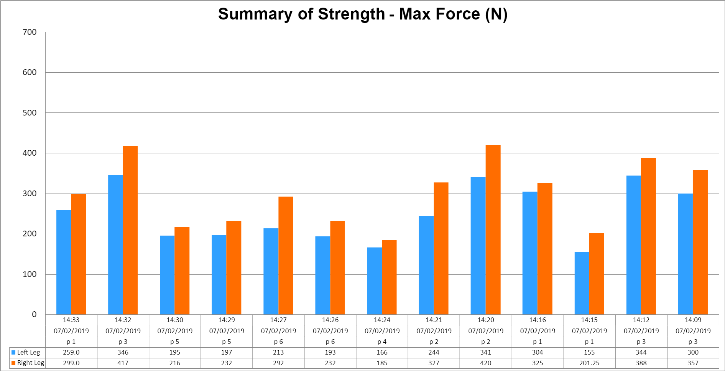
Strength balance of the hamstring in female university rugby player
Matthew Ellis, BSc (Hons) Sports Therapy, 2021
Introduction
The hamstring plays a crucial role in high performance running sports, such as rugby, where sprint running Is paramount and vital for performing offensive and defensive efforts⁽¹⁾ . One of the main phases of sprinting requires the hamstrings to contract eccentrically ⁽²⁾. A strength imbalance between both lower limbs can often result in injury ⁽³⁾. By highlighting the hamstring strength differences between each leg in female university rugby players, this can increase the understanding of how important it is to have similar or equal strength in both hamstrings⁽⁴⁾. ​
Objective
To investigate the hamstring strength balance between dominant and non-dominant limb in female university rugby players.
Methods
Results
Design: An observational cross sectional research design was used to assess hamstring strength balance using The Nordbord Hamstring Testing System (Picture 1)
Participants: 13 female university rugby player volunteered for this study.
Statistical Analysis: The independent T-test using SPSS Software calculated the difference between dominant and non-dominant limb hamstring maximal force output.
The mean difference between left (Mean 250.5385± SD 69.75865, CI : 208.3837- 292.6932) and right leg pull strength (mean 299.3269 ±SD 81.53510, CI: 250.0558 -348.5981 N ) was not significantly different (T(24)=-1.639, p=.114). However, the data did show that all right leg force were greater (Figure 1 and 2) than left leg by an average of 16.2%.
Picture 1. The Nordbord Hamstring Testing System
Figure 1: Force imbalance between left and right hamstring using Nordbord Hamstring testing system
Conclusion
These findings demonstrate that all the female rugby players have a stronger right leg than left, which could indicate a higher risk in injury compared to those with equal force output. There was no statistical difference between the dominant and non-dominant leg however, the importance isn't from a group perspective, it’s from an individual's perspective where the data shows that everyone has some form of imbalance.
Figure 2: Summary of maximal strength (N)
References
1. Brukner, P. and Khan, K. (2017) 'Brukner & Khan's clinical sports medicine', Sydney: McGraw-Hillu​
2. Buckthorpe, M., Wright, S., Bruce-Low, S., Nanni, G., Sturdy, T., Gross, A.S., Bowen, L., Styles, B., Della Villa, S., Davison, M. and Gimpel, M. (2019) 'Recommendations for hamstring injury prevention in elite football: translating research into practice', British journal of sports medicine, 53(7), pp.449-456.​
3. Oakley, A.J., Jennings, J. and Bishop, C.J. (2018) 'Holistic hamstring health: not just the Nordic hamstring exercise', 23(2), pp. 221-229.​
4. Rizi, R.M., Yeung, S.S., Stewart, N.J. and Yeung, E.W. (2017) 'Risk factors that predict severe injuries in university rugby sevens players', Journal of science and medicine in sport, 20(7), pp.648-652.​

