Slide 1
Instructor Materials lecture 2: The Cybersecurity Sorcery Cube
Advanced Cyber Security
Lecture 1
Introduction to Advanced Cyber Security
Dr. Carlene Campbell

Slide 2
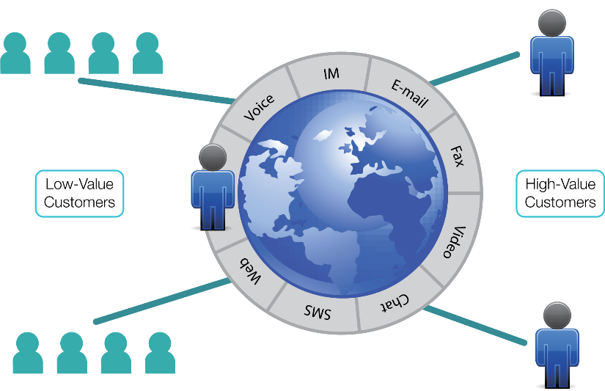
Multimodal Communications
Notes:
VoIP and SIP packets segmented from IP data packets

Slide 3
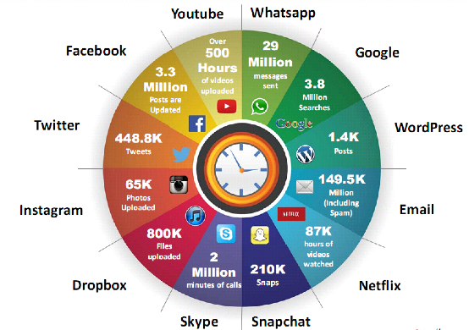
The Internet
Internet is Integral Part of Business and Personal Life
What happen online in 60 seconds?
Notes:
https://www.smartinsights.com/
https://www.go-globe.com/

Slide 4
Example of a New Cybercrime:
The Emergence of e-Cash
Increased electronic commerce requires new ways to pay for goods and services.
The increased flexibility and utility of these make them appealing.
  Prepaid cards: like debit cards, not geographically limited
  Stored value cards: sometimes called electronic purses. Data is on a computer chip.
Mobile payments may be transmitted via smartphones.
  Internet payment services, like PayPal
  Digital precious metals: value of electronic payments linked to a precious metal

Slide 5
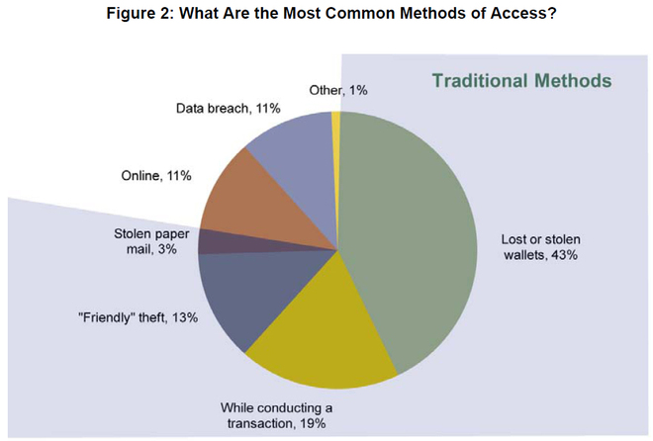

Slide 6
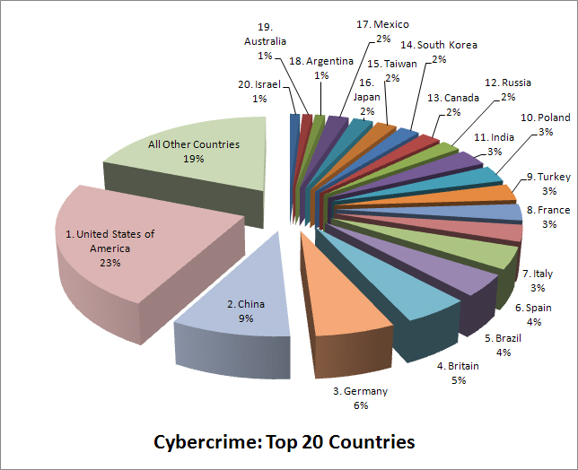
Cybercrime: Top 20 Countries

Slide 7
The Danger
War Stories
Hijacked People
  A hacker set up an open “rogue” wireless hotspot posing as the coffee shop’s wireless network. When a customer logged onto her bank’s website, the hacker hijacked her session, and gained access to her bank accounts.
Ransomed Companies
  An employee of a major corporation receives an email that appears to come from his CEO, containing an attached PDF. When the PDF is opened, ransomware is installed on the employee’s computer and begins gathering and encrypting corporate data. The attackers hold the company’s data for ransom until they are paid.
Targeted Nations
  Stuxnet was designed to infiltrate Windows operating systems and then target Step 7 software. Step 7 was developed by Siemens for their programmable logic controllers (PLCs). Stuxnet was looking for a specific model of the Siemens PLCs that controls the centrifuges in nuclear facilities. The worm was transmitted from the infected USB drives into the PLCs and eventually damaged many of these centrifuges.

Slide 8
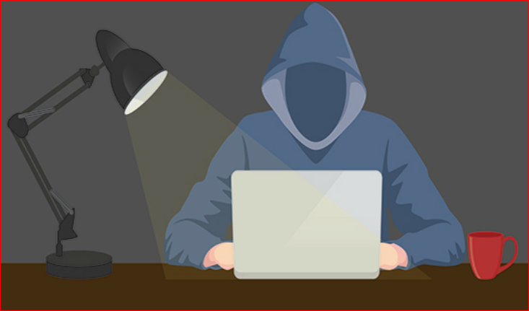
The Danger
Threat Actions
Amateurs, also known as script kiddies, have little or no skill. They often use existing tools or instructions found on the Internet to launch attacks.
Hacktivists protest against organizations or governments by posting articles and videos, leaking information, and disrupting web services with DDOS attacks.
Much hacking activity is motivated by financial gain. These cybercriminals want to gain access to our bank accounts, personal data, and anything else they can leverage to generate cash flow.

Slide 9
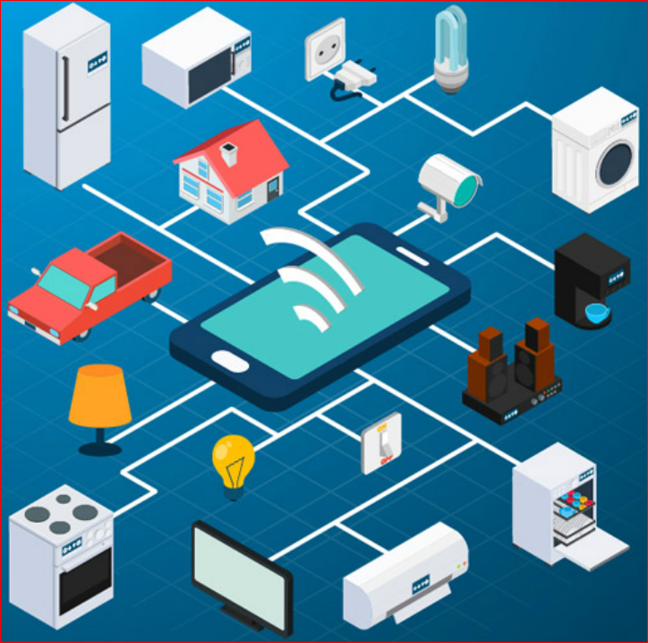
The Danger
Threat Actions (Cont.)
Nation states are also interested in using cyberspace for industrial espionage. The theft of intellectual property can give a country a significant advantage in international trade.
The IoT is all around us and quickly expanding. How secure are these devices? In October 2016, a DDoS attack against Dyn took down many websites. The attack came from webcams, DVRs, routers, and other IoT devices that had been compromised by malicious software. These devices formed a “botnet” that was controlled by hackers and used to create an enormous DDoS attack that disabled essential Internet services.

Slide 10
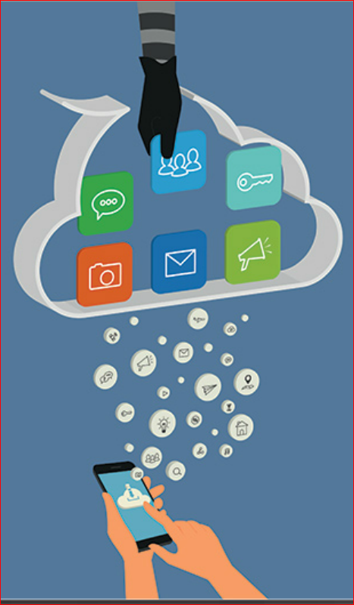
The Danger
Threat Impact
Personally identifiable information (PII) is any information that can be used to positively identify an individual. A subset of PII is protected health information (PHI).
Companies are worried about corporate espionage in cyberspace, as well as the loss of trust that comes when a company is unable to protect its customers’ personal data.
In 2016, a hacker published PII of 20,000 U.S. FBI employees and 9,000 U.S. DHS employees.

Slide 11
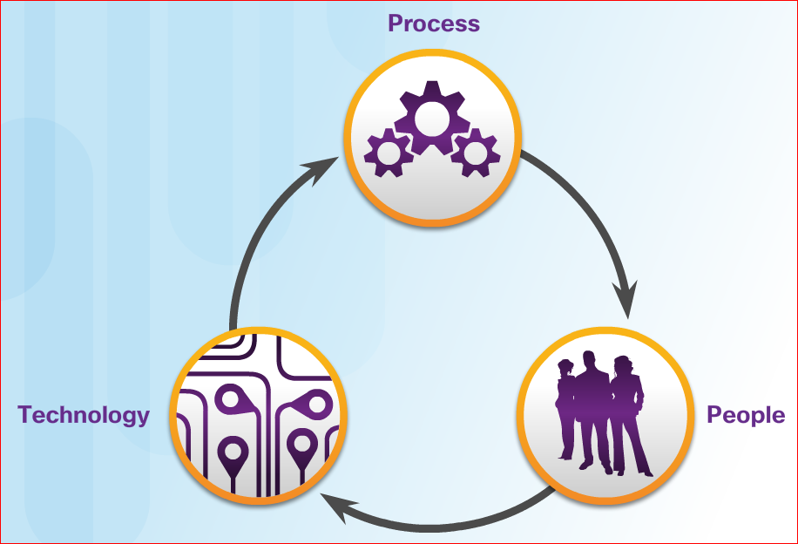
Fighters in the War Against Cybercrime
Elements of a Security Operations Center (SOC)
SOCs provide a broad range of services, from monitoring and management, to comprehensive threat solutions and hosted security.
The major elements of a SOC are people, processes, and technology.
The SANS Institute (www.sans.org) classifies the roles people play in a SOC into four job titles:
  Tier 1 Alert Analyst
  Tier 2 Incident Responder
  Tier 3 Subject Matter Expert (SME)/Hunter
  SOC Manager
Notes:
SOC - Security Operation Centre
1.2.1 – Elements of a SOC

Slide 12
Fighters in the War Against Cybercrime
Elements of a SOC (Cont.)
A Tier 1 Alert Analyst begins with monitoring security alert queues. The software that generates alerts can trigger false alarms. The Tier 1 Alert Analyst may have to verify that an alert represents a true security incident. The incident can be forwarded to investigators, or resolved as a false alarm.
SIEM systems are used for collecting and filtering data, detecting and classifying threats, analyzing and investigating threats, and implementing preventive measures and address future threats.
Organizations may implement an enterprise-level SOC. The SOC can be a complete in-house solution, or larger organizations may outsource at least part of the SOC operations to a security solutions provider.
Most enterprise networks must be up and running at all times.
Preferred uptime is often measured in the number of down minutes in a year. A “five nines” uptime means that the network is up 99.999% of the time (or down for no more than 5 minutes a year).

Slide 13
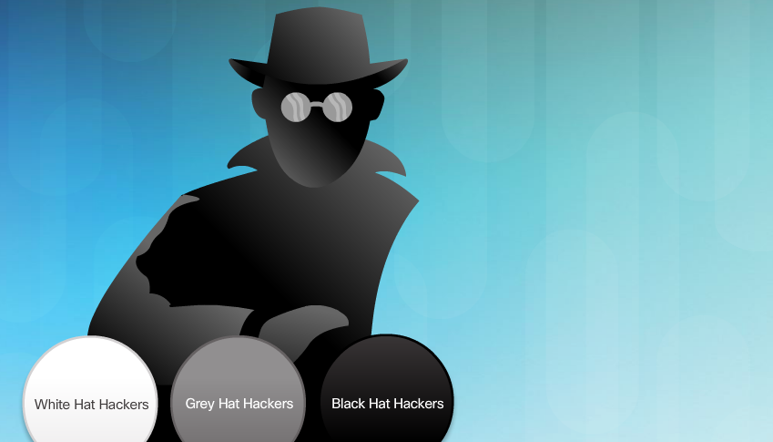
The Hacker & The Evolution of Hackers
Modern hacking titles:
Script Kiddies
Vulnerability Brokers
Hacktivists
Cyber Criminals
State-Sponsored Hackers

Slide 14
Evolution of Security Tools
Penetration testing tools:
Password crackers
Wireless hacking
Network scanning and hacking
Packet crafting
Packet sniffers
Rootkit detectors
Fuzzers to search vulnerabilities
Forensic
Debuggers
Hacking operating systems
Encryption
Vulnerability exploitation
Vulnerability Scanners

Slide 15
Categories of Attack Tools
Network hacking attacks:
Eavesdropping
Data modification
IP address spoofing
Password-based
Denial-of-service
Man-in-the-middle
Compromised-key
Sniffer

Slide 16
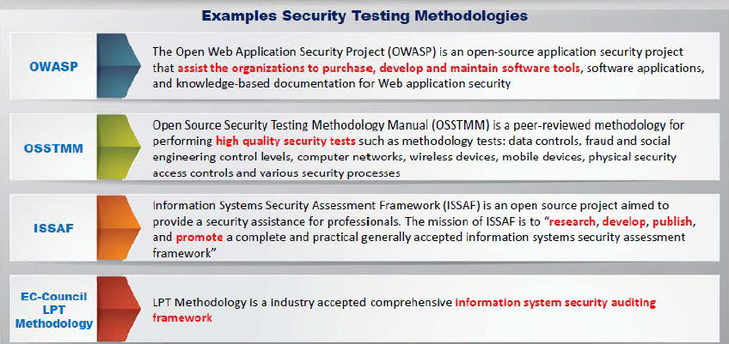
Security Testing Methodology

Slide 17
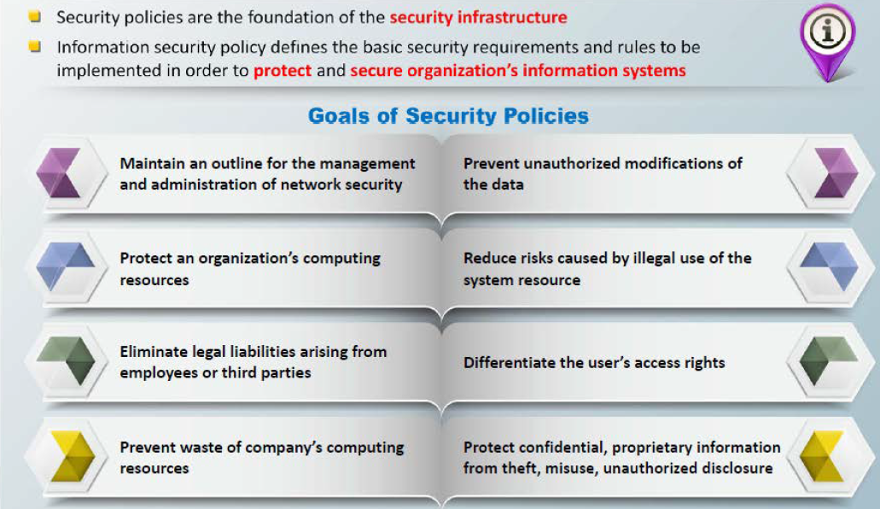
Information Security Policies

Slide 18
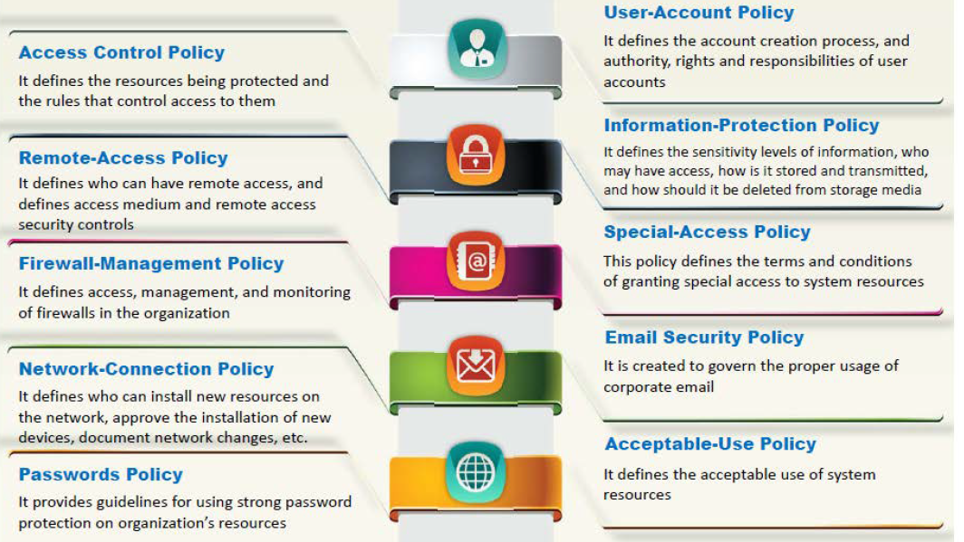
Examples of Security Policies

Slide 19
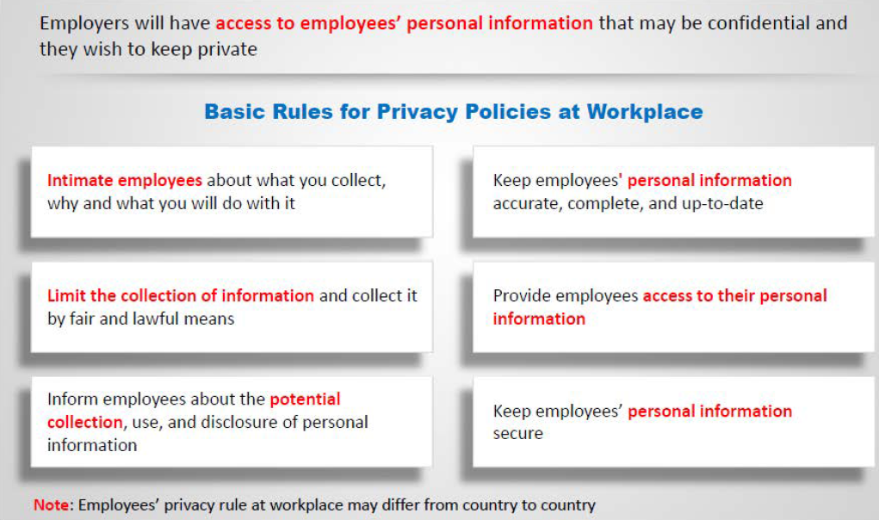
Privacy Policies at Workplace

Slide 20
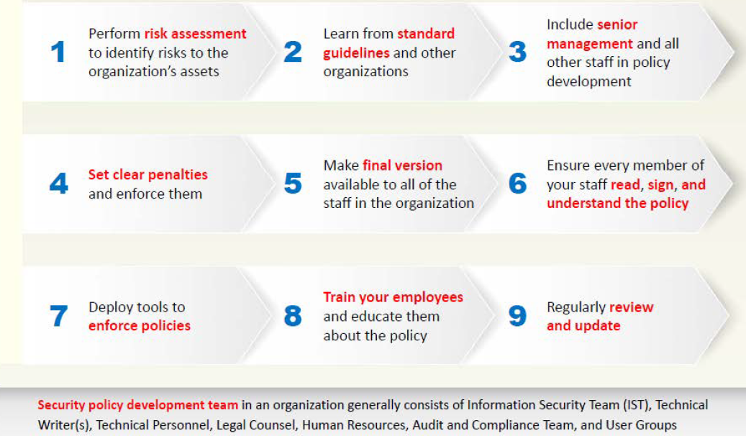
Steps to Create and Implement Security Polices

Slide 21
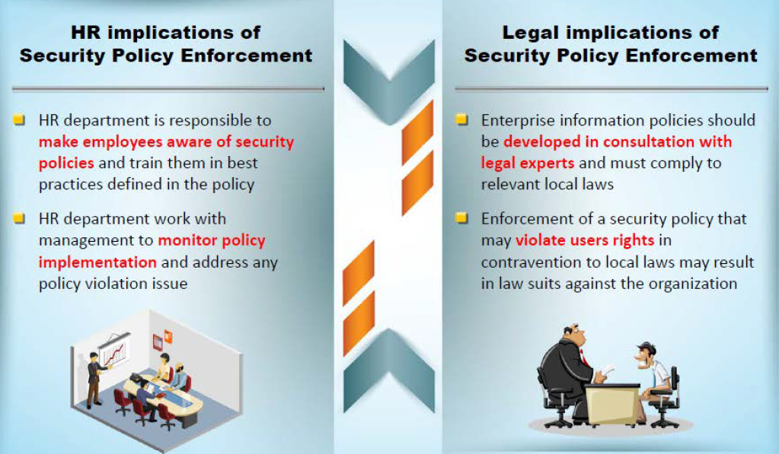
HR/Legal Implications of Security Policy Enforcement

Slide 22
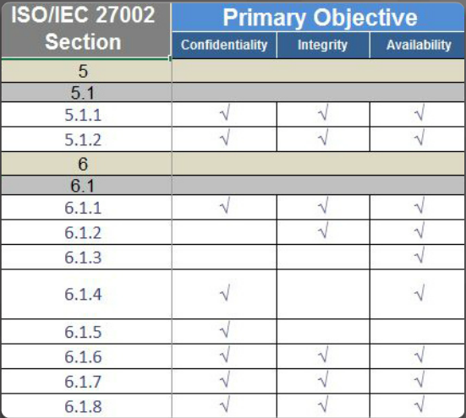
Using the ISO Cybersecurity Model
The ISO 27000 is a universal framework for every type of organization. In order to use the framework effectively, an organization must narrow down which domains, control objectives, and controls apply to its environment and operations.
The ISO 27001 control objectives serve as a checklist. The first step an organization takes is to determine if these control objectives are applicable to the organization.

Slide 23
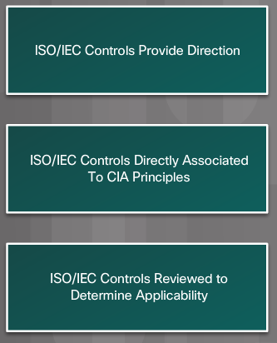
Using the ISO Cybersecurity Model
The ISO Cybersecurity Model and the States of Data
Different groups within an organization may be responsible for data in each of the various states.
For example, the network security group is responsible for data during transmission.
Programmers and data entry people are responsible for data during processing.
The hardware and server support specialists are responsible for stored data. The ISO Controls specifically address security objectives for data in each of the three states.

Slide 24

Using the ISO Cybersecurity Model
The ISO Cybersecurity Model and Safeguards
The ISO 27001 control objectives relate directly to the organization’s cybersecurity policies, procedures and guidelines which upper management determines.
The ISO 27002 controls provide technical direction. For example, upper management establishes a policy specifying the protection of all data coming in to or out of the organization. Implementing the technology to meet the policy objectives would not involve upper management.
It is the responsibility of IT professionals to properly implement and configure the equipment used to fulfill the policy directives set by upper management.

Slide 25
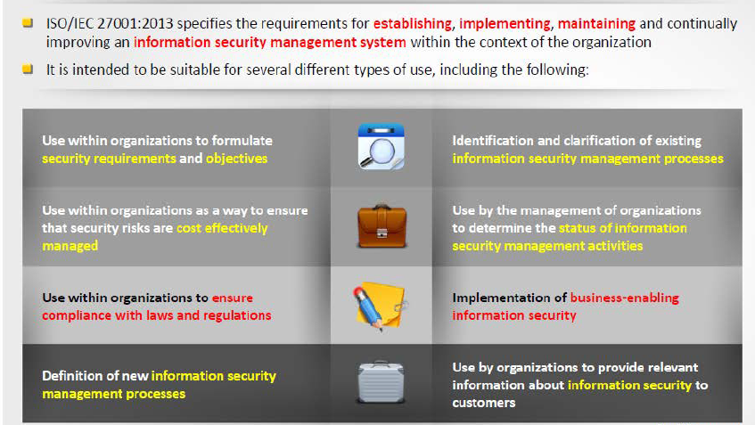
ISO/IEC 27001:2013

Slide 26
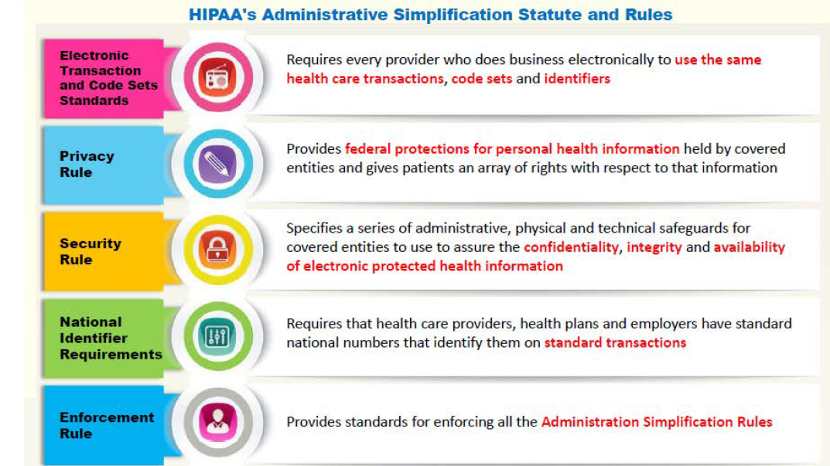
Health Insurance Portability and Accounting ACT (HIPPA)

Slide 27
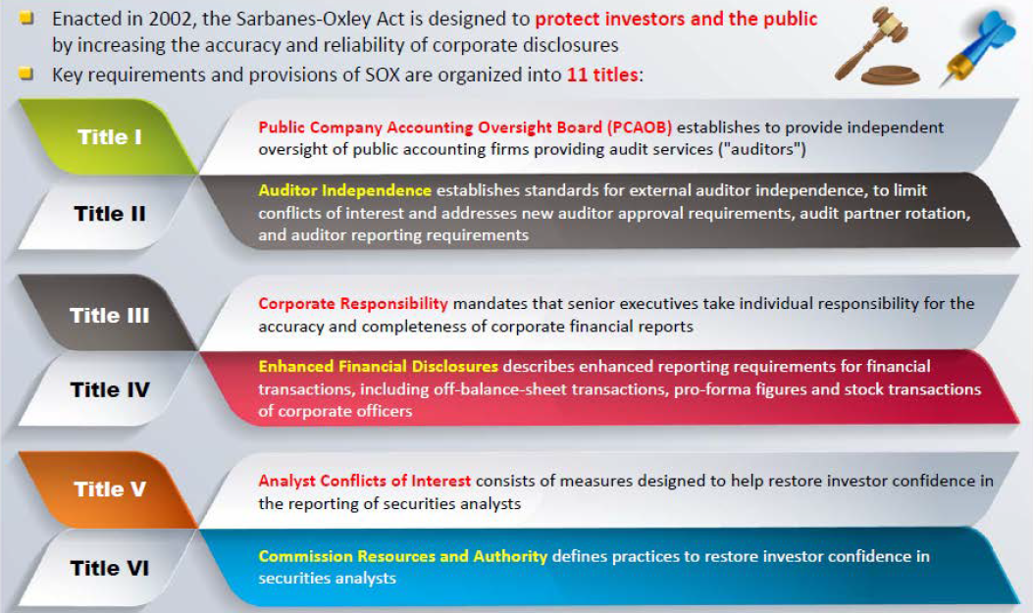
Sarbanes Oxley Act (SOX)

Slide 28
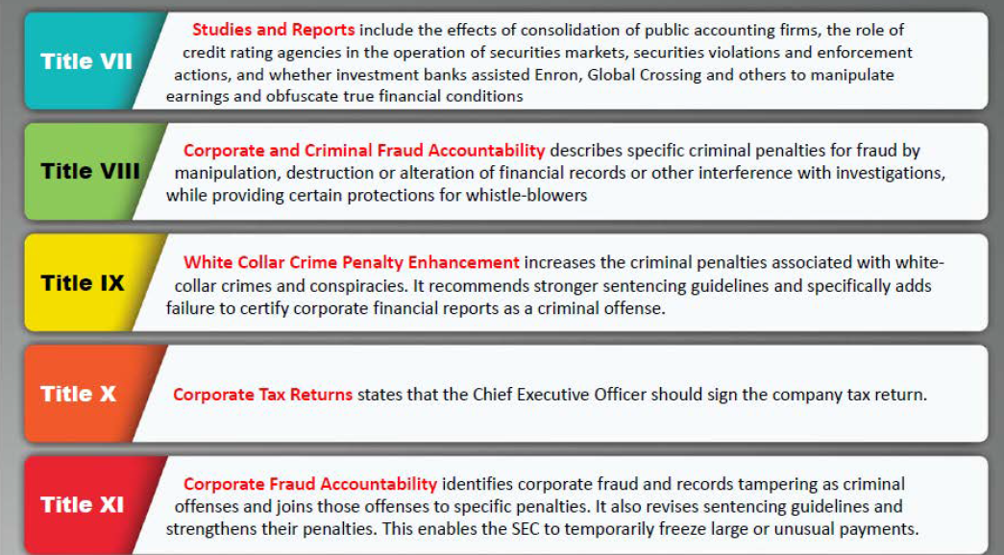
Sarbanes Oxley Act (SOX) (cont.)

Slide 29
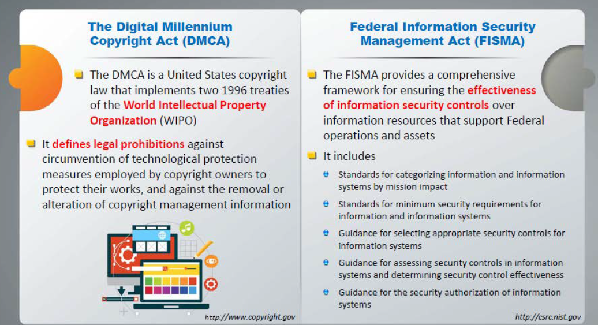
The Digital Millennium Copyright Act (DMCA and Federal Information Security Management ACT (FISMA)

Slide 30
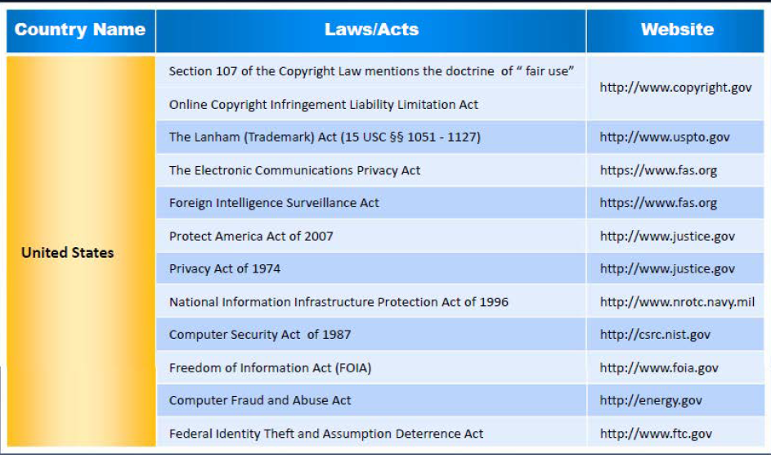
Cyber Law in different Countries

Slide 31
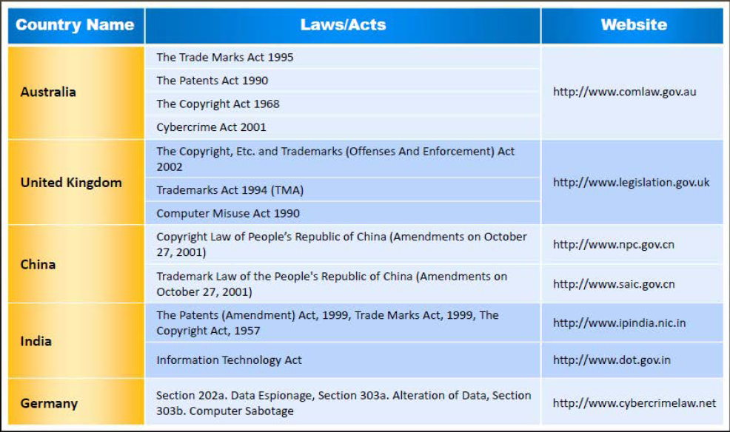
Cyber Law in different Countries (cont.)

Slide 32
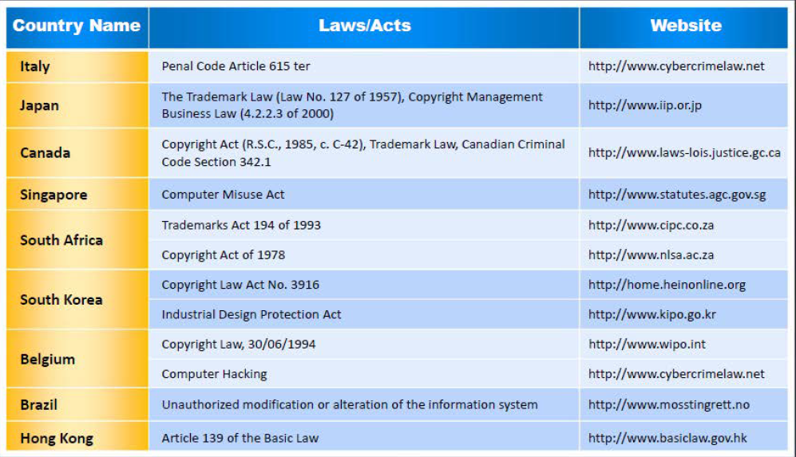
Cyber Law in different Countries (cont.)

Slide 33
Why I teach people how to hack | Ýmir Vigfússon | TEDxReykjavík
https://www.youtube.com/watch?v=KwJyKmCbOws

Slide 34
Questions?

Slide 35
Sources References
Fundamentals of Information Security Systems, David Kim, Michael G Solomon, 2nd ed.
CCNA security v2
CCNA Cybersecurity Operations v1.0
Certified Ethical Hacker (CEH) v9, EC-Council certified
Technology, Entertainment and Design (TEDx) Talks, www.ted.com

