Slide 1
Student Name – Nadia Akther
Student Number – 1914510
Moodle code – BMHP6029
Teacher Name - Kennedy Obohwemu

Slide 2
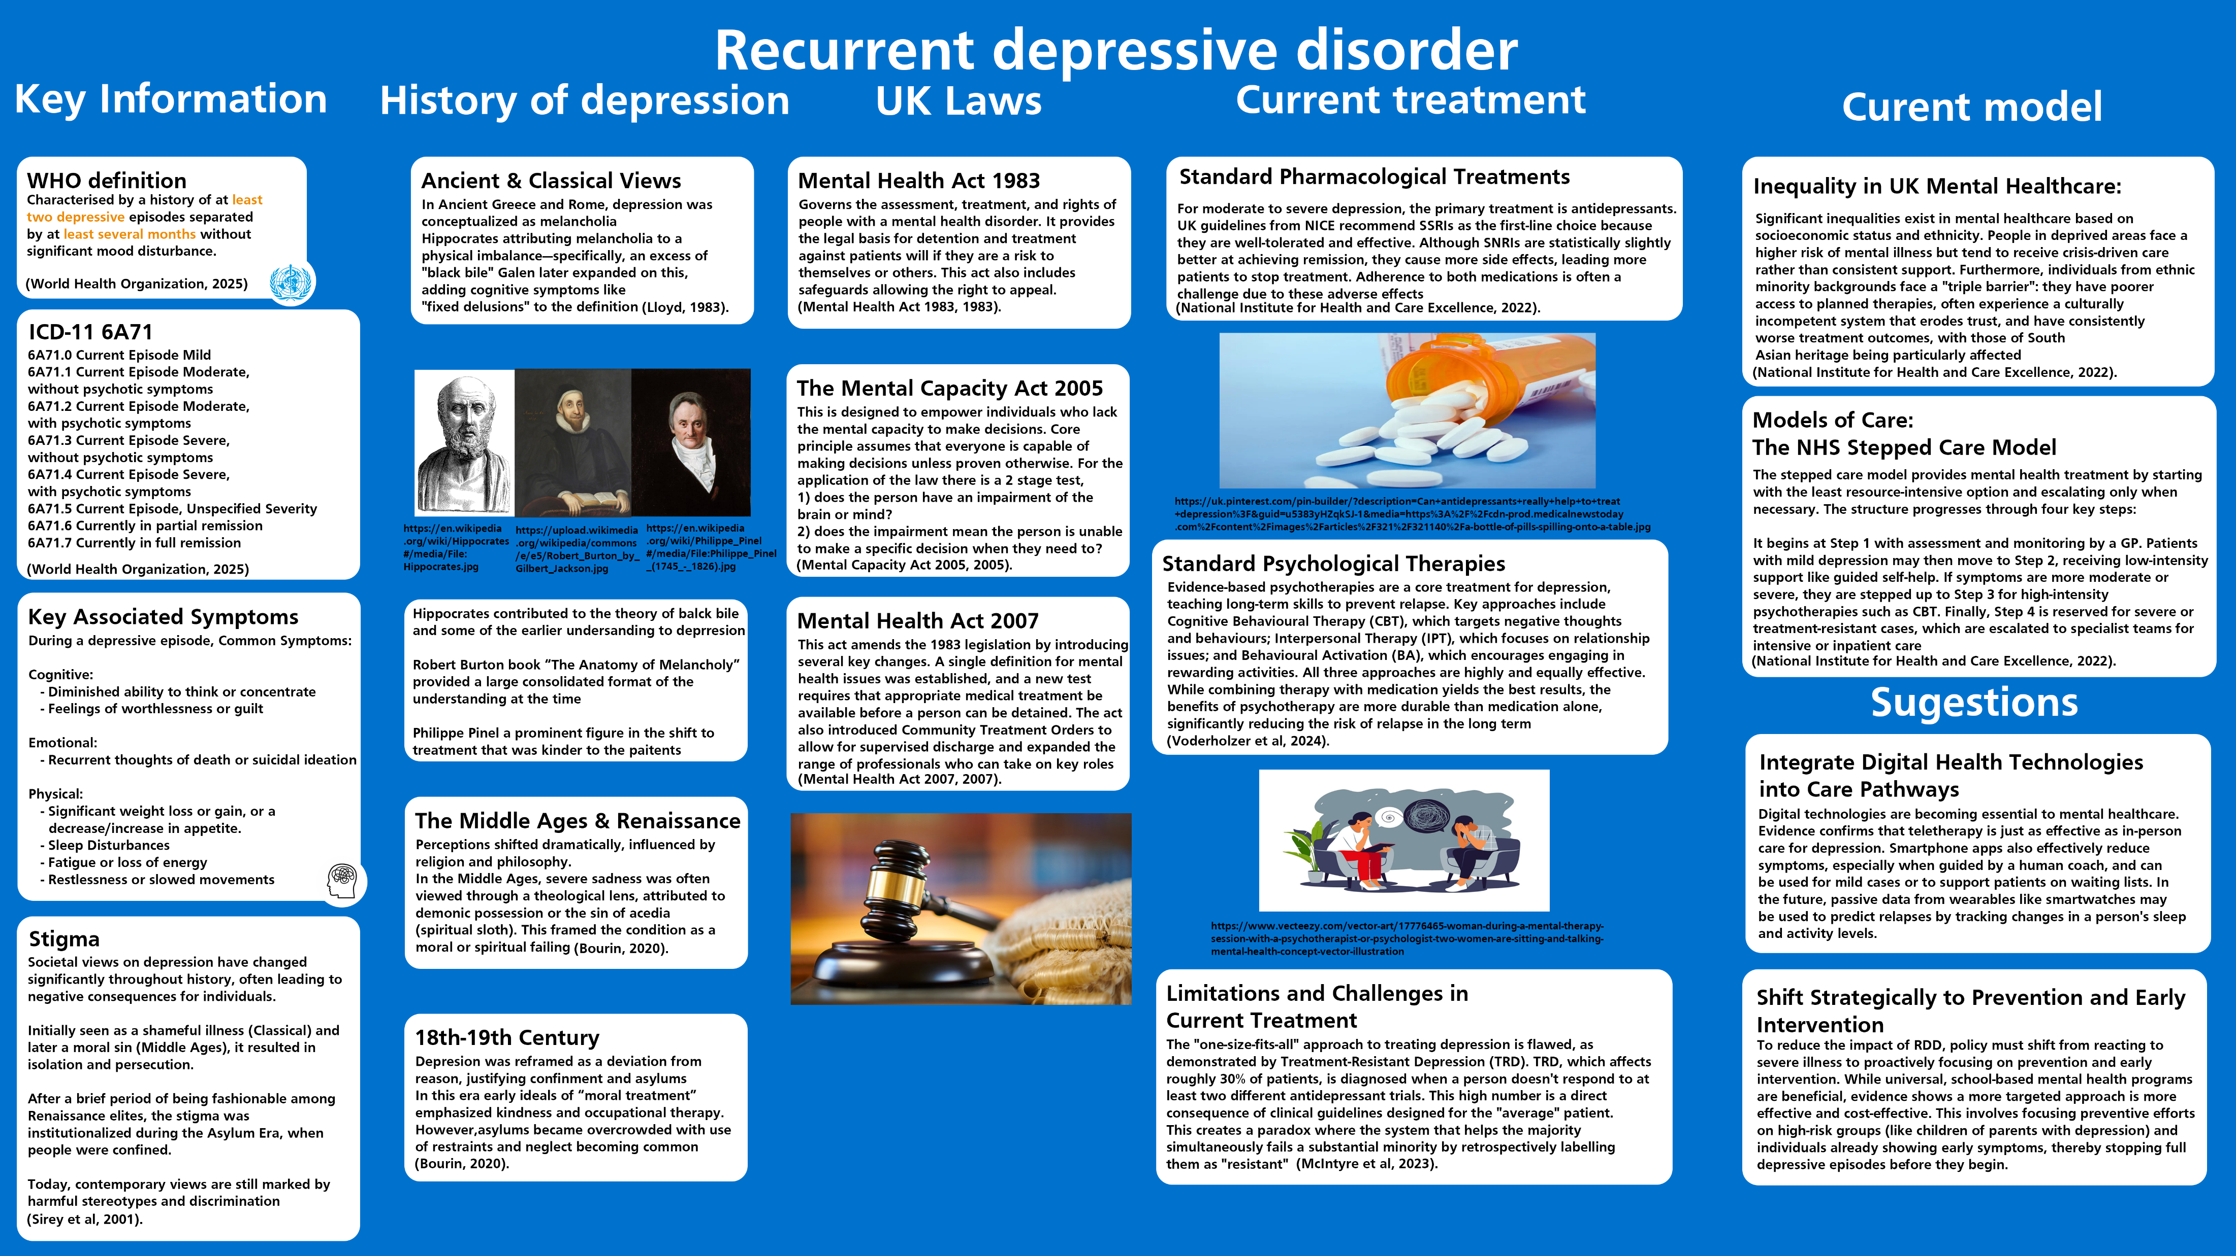

Slide 3
Reference list
Bourin, M. (2020) ‘History of depression through the ages’, Archives of Depression and Anxiety, 6, pp. 10-18. Available at: https://doi.org/10.17352/2455-5460.000045.
Lloyd, G.E.R. (ed.) (1983) Hippocratic Writings. Penguin.
McIntyre, R.S., Alsuwaidan, M., Baune, B.T., Berk, M., Demyttenaere, K., Goldberg, J.F., Gorwood, P., Ho, R., Kasper, S., Kennedy, S.H., Ly‐Uson, J., Mansur, R.B., McAllister‐Williams, R.H., Murrough, J.W., Nemeroff, C.B., Nierenberg, A.A., Rosenblat, J.D., Sanacora, G., Schatzberg, A.F., Shelton, R., Stahl, S.M., Trivedi, M.H., Vieta, E., Vinberg, M., Williams, N., Young, A.H. and Maj, M. (2023) ‘Treatment‐resistant depression: definition, prevalence, detection, management, and investigational interventions’, World Psychiatry, 22(3), pp. 394–412. Available at: https://doi.org/10.1002/wps.21120.
Mental Capacity Act 2005, c. 9. (2005) Available at: https://www.legislation.gov.uk/ukpga/2005/9/contents (Accessed: 5 October 2025).
Mental Health Act 1983, c. 20. (1983) Available at: https://www.legislation.gov.uk/ukpga/1983/20/contents (Accessed: 5 October 2025).
Mental Health Act 2007, c. 12. (2007) Available at: https://www.legislation.gov.uk/ukpga/2007/12/contents (Accessed: 5 October 2025).
National Institute for Health and Care Excellence (NICE) (2022) Depression in adults: treatment and management (NG222). Available at: https://www.nice.org.uk/guidance/ng222/resources/depression-in-adults-treatment-and-management-pdf-66143832307909 (Accessed: 5 October 2025).
Sirey, J.A., Bruce, M.L., Alexopoulos, G.S., Perlick, D.A., Friedman, S.J. and Meyers, B.S. (2001) ‘Stigma as a barrier to recovery: Perceived stigma and patient-rated severity of illness as predictors of antidepressant drug adherence’, Psychiatric Services, 52(12), pp. 1615-1620. Available at: https://doi.org/10.1176/appi.ps.52.12.1615.
Voderholzer, U., Barton, B., Favreau, M., Zisler, E.M., Rief, W., Wilhelm, M. and Schramm, E. (2024) ‘Enduring effects of psychotherapy, antidepressants and their combination in major depressive disorder: a systematic review and meta-analysis’, Frontiers in Psychiatry, 15. Available at: https://doi.org/10.3389/fpsyt.2024.1415905.
World Health Organization (2025) ICD-11 for Mortality and Morbidity Statistics (MMS). Available at: https://icd.who.int/browse/2025-01/mms/en#1194756772 (Accessed: 5 October 2025).
Image reference
https://en.wikipedia.org/wiki/Philippe_Pinel#/media/File:Philippe_Pinel_(1745_-_1826).jpg
https://en.wikipedia.org/wiki/Hippocrates#/media/File:Hippocrates.jpg
https://upload.wikimedia.org/wikipedia/commons/e/e5/Robert_Burton_by_Gilbert_Jackson.jpg
https://uk.pinterest.com/pin-builder/?description=Can+antidepressants+really+help+to+treat+depression%3F&guid=u5383yHZqkSJ-1&media=https%3A%2F%2Fcdn-prod.medicalnewstoday.com%2Fcontent%2Fimages%2Farticles%2F321%2F321140%2Fa-bottle-of-pills-spilling-onto-a-table.jpg&method=button&url=https%3A%2F%2Fwww.medicalnewstoday.com%2Farticles%2F321140
https://www.vecteezy.com/vector-art/17776465-woman-during-a-mental-therapy-session-with-a-psychotherapist-or-psychologist-two-women-are-sitting-and-talking-mental-health-concept-vector-illustration

