Slide 1
PRESENTATION
SIMONA IOANA ACATRINE

Slide 2


Digital Marketing and Its Significance in Today's Business
Promoting goods through digital media.
Connecting the business to its users via the internet.
Enhancing the recognizability of a company.
Maximizing the value of marketing to certain groups of customers.
Adapting to the dynamics of customers' behavior (Birzu, 2023).
Providing help for modern marketing methods (Kotler et al., 2023).

Slide 3
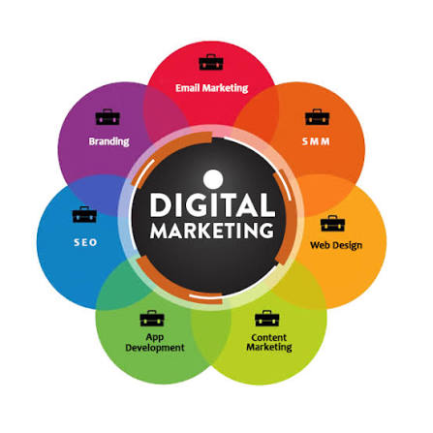

How Digital Marketing Function
Social networks: Increases the company's visibility.
Influencer marketing: Reaches the targeted audience (Rachmad, 2024).
Personalisation: Customise the experience of every consumer (Chandra et al., 2022).
Digital advertisement: The promotion of the products is performed digitally.
Integrated communication: The organisation of the marketing communications (Rehman et al., 2022).
Analytics: The evaluation of the efficiency of marketing activities.

Slide 4
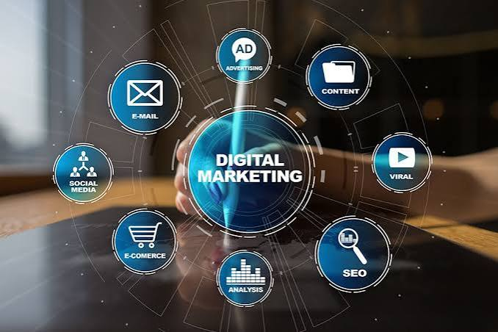

Applications in Contemporary Business
Creation of e-commerce websites.
Management of social media campaigns.
Generation of personalized ads.
Increasing online activity of the clients (Ahmad, 2025).
Assistance in the performance of start-ups (Sutisna et al., 2025).
Studying customers’ purchasing behavior.
For instance, Nike uses internet campaigns, cooperation with influencers and e-commerce websites for the promotion of its products.

Slide 5
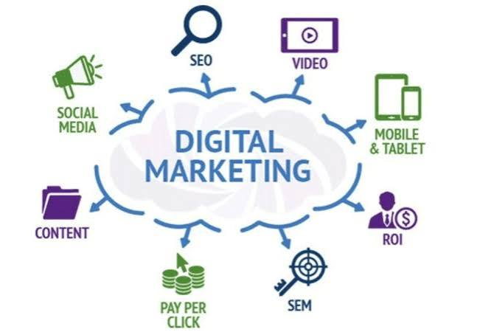
Advantages for Modern Companies
Reach: connects with international audience.
Flexibility: adapts to the changes in the market.
Engagement: increases customer interaction (Kamyabi et al., 2025).
Personalisation: makes marketing relevant (Chandra et al., 2022).
Performance: contributes to the development of companies in e-commerce (Sutisna et al., 2025).
Competitiveness: create strong position of the brand online.

Slide 6
References
Ahmad, N. R. (2025). Digital marketing strategies and consumer engagement: A comparative study of traditional vs. e-commerce brands. The Critical Review of Social Sciences Studies, 3(1), 1537–1548.
Bîrzu, S. (2023). Tracing the evolution of digital marketing from the 1980s. Review of Management and Economic Engineering, 22(1), 73–77.
Chaffey, D., Ellis-Chadwick, F., & Abed-Rabbo, M. (2025). Digital marketing (9th ed.). Pearson.
Chandra, S., Verma, S., Lim, W. M., Kumar, S., & Donthu, N. (2022). Personalization in personalised marketing: Trends and ways forward. Psychology & Marketing, 39(8), 1529–1562.
Kamyabi, M., Özgit, H., & Ahmed, J. N. (2025). Sustaining digital marketing strategies to enhance customer engagement and brand promotion: Position as a moderator. Sustainability, 17(7), Article 3270.
Kotler, P., Armstrong, G., & Balasubramanian, S. (2023). Principles of marketing (19th ed., Global ed.). Pearson.
Rachmad, Y. E. (2024). Marketing strategy with social media marketing, viral marketing, gimmick marketing, and influencer marketing. Sonpedia Publishing Indonesia.
Rehman, S. U., Gulzar, R., & Aslam, W. (2022). Developing the integrated marketing communication (IMC) through social media (SM): The modern marketing communication approach. SAGE Open, 12(2), Article 21582440221099936.
Sutisna, F., Lutfiani, N., Anderson, E., Danang, D., & Syaidina, M. O. (2025). E-commerce and digital marketing strategies: Their impact on startupreneur performance using PLS-SEM. IAIC Transactions on Sustainable Digital Innovation (ITSDI), 6(2), 215–223.
Notes:
6

