Slide 1
Did the Longbow win
The Battle of Agincourt?
Katie Byrne

Slide 2
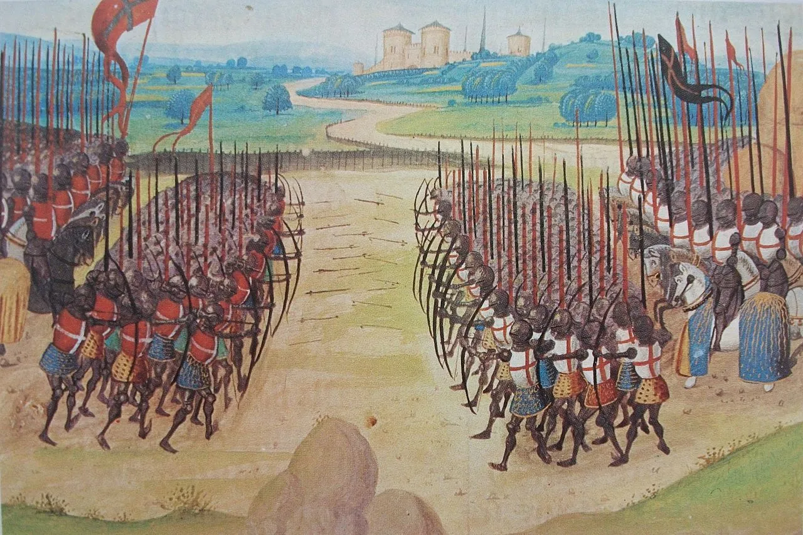
History of the battle
On October 25th, 1415, The Battle of Agincourt took place. The battle was fought between The French and The English close to the small town of Agincourt in the Northern part of France.
After having almost 25 years of peace between the two nations, King Henry V decided to reignite the 100 years’ war which took place between 1337 and 1453. The reason behind King Henry’s decision was that of the same as his Great-grandfather Edward lll. Their aim was to restore the English claim to the French thrown and take over the French territory.
The time was perfect: Henry would be able to solidify his kingship and fortify the allegiance of his subjects by taking military action against an external foe while France was reeling from a civil war.
The monarch announced his plan to lead an army to France on April 15th during a meeting with prominent noblemen.

Slide 3
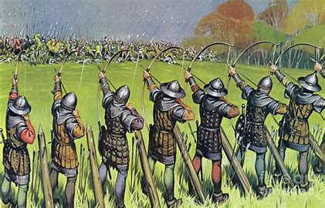
Army
The Battle between the two nations was extremely one-sided when it came to personnel. There were estimated to be around 6,000 English troops on the ground compared to the French who were estimated to have around 20 to 30 thousand. This huge difference in amount of personnel is around about a ratio of 5:1
The French army, according to at least one researcher, totalled no more than 12,000, meaning the English were outnumbered two to one. Nonetheless, it is evident that the English were clearly outnumbered.
The exact toll is uncertain, but estimates place the French losses at roughly 6,000 and the English at about 400, with many of the French being noblemen.
The French outnumbered everyone else on the battlefield, though it is impossible to know for sure how many French soldiers actually took part in the conflict. Knights and other nobles constituted the heavily armed cavalry that made up as much as 60% of the French army.
There were a lot of professional troops in the English army. The majority of the English infantrymen carried longbows, which had a good track record in combat. The remaining infantry used swords, halberds, and spears in their combat. To increase the forces' mobility, some of the riflemen rode horses. There was a comparatively small number of heavy cavalry regardless.
Notes:
Worst case scenario 5-1 best case 2-1.
Not confirmed how many French ended up fighting, help from servants to leave the battle unharmed. French heavily armed.
The English weren’t alone in battle they had Welsh allies Including Notable General Dafydd Gam who died in the battle after reportedly saving Henry the 8ths life

Slide 4
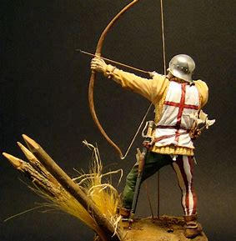
The Long Bow Penetrator
The Long bow was used for many reasons in the Battle of Agincourt, as can be seen below:
    The Longbow was known for its durability and strength which was perfect for the battle conditions.
    It could be loaded faster which allowed the archers to fire up to 12 arrows per minute and preventing the enemy from making ground.
    The longbow had a longer range than many other pieces of weaponry available at the time. It could be fired up to 200m which kept the enemy at distance.
    Arcing high with a force of impact to being hit with a sledgehammer the arrows fired by the longbows in the Battle of Agincourt would reach a terminal velocity of around 200mph.
Notes:
arking

Slide 5
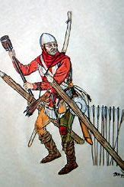
“The arrowhead could not penetrate the armour of the French knight, only the slots and bare sections of the armour”
UK Archaeologists have recently discovered that injuries caused by the longbows used in the battle have similar effects to modern gunshot wounds. This damage was caused due to the arrows spinning clockwise.
Henry 8th had 6,000 men at the battle and around 5,000 of these men were archers using long bows. Proving that the long bow was the most deadly weapon that could be used at the time.
Although the arrows may have ricocheted from the armour of the French this would lead to them penetrating the unprotected bodies of the horses and cause further disruption.
Very important weapon that arguably won the battle- Henry 8th positioned his army of around 6,000 men and issued around 80% of them with longbows that fired bodkin and plate cutter arrows. It was the most used piece of weaponry used in the battle showing its importance in the victory.
Notes:
Although being hit by an arrow would most likely not kill you instantly, the infection would be difficult to overcome therefore, leading to death.
The Long bow was also very hard to draw back with a draw weight of 140 pounds (10 stone) compared to a modern long bow draw weight of 60 pounds (4 stone) meaning the archers operating the bows had to be extremely strong and could be identified by their physique alone (strong upper half).

Slide 6
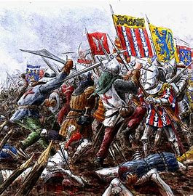
Conditions
“The field that the French had to cross to meet their enemy was muddy after a week of rain and slowed their progress, during which time they endured casualties from English arrows.”
“the French knights, in heavy armour, were forced to cover a distance of 300 yards; very difficult in the mud.”
“having lost their horses, dismounting and getting bogged down with heavy boots and steel armour in the mud. Knights could not move in the muddy terrain because of their armour”
Notes:
The battle of Agincourt couldn’t of happened on a worse day for the French. On the eve of the battle strong winds and rain swept the countryside with the French describing it as “filthy, wet and windy”. The day of the battle the bad weather had stopped however, the damage was already done which was a huge hindrance to the French.

Slide 7
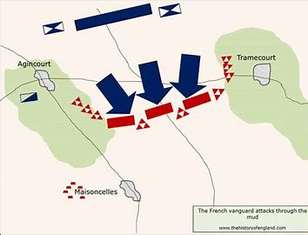
Disciplinary/Position
Any of the French knights who managed to get through the mud ended up so tightly compact (the battlefield narrowed towards England) that they could not use their weapons effectively. Henry positions his army for battle on a newly ploughed field surrounded by woods.
In the centre of the field stood Henry's cavalry, flanked by archers wielding longbows and arrows. Because it narrowed the front and reduced the French's numerical advantage.
This would prevent manoeuvres that could overwhelm the British ranks.
The French refused to believe that the English would dare to assault their knights during battle.
Notes:
The English who wore plate and mail armour were placed together shoulder to shoulder four deep whilst the English and Welsh allied archers came up from either side.

Slide 8
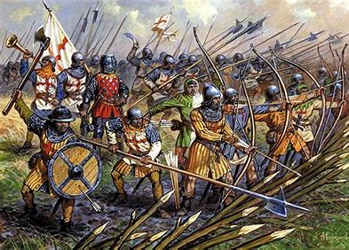
Sharpened stakes
When the French arrived on the battlefield and reached the English frontline the cavalry was incapable of overwhelming the English archers. The English had used a strategic plan to stop the French cavalry by driving sharpened wooden stakes into the ground in front of them at an angle giving themselves a layer of protection and to keep the French cavalry back.
This was a huge shock to the French who were surprised by the new defence tactic. Eventually the French reached the English Archers. Meaning the English had to abandon their bows and fight with the French in hand-to-hand combat.

Slide 9
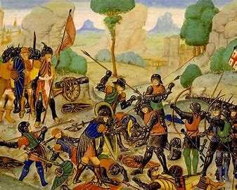
Hand-to-hand Combat
The French had to travel uphill in muddy conditions after a week of rain. After the tough travel conditions the French were exhausted even before the hand-to-hand combat had even started.
After reaching enemy positions, the French soldiers entered hand-to-hand combat with the English. The French knights were physically exhausted and on foot. Armed with axes and swords, lightly armed English archers had an advantage over the tired, armoured French knights.
Notes:
Having many more men on their side you would think that the French would have the upper hand when it came to hand-to-hand combat however, with other problems to deal with it was a harder of a fight than they would have expected. With fatigue and exhaustion setting in from the tough conditions under foot the English gained the upper hand. Just to make matters worse for the French Henry the 8th ordered his archers to rush forward with swords and axes and join the battle from the front.

Slide 10
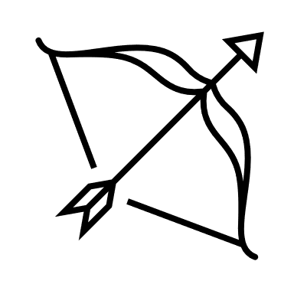



Final Opinion
Yes, the Longbow won The Battle of Agincourt.
Muddy Conditions
Horses became useless
Trampled soldiers
Exhaustion of the French
Notes:
Couldn’t have won without the Muddy conditions and longbow together
Lucky conditions for English.

Slide 11

Any Questions?

Slide 12
References
Battle Of Agincourt - The Introduction Of A New Warfare And The Longbow - About History (about-history.com)
Battle of Agincourt | Facts, Summary, & Significance | Britannica
Why the battle of Agincourt happened - The National Archives
Study: Medieval arrows were as damaging as gunshots - Big Think
9 Things You May Not Know About the Battle of Agincourt | HISTORY
Agincourt (longbow-archers.com)
The Longbow in the Hundred Years' War - Video & Lesson Transcript | Study.com
English Longbows: A Look into the Iconic Weapon of Medieval England (thelongbowshop.com)
How the English won the day at the Battle of Agincourt - Country Life

