Slide 1

Making the Most of the Reading
Dr. Badir Miftah

Slide 2

Getting the Most from Your Reading
Take lots of notes (including references)
Ask yourself questions about what you read (its value to your topic, methods used, conclusions) (i.e. Demonstrate critical thinking)
Find research questions (perhaps, because what you read indicates contention)
Identify sources to which you will want to return later on;
Be selective (read for relevance)
Don’t stop reading!

Slide 3
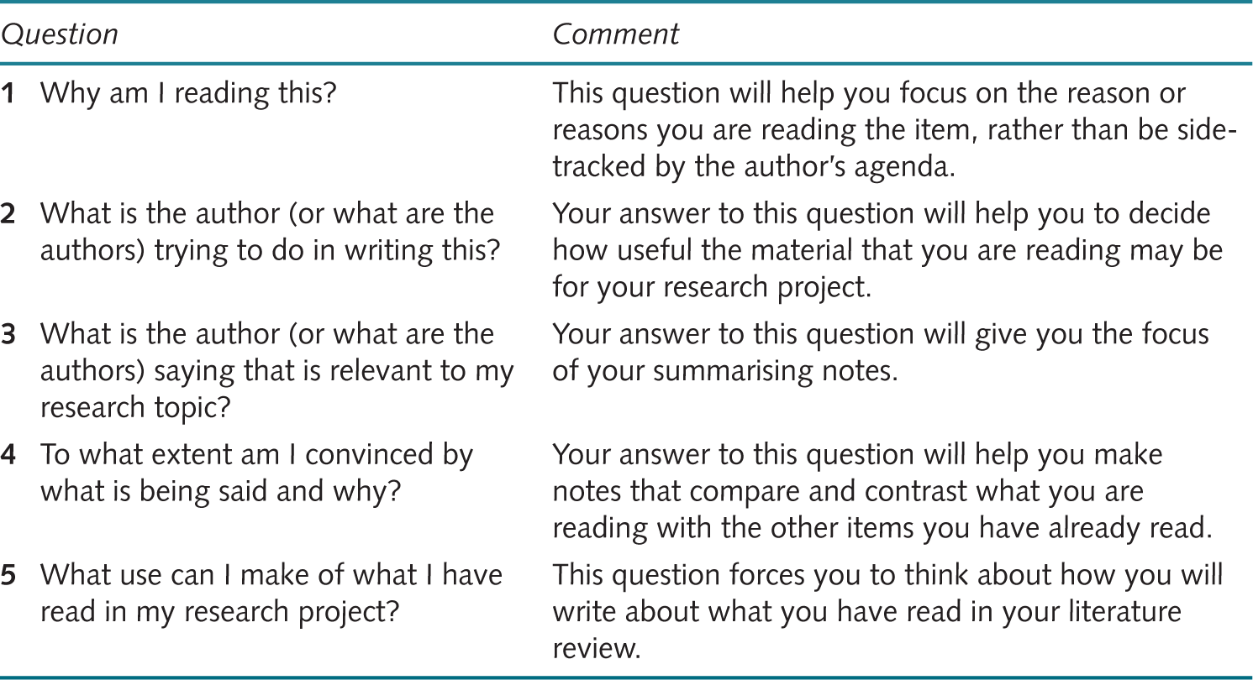
Five questions to help critical reading
Source: Developed from Wallace and Wray (2016).

Slide 4
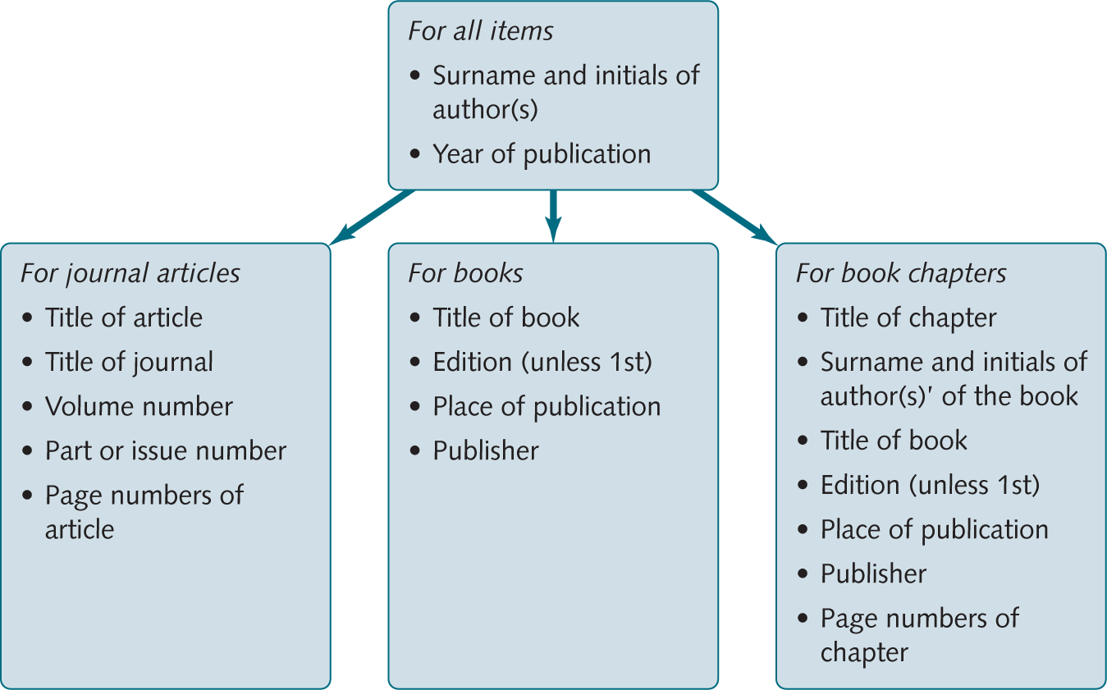
Information you need to reference publications
(Saunders & Lewis, 2018)

Slide 5

Common questions
How long should my literature review be?
How do I write a literature review?
How many chapters shall I devote to my literature review?
What type and how many sources do I need to include in my literature review?

Slide 6
Summary - Key Points
The literature is a critical part of understanding the subject that you are researching
It establishes the ‘landscape’ of that subject
Writing a literature review: review the main ideas and research relating to your chosen area of interest.
Key skills can be acquired to help you get the most from your reading.
There are traps that can use up your time and energy so make sure you know what they look like

