Slide 1

DERM: Deep Ensemble for
Recognition of Malignancy
Critical evaluation of AI-assisted smartphone dermoscopy in NHS skin cancer pathways
Lecturer Name: Dr. Laila Surani
Code Module: BMHP6029
Student Name: Rina Lopez
Student ID: 2337019

Slide 2

Sources were checked against UK guidance and research. The presentation follows the Component 2 template: introduction, impacts, challenges, recommendations, conclusion and references. AI was not used as a substitute for understanding the topic

Slide 3
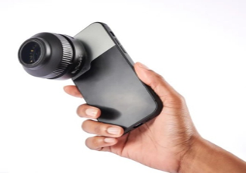
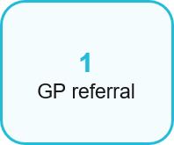
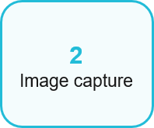
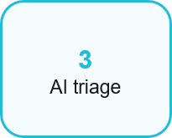
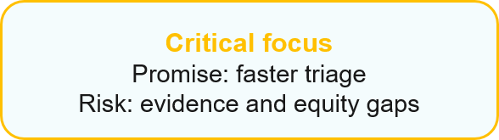
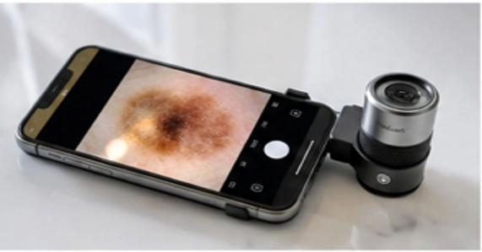
Introduction
What is DERM?
https://www.mistrymedical.com/dermlite-foto-x-dermoscopy-lens-de-l-dlfx
DERM is an artificial intelligence (AI) medical device implemented within NHS teledermatology services
Clinical staff obtain dermoscopic images of skin lesions using a smartphone equipped with a specialized lens
The device facilitates triage following general practitioner (GP) referral and is not intended for patient self-diagnosis
(NICE, 2025a; NHS England, 2026)
https://www.dermlens.net

Slide 4
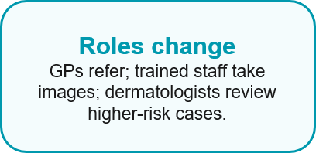
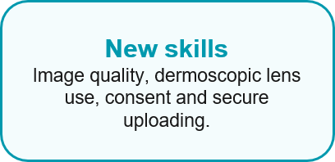
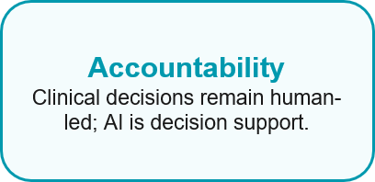
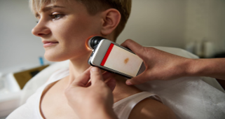
Impact on Workforce
DERM changes roles — it does not replace staff
NHS England is optimistic about capacity gains, but NICE asks for more evidence before wide adoption.
Workforce benefit depends on adequate training, systematic audit and allocation of protected time for virtual review
There is a risk of automation bias if staff rely on algorithmic outputs without applying clinical judgment (NHS England, 2023a; NHS England, n.d.; NICE, 2025a; MHRA, 2025)
https://thedevonshireclinic.co.uk/how-ai-is-transforming-skin-cancer-detection-from-dermoscopy-to-teledermatology/

Slide 5
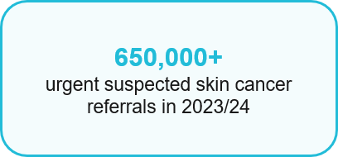
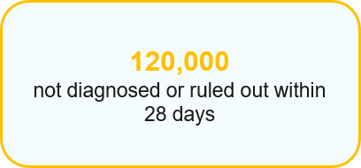
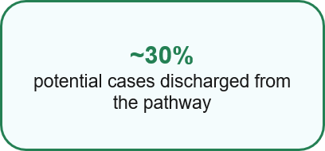
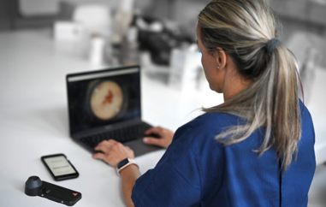
Impact on Service Delivery
Potential improvement, but not guaranteed savings
DERM could help cut down on unneeded hospital visits and make it quicker to review higher-risk cases
NICE estimates that around 25% of lesions might not be suitable, so both in-person visits and standard teledermatology are still necessary
The main question is whether DERM offers any extra benefits compared to high-quality teledermatology by itself
(NHS England, 2026.; NICE, 2025a; NICE, 2025c)
https://dermicus.com/us/teledermatology/

Slide 6
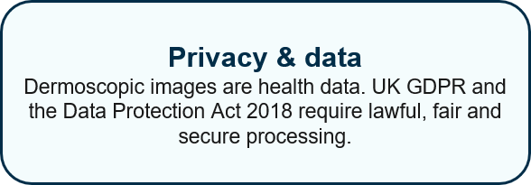
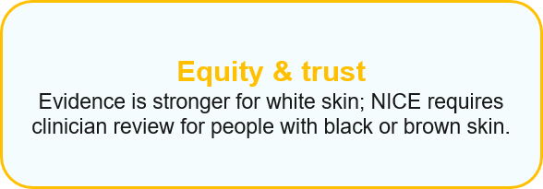
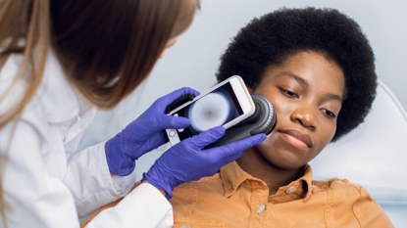
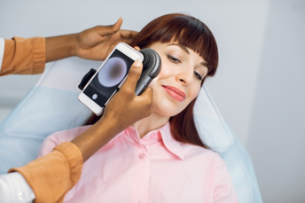
Impact on Patients
Faster access must still feel safe
Potential benefits include local appointments, reduced waiting times, decreased travel requirements, and a lower likelihood of unnecessary diagnostic tests
Patients should receive clear explanations of their results as well as comprehensive safety-netting advice following discharge
Informed consent must be obtained prior to the analysis of medical images
(NICE, 2025a; NHS England, 2026)
https://renascancederm.com/skin-cancer-treatment-fairfax/
https://www.medisave.co.uk/collections/dermatology?page=6

Slide 7
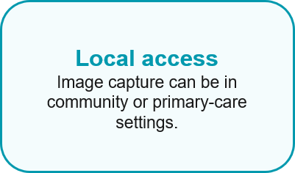

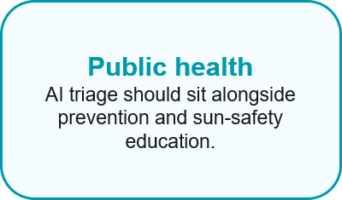
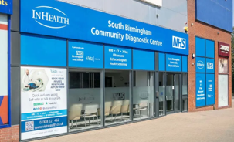
Impact on Community
Care closer to home — planned around local needs
Rural areas may need local image hubs; urban areas may need interpreters and culturally appropriate information
Digital exclusion can still happen through online bookings, results or language barriers
Co-production with patients, carers and community groups helps avoid widening inequalities
(NHS England, 2023a; NHS England, 2023c; Cancer Research UK, n.d.)
https://www.uhb.nhs.uk/about/sites/south-birmingham-community-diagnostic-centre/

Slide 8

Challenges of the Innovation
Why cautious implementation is needed
Evidence base: The current evidence is promising but remains limited; not enough direct comparison with mature teledermatology.
Clinical risk: missed cancers diagnoses are possible, so safety-netting procedures and audit are essential.
Equity: limited evidence across darker skin tones (NICE, 2025a; Thomas et al., 2023; Walton et al., 2026)
Cost-effectiveness: £30 per assessment plus equipment, staff and IT costs.
Data protection: images are sensitive health data under UK GDPR and the Data Protection Act 2018.
Governance: Artificial intelligence (AI) medical devices are subject to regulatory oversight and require ongoing post-market monitoring (NICE, 2025c; ICO, 2023; MHRA, 2025)
https://www.dreamstime.com/stock-illustration-risk-vs-safety-words-balance-scale-comparing-danger-options-d-gold-to-illustrate-weigh-compare-differences-two-image50111937

Slide 9
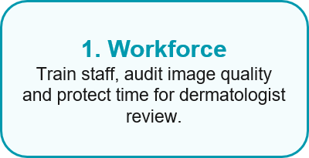
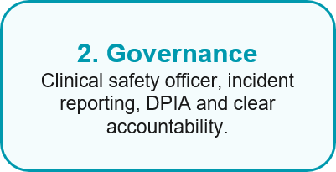
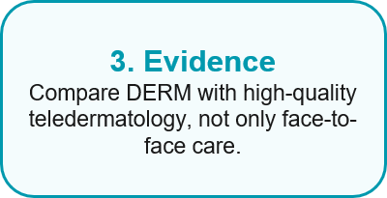
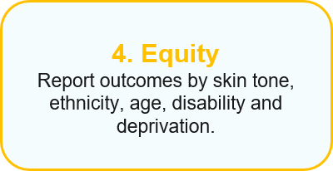
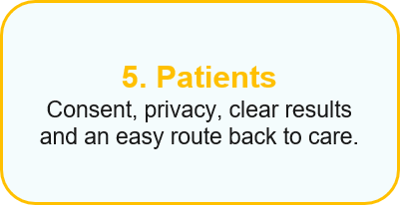
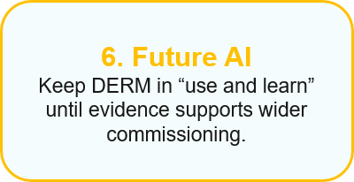

Recommendations
What should happen before wider rollout?
Sources: NICE (2025a); ICO (2023); MHRA (2025)
https://1lifehypnotherapy.co.uk/hypnotherapy-trends-for-2025/hypnotherapy-blog/

Slide 10

Conclusion
Balanced judgement
DERM has the potential to enhance NHS dermatology services by decreasing avoidable urgent appointments and enabling specialists to concentrate on higher-risk cases
However, current evidence is insufficient to support DERM as a replacement for dermatologists or as a definitive solution to capacity challenges
The most prudent approach is evidence-led adoption, which includes workforce training, legal governance, equity monitoring, and public health prevention
Success should be evaluated based on safety, timely diagnosis, patient trust, equity, and staff workload, rather than solely on discharge numbers
(NICE, 2025a; Walton et al., 2026; NHS England, 2026)
https://www.dreamstime.com/stock-photography-smiling-medical-doctor-woman-stethoscope-isolated-over-white-background-image35552912

Slide 11
References
Cancer Research UK (2026) Sun, UV and cancer. Available at: https://www.cancerresearchuk.org/about-cancer/causes-of-cancer/sun-uv-and-cancer (Accessed: on 14 July 2026).
Information Commissioner’s Office (2023) Guidance on AI and data protection. Available at: https://ico.org.uk/for-organisations/uk-gdpr-guidance-and-resources/artificial-intelligence/guidance-on-ai-and-data-protection/ (Accessed on 14 July 2026).
Medicines and Healthcare products Regulatory Agency (MHRA) (2025) Software and artificial intelligence (AI) as a medical device. Available at: https://www.gov.uk/government/publications/software-and-artificial-intelligence-ai-as-a-medical-device/software-and-artificial-intelligence-ai-as-a-medical-device
(Accessed on 14 July 2026).
National Institute for Health and Care Excellence (NICE) (2025a) Artificial intelligence technologies for assessing and triaging skin lesions referred to the urgent suspected skin cancer pathway: early value assessment (HTG746). Available at: https://www.nice.org.uk/guidance/htg746 (Accessed on 14 July 2026)
.
National Institute for Health and Care Excellence (NICE) (2025c) Resource impact summary report: Artificial intelligence technologies for assessing and triaging skin lesions referred to the urgent suspected skin cancer pathway. Available at: https://www.nice.org.uk/guidance/htg746/resources/resource-impact-summary-report-15430914685 (Accessed on 15 July 2026).
NHS England (2023a) A teledermatology roadmap: implementing safe and effective teledermatology triage pathways and processes. Available at: https://www.england.nhs.uk/long-read/a-teledermatology-roadmap-implementing-safe-and-effective-teledermatology-triage-pathways-and-processes/ (Accessedon 15 July 2026).
NHS England (2023c) Ensuring equity of access to care when redesigning dermatology pathways. Available at: https://www.england.nhs.uk/long-read/ensuring-equity-of-access-to-care-when-redesigning-dermatology-pathways/ (Accessed on 15 July 2026).
NHS England (2026) AI based skin lesion analysis technology. Available at: https://www.england.nhs.uk/elective-care/best-practice-solutions/ai-based-skin-lesion-analysis-technology/ (Accessed: 16 July 2026).
Thomas, L. et al. (2023) ‘Real-world post-deployment performance of a novel machine learning-based digital health technology for skin lesion assessment’, Frontiers in Medicine, 10, 1264846. Available at: https://doi.org/10.3389/fmed.2023.126484 (Accessed on 16 July 2026).
Walton, M. et al. (2026) ‘Artificial intelligence technologies for assessing skin lesions for referral on the urgent suspected cancer pathway’, Health Technology Assessment, 30(10). Available at: https://doi.org/10.3310/GJMS0317
(Accessed on 16 July 2026).

