Slide 1

RESEARCH PRINCIPLES AND PHILOSOPHY
REVISITED
DR HELEN LEE 2025

Slide 2

Please note
This presentation will introduce you to some aspects of research methods – but it is NOT intended to replace key reading, such as Bryman, Crotty, Creswell, Maxwell, Denscombe, Denzin, Guba and Lincoln and Cohen.
You must read key texts and beyond at doctoral level that cover the method and for this you may have to go beyond your modules reading list.
Some slides will not be focused on and you are expected at this doctoral level to be motivated, engaged and understand the areas you need to explore.
Notes:
For him is Paradise packed with bounties, pleasure and delight and spiritual sustenance and comforts

Slide 3


Slide 4

Alien B

Slide 5




Slide 6
Concept | Explanation
Key Message | Your beliefs about reality and knowledge shape every research decision.
Analogy | Imagine two aliens studying Earth:
Alien A (Quantitative) | Measures rainfall objectively with tools.
Alien B (Qualitative) | Asks humans how rain feels to them.
Key Insight | Neither is better—they answer different questions!
Business Example
Researcher A (Quantitative) | What percentage of gig workers face financial instability?
Researcher B (Qualitative) | How do gig workers experience job insecurity?
Mixed Methods | Combines both approaches to gain a fuller understanding.
Mixed Methods Example | First, a survey measures the percentage of gig workers facing financial instability (quantitative). Then, interviews explore their personal experiences and coping strategies (qualitative).
Concept | Explanation
Key Message | Your beliefs about reality and knowledge shape every research decision.
Analogy | Imagine two aliens studying Earth:
Alien A (Quantitative) | Measures rainfall objectively with tools.
Alien B (Qualitative) | Asks humans how rain feels to them.
Key Insight | Neither is better—they answer different questions!
Business Example
Researcher A (Quantitative) | What percentage of gig workers face financial instability?
Researcher B (Qualitative) | How do gig workers experience job insecurity?

Slide 7

Core Concept | Explanation
Ontology (What is REAL?)
Objective Reality | Corporate culture exists like gravity—measurable.
Subjective Reality | Corporate culture is created through daily interactions.
Epistemology (How do we KNOW?)
Quantitative | Knowledge = Numbers (e.g., sales data).
Qualitative | Knowledge = Stories (e.g., employee interviews).
Axiology (Role of VALUES) | How your biases (e.g., pro/anti-gig economy views) influence research.
Methodology (TOOLS) | Surveys vs. interviews? Depends on your philosophy!

Slide 8


Slide 9
To revisit Kuhn
Kuhn used the term ‘paradigm’ in two ways:
  1. to represent a particular way of thinking that is shared by a community of scientists in solving problems in their field and
  2. to represent the “commitments, beliefs, values, methods, outlooks and so forth shared across a discipline” (Schwandt, 2001, p. 183-4).

Slide 10
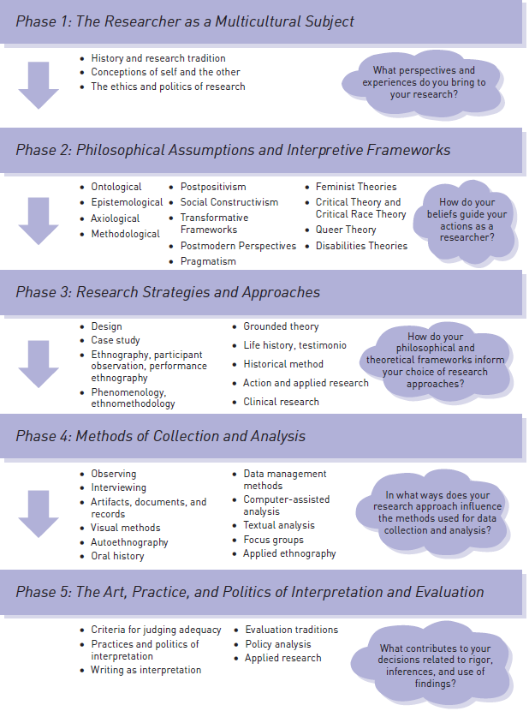
Situating philosophy within the research process
Denzin and Lincoln (2011, p. 12)

Slide 11


Slide 12
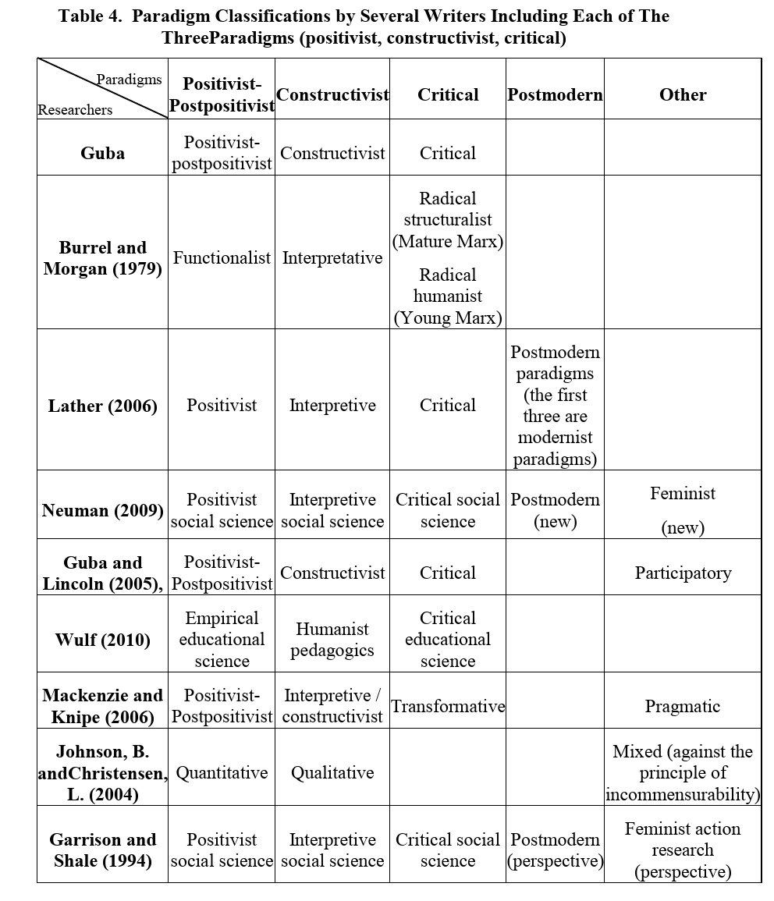

Slide 13
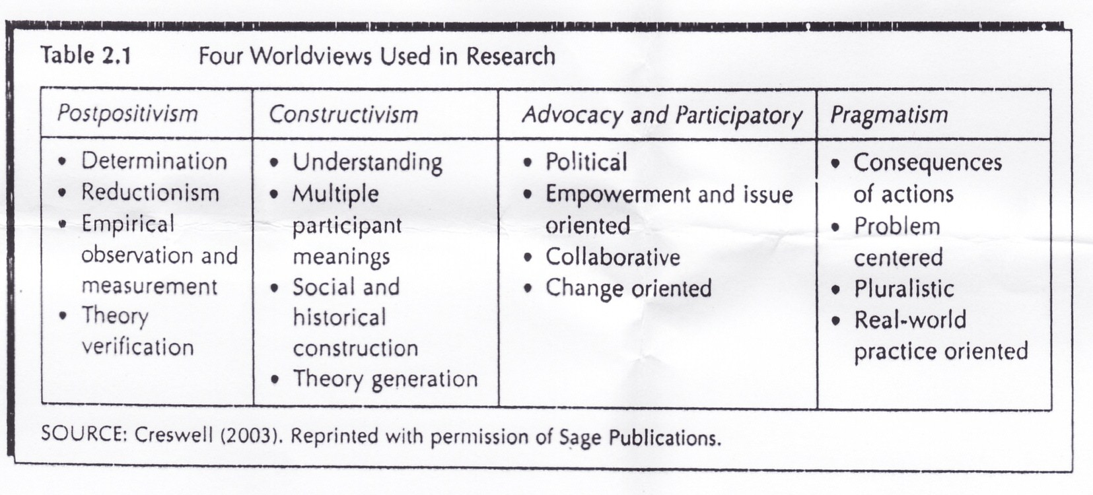
Creswell
Can also be called Transformative or Critical Theory

Slide 14
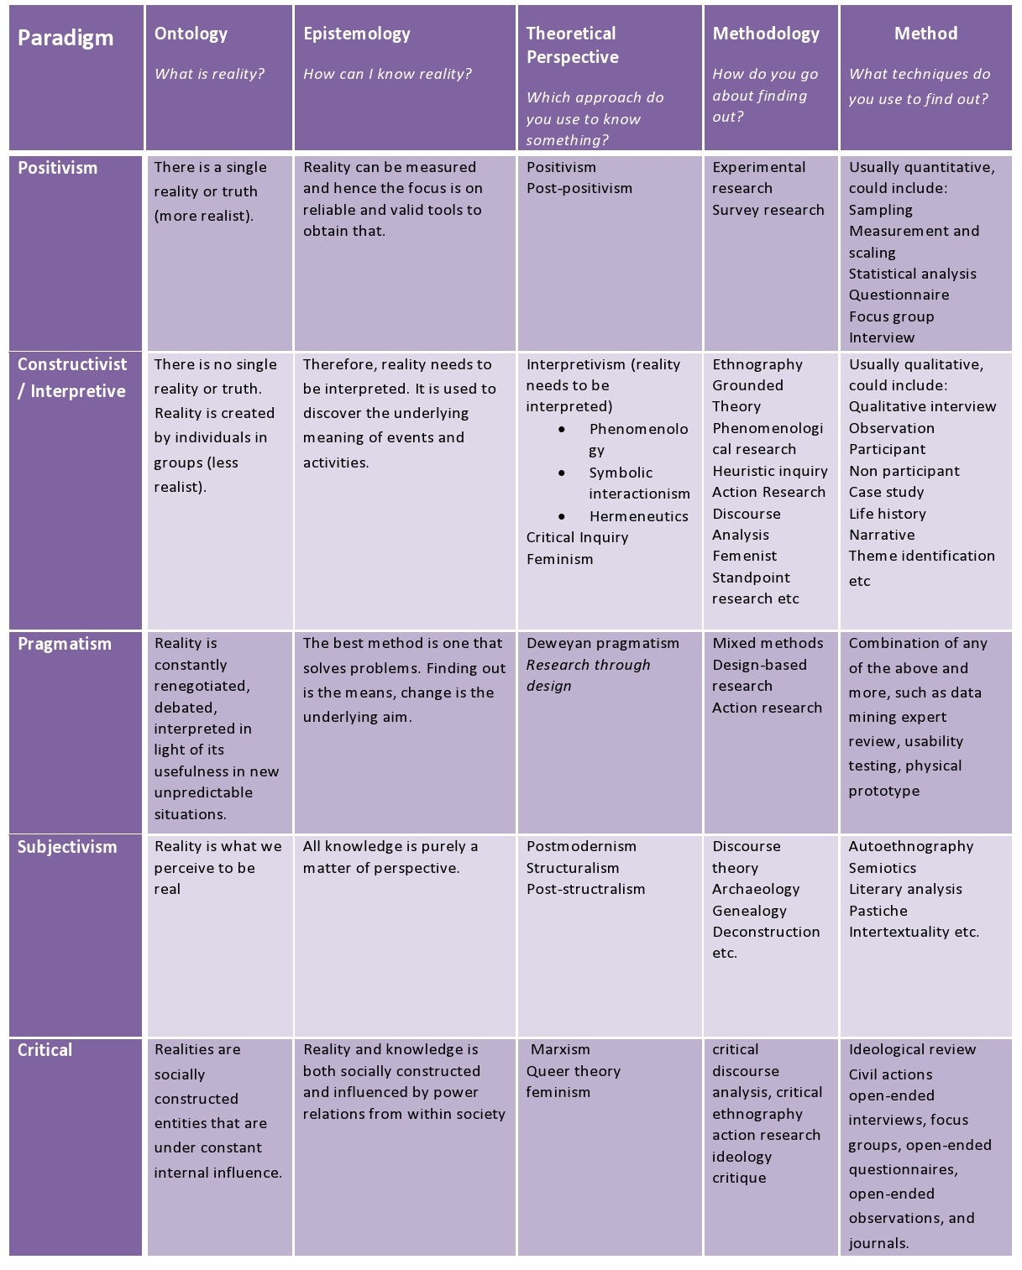
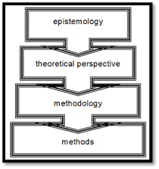
Crotty

Slide 15

Sometimes Constructionism and Interpretivism are separate
I INSIST THAT YOU THINK OF THEM AS SEPARATE
Can be referred to as Participatory or Transformative

Slide 16

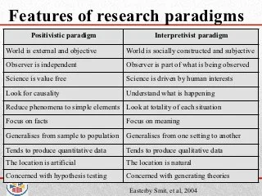

Easterby-Smith in Cohen

Slide 17
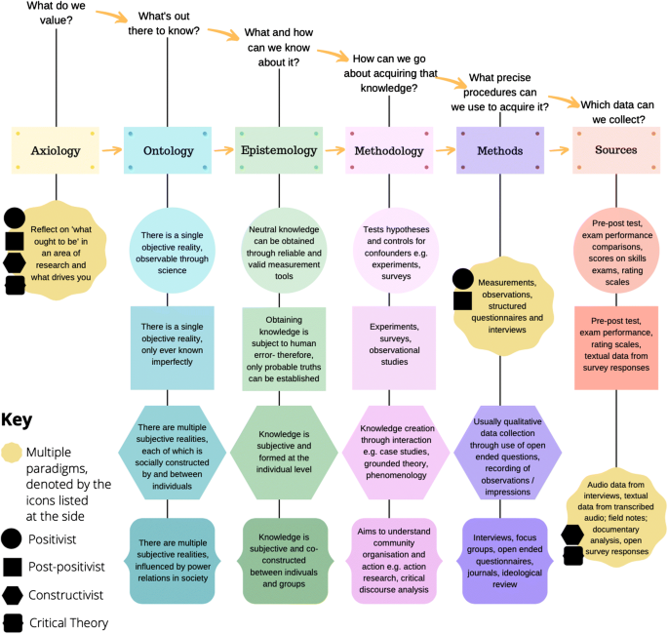
Mackenzie and Knipe

Slide 18
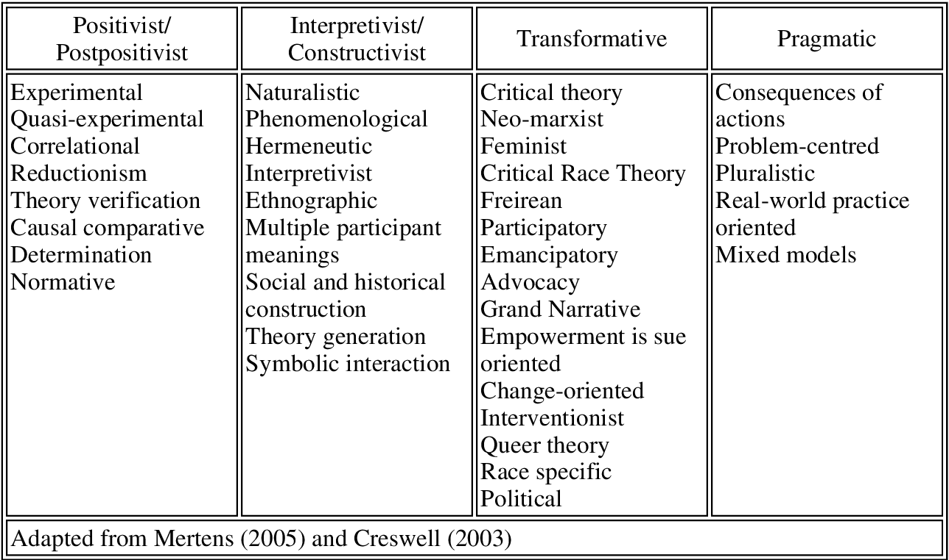
Mertens 2005 and Creswell 2003

Slide 19
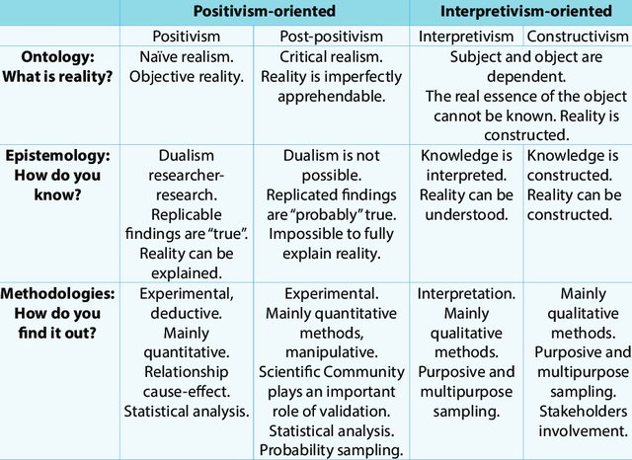
Iofrida

Slide 20
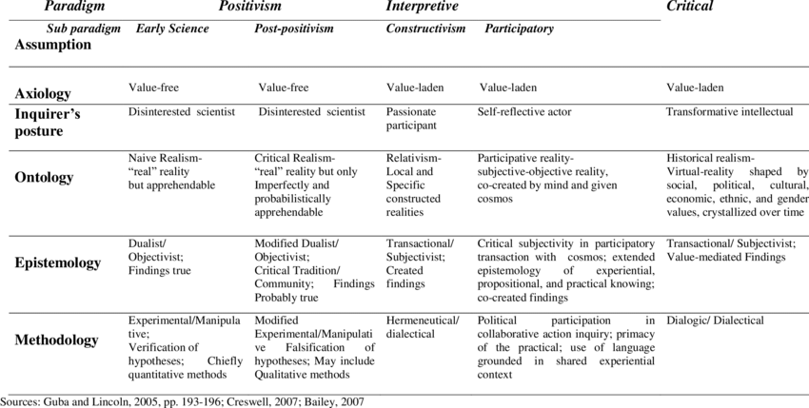
Guba and Lincoln

Slide 21
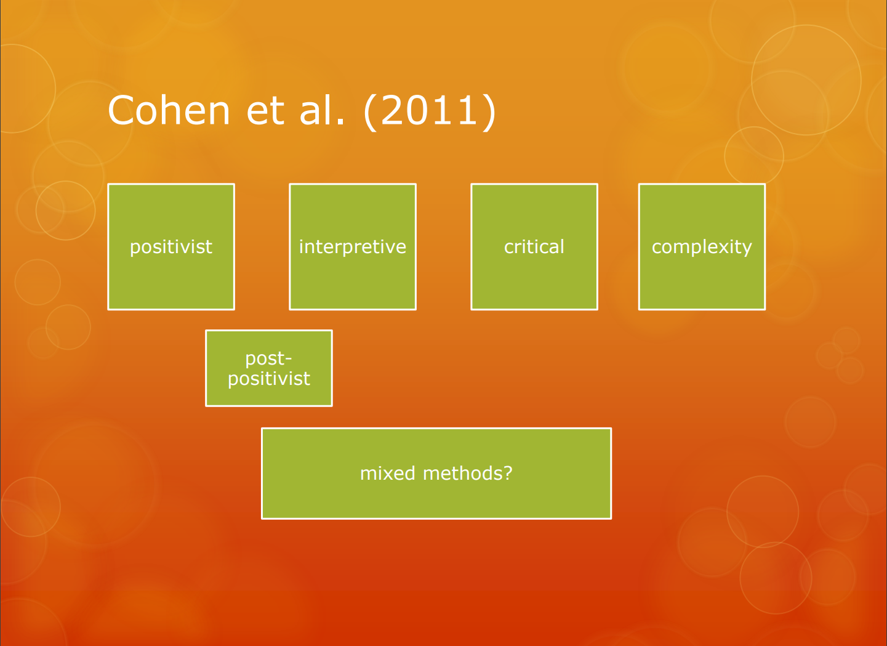

Slide 22
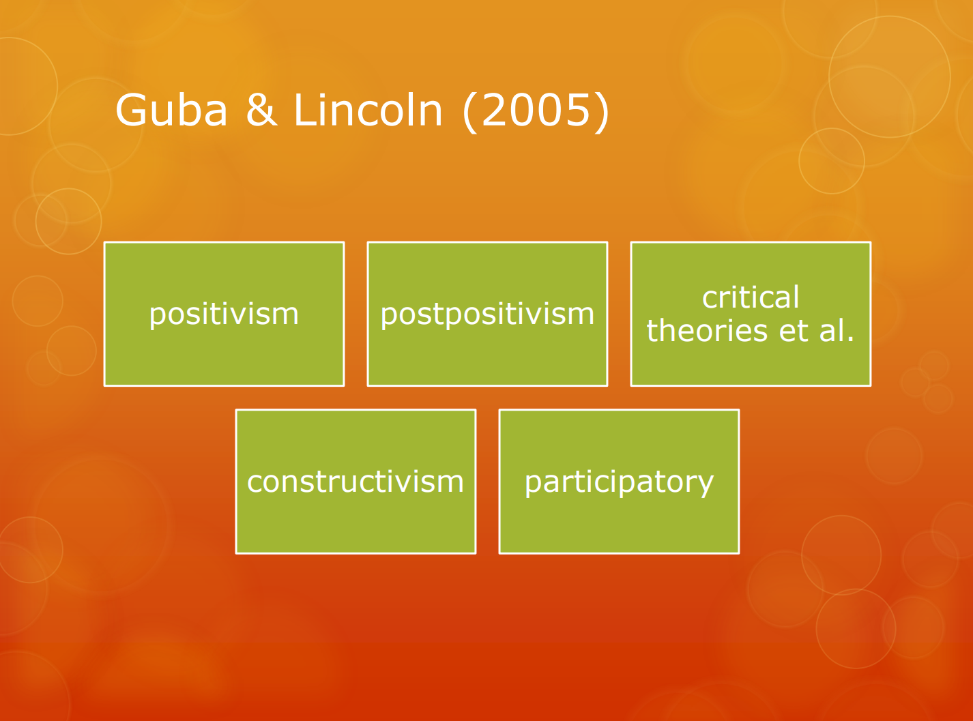

Slide 23
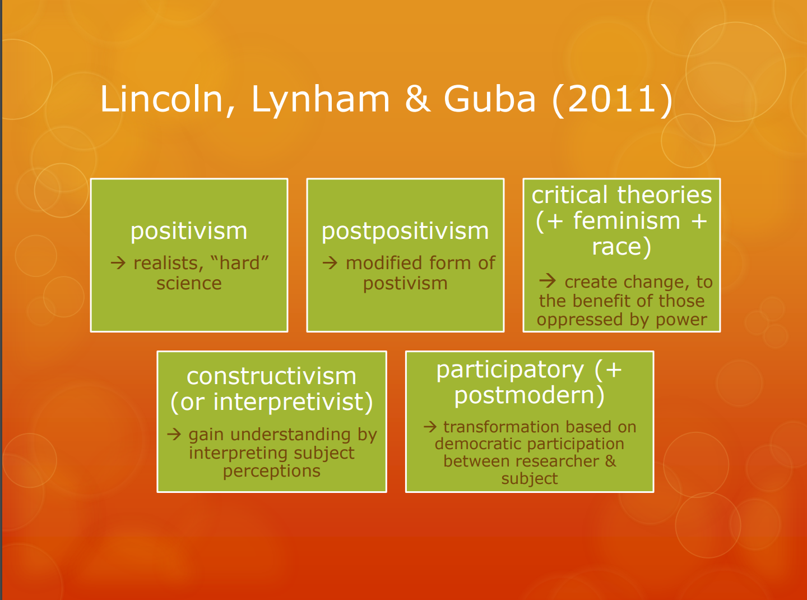

Slide 24
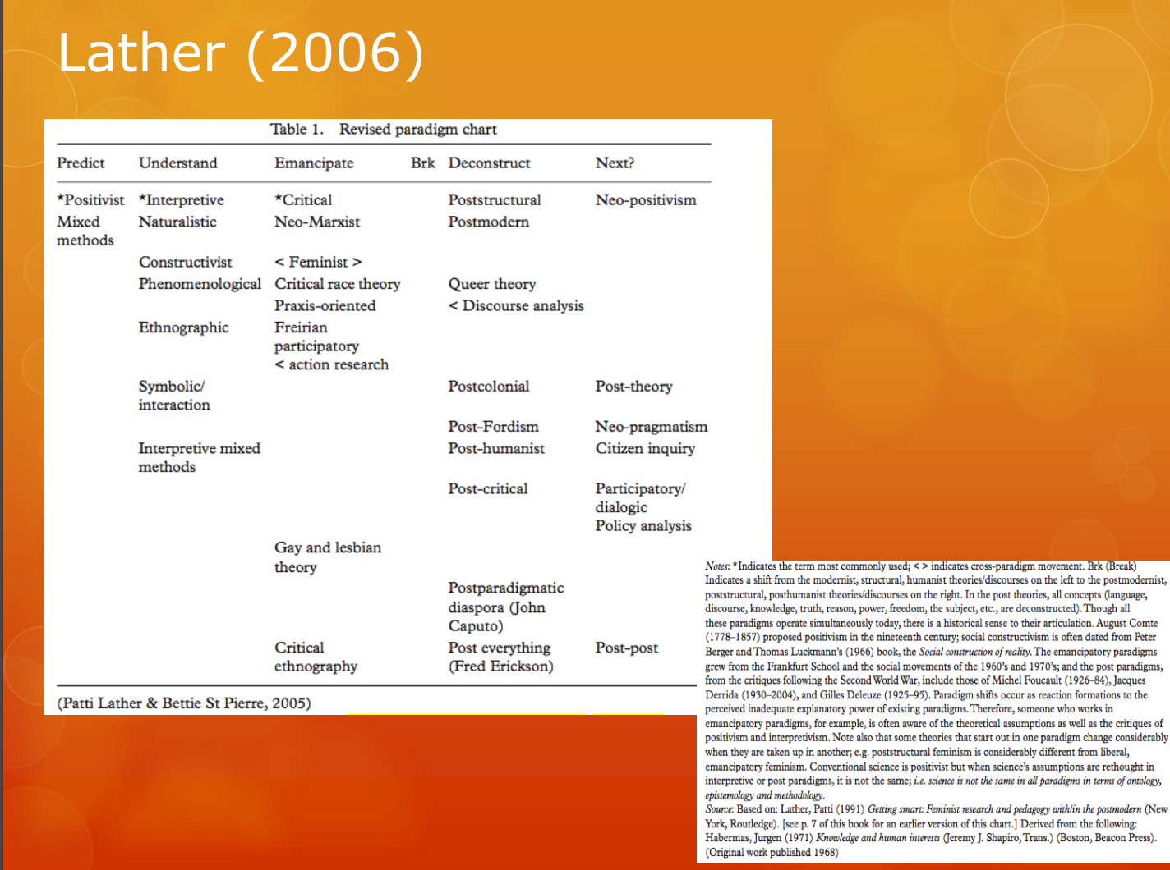

Slide 25


