Slide 1
Digital Strategy 2018
Lecture 2

Slide 2
What is marketing?
Not just promotion/advertising – in reality it covers a much broader range of activities.
See CIM’s brochure: A brief summary of marketing and how it works.
Also look at Hubspot’s 3 minute read: What is Marketing? FAQ

Slide 3
Socialnomics2019
Annual video from digital guru Erik Qualman on the effects of social media.

Slide 4
Strategic Agility
Digital marketers should consider
  Collection and dissemination of information
  Processes for generating and reviewing
  Research into potential customer value of innovations
  Implementation of prototypes and review results
  Measurement and review of results from prototypes to revise further

Slide 5
Digital Disruption from an incumbent perspective
McKinsey video
A good detailed article of the process of digital disruption from McKinsey

Slide 6
Digital Disruption from a start up perspective
Interesting video on how easy it is for startup to launch and disrupt.

Slide 7
Is there a change in disruption?
This blog discusses the fact that disruption is now coming from the incumbents.

Slide 8
Are the disruptors now the incumbents?
What is Google/Alphabet doing?
Thought provoking article on how Google is taking over the world.
A list of mergers and acquisitions by Alphabet.

Slide 9
What is Amazon doing?
Video on Amazon’s new Go store that opened to the public in January 2018
Amazon’s new In-Home Kit
Amazon’s website showcasing their latest innovations

Slide 10
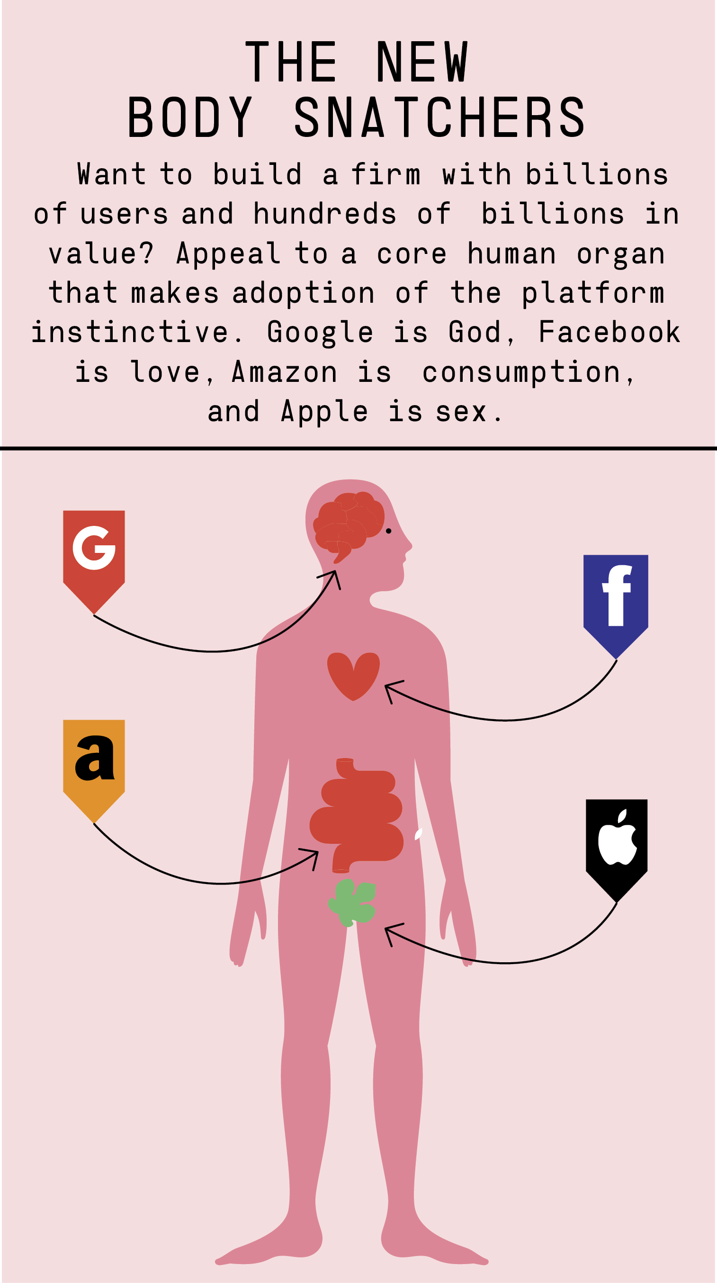
We must bust up big tech?
Very readable article in Esquire.com on the problems with the ‘GAFA’ companies
Source: esquire.com

Slide 11
Big Tech
Article on why the EU doesn’t love the GAFA companies.
Forbes article on Have Big Tech become the Bad Boys?

Slide 12
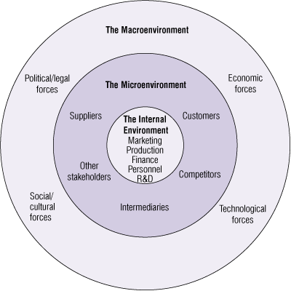
THREE LEVELS OF THE BUSINESS ENVIRONMENT
Macro- Environment
Micro- Environment
Internal environment
(Palmer and Hartley (2009); The Business Environment 6e. McGraw-Hill)

Slide 13
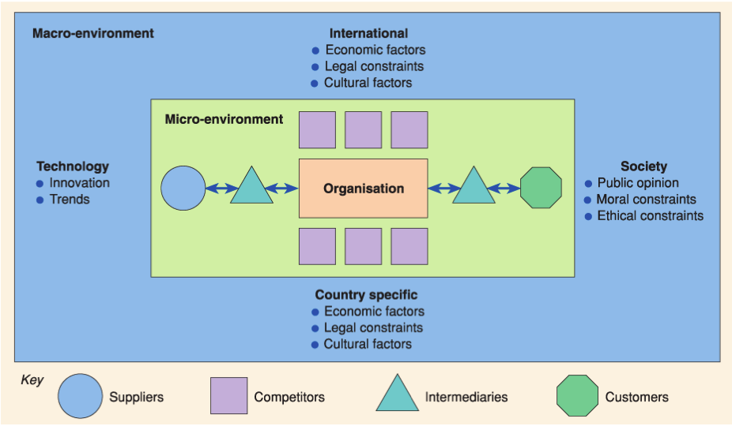
Environment Factors affecting a business - Source: Chaffey and Ellis-Chadwick - Digital Marketing, Strategy, Implementation and Practice

Slide 14
The Macro Environment
PESTEL
Beyond an organisation’s control
Organisations should monitor, understand and respond to the changes in the environment to utilise opportunities and overcome threat that are created by the environment,
Monitor trends, where people are going. You are responding not leading if you don’t.
Since these factors are uncontrollable, it is important that organisations adjust their decision as per the changes in the environment

Slide 15
Political factors
These are all about how and to what degree a government intervenes in the economy. This can include – government policy, political stability or instability in overseas markets, foreign trade policy, tax policy, labour law, environmental law, trade restrictions and so on.
It is clear from the list above that political factors often have an impact on organisations and how they do business. Organisations need to be able to respond to the current and anticipated future legislation, and adjust their marketing policy accordingly.

Slide 16
Political factors: Examples
GDPR
Governments can ban or block activities For example, Facebook has been blocked in Iran, Vietnam and North Korea. Twitter is currently banned in several other countries.
This means if you're a business using Facebook in these areas, you cannot use these advertising options and it is less likely that your target audience can see your updates. It also means you need to consider local alternatives, for example, Sina Weibo in China and Facenama in Iran and Afghanistan.

Slide 17
Economic Factors
Economic factors have a significant impact on how an organisation does business and also how profitable they are.
Factors include – economic growth, interest rates, exchange rates, inflation, disposable income of consumers and businesses and so on.
These factors can be further broken down into macro-economical and micro-economical factors.
Macro-economical factors deal with the management of demand in any given economy. Governments use interest rate control, taxation policy and government expenditure as their main mechanisms they use for this.
Micro-economic factors are all about the way people spend their incomes. This has a large impact on B2C organisations in particular.

Slide 18
Economic Factors
The arrival of the Internet created many pricing options that would have previously been impossible to imagine. For example:
First visitor and return visitor pricing is available through the use of cookies
24 hour sales are easier to accommodate with a code to enter at checkout, "only available until midnight"
Dynamic pricing based on availability and quantity is now used by most airlines and by many hotel groups and hotel chains
Auction pricing focused on highest and lowest offers (reverse auctions) is used by eBay, Priceline and many others
Software being sold as a service, with monthly payments rather than an upfront fee for a box of disks!
Free, freemium and premium services have evolved with some services such as games, being free, but showing ads and premium options available for ad-free services

Slide 19
A major challenge to many businesses are price comparison websites, where the prices are compared in a situation that isn't always accurate as delivery charge may be excluded.
In the future, most delivery charges will be removed as free delivery becomes the norm. The difference may be the speed of delivery with options for premium charges for super-fast delivery.

Slide 20
Social/Cultural Factors
The areas that involve the shared belief and attitudes of the population.
These factors include – population growth, age distribution, health consciousness, career attitudes etc.
These factors are of particular interest as they have a direct effect on how marketers understand customers and what drives them.

Slide 21
Examples
A good example is Moonpig. There may have been a time where they offered cards for birthdays, weddings and events like Christmas. Today they offer a wide range of cards for all occasions and religions.
Christmas, Chinese New Year, Diwali, Easter, Eid etc etc

Slide 22
Other issues on a socio cultural level include
Access to internet – surprising as it may seem, not everyone has access to the internet. This is especially true of the 80+ demographic, as well as those on lower incomes.
Acceptance of the technology – as the age profile in Facebook grows with more parents and grandparents adopting the platform, younger users are finding it less socially acceptable and are moving towards other social platforms.
Food/diet trends are other good examples: Low fat food; low carb food, gluten-free food; high protein food.

Slide 23
Teens
Two good articles on how teens are using social media and how it is affecting their lives.
https://www.theguardian.com/lifeandstyle/2016/dec/10/generation-z-latest-data-teens
http://www.pewinternet.org/2018/05/31/teens-social-media-technology-2018/

Slide 24
Technological Factors
We all know how fast the technological landscape changes and how this impacts the way we market our products. Technological factors affect marketing and the management thereof in three distinct ways:
New ways of producing goods and services
New ways of distributing goods and services
New ways of communicating with target markets
It's all about the technology being used, whether that's desktop or mobile, tablets or wearables.
Issues for your business include:
Screen size and where the internet is accessed
How you can make your user journeys easier
Whether new technology makes elements of your marketing mix redundant

Slide 25
Environment factors
These have become important due to the increasing scarcity of raw materials, pollution targets, doing business as an ethical and sustainable company, carbon footprint targets set by governments.
More and more consumers are demanding that the products they buy are sourced ethically, and if possible from a sustainable source.

Slide 26
Legal factors
Legal factors include - health and safety, equal opportunities, advertising standards, consumer rights and laws, product labelling and product safety. It is clear that companies need to know what is and what is not legal in order to trade successfully. If an organisation trades globally this becomes a very tricky area to get right as each country has its own set of rules and regulations.

Slide 27
Legal issues online are a major consideration. Here are some issues that you may need to consider within your local laws:
Bloggers being paid, but not disclosing that they are promoting a business (misleading practices)
Product placement including verbal mentions during ‘editorial content’
Stealing images from other websites (copyright infringement)
Using well-known brand names on your own website (passing off – common tort)
Paying commissions direct to staff (Bribery Act)
Selling customer data (Data Protection)

Slide 28
Plus, when setting up social media pages, you may need to adapt to meet different laws in different places.
For example, if you’re setting up a Facebook page to promote alcoholic drinks, it’s essential to age-gate and country-gate; ensuring your page is only available to those aged over 18 and those in the UK. If you ignore this, you could be breaking laws in other jurisdictions and this could have a negative impact on your business.

Slide 29
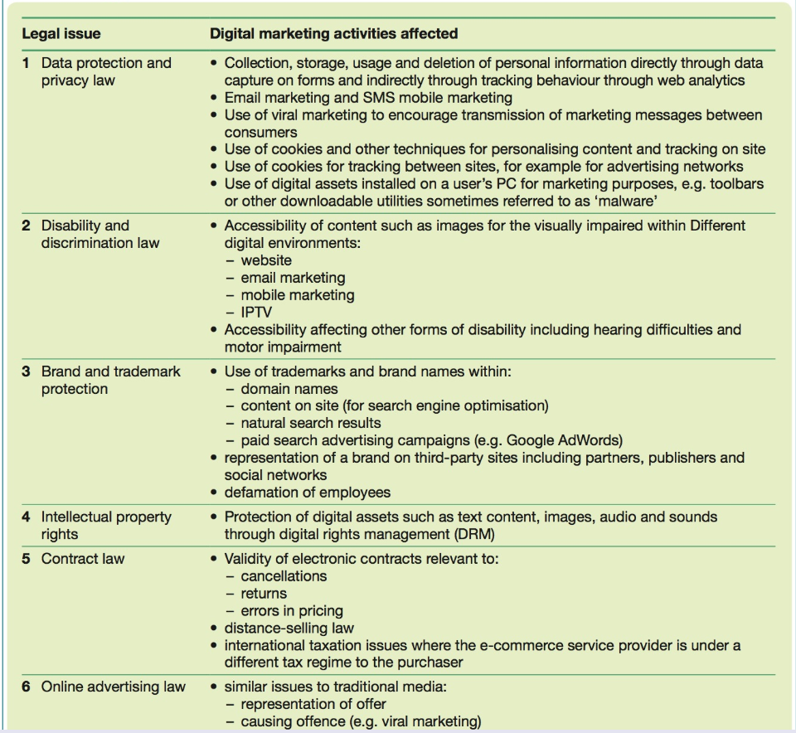

Slide 30
Strategic PESTEL
The next slide show you how to use to a PESTEL analysis strategically.

Slide 31
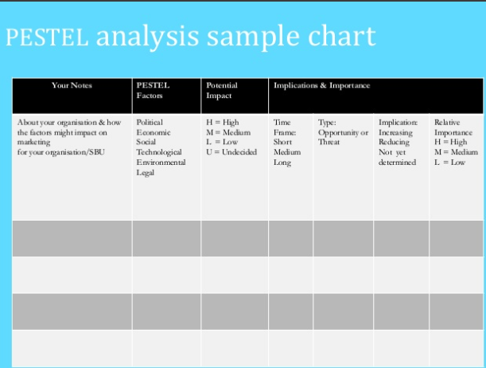

Slide 32
How might the areas you have identified have influence on your digital strategy/tactics?

Slide 33
THREE LEVELS OF THE BUSINESS ENVIRONMENT
Macro- Environment
Micro- Environment
Internal environment
(Palmer and Hartley (2009); The Business Environment 6e. McGraw-Hill)

Slide 34
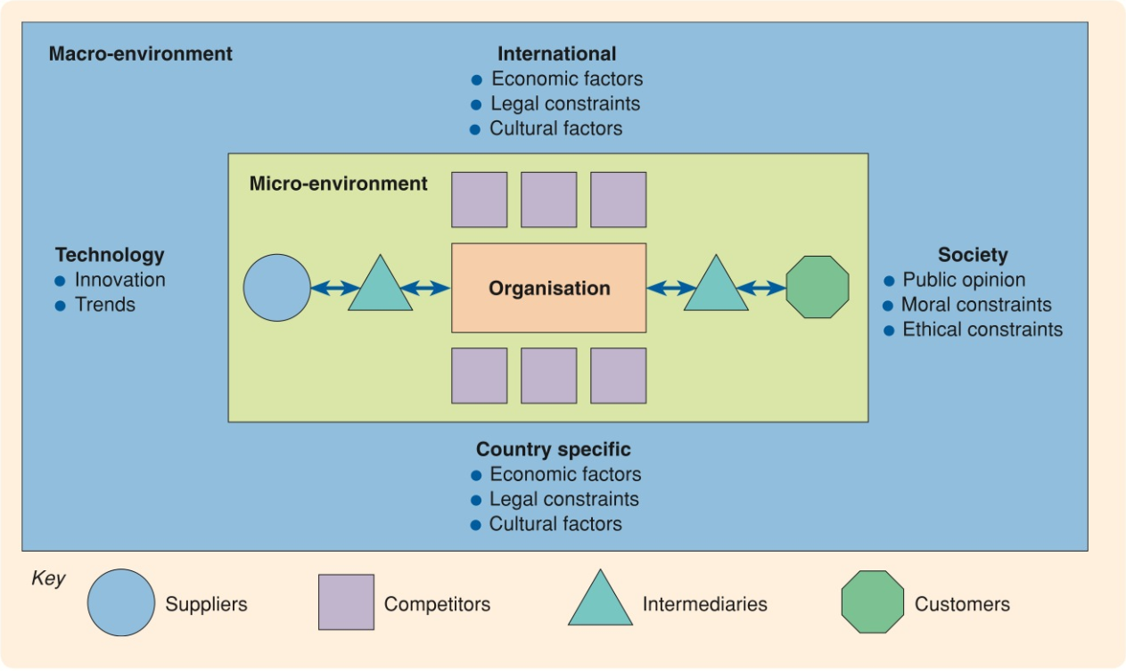
Chaffey & Ellis 2016

Slide 35
Micro Environment/ Operating Environment
Organisations can have some influence over micro-environment

Slide 36
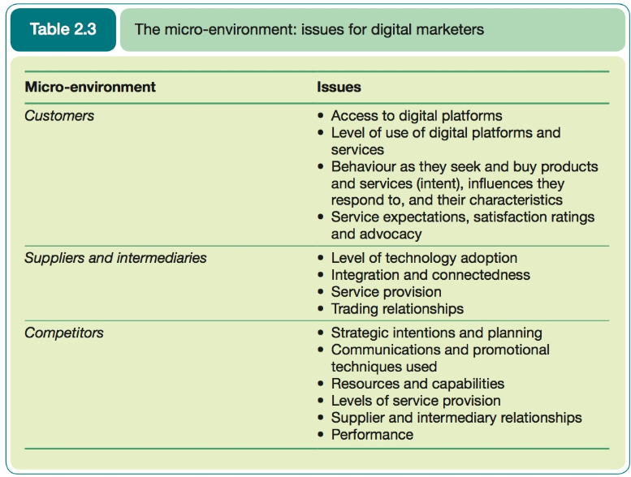

Slide 37

The Customer

Slide 38
Online Communities
Community Life Stages
https://twitter.com/datkin
How Important Is The Digital Community To A Marketing Strategy?

Slide 39
Online Communities
Online communities are a must-have tool for customer-led marketing decisions

Slide 40
Online Communities
Why online communities are growing—and how you can get more from them

Slide 41
Customers
As marketing should be laser-focused on customers. This is a REALLY IMPORTANT section.
As marketers you should:
  Know who your customers are: Customer Personas
  Understand what channels they use
  Understand what content engages them
  Welcome feedback
  Research you customers
Great article from another digital luminary Neil Patel

Slide 42
Customers
Consumer behaviour analysis
  Demand analysis: the potential and actual volume of visitors to a site and the extent to which this achieves strategic objectives.
  Digital consumer behaviour: the characteristic and digital experiences of target consumers. Customers segments can be created from this.

Slide 43
Simple trend analysis
Use google trends for you content marketing

Slide 44
Discussion
What influences you, to buy from a website or not?

Slide 45
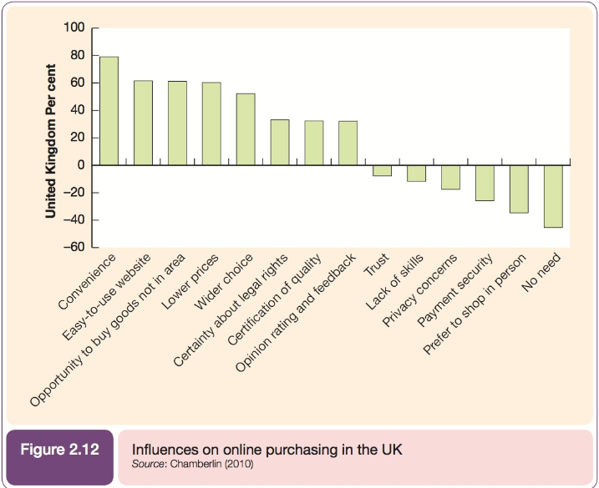

Slide 46
Why people buy online
https://www.specbee.com/blogs/why-people-buy-online-5-factors-influences-consumer-purchase-decision

Slide 47
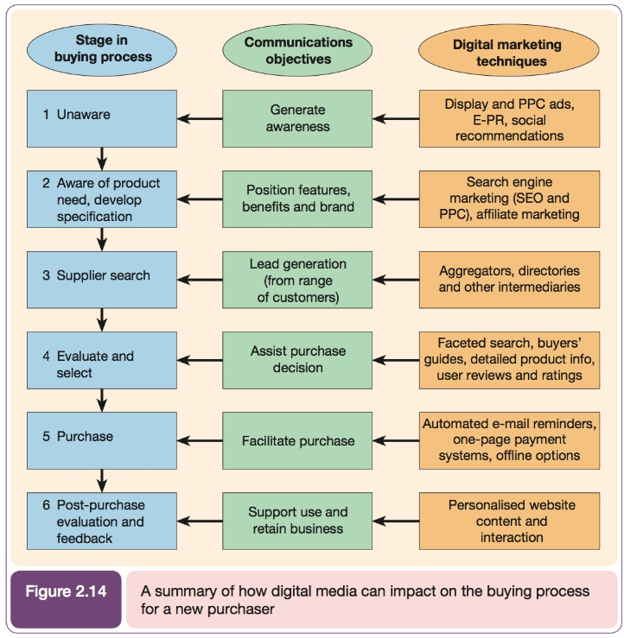

Slide 48
Customer Personas
https://digitalmarketinginstitute.com/en-gb/blog/2017-4-27-the-beginners-guide-to-defining-buyer-personas

Slide 49
Customer Personas
https://www.smartinsights.com/persuasion-marketing/marketing-personas/dave-chaffey-use-personas-digital-marketing/

Slide 50
Content Marketing Matrix
https://www.smartinsights.com/wp-content/uploads/2014/01/Smart-Insights-Content-Marketing-matrix.png

Slide 51
The Buying Process
Awareness
Interest
Evaluation
Trial
Adoption
    Kotler et al (2001)

Slide 52
The Digital Buying Process
Problem Recognition
Information Search
Evaluation
Decision
Action
Post-purchase
      Chaffey and Smith (2012)

Slide 53
How customers process your message
To understand how your web copy communicates with your intended audience
Hofacker’s 5 stages of information processing

Slide 54
Lauterborn’s 4 C’s Model
If you are truly customer focused you should be considering the 4C’s of marketing and not the 4 P’s ?
http://www.smartinsights.com/marketing-planning/m§arketing-models/4cs-marketing-model/

Slide 55
Multichannel conversion models
Conversion modelling can be quite complex because it needs to take into account online and offline behaviour.
Some shopper may buy online while others use phone or buy in-store.
Useful to put in place some sort of monitoring of cross-channel conversion at different stages of the buying process.

Slide 56
How?
Phone numbers unique to the website can be used as an indication of the volume of callers to a contact centre influenced by the website

Slide 57
ROBO
https://internetretailing.net/themes/themes/the-rise-of-robo-research-online-and-buy-offline-with-mobile-must-be-used-to-drive-in-store-sales-15977

Slide 58
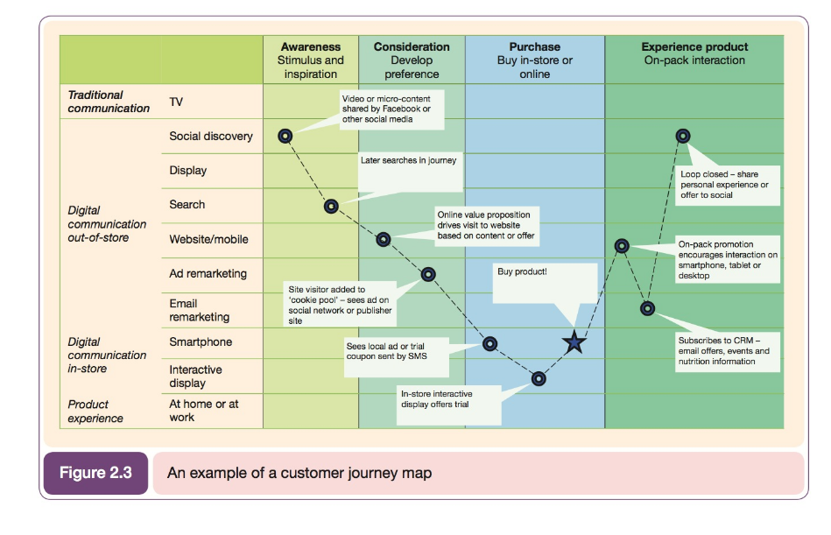

Slide 59
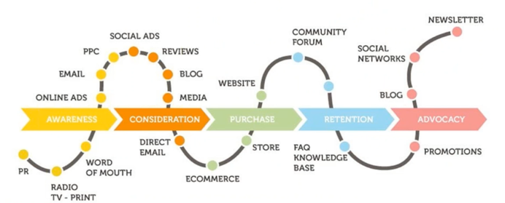
Customer Touchpoints

Slide 60
https://exchange.cim.co.uk/blog/five-stages-of-your-customers-buying-journey/

Slide 61
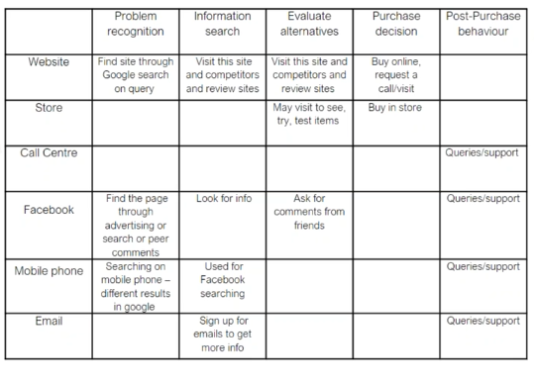
Try and map your customer journey

Slide 62
The consumer buying decision process
https://www.smartinsights.com/marketplace-analysis/customer-analysis/consumer-decision-buying-process/

Slide 63
Map your own customer journeys
https://www.smartinsights.com/user-experience/customer-experience-management-cxm/mapping-customer-journey/

Slide 64
ZMOT Google’s retail-specific model for understanding customer journey

Slide 65
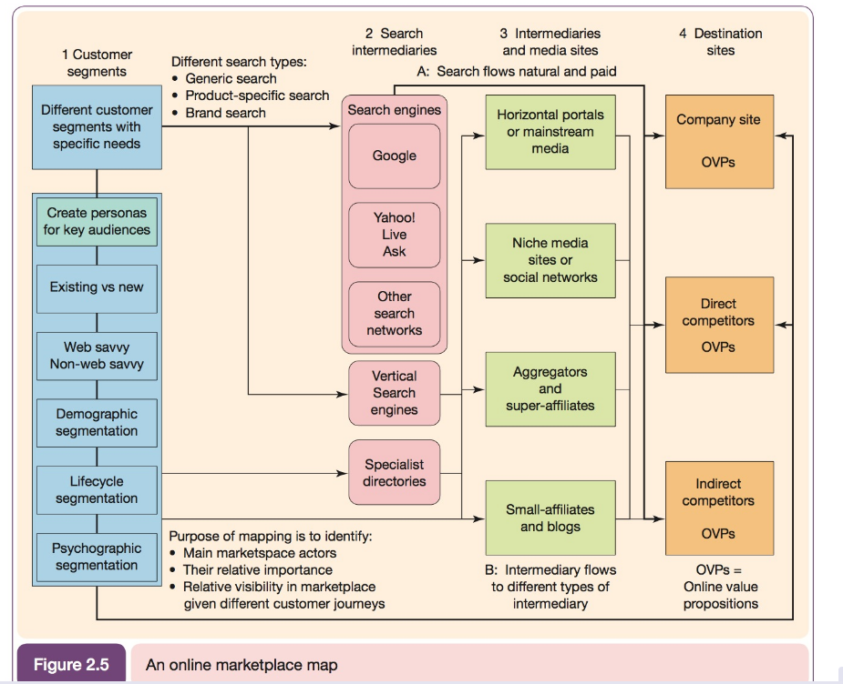
Customer Journey

Slide 66
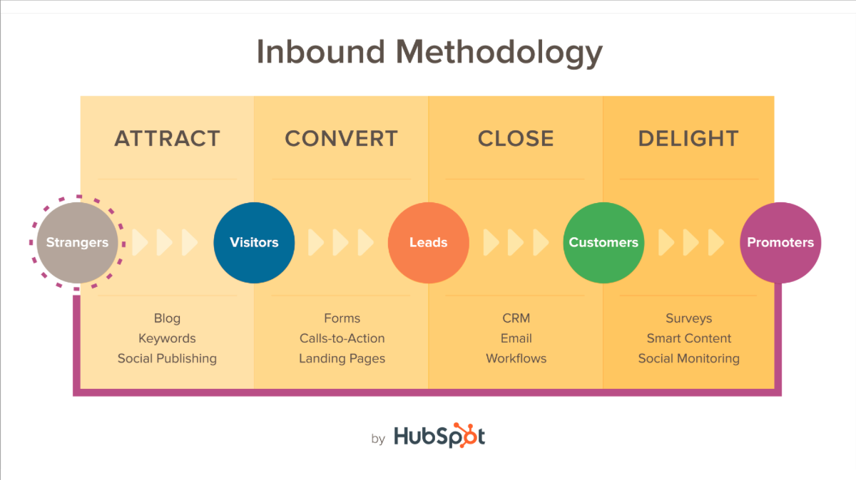

Slide 68
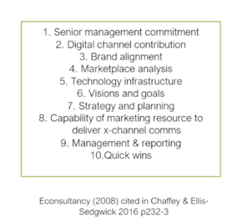
Internal capabilities

Slide 69
Digital Marketing Resources
MEN (Labour).
MONEY (Finances).
MACHINERY (Equipment).
MINUTES (Time).
MATERIALS (Factors of Production)
http://www.marketingteacher.com/digital-marketing-internal-audits/

Slide 70
Technology Adoption
https://ondigitalmarketing.com/learn/odm/foundations/5-customer-segments-technology-adoption/
Understanding where these fit into the product-life cycle can enable selective marketing and design activities which are focused on tapping into these adopters specific needs. This can improve a product’s chances of success.

Slide 71
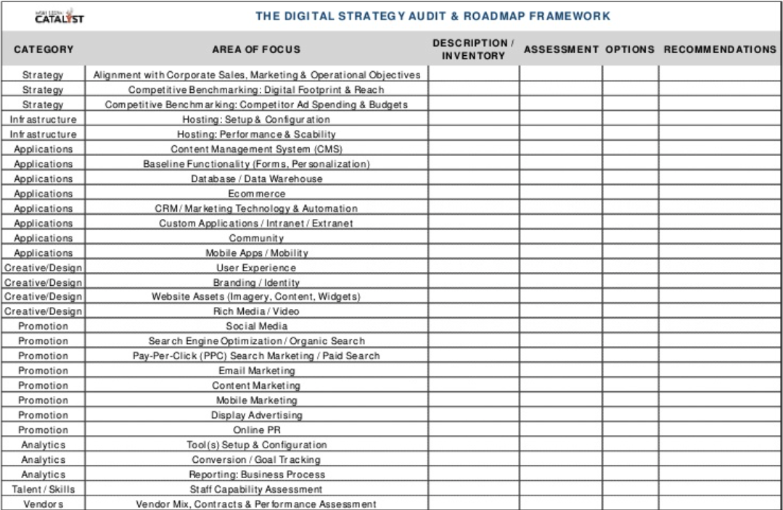

Slide 72
Barriers to effective marketing
https://360encompass.com/barriers-adoption-effectiveness-marketing/

