Slide 1
Assessment component 1
Riverdale Nursing Home
Module code LCHS4007​
Digital skill and research methods​
lecture: Hajra Mustasim (module lead)
Student's names and ID number:
Nadia Farooq 2541963
Maira Ali 2539951
Musliha Yahya Abajebel 2520501
Svitlana Kiseliuk 2542313
Vlasta Tancosova 2535023

Slide 2

Introduction
Riverdale Nursing Home has carers, nurses, senior carers, and administrative staff working across two building and different shifts.
Because staff are unsure which Microsoft 365 tools to use, communication problems have occurred at work, and confusion which has led to inefficient ways of working, for example; missed messages and duplicated work
I will explain why Microsoft Teams is the most suitable tool to improve staff communication and efficiency in the workplace.

Slide 3

According to Microsoft (2026), Microsoft Teams is a communication platform that allows staff to send messages instantly, join video meetings, share files and stay connected because everything is stored in one place, so that different members of staff can communicate more efficiently and access information in an easy to find and organised manner.
How can Microsoft Teams Help Staff within Riverside Nursing Home?
Faster communication
Reduces missed messages
Improves teamwork
Support shifts handovers
Easy file sharing
Saves time
Improves patient care
Reduces duplicate work (Microsoft, 2026).

Slide 4
Advantages and Disadvantages
ADVANTAGES:
Quick Communication between different members of staff within the two different buildings.
Accessible on different devices.
Secure file sharing between staff members.
Video meetings and allows teamwork and collective collaboration (Melati, 2025).
DISADVANTAGES:
Staff may need training and demonstrations on how to use.
Requires internet connection.
Software issues or device issues can disrupt usage.

Slide 5
Conclusion
In conclusion, staff in Riverdale Nursing Home using Microsoft teams can benefit from strong and effective communication between each different members of staff, it will make it easier for them to share information quickly, staff in the different buildings/ departments or shifts can stay connected through messages, video calls and important updates. This ensures there is less misunderstandings, helps staff work as a team, and overall improved efficiency and smooth running of the Nursing home and great standard of care to service users,
REFERENCES
Melati, R. (2025). Analysis of The Advantages of Microsoft Teams as A Corporate Communication Tool in Supporting Employee Performance. Eduvest - Journal of Universal Studies, 5(3), pp.2893–2899. doi:https://doi.org/10.59188/eduvest.v5i3.50900.[Accessed 25 May 2026]
Microsoft.com. (2026). Try Copilot for Individuals | Microsoft 365. [online] Available at: https://www.microsoft.com/en-gb/microsoft-365/try-copilot/individuals?msclkid=3bab5383d5471d5e91673997a7a8c1da [Accessed 25 May 2026]

Slide 6
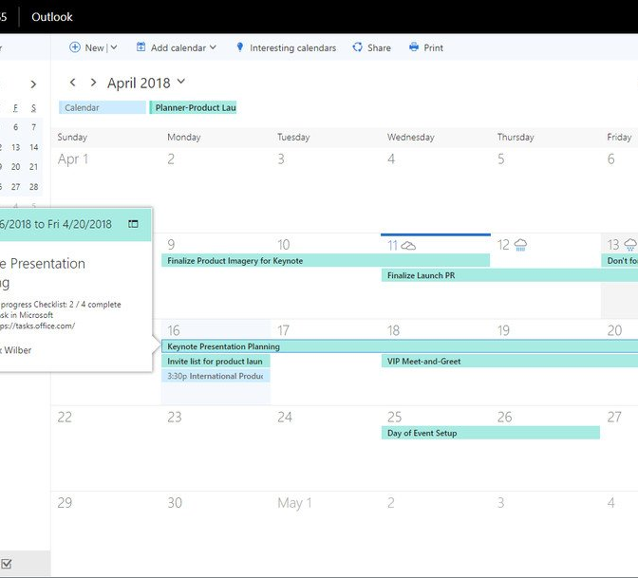
STAFF SCHEDULING/ROTAS USING OUTLOOK
Student name: MAIRA ALI
Student id: 2539951
Lecture: Hajra mustasim
Module: lchs007

Slide 7

Riverdale's Nursing Home:
Riverdale's nursing home has a carers, nursing, senior carers, and administrative staff working across the two different building and have a different shifts.
And the staff members are unsure about Microsoft 365 tools and do not know how to use them so that is the reason they have a communication problem and confusion about Microsoft 365.
Now I will explain why outlook is important and suitable tool to improve the staff scheduling/rotas at the workplace or anywhere else.

Slide 8

The outlook is more suitable and important for the staff member of Riverdale's nursing home because they can email each other about the shifts or schedule their timing.​
Let the everyone know about the changes, and this is really help full for them to use it and improve their communication skills.

Slide 9
Advantages and disadvantages
Disadvantages:​
Learning curve: outlook is extensive feature may result in a learning curve for a new user, but some individual user find it challenging to navigate. ​
Storage limitations: it depending on the emails providers that they might have a limitations amount of the data that can be stored in outlook and for the larger emails you must manage the storage carefully. ​
Performance: outlook may have a performance issues, especially with the larger email's accounts or with the slow internet connection.​
Also, in outlook certain functions require an internet (for example: updating calendar or syncing emails) so that might be a challenging situation.​
Cost: outlook included in Microsoft office 365 which is a paid software, but the standalone version might require to buy it separately this is a disadvantage for the budget-conscious users
Advantages: ​
Unified emails managements which helps them to managing multiple emails accounts.​
people can access and organize their emails and folders. ​
Calendar and scheduling: outlook have a robust calendar feature that allows people to schedule their appointments.​
People can set reminders and organize those events through outlook. ​
Security feature: outlook have an ability to secure the files or block the specific email addresses. ​
(Barraza Carlos, n.d)

Slide 10

Efficiency or communication:
They must use outlook more to communicate with each other by sending emails to each other which will help them to improve their using of Microsoft outlook.
They must communicate through outlook because they work in two different building and, they do not know each other timing so I think it help a lot with the communication. They must practice a lot on outlook to use it.
Well, communication
Email sending
Calendar
Individual or business use
Also, outlook have a maximize the effectiveness of the team organization and scheduling the shift and it has a feature which is called calendar which help you to remember any appointments or meeting and, it gives you a reminder for it.

Slide 11
Conclusion:
In this conclusion, the staff in Riverdale nursing home using outlook can be benefit for them in their communication skills and using of an outlook through Microsoft tools because after knowing all the feature and functions and facing all the challenges about these tools. The confusion they had in their mind will be solved and they will be able to use the Microsoft outlook with freedom and they can schedule their own timing or someone else's timing easily also; they can organize as well along with the scheduling and that is really help full for them in the present or future. They improved that the nursing home are great care of service providers.
References: ​
https://barrazacarlos.com/advantages-and-disadvantages-of-microsoft-outlook/#elementor-toc-heading-anchor-0

Slide 12
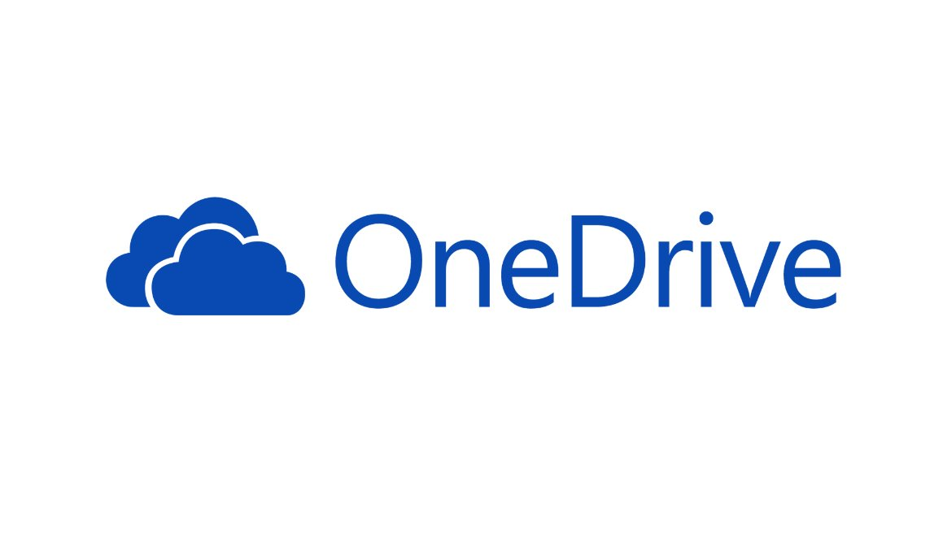
Riverdale Nursing Home
Secure File Storage and Sharing Using Microsoft OneDrive.
Name: Musliha Abajebel​​
Student No: 2520501​​
Module Code: LCHS4007​​
Module Name: Digital Skills and Research Methods​​
Lecturer Name: Hajra Mustasim​

Slide 13

Riverdale Nursing Home offers care and support for older adults who need help with day-to-day personal care, medication supervision, routine health inspection. Caregivers work at a dual-cite shift patterns involve Care assistant, Senior care assistant, Nurse, and Administrative personnel. ​​
Although they use Microsoft 365, workers stay poor understood which tools are best fitting to specific work activities. Therefore, these led the staff to experience in communication breakdowns, repeated tasks, reduced efficiency, and overlooked messages.
Microsoft 365 has various kinds of tools that can resolve the Riverdale Nursing home's current issues. One of these tool is Microsoft One drive.

Slide 14
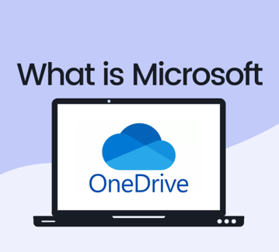
OneDrive is Microsoft's platform that hosts remote files. This platform practically allows users to : ​
Store data securely in central hub (Lober,2023) ​
Update files simultaneously across multiple devices (Spencer, 2020)
Distribute files instantly to other users.​
Cooperate on group tasks in real time.​
Access files flexibly from any place and device.​
Backup data automatically in the cloud while working via Autosave/ Auto-recovery features.​
Protect confidential information with built- in security protocols.​
Enhance overall storage workflow efficiency.

Slide 15
OneDrive improves Riverdale Nursing Home by presenting a secure central hub for storing and distributing important data to avoid duplication of tasks. Such as care plans, medication records, and shift hand over notes.​
It allows care workers to corporate smoothly in real time and allowing them to work from anywhere at any time. For example: they can work on the same task without creating another version.
Conclusion on How to improve Riverdale Nursing Home.

Slide 16
Reference List:
Microsoft, 2024 685c2a2addb16026f27de98b_6839f3f6eae85e90766b8e35_ReclaimAI-Blog-Images-What-Is-Microsoft-OneDrive.png (1921×1081) Accessed at 4th june,2026)
microsoft onedrive - Search
Lober, J. (2023) 'What is Microsoft OneDrive and how does it work for SMBs?', NOC Technology, 5 December. Available at: What is Microsoft OneDrive and how does it work (Accessed: 8 June 2026)
Spencer, S. (2020) 'USING ONEDRIVE TO COLLABORATE ACROSS WORK AND HOME', Care Computers, 17 August. Available at: Using OneDrive to collaborate across work and home - Care Computers (Accessed: 9 June 2026)

Slide 17

STAFF TRAINING
Student name: Svitlana Kiseliuk​
Student ID: 2542313​
Lecture name: Hajra Mustasim​
Module Code: LCHS4007

Slide 18

Staff training in a nursery home include:
Teaching staff how to care for residents ​
Health and safety procedures.​
Medication training.​
Infection control.​
Training new employees. (Care Quality Commission, (2023)
Why training is important:​​
Improves quality of care.​​
Keeps residents safe.​​
Helps staff work correctly and confidently. (Skills for Care, (2023)

Slide 19
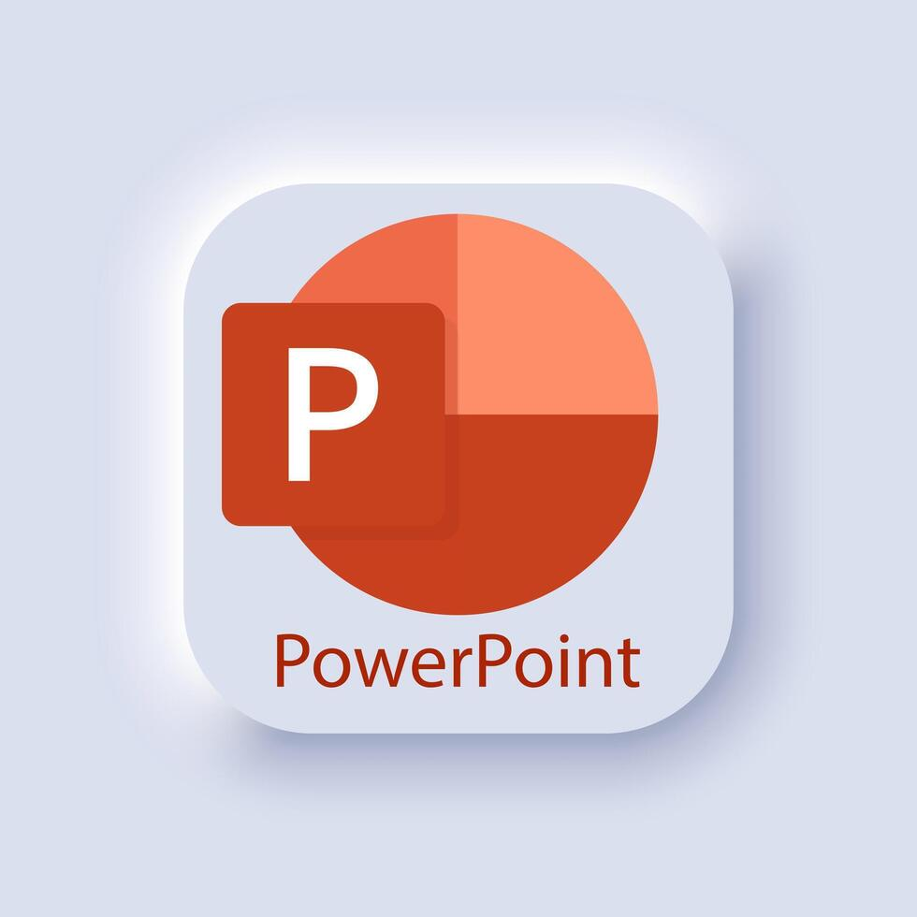
Microsoft Power point
Why PowerPoint?
Easy to create training presentations.​
Visual and simple to understand.​
Can include images, videos, and diagram.​
Useful for group training sessions.​
Helps staff member important information . (Microsoft Support, (2024) ​

Slide 20
How PowerPoint helps staff training:
Provides clear and organised training information.​
Helps inexperienced staff learn workplace procedures.​
Makes training sessions more interactive.​
Allows trainers to explain information step by step.
Examples:
Managers can use PowerPoint presentations to train careers abut:​
infection control​
moving and handing patients.​
emergency procedures.
Results:
Staff become more confident, informed, and prepared to provide safe care.​

Slide 21
Conclusion
Microsoft PowerPoint is a suitable tool for​
staff training in Riverdale Nursing Home​
because:​
Improves learning.​
Supports communication.​
Saves time.​
Helps staff provide care to residents.

Slide 22
Reference:
All information and ideas in this presentation are based on official guidance for health and social care, and Microsoft help guides.​
You can find the sources we used below:​
Skills for Care (2023)- Common Core Principles for Learning and Development.​
Care Quality Commission (2023)- Regulation: Good Management and Staff Training. ​
Microsoft Support (2024) – Using PowerPoint for Training and Presentations.

Slide 23
Written care-related documents/care documents
Student name: Vlasta Tancosova ​
Student ID: 2535023​
Lecture name: Hajra Mustasim​
Module Code: LCHS4007

Slide 24
1. Identify the Workplace Task (Care Quality Commission)​
​
What we do:​
​
• Write, save, and update all care records for every resident​
• Includes daily care notes, care plans, medical records and reports​
• Record all care given, changes in health, behaviour, medicine and incidents​
• Share information between carers, nurses, doctors, and families.​
​
Why it matters: (Skills for Care)​
​
• Records must be clear, correct, and easy to read​
​
• They are legal proof of the care we provide​
​
• Keep residents safe and help staff work together. ​
(Nursing and Midwifery Council)​
Written Care Documents​
​
​
Using Microsoft 365 at Riverdale Nursing Home.

Slide 25

Selected Tool
2. Select the Most Suitable Microsoft 365 Tool (Microsoft Support 2024).
✅ Microsoft Word
This is the best tool for writing and managing all care documents.
Why this Tool is Appropriate.
3. Why Microsoft Word is Suitable (Care Quality Commission)​
✅ Easy to use – simple to type, edit and update notes; good for all staff​
✅ Clear & organised – make neat documents with dates, headings and clear text​
✅ Use templates – standard forms so everyone writes the same way; nothing is missed​
✅ Safe storage – saved digitally, no lost or damaged papers; easy to find later​
✅ Share easily – send files quickly to other staff, doctors or managers​
✅ Follows rules – helps meet legal and CQC standards for accurate, dated records

Slide 26
📑 Slide: Summary – Key Benefit show
​
Microsoft Word helps us✅ Clearer records – easy to read, no messy hand writing​.
✅ Same style every time – templates make sure we never miss important details​
✅ Saves time – quick to write, edit and share​
✅ Always safe – files stored securely, never lost or damaged​
✅ Better teamwork – everyone can read and understand the same information​
✅ Meets all rules – follows CQC and legal requirements Using the right tool makes our work easier, safer, and better for residents. (skills for care 2023) ​
(Health and safety executive)​
(Microsoft support 2024)

Slide 27
Conclusion:
• Written care documents are the foundation of safe, safe care
• They help us work as a team and keep residents protected
• Microsoft Word is the perfect choice: simple, safe, reliable and meets all our needs
• It saves time, makes records clear, and helps us give the best possible care
Good records = better care, every day.
(skills for care 2023)
(care quality commision 2023)
(nursing and midwifery 2024)
(health and safety executive 2022)

Slide 28
References​
​
Care Quality Commission (2023) Regulation: Safe Care and record keeping. Available at: https://www.cqc.org.uk/guidance-providers/regulation-enforcement/regulation-17-good-governance (Accessed 13 June 2026)​
Health and Safety Executive (2022) Good record keeping in care setting. Available at: https://www.hse.gov.uk/healthservices/record-keeping.htm (Accessed 13 June 2026)​
Microsoft Support (2024) Using word for documents and templates. Available at: https://support.microsoft.com/en-us/word (Accessed 13 June 2026)​
Nursing and midwifery Council (2024) Standards for records keeping. Available at: https://www.nmc.org.uk/standards/standards-for-practice/record-keeping (Accessed 13 June 2026)​
Skills for Care (2023) Record keeping and documentation guidance. Available at: https:www.skillforcare.org.uk/resource/record-keeping.aspx (accessed 13 June 2026)
Any Question?
Thank you.

