Slide 1
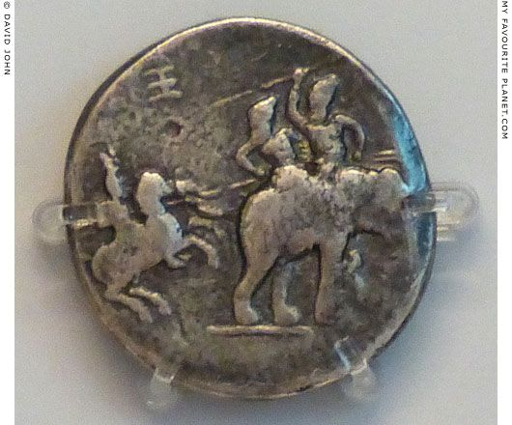
Warfare: theory, strategy and ethics
Elephants in Hellenistic Armies
HPHI4008

Slide 2
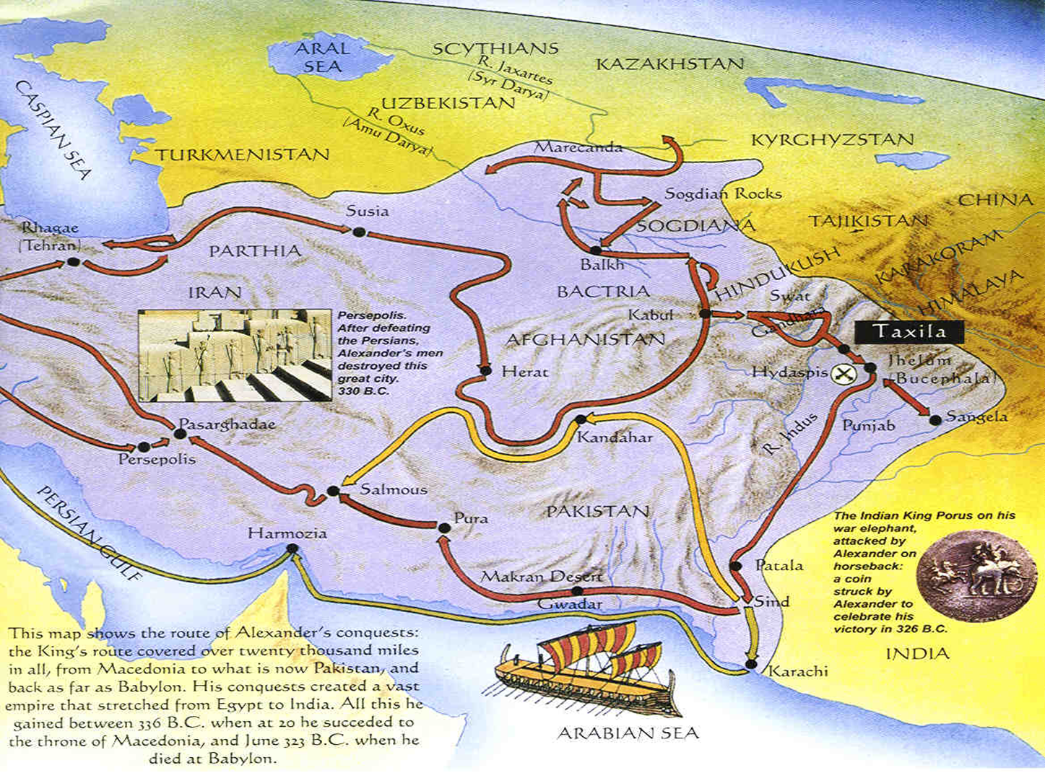
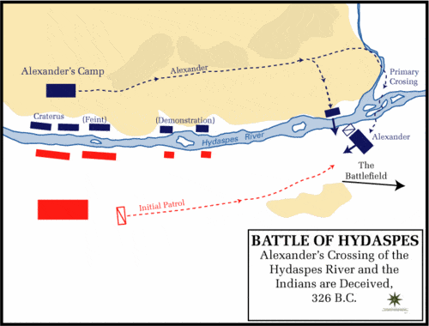
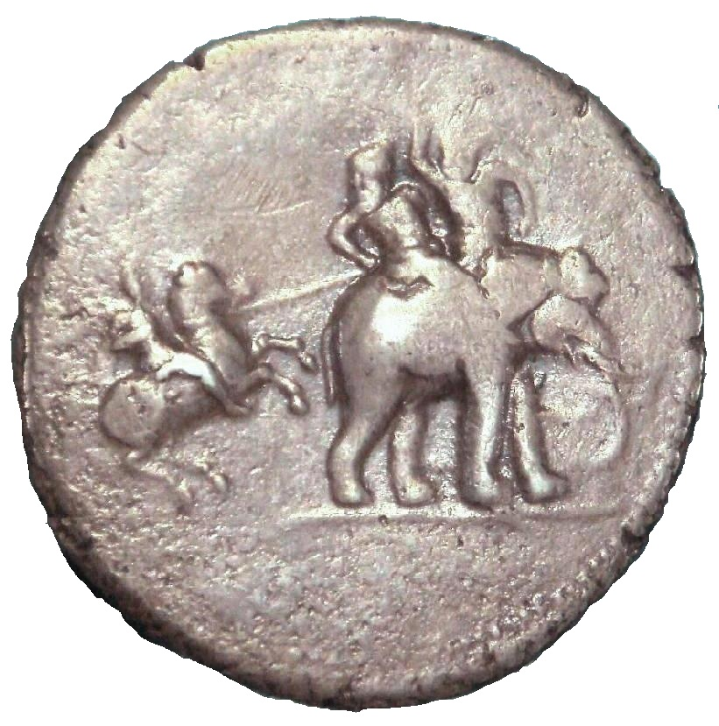
Alexander and elephants
Alexander encounters 15 elephants at Gaugamela (sort of) in Mesopotamia (331 BC) and 85 at the Hydaspes (modern Jhelum River) in the Indus region (326 BC).
Alexander seems to have acquired 27 elephants when he left Babylon in 327 BC and acquired more subsequently.
  He never actually deploys them in battle.
These elephants later divided up among his successors, including by capture.

Slide 3
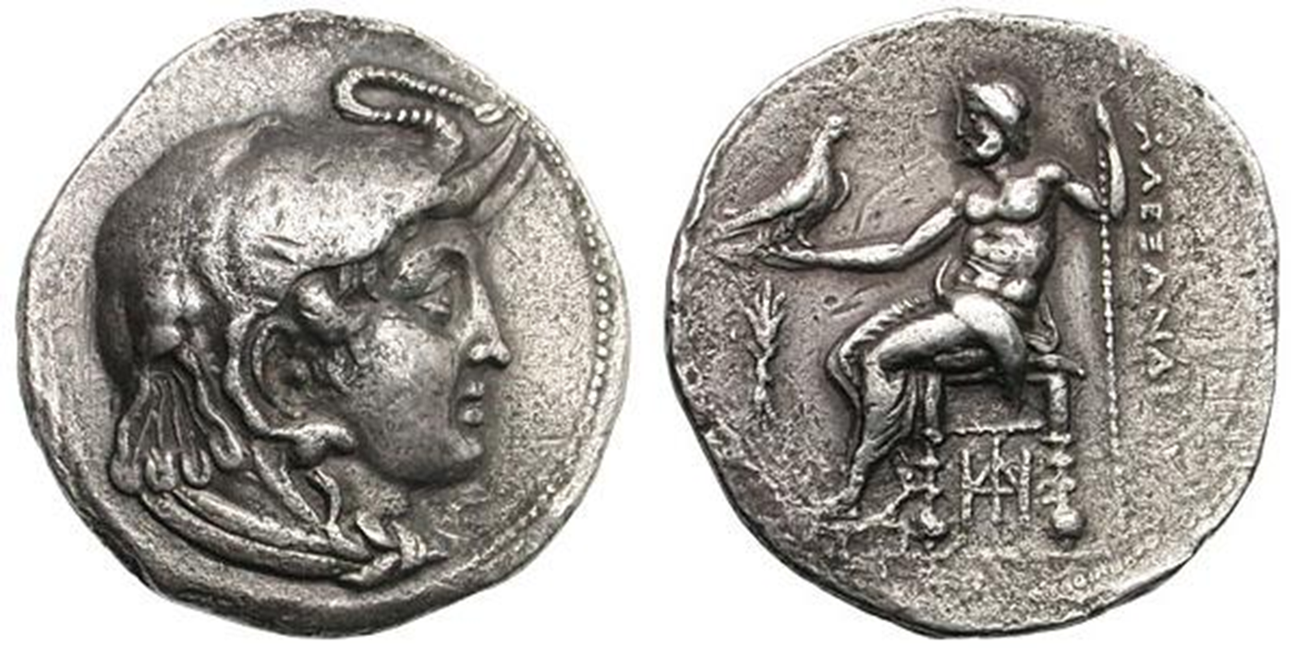
Symbolism
Ptolemy I, as Satrap, AR Tetradrachm. Memphis, ca 315 BC. Head of deified Alexander right with horn of Ammon, in elephant headdress & aegis / ALEXANDPOY, Zeus enthroned left, holding eagle on extended right hand & resting left on sceptre, thunderbolt in left field, HDI monogram under throne. SNG Cop 11.

Slide 4
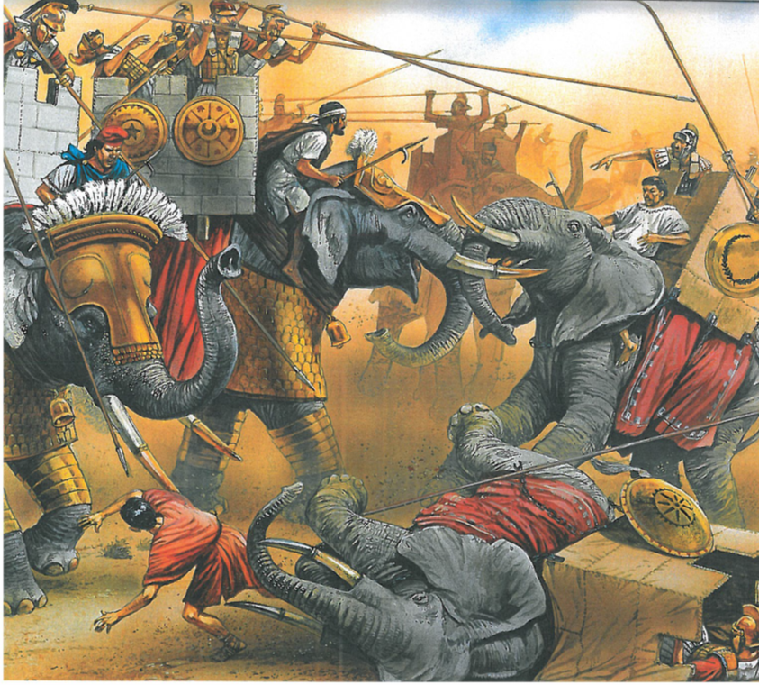
Elephants in combat
“In the second consulship of Pompeius [55 BC], at the dedication of the temple of Venus Victrix, twenty elephants, or, as some say, seventeen, fought in the Circus against a number of Gaetulians, who attacked them with javelins. One of these animals fought in a most astonishing manner; being pierced through the feet, it dragged itself on its knees towards the troop, and seizing their bucklers, tossed them aloft into the air: and as they came to the ground they greatly amused the spectators, for they whirled round and round in the air, just as if they had been thrown up with a certain degree of skill, and not by the frantic fury of a wild beast. Another very wonderful circumstance happened; an elephant was killed by a single blow. The weapon pierced the animal below the eye, and entered the vital part of the head.” – Pliny NH 8.7.20.
“A few only of Ptolemy's elephants ventured to close with those of the enemy, and now the men in the towers on the back of these beasts made a gallant fight of it, striking with their pikes at close quarters and wounding each other, while the elephants themselves fought still better, putting forth their whole strength and meeting forehead to forehead. The way in which these animals fight is as follows. With their tusks firmly interlocked they shove with all their might, each trying to force the other to give ground, until the one who proves strongest pushes aside the other's trunk, and then, when he has once made him turn and has him in the flank, he gores him with his tusks as a bull does with his horns.” – Polybius 5.84.2-4.

Slide 5

Acquiring elephants
Ptolemy II sent explorers to investigate sources of elephants in East Africa, as would Ptolemy III Euergetes (r. 246-222) and Ptolemy IV Philopator (r. 221-204).
Seleucus I acquires 500 from Sandrocottus (Chandragupta) after 305 BC.
Decline in elephant hunting activity by latter second century BC.

Slide 6
Bibliography
Burstein, S. M. (2008) ‘Elephants for Ptolemy II: Ptolemaic Policy in Nubia in the Third Century BC’, in P. McKechnie and P. Guillaume (eds.), Ptolemy II Philadelphus and his World (Brill), 135-147.
Casson, L. (1993) ‘Ptolemy II and the Hunting of African Elephants’, Transactions of the American Philological Association 123: 247-260.
Coşkun, A. (2012) ‘Deconstructing a Myth of Seleucid History: The So-Called “Elephant Victory” Revisited’, Phoenix 66: 57-73.
Scullard, H. H. (1974) The Elephant in the Greek and Roman World. Thames & Hudson.

