Slide 1


‘TRANSFORMING EDUCATION, TRANSFORMING LIVES…..’
Daniel Martin
MSc BSc MHCPC MCSP MAACP

Slide 2
Learning Outcomes
Describe types of bony injury
Discuss bone healing including timescales and timeframes that facilitate appropriate bone healing
Discuss bones tolerance to loading
Daniel Martin
MSc BSc MHCPC MCSP MAACP

Slide 3
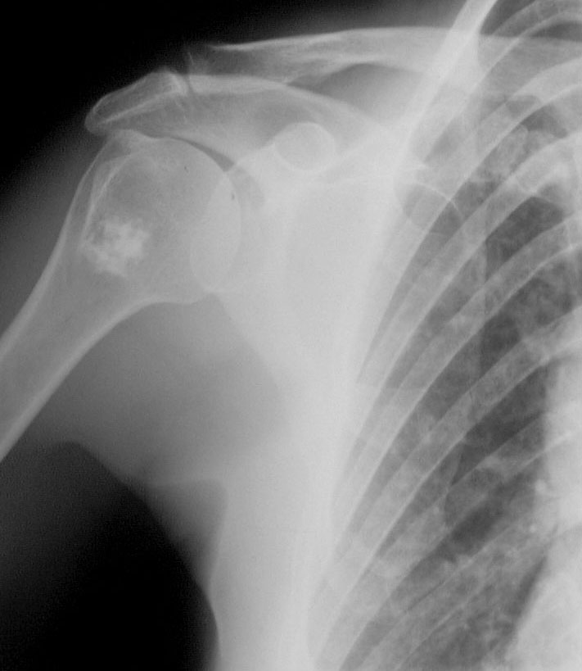
Bony Anatomy
Constituents
Organic (20-25%), Inorganic (65-70%), Water (10%)
Organic matrix
90% of the matrix is made of Type 1 collagen
8% is composed of proteoglycans and non collagenous proteins
2% is bone cells
Inorganic matrix
Made of platelet-like crystals of hydroxyapatite (Ca,P)
Daniel Martin
MSc BSc MHCPC MCSP MAACP

Slide 4
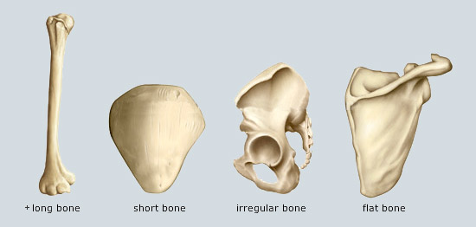
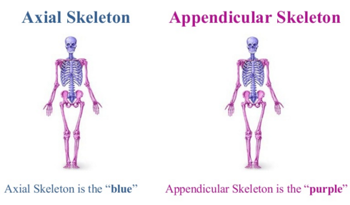
Bony Anatomy
Types of Bones
Long Bones
Irregular
Short
Flat
Skeleton
Appendicular
Axial
Daniel Martin
MSc BSc MHCPC MCSP MAACP

Slide 5
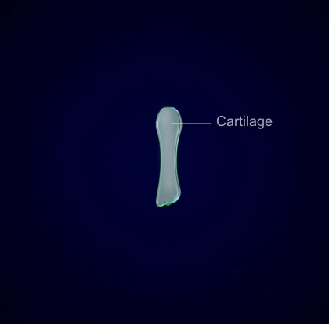
Bony Anatomy
Daniel Martin
MSc BSc MHCPC MCSP MAACP

Slide 6
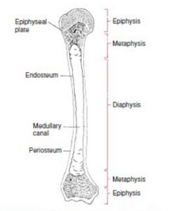
Bony Anatomy
Structure of Long Bones
Types of tissue/ Terminology:
Woven – Immature form of bone, birth, growth, # healing
Lamellar – replaces woven
Cortical – hard (calcium 80- 90%), structure/ protection
Trabecular – spongy, allows blood, tissues and bone
marrow through
Daniel Martin
MSc BSc MHCPC MCSP MAACP

Slide 7
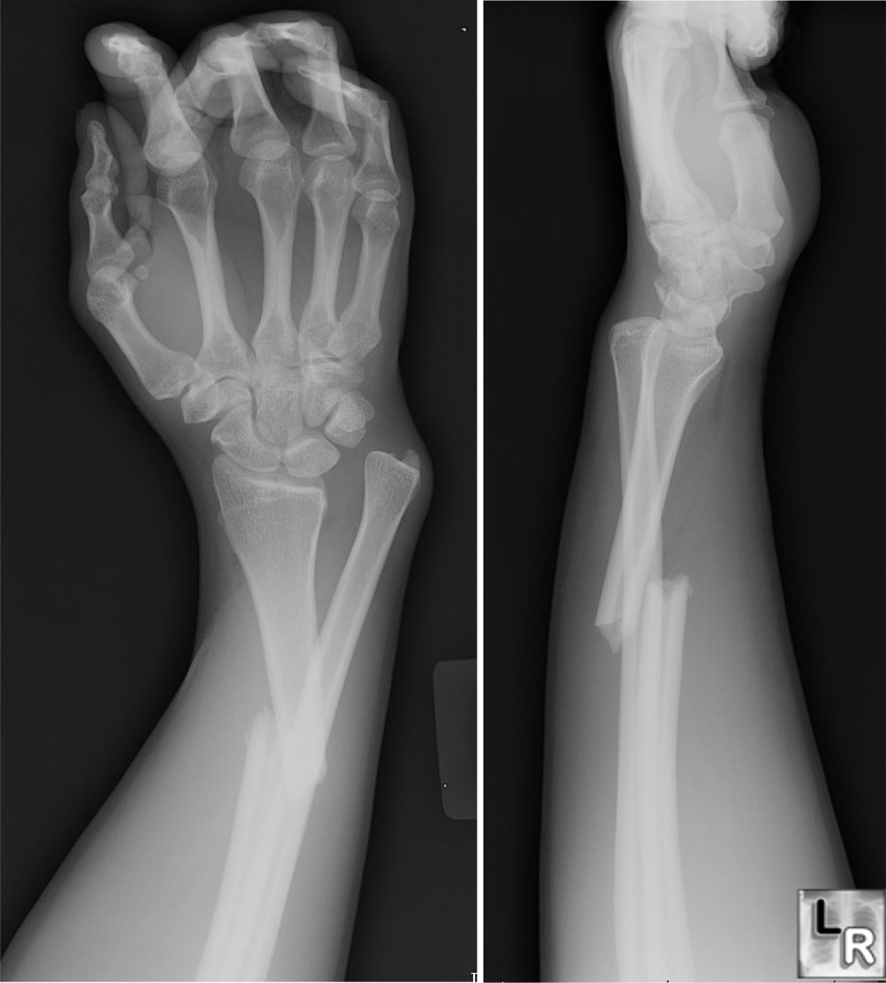
Bony Injury
Potential Forces
Tensile
Compression
Transverse
Torsion
Anisotropic
Daniel Martin
MSc BSc MHCPC MCSP MAACP

Slide 8
Bony Injury
Bony Loading
Strain magnitude proportional with bone formation
Strain rate proportional to adaptive response
Irregular strain distribution leads to increased
osteogenesis, whereas repetitive strains leads to reduced osteogenesis.
Strain cycles – a minimum number required to elicit a positive bone response.
Daniel Martin
MSc BSc MHCPC MCSP MAACP

Slide 9
Clinical Point
Osteoporosis
Condition characterised by low bone mass and microarchitectural deterioration leading to skeletal fragility and increased risk of fractures.
RISK FACTORS
Family Hx, Postmenopausal, Late onset menstrual periods, sedentary life, inadequate Ca/ Vit D, smoking, alcohol, caffefine, somatotype,
Caucasian, Asian
Daniel Martin
MSc BSc MHCPC MCSP MAACP

Slide 10
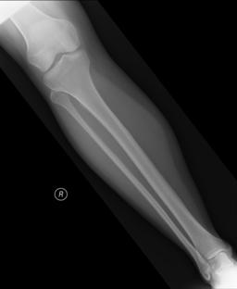
Bony Injury
Types of Bony Fracture
Simple/Open/Closed
Communited/Greenstick/Avulsion
Transverse/Spiral/Oblique
ABC
Alignment
Bones
Cartilage
Daniel Martin
MSc BSc MHCPC MCSP MAACP

Slide 11
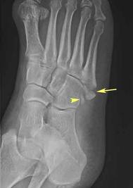
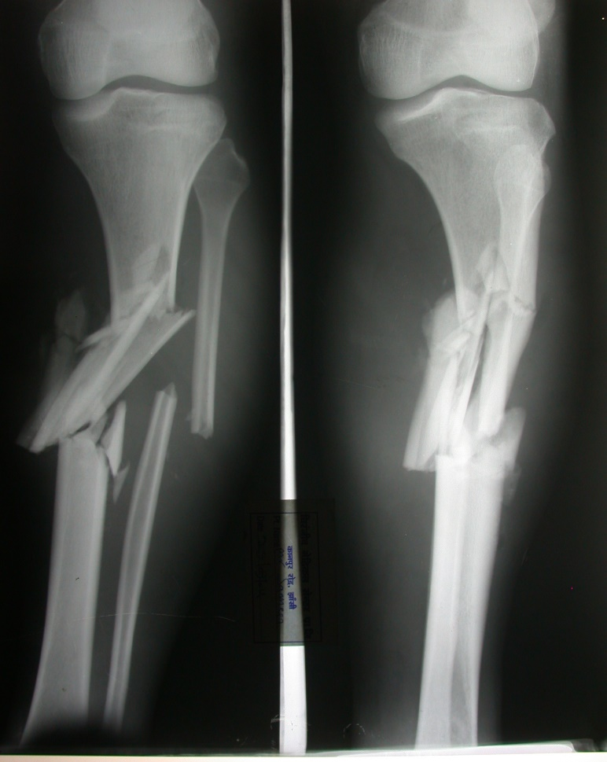
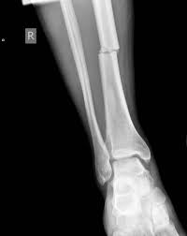
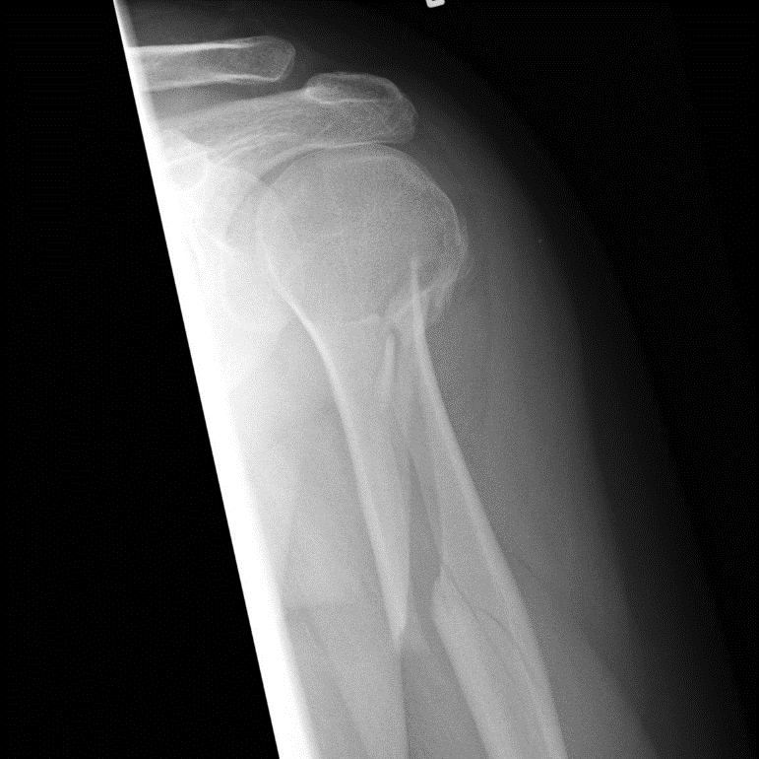
Bony Injury
Daniel Martin
MSc BSc MHCPC MCSP MAACP

Slide 12
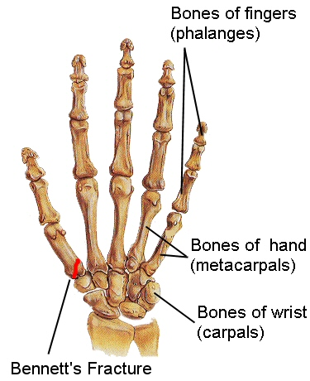
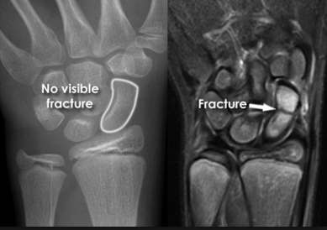
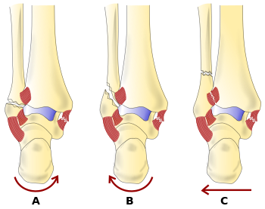
Bony Injury
Common Sporting Fractures
Where are the most common fractures in general population?
Bennetts
Scaphoid
Weber
Daniel Martin
MSc BSc MHCPC MCSP MAACP

Slide 13
Bony Injury
Other Bony Injuries
Contusions
Sub-periosteal – blood under periosteum, high force
Inter-osseous – high compressive force, b/v affected
Subchondral – cartilage and bone disrupted, bleed.
Stress Fractures
Accumulation of microdamage that is not adequately repaired by remodeling process.
Daniel Martin
MSc BSc MHCPC MCSP MAACP

Slide 14

Bony Injury
Wolff’s Law – Remodelling
Balance between osteoblasts and osteoclasts
- Osteoporosis occurs when osteoclast activity
Predominates
- Piezoelectric effect – generation of electrical charge through mechanical stimulus (squeeze).
- Potential to be altered by electrotherapy?
Daniel Martin
MSc BSc MHCPC MCSP MAACP

Slide 15
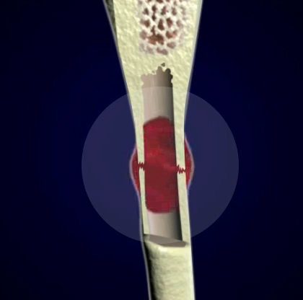
Bony Injury
Daniel Martin
MSc BSc MHCPC MCSP MAACP

Slide 16
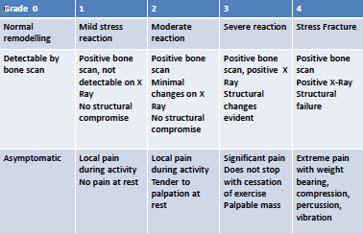
Bony Injury
Bony Stress Reaction
Symptoms often occur before radiological change
Daniel Martin
MSc BSc MHCPC MCSP MAACP

Slide 17
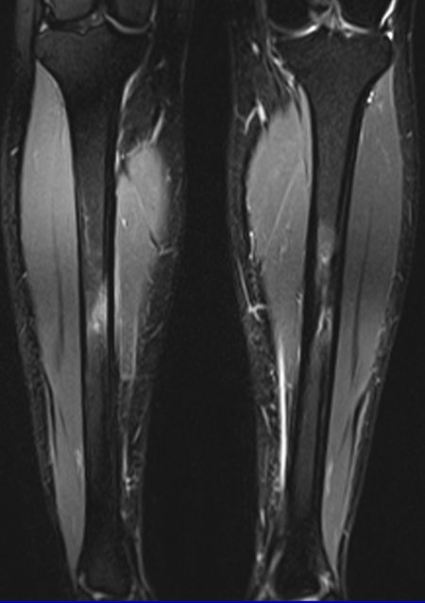
Bony Injury
Bony Stress Reaction
Symptoms often occur before radiological
change
What factors cause
Bony Stress?
Biomechanics/ Growth
Inflammatory/ Genetic
Daniel Martin
MSc BSc MHCPC MCSP MAACP

Slide 18
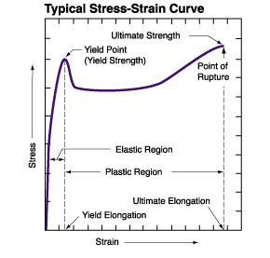
Bony Injury
The Point of No Return
Daniel Martin
MSc BSc MHCPC MCSP MAACP

Slide 19
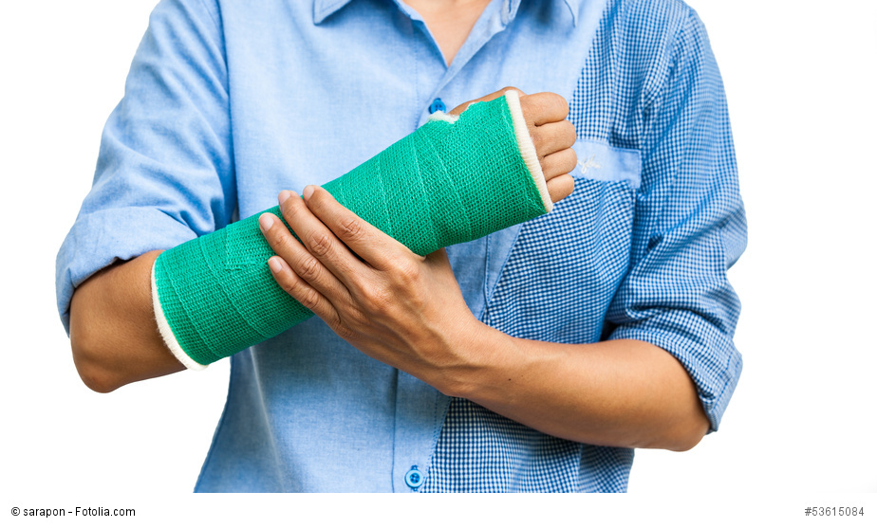
Bony Injury
Fracture Healing – Management Principles
Reduction
- Ensure correct bone alignment
Immoblisation
- Maintain the alignment until sufficient healing has occured
Rehabilitation
- Return to full function
Daniel Martin
MSc BSc MHCPC MCSP MAACP

Slide 20
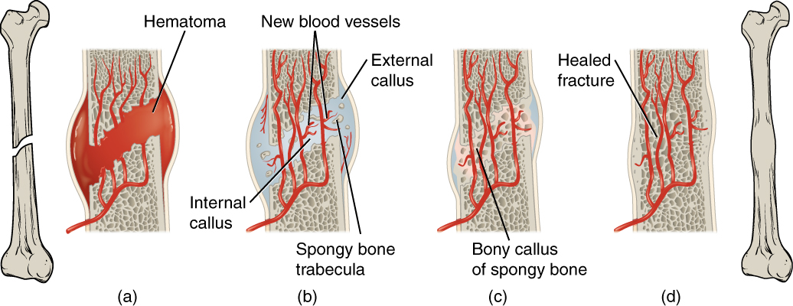
Bony Injury
Fracture Healing
Daniel Martin
MSc BSc MHCPC MCSP MAACP

Slide 21
Bony Injury
COFFEE BREAK TASK
Describe what these are? When they would be used? What areas of the body use these?
Open reduction internal fixation -
Cannulated Screws –
I/M Nail –
External fixation –
K-wires –
Daniel Martin
MSc BSc MHCPC MCSP MAACP

Slide 22
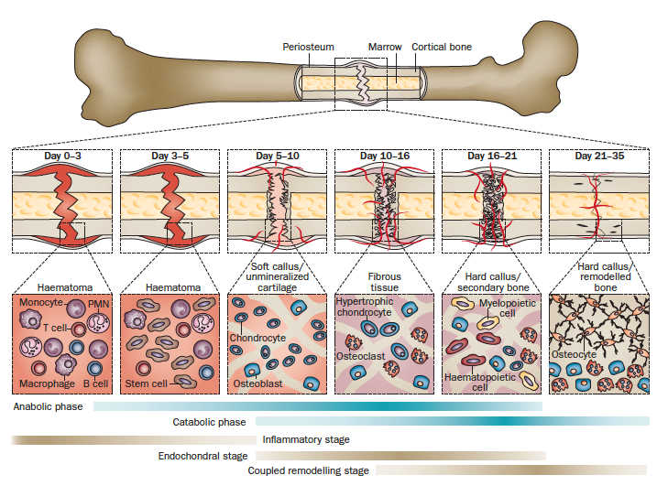
Bony Injury
Fracture Healing
Daniel Martin
MSc BSc MHCPC MCSP MAACP

Slide 23
Bony Injury
Fracture Healing
Internal fixation
Pins/Plates/Wires
Prevent mvt #
↓ piezoelectric
↓ mechanotherapy
Longer Healing Time
< 1yr
Risk ↓ / ↑ of further #
Removal of ORIF?
Callus
Less stability in # site
Compressive Load needed (P & FWB)
No increased risk ↓ / ↑ #
No hardware issues
No surgery required
Hypomobility of other joints?
Daniel Martin
MSc BSc MHCPC MCSP MAACP

Slide 24
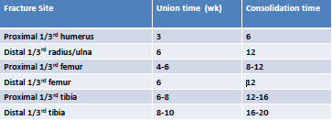
Bony Injury
Fracture Healing
Union – callus formation, but # line still visible on X-Ray : PWB
Consolidation – bone fully repaired, no movement at # site. Trabeculae bone crosses # site. FWB
Daniel Martin
MSc BSc MHCPC MCSP MAACP

Slide 25
Bony Injury
Fracture Healing
Application
Bone responds better to compression forces
Awareness of Tensile/Shear/Torsion/Bending
Factors affecting healing
Age
Pathology (Diabetes/ PVD/ Hypothyroidism)
Drugs (Steroids/NSAIDs/Alcohol/Antibiotics)
Lifestyle (Smoking/Diet – vit B6/C/D Protein ca²⁺)
Daniel Martin
MSc BSc MHCPC MCSP MAACP

Slide 26
Example
A 24 year old football player has just fractured my right tibial plateau.
What factors are going to affect her recovery?
Daniel Martin
MSc BSc MHCPC MCSP MAACP

Slide 27
Conclusion
Contusions/ Stress reaction/ Fracture
Healing
Reduction
Immobilisation (important decision)
Rehabilitation
Factors affecting and promoting healing
Oxygen? Mechanical Load, Piezoelectric stimulus, Age, Diet, Drugs, Lifetsyle.
Daniel Martin
MSc BSc MHCPC MCSP MAACP

Slide 28
Learning Outcomes
Describe types of bony injury
Discuss bone healing including timescales and timeframes that facilitate appropriate bone healing
Discuss bones tolerance to loading
Daniel Martin
MSc BSc MHCPC MCSP MAACP

