Slide 1
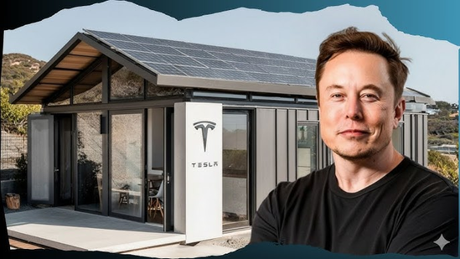
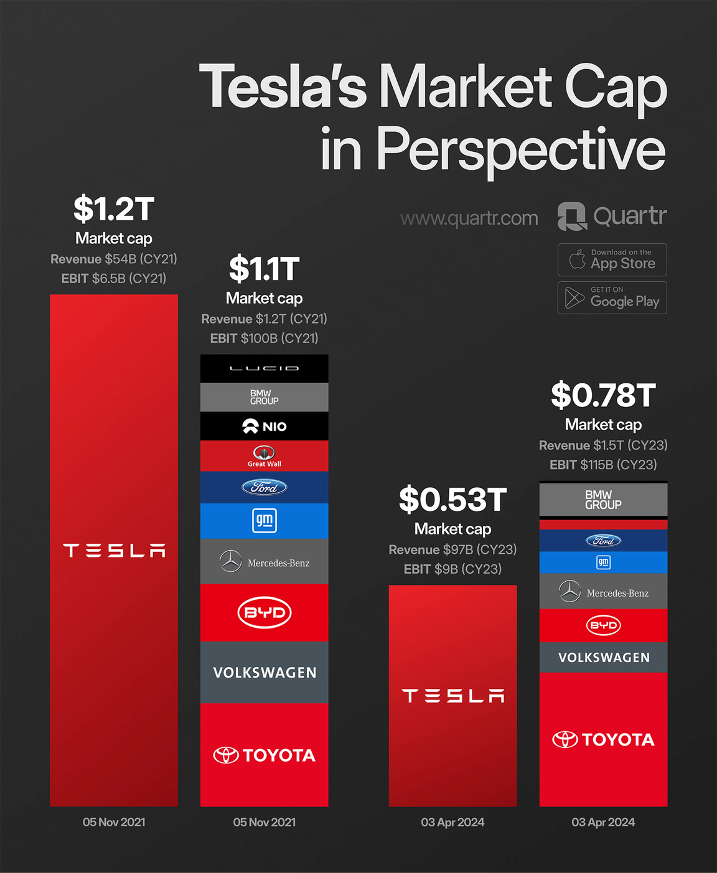
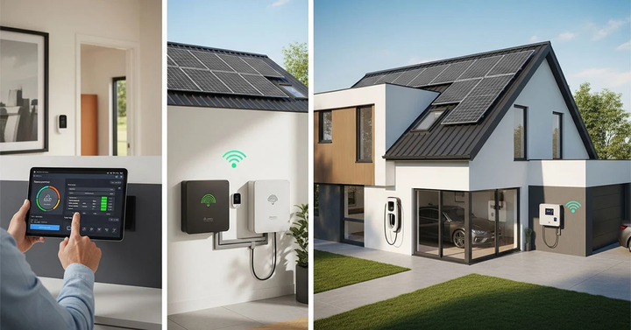
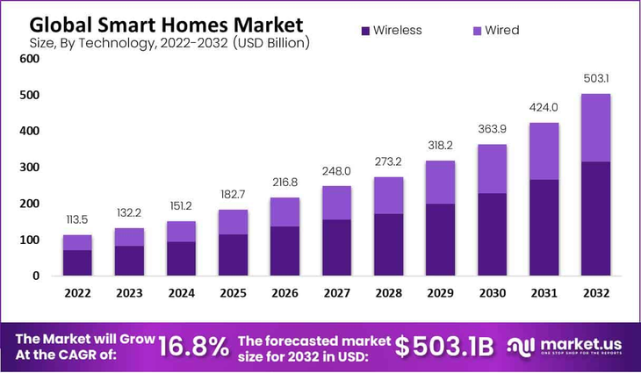
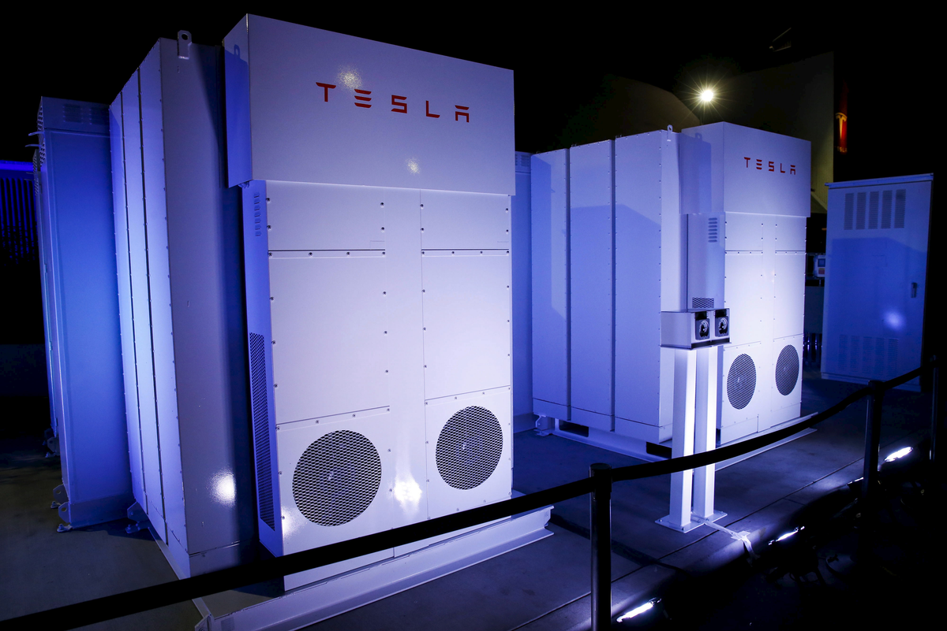
BRAND EXTENSION POSTER
TESLA SMART HOME ECOSYSTEM
01
COMPANY OVERVIEW
TESLA, INC. IS A GLOBAL LEADER IN ELECTRIC VEHICLES, AI, AND RENEWABLE ENERGY (TESLA, 2025)
  Founded: 2003
  CEO: Elon Musk
  Known for: EVs (Model 3, Model Y), Solar Roof, Powerwall
  Revenue: $96+ billion (2023)
02
BRAND EXTENSION IDEA
TESLA SMART HOME ECOSYSTEM – AN INTEGRATED SYSTEM
  Solar energy (Tesla Solar Roof)
  Energy storage (Powerwall)
  AI-powered home assistant
  Smart devices (lighting, security, appliances)
  An intelligent home where all of its constituent parts are integrated and optimized automatically (Tesla Properties, 2025).
03
MARKET APPEAL (TRENDS)
  Growth in smart homes (e.g., Amazon Alexa, Google Nest)
  Rising demand for sustainable living
  Increasing energy costs to need for efficiency
04
SUSTAINABILITY ALIGNMENT
  All energy needs can be supplied through 100% renewable energy sources.
  The organization has achieved a smaller carbon footprint through its current operations.
  Households can achieve energy independence through the use of their home energy systems.
  The Tesla Powerwall system provides homeowners with the ability to store solar energy for their actual energy needs (Tesla, 2025).
05
VALUE PROPOSITION
06
REFERENCES
  The premium product line delivers innovative environmental solutions for sustainable living.
  The technology enables smooth connections between vehicles with residential spaces and energy systems.
  The company builds consumer trust through its established brand reputation while preparing for upcoming business challenges (Aldboush, and Ferdous, 2023).
Aldboush, H.H. and Ferdous, M., 2023. Building trust in fintech: an analysis of ethical and privacy considerations in the intersection of big data, AI, and customer trust. International Journal of Financial Studies, 11(3), p.90. Solar energy (Tesla Solar Roof)
Energy storage (Powerwall)
AI-powered home assistant
Smart devices (lighting, security, appliances)
An intelligent home where all of its constituent parts are integrated and optimized automatically (Tesla Properties, 2025).
Tesla (2025) How Powerwall Works. Available from: Solar energy (Tesla Solar Roof)
Energy storage (Powerwall)
AI-powered home assistant
Smart devices (lighting, security, appliances)
An intelligent home where all of its constituent parts are integrated and optimized automatically (Tesla Properties, 2025).. Accessed on 04.04.2026.
Tesla (2025) Travel Safer, Arrive Refreshed. Available from: Solar energy (Tesla Solar Roof)
Energy storage (Powerwall)
AI-powered home assistant
Smart devices (lighting, security, appliances)
An intelligent home where all of its constituent parts are integrated and optimized automatically (Tesla Properties, 2025).. Accessed on 04.04.2026.
Tesla Properties (2025) The Future of Smart Homes: Integrating AI for Luxury. Available from: Solar energy (Tesla Solar Roof)
Energy storage (Powerwall)
AI-powered home assistant
Smart devices (lighting, security, appliances)
An intelligent home where all of its constituent parts are integrated and optimized automatically (Tesla Properties, 2025).. Accessed on 04.04.2026.

