Slide 1
Reflective – Reflexive Practice
Lecture 3

Slide 2
What is Reflective Practice?
…….. reflecting everyday on your actions and inactions and those of the people around you
Develop these skills further by undertaking activities of more critical reflection; by ‘stepping back’ from events and actions and exploring your personal role or interpretations.
This increases the learning potential of these experiences and allows you to recognize events and actions from multiple perspectives (Hatton & Smith,1995)

Slide 3
What is it & how do you do it?
Reflective practice is a process by which you:
  stop and think about your practice,
  consciously analyze your decision making and
  draw on theory and relate it to what you do in practice.
Critical analysis and evaluation refocuses your thinking on your existing knowledge and helps generate new knowledge and ideas.
As a result, you may modify your actions, behaviour, treatments and learning needs.
Make time to write down your reflections, as this process often helps clarify thoughts.

Slide 4
Reflexive – Reflective
Donald Schon (1983) developed the notions of reflection in action and reflection on action.
Very simply as:
  `reflecting while you're doing it’
  `reflecting after you've done it'

Slide 5
Schon believed that reflection begins in working practice, particularly those areas of practice where professionals are confronted with unique and confusing situations `the swampy lowlands of practice’.
Teachers may have acquired the theoretical knowledge (technical rationality) of their subject or of the practice of teaching and learning, but whilst this might explain their classroom practice as it should be, it might not explain it as it actually is.
From these real-life experiences teachers can develop tacit knowledge : a synthesis of theory and practice which they have developed for themselves.

Slide 6
Here are two ways of looking at it:
(1) Reflection is concerned with thoughtful questions about something you want to understand. We might say it is about using your "mental tools" in order to build your understanding - and so solve some problem or puzzle you are interested in.
In contrast reflexivity is concerned with thoughtful questions about yourself. We might say it is about asking why you see something as a problem or puzzle, and why you and (instinctively) choose particular frames / tools for thinking (and not others - of which you may not yet be aware).
Reflection achieves some learning but learner is the "same person" afterwards.
(2) Reflexivity achieves learning but also leaves the learner changed as a result. So (very crudely!) we could say that
Reflexivity = reflection + self change.
It's important to point out, though, that debate on reflexivity is rich and nuanced, and there are different ways of looking at it (Hibbert, p. 2015)

Slide 7
Bloom and Reflection
Bloom’s taxonomy is a powerful tool to help develop learning objectives, because it explains the process of learning:
Before you can understand a concept, you must remember it.
To apply a concept you must first understand it.
In order to evaluate a process, you must have analyzed it.
To create an accurate conclusion, you must have completed a thorough evaluation.

Slide 8
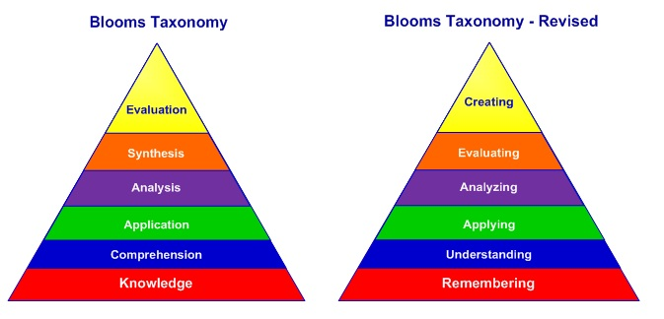
Bloom’s Taxonomy (over time)

Slide 9
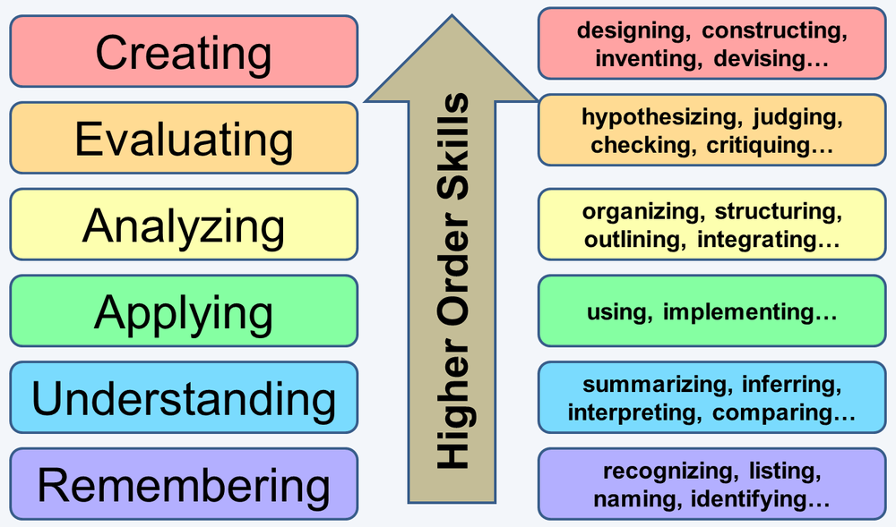
Higher order thinking skills in reflection

Slide 10
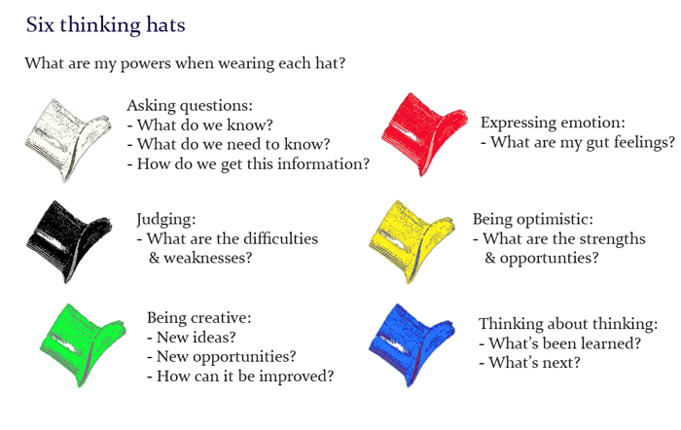
De Bono’s Six Hats
White – Facts / Practicalities
Red – Emotional response
Black – Difficulties & Weaknesses
Yellow – Strengths & Opportunities
Green – Being creative
Blue – Process….thinking about thinking!

Slide 11

De Bono’s Six Thinking Hats

Slide 12
Reflective Practice Exercise
Track backwards through your day
Note down – (4X)
  The facts / practicalities, then go through your day again noting :
  Your emotions – how you felt about ….
  And again, noting – what you would change?
  And again – how do you think about how you are thinking ????
Use the six hats methodology to critically reflect on your day
In pairs – discuss !
Feedback

