Slide 1

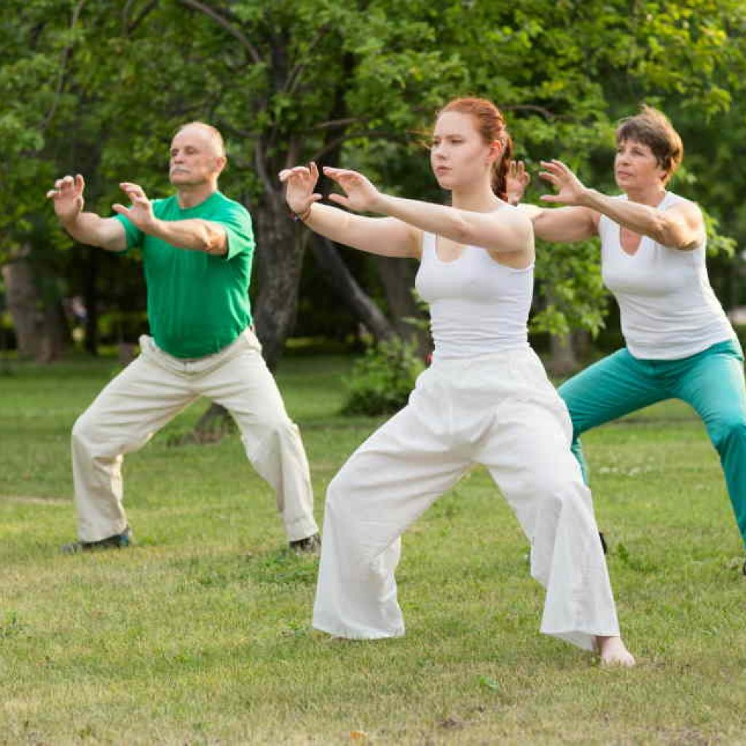

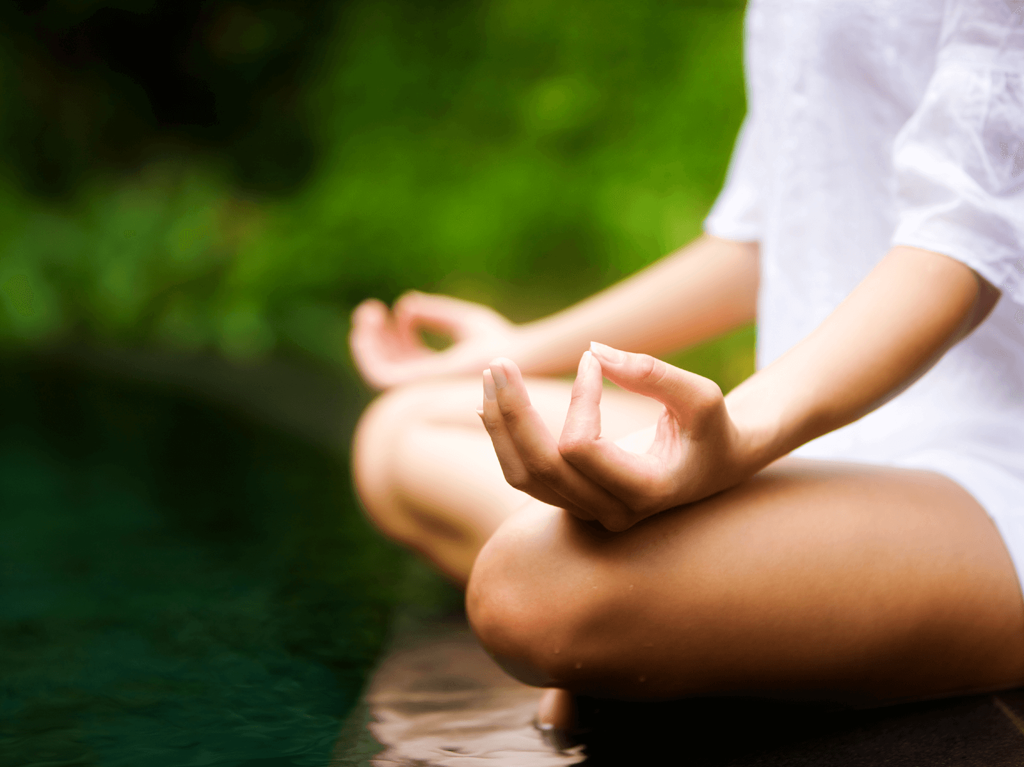
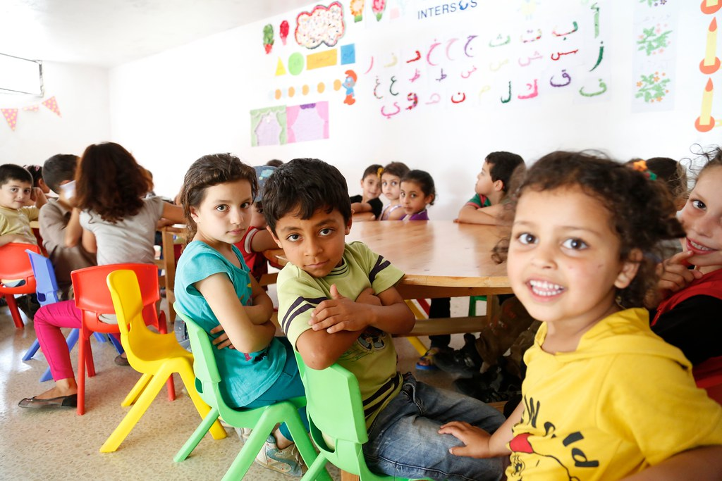
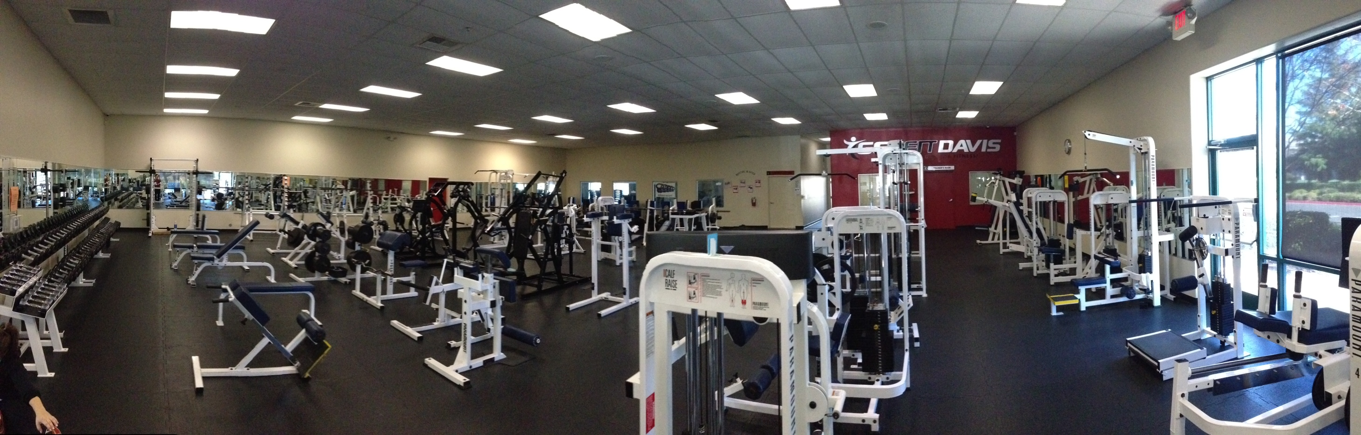
Fitness & well-being
Center this is available to all
This Photo by Unknown Author is licensed under CC BY-SA
Health & Fitness lead to a better you

Slide 2
Fitness for all
Promote and Start After school clubs
Start by Play fitness
Little dragan (Martial Arts) Witch promotes
Play fitness
Self Confidence
Self esteem
Social skills
And self Defence

Slide 3
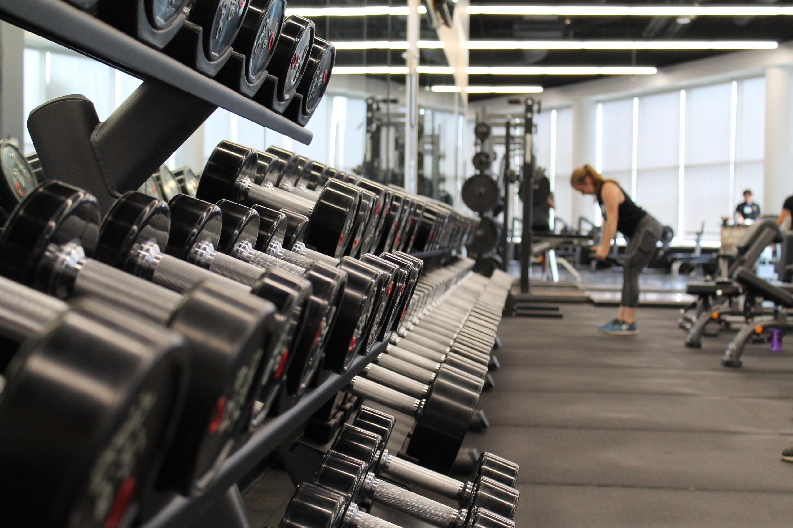
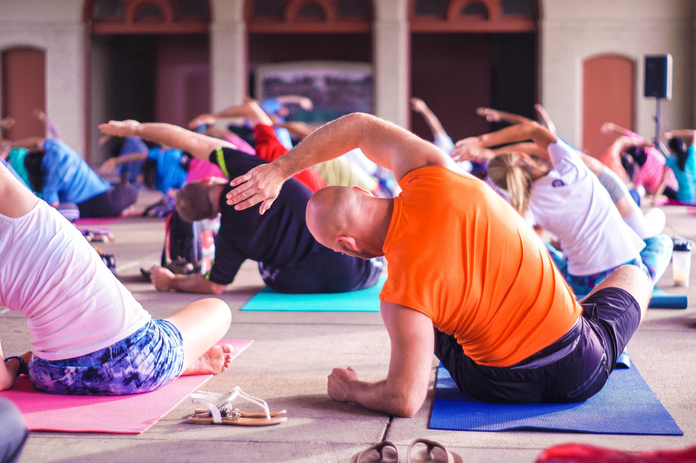
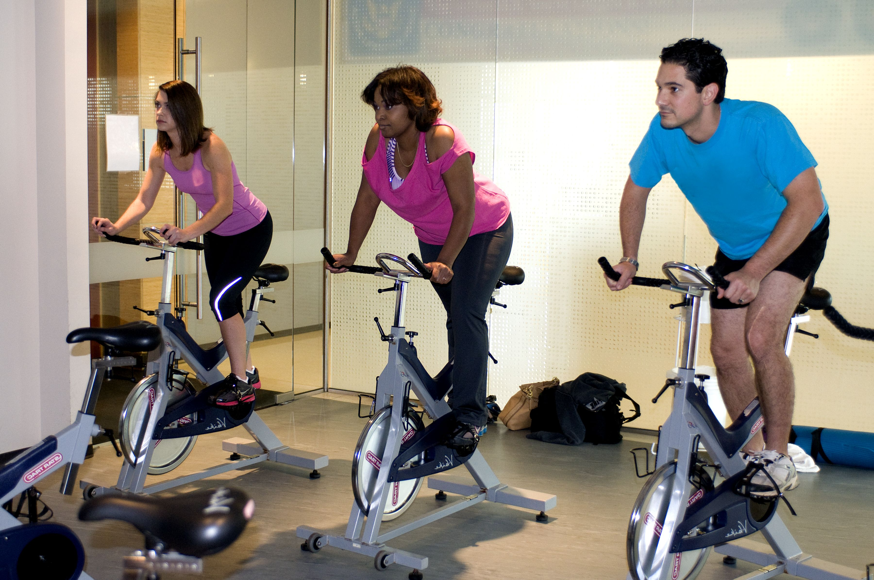
Gym fitness
Healthy eating program
Circuit training
weight training
Martial Arts
Tai-Chi
This Photo by Unknown Author is licensed under CC BY
This Photo by Unknown Author is licensed under CC BY-SA

Slide 4
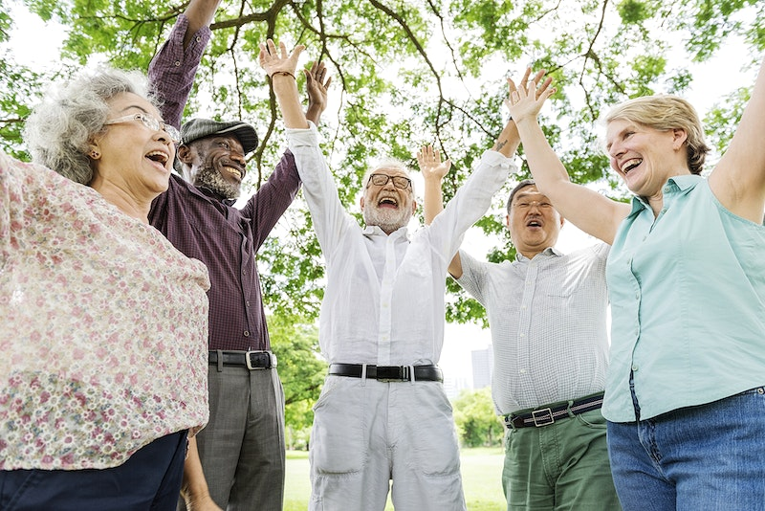
Help to bring well-being and some form fitness like Tai-chi class to the ageing population
Bring a new look at Life
New
Flexibility

Slide 5
Cost, Target marketing, promotion,
Cost per hour
Cost Per activity
Local government grants
Reduce costs for the elderly and young

Slide 6
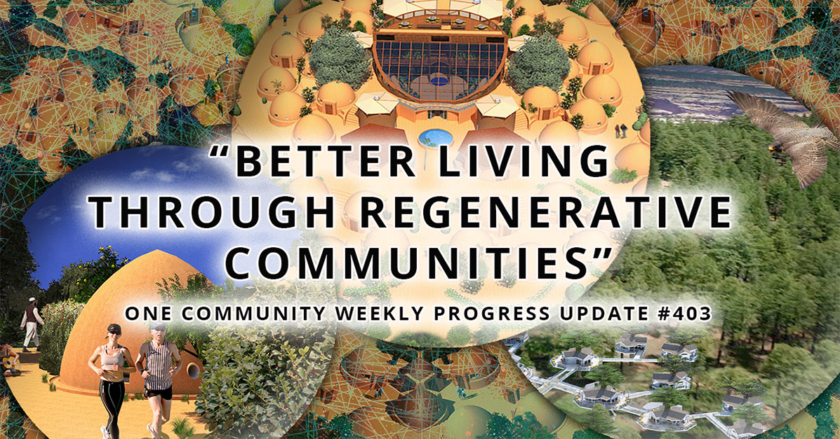
Funding for this program could come from local governing bodies
This Photo by Unknown Author is licensed under CC BY

