Slide 1
How to build a team you’d like to be in
Andrew Price

Slide 2
The territory
Teams – what and why?
How teams learn and avoid learning
Team leadership
Organisational culture and teams
How teams talk; balancing dialogue with discussion
Team norms

Slide 3
When is a team not a team?
When it’s a group
Teams tend to have a number of common features, a group is any collection of people who perceive themselves to be a group
Effective teams can be powerful and creative, but they aren’t the answer to every question and they rarely just happen

Slide 4
What makes an effective (true) team
The myth: it’s all about chemistry. If you’re in a good team it’s a bonus
The reality: great teams are built. Chemistry might help but there are clear principles underpinning great teams
The puzzle: In high performing teams in e.g. sport and armed forces, teamwork is worked at. Why do we think that in business it’ll just happen?

Slide 5
What makes an effective (true) team?
Michael West studied over 400 health care teams in the UK
Ruth Wageman studied 120 senior teams around the world
They, and many others, found that effective teams had similar characteristics

Slide 6
What makes an effective (true) team
Clear, shared, compelling direction. The team must have a challenging task that matters
Clear membership and clear roles. Wageman found that most teams thought the team had clear boundaries but members disagreed about who was on the team
Interdependence. Members need to interact to achieve goals

Slide 7
What makes an effective (true) team
The team’s structure helps rather than hinders. Right size, right people, effective meetings, helpful norms
Supportive organisational context. Team rewards, adequate information
Availability of coaching. Intervening in team processes in order to improve them - by team leader and/or external coach

Slide 8
Benefits of true teams in healthcare (West et al, 2002)
True teams provide higher quality care and produce more innovations
Members of true teams have lower stress levels
Good, regular meetings contribute to innovation and improvement
Clear leadership contributes to effective team processes, quality of patient care and innovation
There was a significant relationship between the percentage of hospital staff in “true” teams and patient mortality

Slide 9
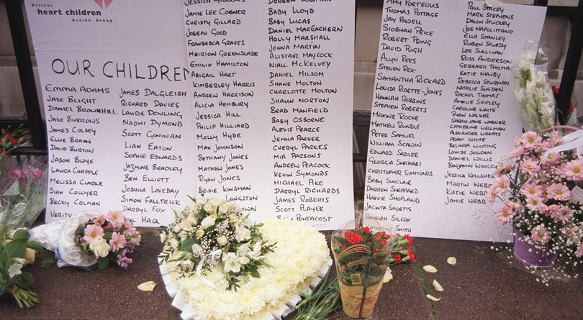
The cost of team failure

Slide 10
Poor teamwork leads to…
Victimisation, humiliation, isolation
Time wasting
Project failure
Two inquiries into paediatric heart surgery (Bristol 2001, Oxford 2010) highlighted poor teamwork as a factor in high child mortality. “Effective teamwork did not always exist at the BRI….The point is that everyone just carried on”

Slide 11
The challenge for team leaders
Don’t just carry on! The willingness to intervene, break patterns, take risks is the critical difference between mere seniority and leadership (Heifetz and Linsky)
Creating the conditions for effectiveness (roles, goals, membership, meetings, coaching etc) will require hard decisions
Focusing on teamwork as well as taskwork

Slide 12
Think about your team – teamleaders’checklist
Purpose | Is team purpose clear, compelling and shared? (n.b. purpose vs activity) What sort of team is it? (e.g. consulting, briefing, decision making, co-ordinating) Is a team the right answer to the question?
People | Is membership bounded, stable and not too big (6-8?) Do you have the right people, bringing the right skills, and are their roles clear? Is leadership clear? – defining direction, bringing hope, encouraging reflection and learning, coaching the team
Processes | Are meetings purposeful and productive? Can the team learn and face up to mistakes? Does the whole team, as well as individual members, get feedback on performance?

Slide 13
Team leadership style
Ambidextrous leadership is best for innovative teams (Zacher and Rosing, 2013. Research with 33 architect teams). Ambidextrous leadership can switch between exploration (opening behaviours) and exploitation (closing behaviours), rather than consistently favouring one or the other.

Slide 14


Slide 15
Defences against learning
Team learning involves behaviour change and may challenge deeply held assumptions. This is hard and many prefer to avoid it. Here’s how to avoid learning!
  The enemy is out there! Blaming is easier than learning (it’s all IT’s/HQ’s/Finance’s fault)
  The illusion of taking charge. Initiate activity without reflection. Do a SWOT! Brainstorm! Call in consultants!
  Intimidate people. Learning often involves admitting mistakes. Intimidated people don’t do this!

Slide 16
…and if you do want to learn!
Encourage error reporting. Better performing teams reported more, not less, mistakes (Edmondson, 1999, research with 51 manufacturing teams)
Encourage “team psychological safety” (no-one will punish me for speaking up) which is different to “team cohesiveness” which can inhibit disagreement and challenge
Wooley et al (2010) Found that social sensitivity and turn taking was a better predictor of team performance than average IQ. Smart people can make poor teams, averagely intelligent people can make good teams.

Slide 17
…and if you do want to learn
Model a learning approach. Admit your own fallibility. Listen carefully to other’s contributions
Familiarise the team with tools and processes to encourage reflection (e.g. fishbone diagram, action learning)
Reward transparency and avoid blame

Slide 18
Learning conversations
We use dialogue and discussion interchangeably but they are different (Senge, 1990)
  Dialogue (Greek; dia-logos, through word)
  Discussion (Latin; discutere, strike asunder, break up)
Reflecting ambidextrous leadership, one is about opening a subject up, the other is about closing it down
Effective teams can do both, switching between them as required

Slide 19
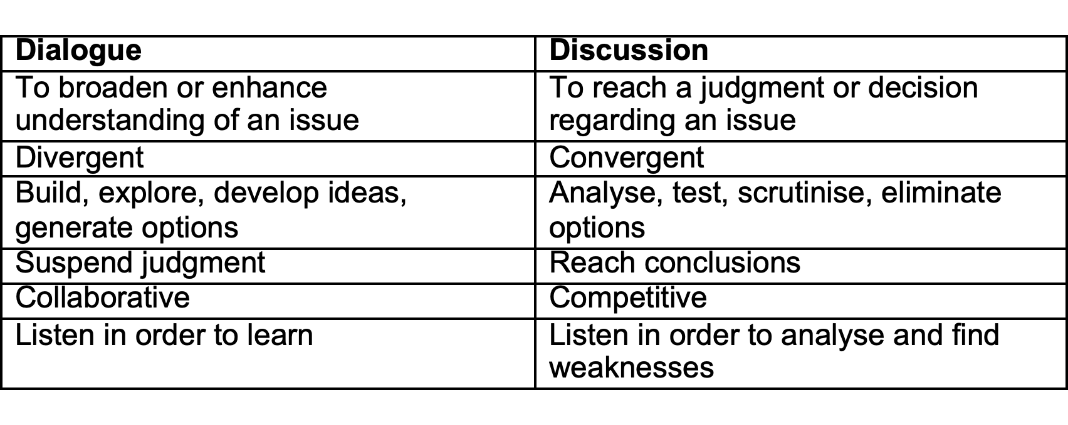
The two modes cannot be combined. The hard-headed analysis needed for discussion would inhibit the exploratory, speculative conversation needed for dialogue
Most teams seem to function mainly in discussion mode. This will limit learning and innovation
Dialogue requires practice and discipline. There must be a conscious (albeit temporary) suspension of judgment

Slide 20
Team norms
All teams will have norms (shared expectations about behaviour). They are powerful. The question is are they helpful? e.g. If late arrivals go unchallenged, late starts might become the norm
Performance can be improved by establishing agreed norms - and sticking to them rigorously. They must define what is wanted – and not wanted – from the team

Slide 21
Extracts from Applebee’s team norms
  These took two days to agree, described by the CEO as “the two most painful days of my life”
  Build trust. Honesty and integrity, being loyal to and defending others – even when they aren’t present – honouring commitments, no matter how small, keeping no secrets, respecting other’s interests and questions about your area (no protecting of one’s turf)
  Be decisive. Taking measured risks, being innovative, admitting mistakes
  Hold great meetings. Meetings should be well planned (with an agenda), start and end on time, and involve all attendees. Only one person should speak at a time. No sidebar conversations. Next steps and accountabilities should be summarised at the meeting’s close
  Have fun. Life is short

Slide 22
Teams and organisational culture
Using Handy’s “Gods of Management” model
Zeus (all powerful boss) cultures are individualistic, command and control oriented and competitive. Collaboration may be difficult.
Apollo (bureaucratic) cultures respect position more than skills. Team membership depends on place in the hierarchy. Avoiding blame can be more important than success.
Athena (task or matrix) cultures respect skills more than hierarchy. Team is the way they do business.
Dionysus (Existential) cultures will resist corporacy or team accountability. An individualistic culture which struggles to pull together except when all are under threat

Slide 23
Conclusion
Teams can be much more than the sum of their parts, but only if you are prepared to work at it and face difficult conversations
They require regular maintenance. What was clear and agreed last year may be fuzzy or forgotten this year
Effective teams don’t just happen. They need leaders prepared to intervene and to model the behaviours they want to see

