Slide 1
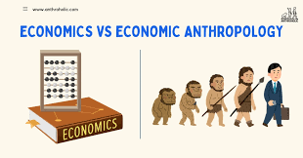

Anthropology Today (HPAN4015)
Week 1 Class 3:
Anthropologies of Economic Activity
Dr Ryan Joseph O’Byrne

Slide 2

PART 1 —
ECONOMIC UNIVERSALISM AND MARX

Slide 3
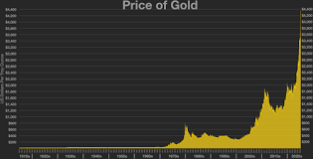
1.1.1 Destabilising “The Economy”
‘The economy’ as singular, measurable, separate domain
Common associations: markets, money, trade, jobs, growth
Capitalism often folded into ‘the economy’, but not identical
Term carries authority in policy, media, and governance
Anthropology asks how this domain is made to appear distinct

Slide 4
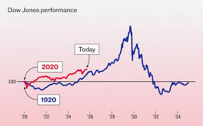
1.1.2 Destabilising “The Economy”
Modern economy rests on specific model of person and order
Rational individuals, scarcity, choice, cost-benefit calculation
Self-interest and utility maximisation treated as basic
Markets framed as neutral allocators of scarce resources
Anthropology treats this as historical claim, not human universal

Slide 5

1.1.3 Destabilising “The Economy”
Economic action intelligible only within wider social relations
Kinship, morality, law, religion, politics, gender, class, history
Loans, gifts, saving, hiring, inheritance, spending: socially saturated
Obligation, shame, status, care, hierarchy, aspiration, power
Economic life as social and moral domain, not neutral system

Slide 6
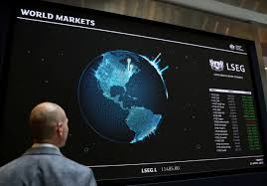
1.1.3 Destabilising “The Economy”
Anthropology rejects economic universalism and flattening logics
Polanyi (1944): economy ‘embedded’ in institutions and social relations
Value exceeds price, preference, and exchange
Memory, labour, status, morality, ancestry, insult, political influence
Multiple regimes of value coexist without collapsing into price

Slide 7
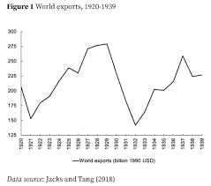
1.1.5 Destabilising “The Economy”
Exchange creates, confirms, strains, or destroys relations
Gift, wage, refusal, lending, repayment: morally charged acts
Scarcity socially mediated: necessity, excess, shame, desirability
Economy as field of struggle over need, value, and responsibility
Marx: capitalism as social relation made to look natural

Slide 8
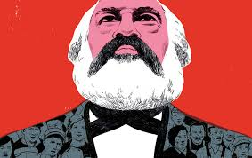
1.2.1 Marx: Labour, Value, and Capital
Wolf: social science as dialogue with Marx (1982, p. 19)
Marx central to analysing capitalism as historical system
19th Cent industrial capitalism: factories, wage labour, urbanisation
Productivity and inequality expanding together (Marx, 1867; Eriksen, 2015)
Core problem: why exploitation and inequality appear normal

Slide 9
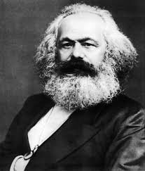
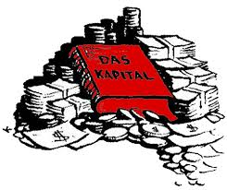
1.2.2 Marx: Labour, Value, and Capital
Marx begins from social relations, not individual choice
Means of production: tools, machinery, land, buildings, materials
Non-owners must sell capacity to work in order to live
Labour power: human capacity to produce, think, make, serve
Labour power becomes commodity under capitalism (Marx, 1867)

Slide 10
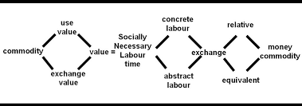
1.2.3 Marx: Labour, Value, and Capital
Wage labour: formal freedom combined with material compulsion
Contract appears equal; underlying conditions structurally unequal
Labour theory of value: labour as source of value
Prices fluctuate, but value rooted in labour-time structure
Socially necessary labour time under normal production conditions (Marx, 1867)

Slide 11
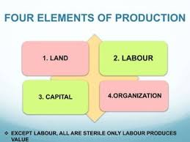
1.2.4 Marx: Labour, Value, and Capital
Socially necessary labour time: socially average labour under usual conditions
Value tied to social production, not individual inefficiency
Profit problem: how capital gains beyond wages paid
Surplus value: value produced beyond value of wage
Surplus appropriated as profit, rent, interest, reinvestment (Marx, 1867)

Slide 12
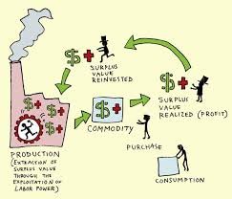
1.2.5 Marx: Labour, Value, and Capital
Wage covers reproduction of labour power, not total value produced
Necessary labour versus surplus labour within working day
Exploitation built into wage relation, not external abuse
Class as position in production, not lifestyle or taste
Capitalism normalises continuous surplus extraction from labour

Slide 13
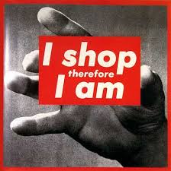
1.2.6 Marx: Labour, Value, and Capital
Commodity fetishism: social relations appear as relations between things
‘Fetishism’ here means misrecognition, not everyday obsession
Commodities seem to carry value naturally within themselves
Labour, extraction, transport, conflict disappear from view
Value appears intrinsic to objects, not social production (Marx, 1867)

Slide 14
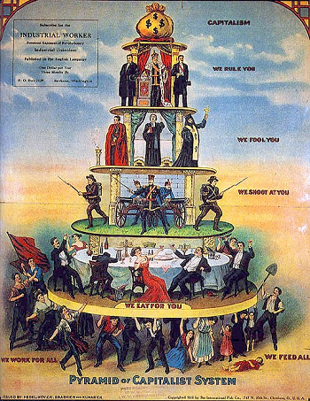
1.2.7 Marx: Labour, Value, and Capital
Capitalism makes labour and inequality systematically invisible
Exploitation appears as price, efficiency, or consumer choice
Marx useful for analysing capitalist mystification
Alienation: structural estrangement under capitalist labour
Four dimensions: product, process, others, species-being (Marx, 1844/1975)

Slide 15
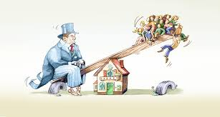
1.2.8 Marx: Labour, Value, and Capital
Alienation: structural separation, not merely low morale
Work controlled by others and directed to profit
Abstract labour: diverse work reduced to measurable exchange units
Time, wages, metrics, and accounting render labour comparable
Human capacities reorganised as calculable inputs

Slide 16
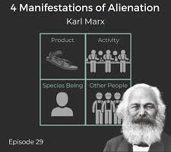
1.2.9 Marx: Labour, Value, and Capital
Commodification extends beyond factory into time and life
Attention, housing, education, rest drawn into valuation circuits
Capitalism as social order of power, dependence, inequality
Marx’s three questions: value, concealed relations, damaged life
Still central where labour is hidden and inequality naturalised

Slide 17
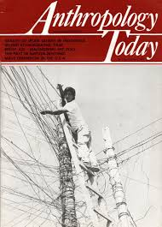
1.3.1 AT Connections 1
Contemporary ethnography reanimates Marx beyond factory settings
Core questions persist: where labour is, how value is produced
Central issue: what disappears for value to seem natural
Mbeubeuss: waste re-enters value circuits through labour
Rimoldi: labour creates value without social visibility or dignity

Slide 18
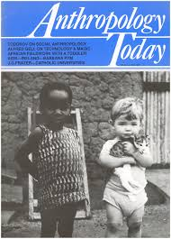
1.3.2 AT Connections 1
Tesema (2024): labour hidden through discipline, productivity, competitiveness
Exploitation appears as efficiency, job creation, workplace hierarchy
Saleh (2024): scrap value shaped by coercion, patronage, war, displacement
Exchange inseparable from violence, informality, unequal power
Precarity systemic: obscured labour, displaced value, normalised insecurity

Slide 19

PART 2 —
MAUSS,
SAHLINS, AND EXCHANGE

Slide 20
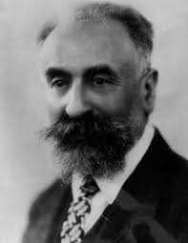
2.1.1 Mauss and the Gift
Mauss central to anthropology’s rethinking of economic life
Marx: production, labour, exploitation; Mauss: exchange, obligation, giving
Focus shifts from market circulation to relation-making
Giving, receiving, returning make persons, groups, relations
Value through reciprocity and obligation (Mauss, 1925; Eriksen, 2015)

Slide 21

2.1.2 Mauss and the Gift
Gift not narrow everyday present-giving
Gifts open relations; commodities close them
Commodity exchange ideally settles and completes relation
Gift exchange opens, confirms, deepens, complicates relation
Gifts ‘never free’: obligation carried beyond the object itself

Slide 22

2.1.3 Mauss and the Gift
Three obligations: give, receive, reciprocate (Mauss, 1925)
Obligation to give: generosity not simply optional
Giving establishes standing, honour, capacity, inclusion
Failure to give may signal indifference, hostility, weakness, exclusion
Giving makes social persons publicly visible

Slide 23

2.1.4 Mauss and the Gift
Obligation to receive: refusal blocks the gift’s social work
Refusal may signal insult, distrust, or relational withdrawal
Acceptance means entering relation, even uneasily
Obligation to reciprocate keeps relation active over time
Return may be material, ceremonial, political, emotional, practical

Slide 24

2.1.5 Mauss and the Gift
Gift as ‘total social fact’ (Mauss, 1925)
Economic, moral, legal, political, religious dimensions at once
Gift exchange also carries ritual, rank, law, kinship, memory, power
‘Total’ because it crosses modern boundaries between social spheres
Exchange reveals the social whole; economy not detached

Slide 25

2.1.6 Mauss and the Gift
Gift exchange can produce alliance across families, clans, political groups
Marriage, ceremony, hospitality, feasting create durable ties
Exchange can also generate prestige through public giving
Wealth converted into honour, recognition, fame, standing
Reciprocity can also produce hierarchy, debt, subordination

Slide 26

2.1.7 Mauss and the Gift
Competitive generosity: conspicuous giving and wealth destruction
Point is status, rivalry, compelled recognition, not charity
Magnificent giving demonstrates power; failed return exposes inferiority
Debt can be moral and political, not only financial
Inability to reciprocate may harden into dependency

Slide 27

2.1.8 Mauss and the Gift
Parallel with Marx: economic forms organise social relations
Marx: labour, property, surplus extraction; Mauss: obligation, reciprocity, debt
In both, economic forms produce status, dependency, inequality
Mauss shapes later work on reciprocity, redistribution, care, debt
Objects carry relations; transfers carry judgment, memory, force

Slide 28


2.1.9 Mauss and the Gift
Critique 1: romanticisation of non-market reciprocity
Critique 2: ‘reciprocity’ can mask deep asymmetry and inequality
Critique 3: Mauss can understate coercion behind obligation
Obligation may be backed by shame, law, violence, exclusion
Exchange makes social worlds through solidarity, debt, prestige, domination (Mauss, 1925; Eriksen, 2015)

Slide 29

2.2.1 Sahlins: The Original Affluent Society
Sahlins (1972) questions scarcity as universal human condition
Targets assumption: wants unlimited, means always insufficient
Economic life not naturally grounded in lack
‘Original affluent society’ redefines affluence against accumulation
Scarcity as relation between means and ends

Slide 30
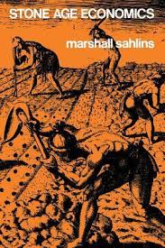
2.2.2 Sahlins: The Original Affluent Society
Scarcity depends on what counts as necessary, sufficient, excessive
Low accumulation does not automatically mean misery
Sahlins rejects foragers as poorest of the poor
Older image: starvation, ceaseless labour, technical inadequacy
Ethnography suggests needs often met with modest labour

Slide 31

2.2.3 Sahlins: The Original Affluent Society
Some foragers ‘affluent’ through different desire-work relation
‘Zen road to affluence’: limited means, limited ends
‘Economic man’ is a bourgeois construction, not natural
Modern acquisitive subject is historically specific
Sahlins provincialises modern assumptions about human need

Slide 32
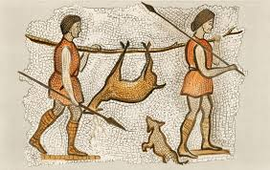
2.2.4 Sahlins: The Original Affluent Society
Sahlins disrupts evolutionary sequence from deprivation to abundance
More production does not necessarily yield more satisfaction
More goods do not necessarily reduce anxiety
Market-industrial societies institutionalise scarcity
Wealthy societies may remain haunted by lack and dissatisfactio

Slide 33

2.2.5 Sahlins: The Original Affluent Society
Core issue not exact labour hours, but social definition of needs
Desire is culturally shaped, not naturally unlimited
Solway (2009): debate concerns whether unlimited ends are universal
Barnard & Woodburn (1988) refine claim through immediate-return systems
Sharing may matter more than accumulation or storage

Slide 34
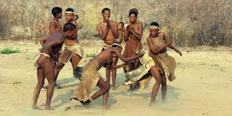
2.2.6 Sahlins: The Original Affluent Society
Foragers may desire more, but desire organised differently
Wants not necessarily met through labour expansion
Production targets may remain relatively low
Sharing can manage desire better than endless production
Desire shaped by institutions, expectations, compulsions

Slide 35

2.2.7 Sahlins: The Original Affluent Society
Critiques: romanticisation, labour undercounting, colonial distortion (Solway 2009)
Contemporary foragers not windows onto untouched human past
Critiques refine rather than cancel Sahlins’s argument
Scarcity, affluence, need, and enough are culturally organised
With Mauss: value, obligation, desire, well-being are social facts

Slide 36
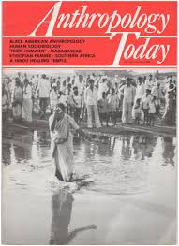
2.3 AT Connections 2
Need is judged through dependence, dignity, and expected return
Poverty, assistance, and debt are moral fields, not just matters of distribution
Wig (2024): begging becomes more acceptable when recast as exchange
Remittances, welfare, and debt all carry duty, scrutiny, and claims on future conduct
Carabini and Malala (2025): even “frictionless” payment remains organised through trust, judgement, unequal conditions

Slide 37
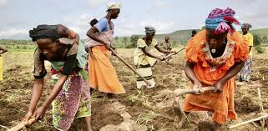
PART 3 —
CONTEMPORARY ANTHROPOLOGIES AND MORAL ECONOMIES

Slide 38
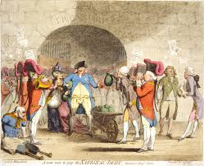
3.1.1 Financialisation, Debt, and Precarity
Shift from production/exchange to finance, debt, speculation
Value pursued through credit, assets, platforms, data, logistics
Production still matters, but finance reorganises economic life
Financial logics penetrate everyday life beyond factories
Hart and Ortiz: money/finance create distinct social worlds (Hart and Ortiz, 2014)

Slide 39
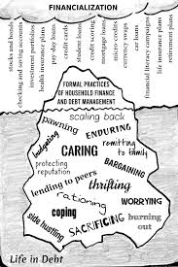
3.1.2 Financialisation, Debt, and Precarity
Financialisation extends profit through debt, fees, securitisation, uncertainty
Speculative value tied to expectations about the future
Future earnings, repayment capacity, risk profiles valued in the present
Graeber: debt as claim on the future and moral relation (Graeber, 2011)
Finance presented as technical, but reorganises life directly

Slide 40

3.1.3 Financialisation, Debt, and Precarity
Debt reshapes time through loans, rent, subscriptions, app-based credit
Tomorrow’s income made available today, but at a cost
Debt reorganises present need and future possibility
Debtor subject formed as self-monitoring, calculative, morally judged
Graeber: debt carries moral weight, not just numerical value (Graeber, 2011)

Slide 41
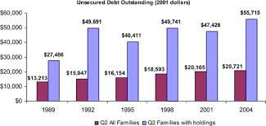
3.1.4 Financialisation, Debt, and Precarity
Platform labour sold as flexibility, autonomy, entrepreneurship
Risk shifted downward; protections weakened; availability made continuous
Ratings, algorithms, opaque systems replace stable supervision
Tesema (2024): labour control normalised through development/competitiveness
Global supply chains redistribute and conceal exploitation

Slide 42
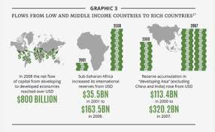
3.1.5 Financialisation, Debt, and Precarity
Welfare systems sort deserving from undeserving
Support tied to moral judgments about dependency, care, work, need
Deservingness functions as economic governance, not neutral administration
Carabini & Malala (2025): payment as ‘affective commodity’
Payment shaped by platforms, infrastructures, trust, convenience, capture

Slide 43

3.1.6 Financialisation, Debt, and Precarity
Contemporary economies shape temporality, aspiration, subjectivity
Life organised through instalments, debt servicing, short-term contracts
Success tied to creditworthiness and entrepreneurial self-investment
Debt, platforms, welfare, finance organise insecurity and judgment
Subjects made flexible, credible, self-managing, permanently accountable

Slide 44
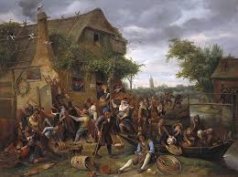
3.2.1 Moral Economies
Markets never treated as self-justifying
Prices, wages, rent, debt, welfare judged in moral terms
Economic life as field of judgement, not calculation alone
Moral economy: norms used to measure and dispute economy
Fairness, reciprocity, obligation, need organise evaluation

Slide 45

3.2.2 Moral Economies
Thompson (1971): food riots as protest against unjust market behaviour
Hoarding, profiteering, lost subsistence protections as moral violations
Price judged against wider conditions of social life
Affordable’, ‘deserving’, ‘hard-working families’ as moral claims
Economic labels classify legitimacy, excess, and need

Slide 46
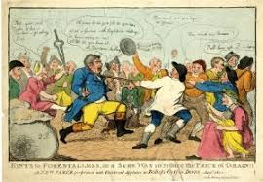
3.2.3 Moral Economies
Reciprocity as ranking and policing, not only solidarity
Return expected through wages, welfare, remittances, care, debt
Honour, duty, responsibility, failure embedded in exchange
Subsistence claims mark needs that cannot be left to markets
Scott (1976): protest sharpens when survival conditions become intolerable

Slide 47

3.2.4 Moral Economies
Present struggles over rent, energy, food, benefits, lending, wages
Claims concern what cannot justly be taken away
Sahlins in background: need socially defined and contestable
Moral protest begins when inequality stops looking necessary
Structural exploitation becomes politically legible

Slide 48

3.2.5 Moral Economies
Mauss: obligation persists and proliferates under capitalism
Resources move under unequal terms of return and indebtedness
Reciprocity may soften hardship or conceal domination
Protest begins when arrangements lose legitimacy
Strikes, riots, organising reveal economy as site of justice struggle

Slide 49
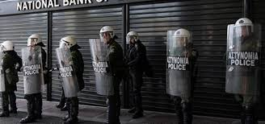
3.2.6 Moral Economies
Anthropology studies these struggles in everyday life
Fairness learned through labour, sacrifice, dependence, expectation
Legitimacy emerges from lived histories, not abstract values
Economic systems survive when made to appear fair or tolerable
Wages, debt, welfare, rent, livelihood remain morally contested

Slide 50
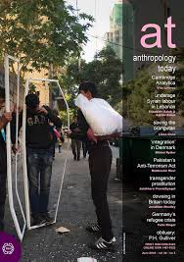
3.3.1 AT Connections 3
Financialisation shifts value extraction toward payment and circulation
Payment now generates value in its own right (Carabini and Malala, 2025)
Payment systems sort people by credit, risk, penalty, and exclusion
Value rises upward; insecurity is pushed downward (Rimoldi, 2025; Saleh, 2024; Tesema, 2024)
Debt, labour, welfare, and waste are tied to kinship, migration, race, state, and environment

Slide 51

3.4 Conceptual Consolidation
Economic life is social, moral, and political, not a separate neutral sphere
Marx: labour produces value, while capitalism normalises exploitation and inequality
Mauss: exchange creates obligation, debt, prestige, and dependence
Sahlins: scarcity, need, and affluence are socially defined, not naturally given
Contemporary economies organise debt, precarity, judgement, and unequal security

