Slide 1

Green haven florists challenges & solutions
Vasile Daniel Remus Stanica
2424143
Problem Solving & Decision Making; LCLM4004
Lecturer: Chijioke Uba

Slide 2

Introduction & Structure
This presentation will focus on the challenges faced by Green Haven Florists and some solutions
Will explore the nature and scope of the issues
Will apply various models and frameworks to evaluate the challenges and find solutions, including:
5W2H framework
PESTEL framework
Cause-and-Effect framework
Fishbone Diagram
Key Findings

Slide 3

Green Haven Florists - Overview
Small & independent flower shop, located in Norwich, founded in 2016
Gained a nice reputation for its bespoke floral arrangements, strong community ties & eco-friendly packaging
Was also known for its personal touch and sustainable ethos
Accommodates a broad range of customers – walk-ins, corporate, weddings and other occasions
Strong focus in in-store sales

Slide 4
Green Haven Florists Challenges – Insights
Significant downturn in foot traffic, approx. 30%
Rising operational costs, including the price of fresh flowers and imported ones
Supply chain and inflation
Increased competition, especially online flower delivery services and strong social media presence
Shop’s location faces reduced activity due to closure of nearby businesses and overall shift towards online retailers
Customers prefer lower prices and offers of large online flower shops
Higher costs to stay sustainable, including biodegradable wrapping
Customers notice the business; outdated website and had to navigate
Lack of delivery options, subscriptions, discounts, packages
Lack of social media presence, digital marketing and over-reliance on word-of-mouth type of advertising (Pec, 2022.)

Slide 5
5W2H Model
WHAT? | WHO? | WHEN? | WHY? | WHERE? | HOW? | HOW MUCH?
The business faces a downturn in revenue and foot traffic by 30%. | The business, including the owners are directly impacted. | Over the last 12-month significant changes occurred. | Failure to adapt to the new technology, including digitalization and online facilities/sales. In plus, another factor is the competition. | Business location is in Norwich; however, using online facilities the business can deliver its flowers all over the world. | With correct understanding of the problem and a correct approach, such as understanding the power of digitalization and online preferences of the customers, the issues can be solved, and the business can continue to thrive. | A good investment is to be done for the marketing matters of the business, including an easy to navigate and user-friendly website, as well as better delivery options (Mull, 2022.)

Slide 6
PESTEL Framework – Critique
The PESTEL framework stands for –
  Political factors
  Economic factors
  Social factors
  Technological factors
  Environmental factors
  Legal factors
This framework is used to analyze the external factors that may have a direct or indirect impact on the business (Oxford College Marketing, 2026.)
This can help the business to better understand the challenges, the threats and also ways how to avoid issues
Some may critique this analysis as being time-consuming and objective, however, the benefits stronger than the disadvantages. This is because it offers direct insights to the most common factors known to impact a business.

Slide 7
PESTEL Analysis – Applied
Political factors: this is a major concern, especially due to the rising costs of imported flowers, including higher taxes and fees to operate (Boyles, 2022.)
Economic factors: increased inflation results in higher production costs. Thus, in order to maintain profitability, the final product price is increased, fact which may not be appealing for clients.
Social factors: the clients are the core of the business and should be listened to, especially when they ask for an updated website and different promotional offers for the products.
Technological factors: this is the key solution for the business and also the major concern. The business should focus on strengthening its online presence through Instagram, Facebook, TikTok and update the website, as well as to make it more user-friendly and easier to navigate (National Business Association, 2026.)
Environmental factors: the business should continue to be sustainable and offer biodegradable packaging, as well as reducing waste.
Legal factors: complying with the law is a major factors as failure to do so may result in lawsuits or even closure of the premises.

Slide 8

Cause-and-Effect – Critique
This is a popular brainstorming framework which is easy to use
It helps the business to clearly map all of the issues and get to the bottom of the problem
Helps to organize ideas and can serve as basis for further analysis
However, the critiques suggest that it is overly-simplistic and only provides a linear view, with no help to finding the problem and a solution, due to a ‘superficial’ approach to the issues (Mindtools, 2024.)

Slide 9
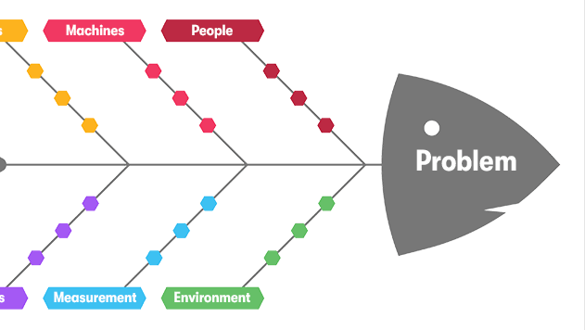
Fishbone Diagram – Applied
The head of the diagram is the problem.
In this case, the problem is the business loss of 30% in foot traffic, as well as reduced foot traffic.
However, to have come to this issue, there have been some actions, presented in the diagrams as the fish bones, including:
Reduced activity due to shift to online flower retailers – resulting in decline in the in-store sales
Rising costs: supply chain, import, operational costs
Sustainability costs
Shop’s website is not updated, and it is difficult to navigate – resulting in customers finding it difficult to use, therefore choosing other retailers
No flexible delivery options nor subscription services – customers shift towards online retailers
No usage of digital marketing trends – lack of advertising
Competitors in the market that use social media and aggressive pricing – customers choosing them over the business due to better offers

Slide 10
Key Findings
Several factors contributed to the loss of foot traffic and in-store sales, including:
Rising operational costs
Lack of digital media advertising, including social media posts
Lack of user-friendly website
Lack of delivery options & subscriptions
Competitors & new market entrants
General shift to online shopping in the area
However, it is important to note that all this can be resolved with a correct approach

Slide 11
Reference List
Boyles, M., (2022), ‘’Understanding how politics can affect your business’’, [online] available on: https://online.hbs.edu/blog/post/politics-and-business, last accessed on 10 March 2026.
Mindtools, (2024), ‘Cause and Effect Analysis’’, [online] available on: https://www.mindtools.com/a25caig/cause-and-effect-analysis/ , last accessed on 10 March 2026.
Mull, J., (2022), ‘’7 reasons to invest in your website and digital marketing’’, [online] available on: https://www.forbes.com/councils/forbesbusinessdevelopmentcouncil/2022/06/21/7-reasons-to-invest-in-your-website-and-digital-marketing-strategy/, last accessed on 10 March 2026.
National Business Association, (2026), ‘’22 benefits of social media for business’’, [online] available on: https://nationalbusiness.org/22-benefits-of-social-media-for-business/, last accessed on 10 March 2026.
Oxford College Marketing, (2026), ‘’What is a PESTEL analysis?’’, [online] available on: https://blog.oxfordcollegeofmarketing.com/2016/06/30/pestel-analysis/, last accessed on 10 March 2026.
Pec, T., (2022), ‘’Why businesses and brands need to be taking advantage of social media’’, [online] available on: https://www.forbes.com/councils/forbesagencycouncil/2022/09/06/why-businesses-and-brands-need-to-be-taking-advantage-of-social-media/, last accessed on 10 March 2026.

