Slide 1


Slide 2
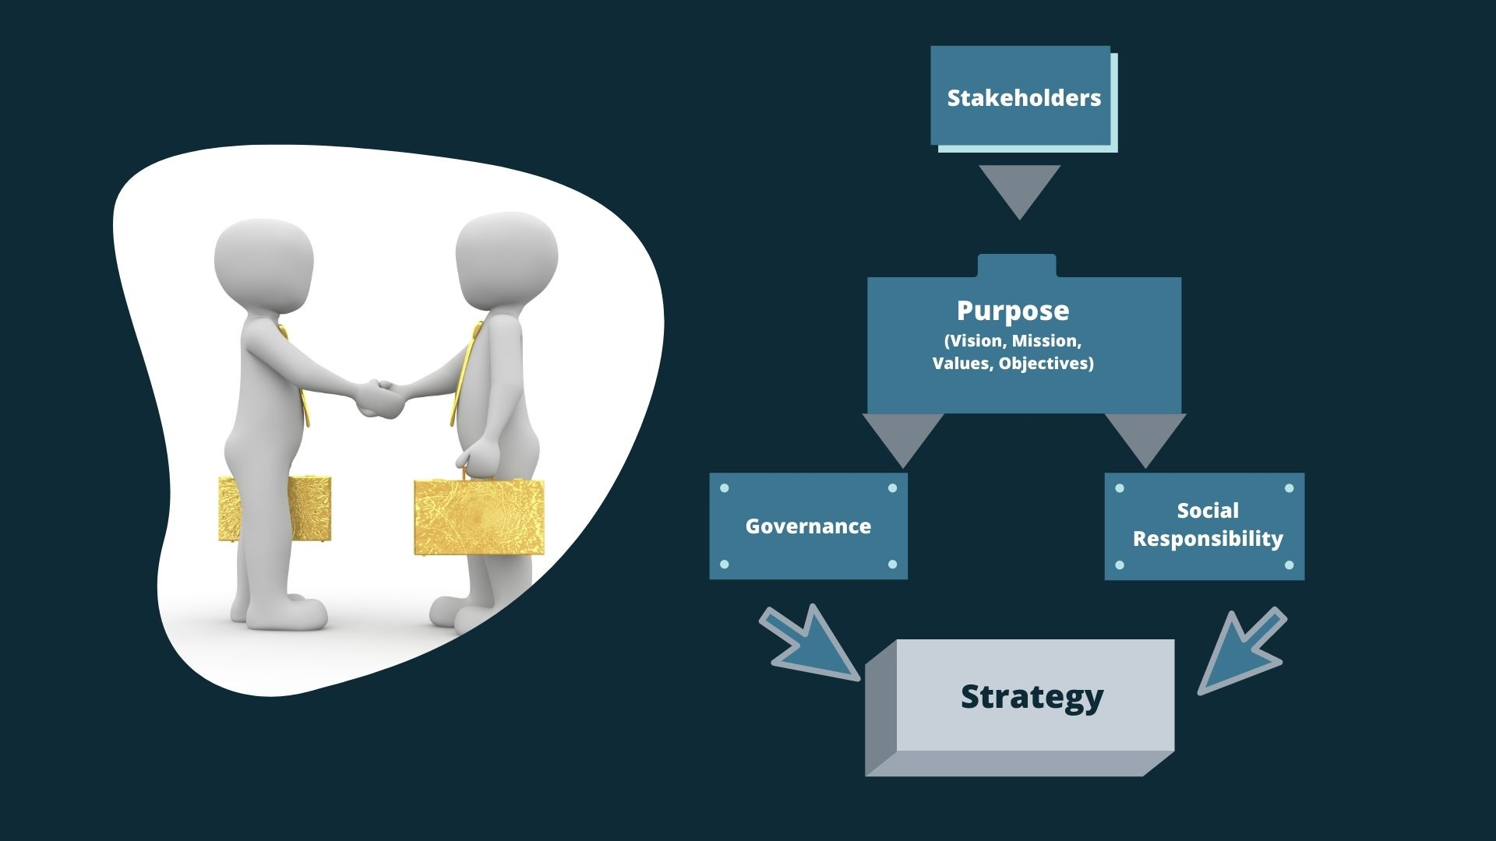
Notes:
This diagram depicts the flow: strategy originates from stakeholders, whose wishes are processed
through governance and social responsibility screens before finally being put into action.
Strategic decisions are influenced by the expectations of stakeholders. Stakeholders are those who have some kind of stake in the future of the business. More formally, stakeholders are those individuals or groups that depend on an organisation to fulfil their own goals and on whom, in turn, the organisation depends.

Slide 3
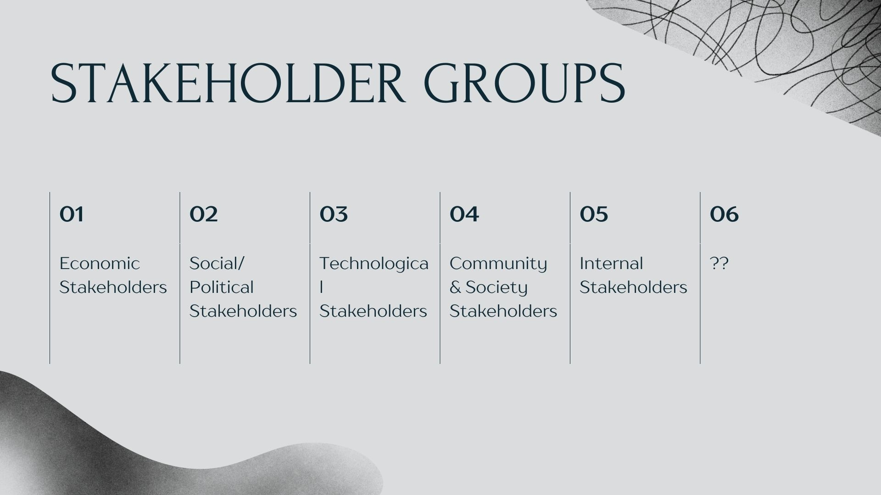
Notes:
Freeman identified five stakeholder groups: -
• Economic stakeholders, including suppliers, customers, distributors, banks and owners (shareholders).
• Social/political stakeholders, such as policy-makers, local councils, regulators and government agencies that may influence the strategy directly or via the context in which strategy is developed.
• Technological stakeholders, such as key adopters, standards agencies and ecosystem members supplying complementary products or services (e.g. applications for particular
mobile phones).
• Community and society stakeholders, who are affected by what an organisation does: for
example, those who live close to a factory or, indeed, groups in the wider society. These stakeholders typically lack the formal powers of social/political stakeholders such as local councils, but may form activist groups to influence the organisation.
• Internal stakeholders, who may be specialised departments, local offices and factories or employees at different levels in the hierarchy.
But there could be more?
Recall the Macro environment and the "MEGA", from a sustainability/ climate change perspective, and the natural ecosystems

Slide 4
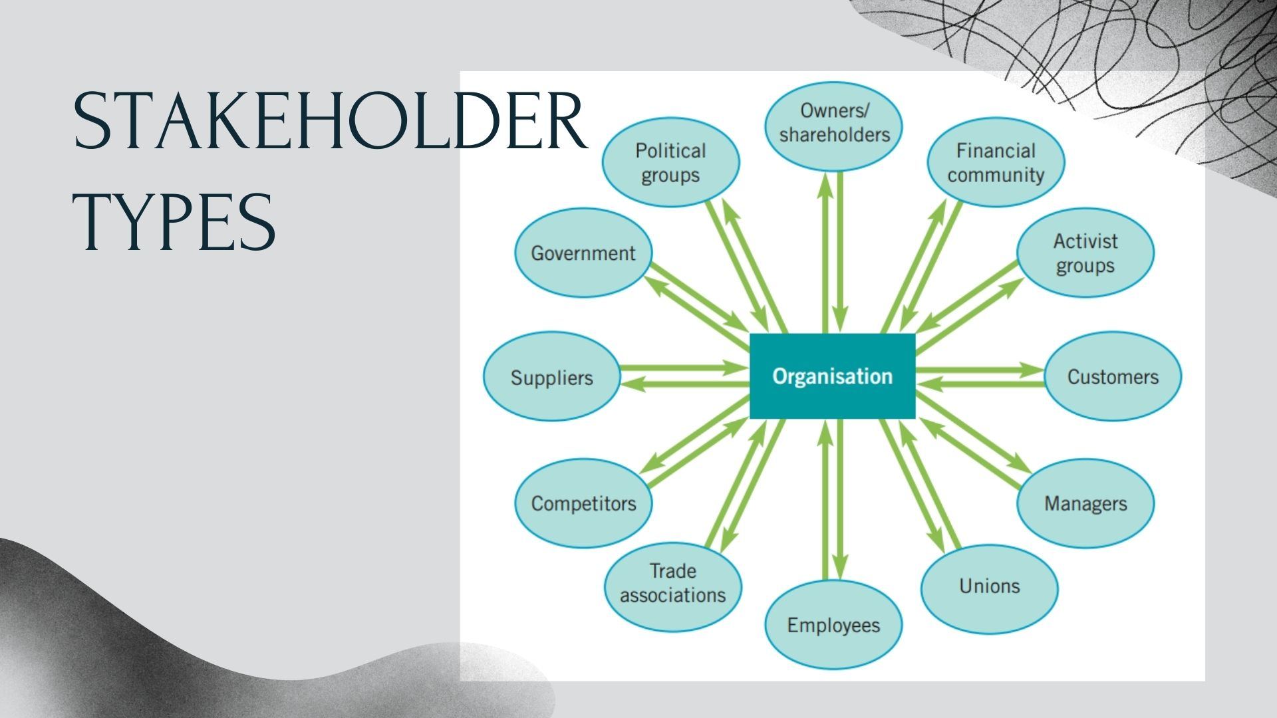
Notes:
From a climate change/ ecological perspective, what stakeholders can be added?

Slide 5
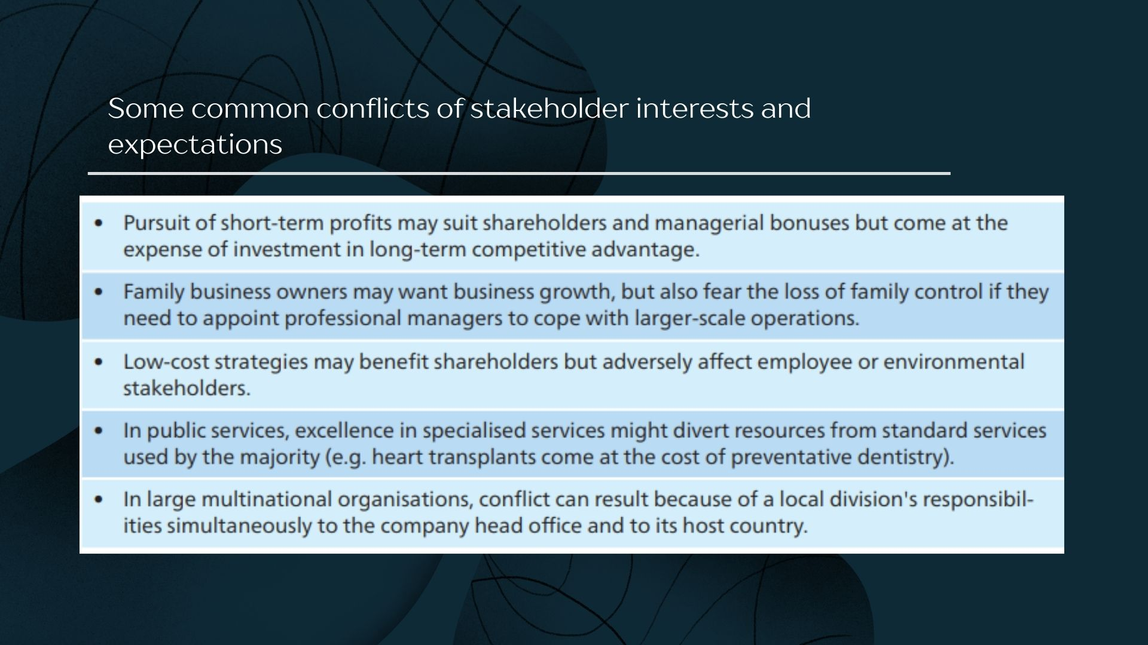
Notes:
The stakeholder concept, and its sensitivity to different wants, helps to understand the organisational politics of strategic decision-making. Taking stakeholder expectations and influence into account is an important aspect of strategic choice

Slide 6

Notes:
Given that there are often so many stakeholders, it is useful to categorise them according to their likely influence on strategic decisions. Stakeholder mapping identifies stakeholder
power and attention in order to understand strategic priorities

Slide 7
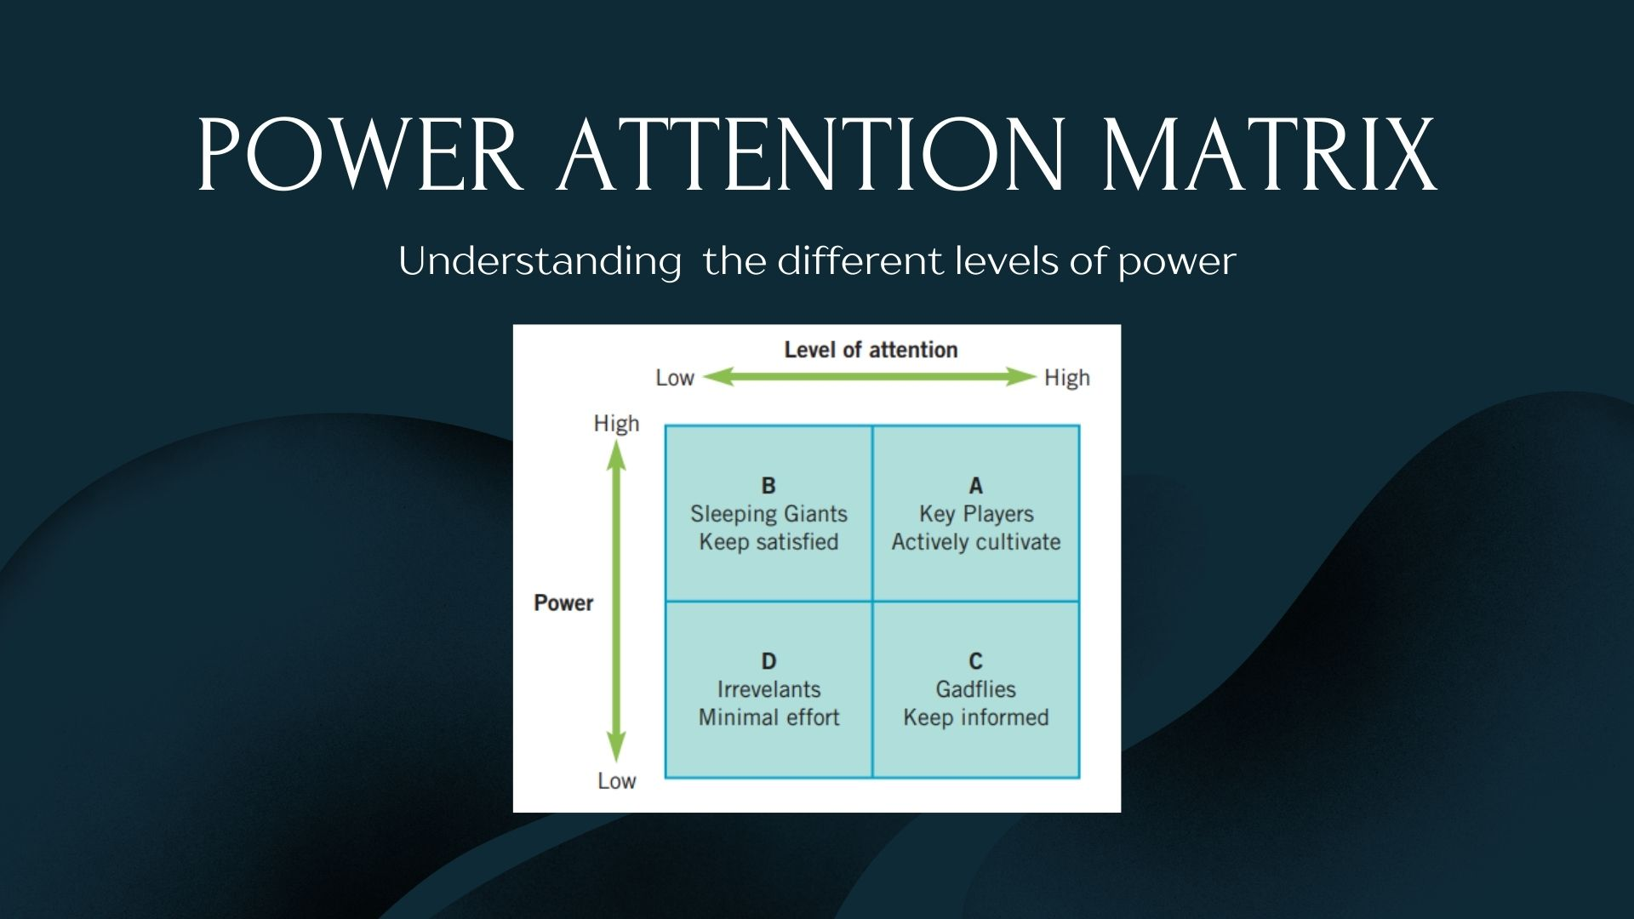
Notes:
Building coalitions of supportive stakeholders is therefore crucial to strategy.
It is therefore important to understand the power different stakeholders have and their likely attention to issues. These two dimensions form the basis of the power/attention matrix

Slide 8
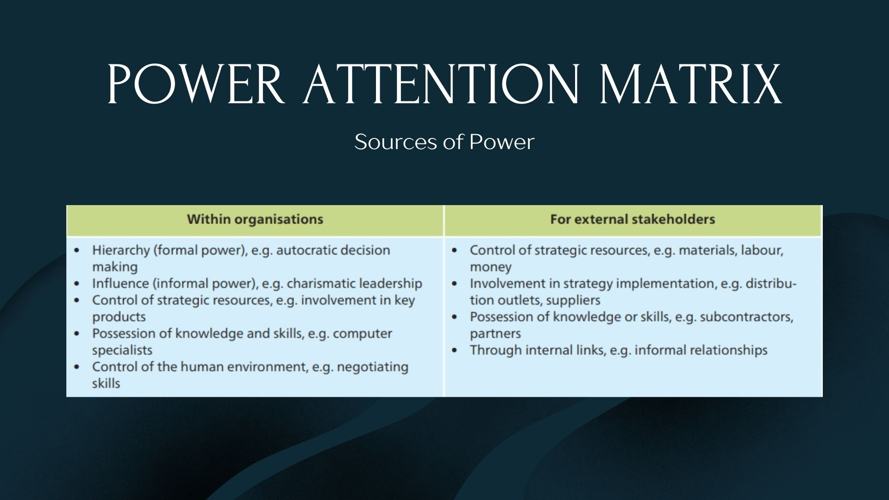
Notes:
Now within organisations, we have to be aware of the management/ ownership of the organisation - what is their scale? intent? their vision, mission, values...?

Slide 9


Slide 10

Notes:
Corporate governance is concerned with the structures and systems of control by which managers are held accountable to those
who have a legitimate stake in an organisation

Slide 11
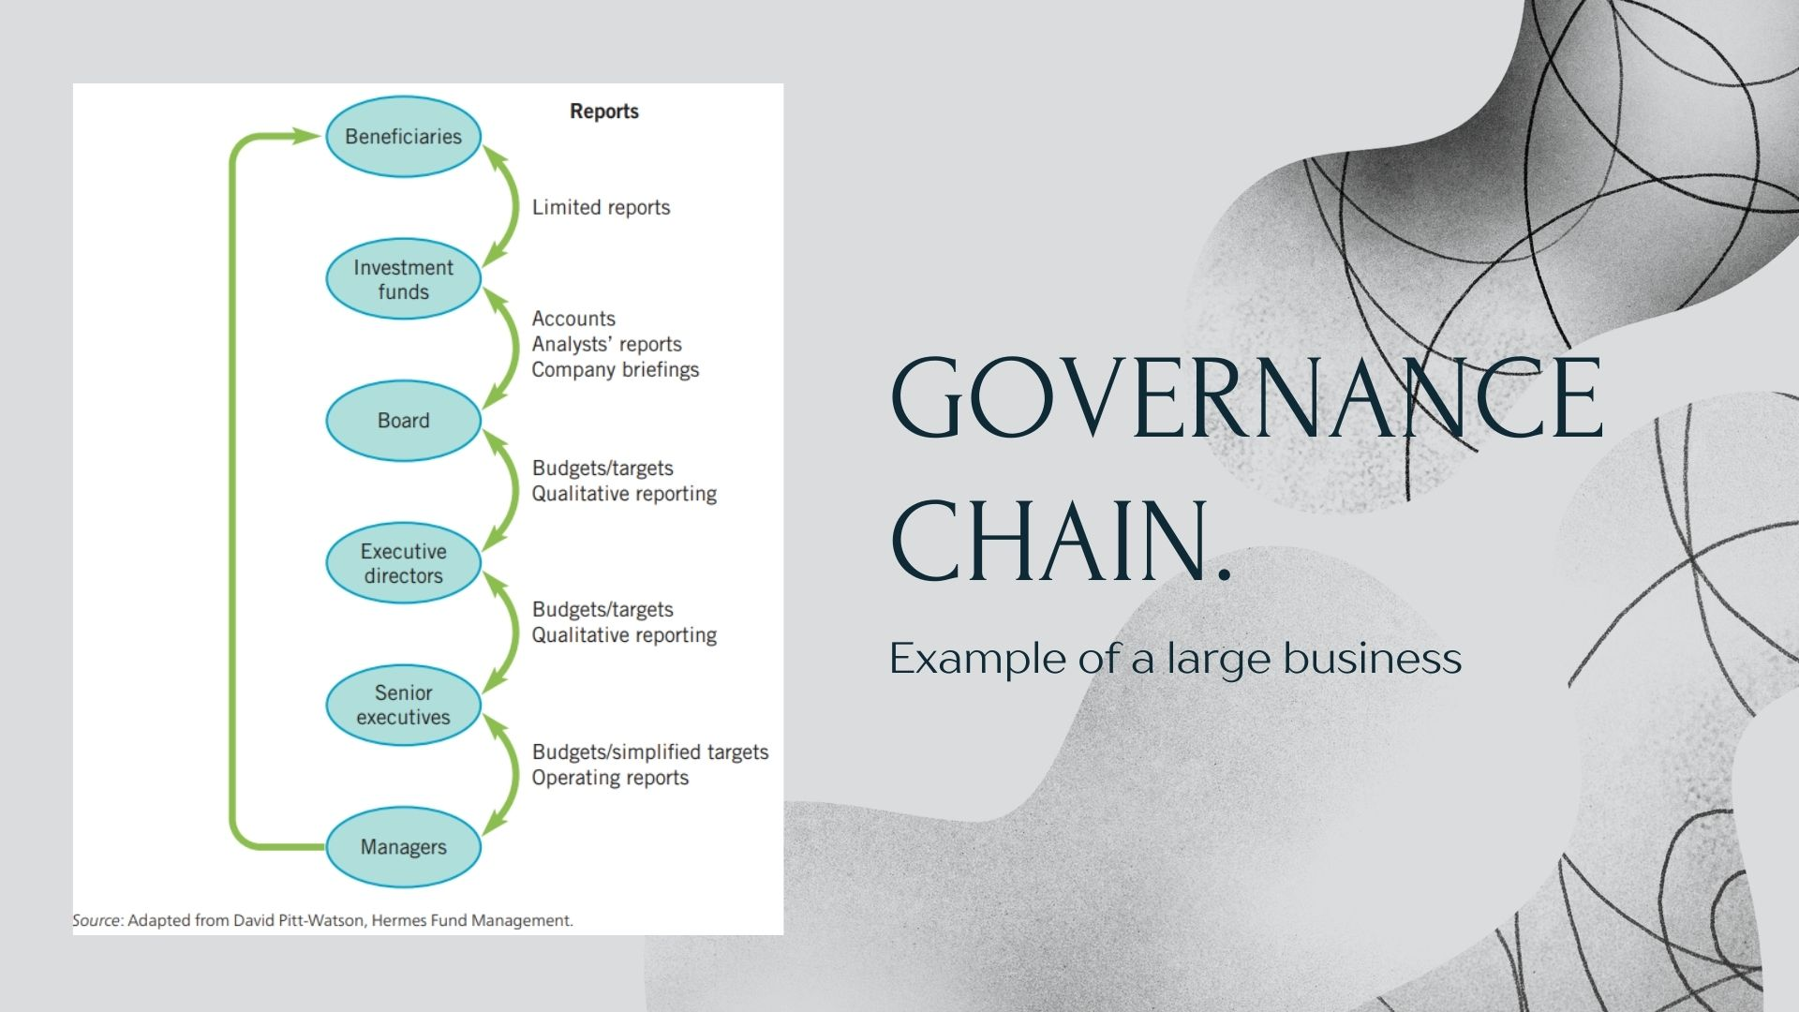
Notes:
The governance chain shows the roles and relationships of different groups involved in the governance of an organisation. In a small family business, the governance chain is simple: there are family shareholders, a board with some family members and there are managers,
some of whom may be family too. Here there are just three layers in the chain. However,
large publicly-quoted corporations have more extended governance chains, potentially diluting accountability for strategy.
Within the larger organisations there can be problems within the interactions of the different layers. These problems can be catogorised as: -
Knowledge Imbalances
Monitoring limits
Mis-aligned incentives

Slide 12
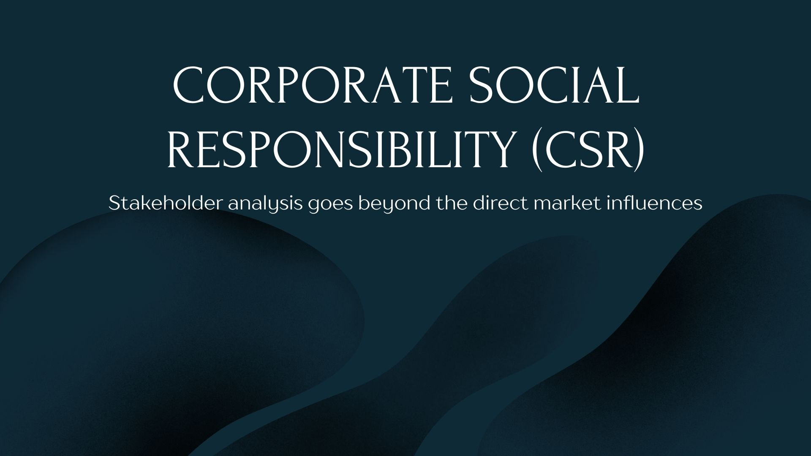
Notes:
The question asked is, should organisations go beyond being of benefit to primary stakeholders?
We know that sustainability is becoming an essential, but to what extent?
There are generally 4 approaches:

Slide 13
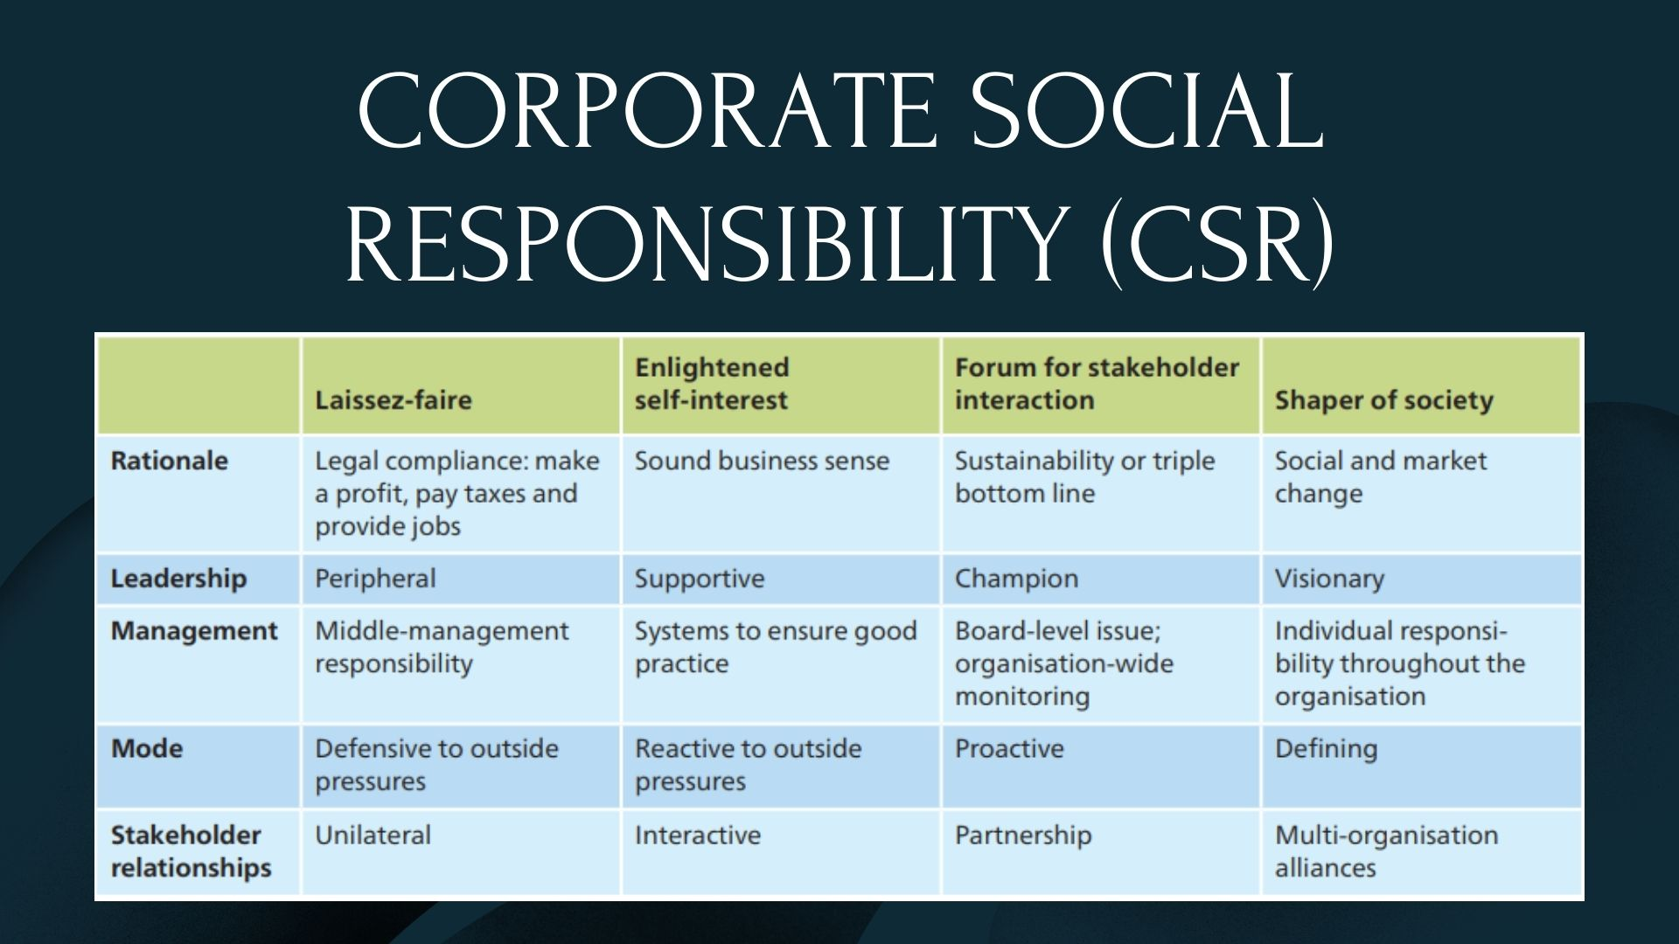
Notes:
The laissez-faire view (literally ‘let do’ in French) represents an extreme stance. In this view,
organisations should be let alone to get on with things on their own account. Proponents
argue that the only responsibility of business is to make a profit and provide for the interests of shareholders. It is for government to protect society through legislation and regulation; organisations need do no more than meet these minimum obligations. Expecting companies to exercise social duties beyond this only confuses decision making, introduces
additional costs and undermines the accountability of managers to their shareholders. This laissez-faire stance may be taken by executives who
are persuaded of it ideologically or by smaller businesses that do not have the resources
to do other than minimally comply with regulations.
• Enlightened self-interest is guided by recognition of the potential long-term financial benefit to the shareholder of well-managed relationships with other stakeholders. Here the justification for social responsibility is that it makes good business sense. For most organisations a good reputation in the eyes of customers and suppliers is important to long-term
financial success.

Slide 14
Notes:
Forum for stakeholder interaction explicitly incorporates multiple stakeholder interests
and expectations rather than just shareholders as influences on organisational purposes and strategies. Here the argument is that the performance of an organisation should be
measured in a more pluralistic way than just through the financial bottom line. Such organisations adopt the principle of sustainability in strategy, one that ensures a better quality of life by attending to all three dimensions of environmental protection, social responsibility and
economic welfare. Performance here is measured and rewarded in terms of the triple bottom
line – social and environmental benefits as well as profits (see Section 12.2.1). Companies in
this category might retain uneconomic units to preserve jobs, avoid manufacturing or selling
‘anti-social’ products and be prepared to bear reductions in profitability for the social good. Sustainability will typically have board-level champions in these kinds of organisations.
• Shapers of society regard financial considerations as of secondary importance or a constraint. These are visionary organisations seeking to change society and social norms. Public-sector organisations and charities are typically committed to this kind of stance. There are also social entrepreneurs who found new organisations that earn revenues but pursue a specific social purpose. For example, Traidcraft UK is a public limited company with a chain of retail shops that fights world poverty by promoting ‘fair trade’. For shapers of society, the social
role is the raison d’être of the business, not profits. Financial viability is important only as
providing the means for continuing the social mission

