Slide 1
LCHS4009 – Professional Development in Health and Social Care
Self-Awareness:
The Power of Knowing Yourself
Presented by: Noshin Gul
ID: 2425431

Slide 2

Introduction to Self-Awareness
Self-awareness is the profound understanding of oneself. It involves the ability to observe your internal state your thoughts, feelings, emotions, strengths, and weaknesses,without immediate judgment.
This understanding is foundational to personal growth and effective professional interaction, especially in complex fields like Health and Social Care.
“Self-awareness is the ability to take an honest look at your life without any attachment to it being right or wrong.”
– Debbie Ford

Slide 3




Why Self-Awareness Matters in Professional Practice
Developing self-awareness yields critical benefits that translate directly into high-quality care and professional success in the Health and Social Care environment.
Improved Confidence
Enhanced Communication
Recognizing true strengths builds confidence, allowing professionals to take initiative and handle challenging situations with assurance.
Knowing one's communication style and triggers reduces misunderstandings, leading to clearer, more constructive interactions with colleagues and patients.
Deeper Empathy
Better Decision-Making
Understanding personal feelings and biases allows us to better understand, validate, and respond genuinely to the emotional states of service users.
Self-aware individuals are less likely to let personal stress or mood influence critical professional decisions, ensuring objectivity in patient care.

Slide 4

Self-Awareness in Health and Social Care
Emotional Intelligence (EI)
Self-awareness is the bedrock of EI. In care settings, understanding one’s own emotions,for example, recognizing fatigue or frustration—is crucial for maintaining professional boundaries and composure.
Compassionate Patient Care
By understanding how personal stress or bias might affect interactions, professionals can consciously provide genuinely compassionate and non-judgmental care tailored to the patient’s needs.
Effective Teamwork
Knowing your role, work style, and limitations facilitates healthier collaboration. It allows for clear delegation and mutual support among multidisciplinary teams.
Ethical Practice
It enables reflective practice, ensuring professionals consistently meet high ethical standards by monitoring their responses and actions in challenging or morally ambiguous situations.

Slide 5
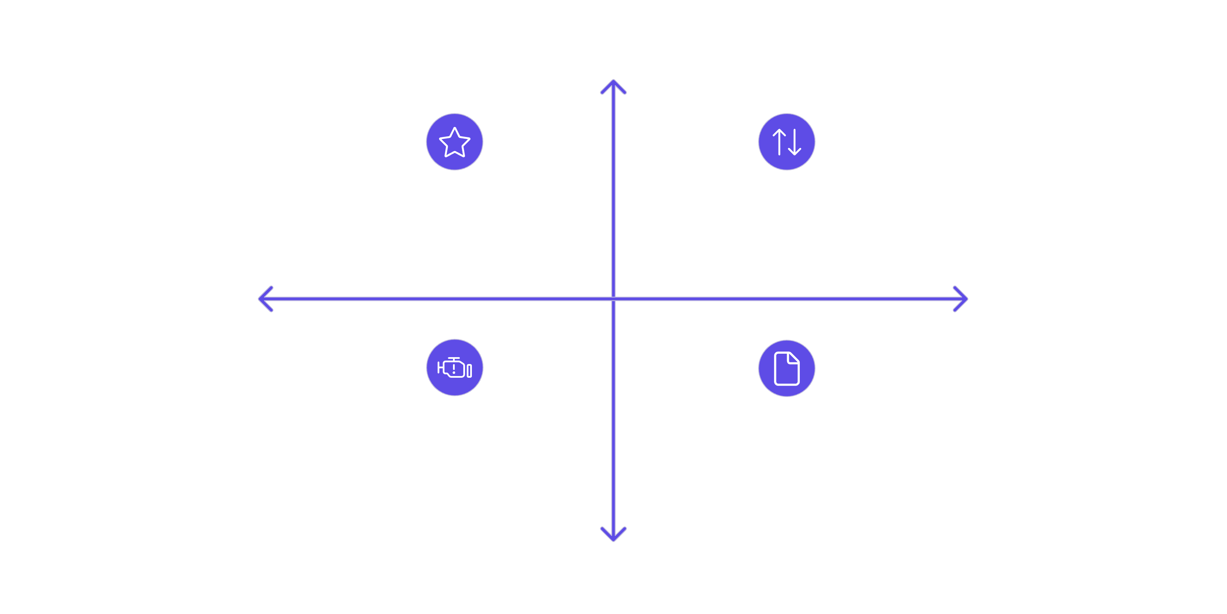




Self-Assessment: The Personal SWOT Overview
The SWOT Analysis is a powerful strategic planning tool adapted for personal and career development. It helps us systematically assess internal factors (Strengths, Weaknesses) and external factors (Opportunities, Threats) relevant to our goals in Health and Social Care.
Internal Strength
Strengths - Core skills and achievements
Opportunities - External growth options
Internal Weakness
External Opportunities
Threats - Market risks and obstacles
Weaknesses - Gaps to improve
External Threats
Utilizing this tool provides clarity for setting targeted developmental goals and informs long-term career planning within the sector.

Slide 6






My Internal Strengths for Caregiving
These are the personal attributes and skills that allow me to connect effectively with service users and contribute
positively to a care team.
Genuine Empathy
Teamwork & Collaboration
I possess a strong ability to understand and share the feelings of others, which enables me to provide truly person-centered and sensitive care.
My strengths include clear communication and a supportive attitude, allowing me to integrate effectively with multidisciplinary teams and foster a positive work environment.
Active Listening
Calm Problem-Solving
I excel at focusing entirely on others to deeply understand their needs and concerns, which is fundamental for building trust with patients and colleagues.
I maintain composure under pressure, allowing me to analyze complex or urgent situations logically and implement effective solutions quickly.

Slide 7




Addressing Weaknesses and Planning Growth
Identifying areas for development is the most critical part of self-awareness. I am committed to turning these weaknesses into areas of growth through targeted action.
Time Management
I sometimes struggle with prioritizing competing tasks.
Improvement Plan: Will use digital planning tools and attend a workshop on prioritizing tasks in high-demand environments.
Presenting Information
I feel anxious when presenting complex information to a group.
Improvement Plan: Will volunteer for small group presentations and seek feedback from mentors to build confidence and clarity.
Dealing with High Stress
The emotional weight of care can sometimes be draining.
Improvement Plan: Implementing daily mindfulness practices and establishing a regular schedule for self-care activities to improve resilience.

Slide 8




Opportunities in Health & Social Care
The sector is dynamic and offers numerous pathways for professional advancement and specialization that align with my
personal career goals.
Specialized CPD Courses
Pursuing Continuing Professional Development in areas like mental health first aid or dementia care to deepen
clinical knowledge and open new career doors.
Formal Placements & NHS Job Roles
Securing high-quality placements and entry-level NHS positions to gain hands-on experience in diverse care
settings and understand organizational structures.
Volunteering and Mentorships
Engaging with experienced professionals through structured mentorships or volunteering to gain industry insight and refine
practical skills in a supportive context.

Slide 9

Threats and Minimization Strategies
External challenges are inevitable, but self-awareness allows me to proactively mitigate risks to my professional journey and well-being.
Potential Threats
Minimization Strategies
High competition for special roles.
Prioritize continuous learning (CPD) to stay competitive.
Risk of professional burnout due to emotional demands.
Implement robust self-care routines and utilize organizational support systems.
Maintaining work-life balance in a demanding profession.
Rapid changes in policy and procedure requiring constant learning.
Actively network with professionals to stay informed and explore hidden opportunities.
Set clear personal and professional boundaries to protect well-being.

Slide 10


Reflection and Conclusion
Understanding my inherent strengths (Empathy, Teamwork) validates my suitability for Health and Social Care, while identifying weaknesses (Time Management, Stress) provides a clear roadmap for intentional professional growth.
The self-awareness gained through this process is not static; it is a continuous, reflective practice that will empower me to navigate future challenges and maximize the sector's opportunities.
“Knowing yourself is the first step to becoming your best self.”
Thank you for your attention. I am now open to any questions.

Slide 11
References and Incitations
Debbie Ford (2001). The Dark Side of the Light Chasers: Reclaiming Your Power, Creativity, Brilliance, and Dreams.
HarperCollins Publishers.
→ Quoted for the definition of self-awareness.
Goleman, D. (1995). Emotional Intelligence: Why It Can Matter More Than IQ. Bantam Books.
→ Supports the link between self-awareness and emotional intelligence in professional practice.
NHS Health Careers (2023). Personal and Professional Development in Health and Social Care.
Available at: https://www.healthcareers.nhs.uk
→ Used for career opportunities, CPD, and reflection in care.
Mind UK (2023). Workplace Well-being and Stress Management for Health Professionals.
Retrieved from: https://www.mind.org.uk
→ Supports strategies for stress management and self-care.
Skills for Care (2022). Developing Self-Awareness in Adult Social Care.
Retrieved from: https://www.skillsforcare.org.uk
→ Reference for SWOT analysis and professional reflection in care roles.

