Slide 1
R Thomas
PowerPoint presentation
Traditional Services

Slide 2
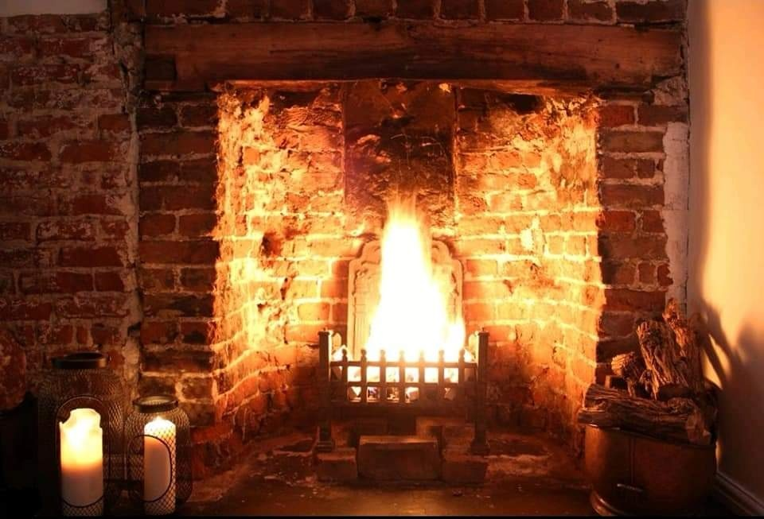
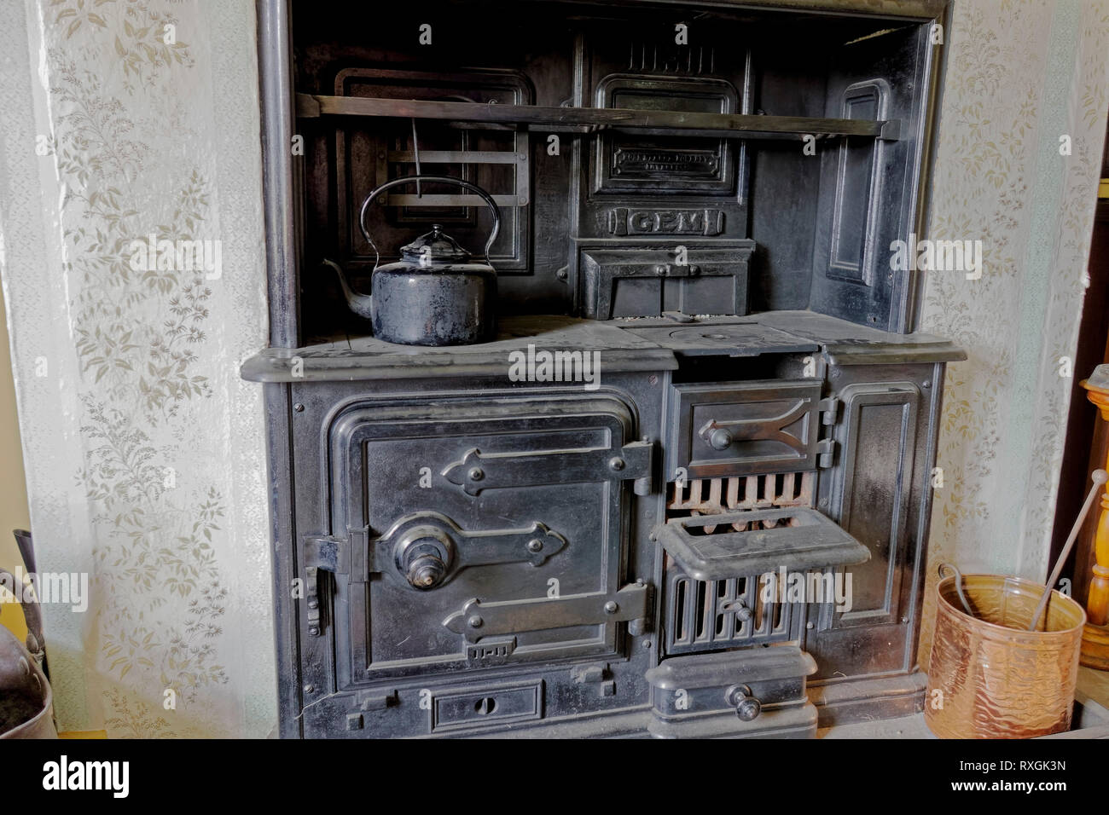
Heating
Generally domestic heating would have come from open fireplaces, in the kitchen possibly a range cooker/Aga which could have been wood or coal fired.

Slide 3
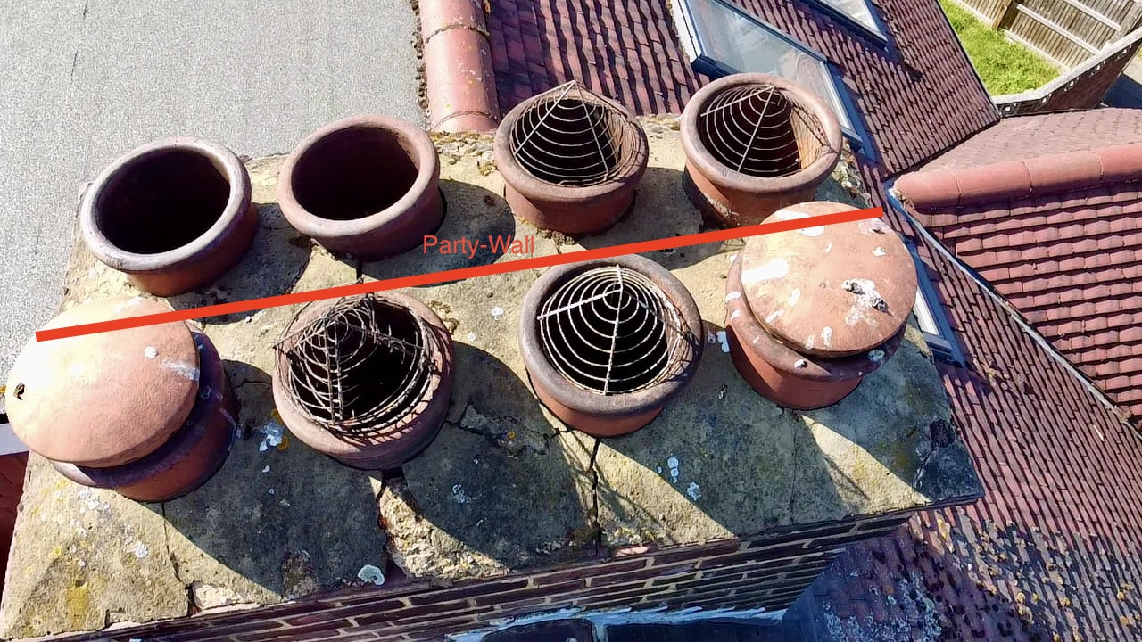
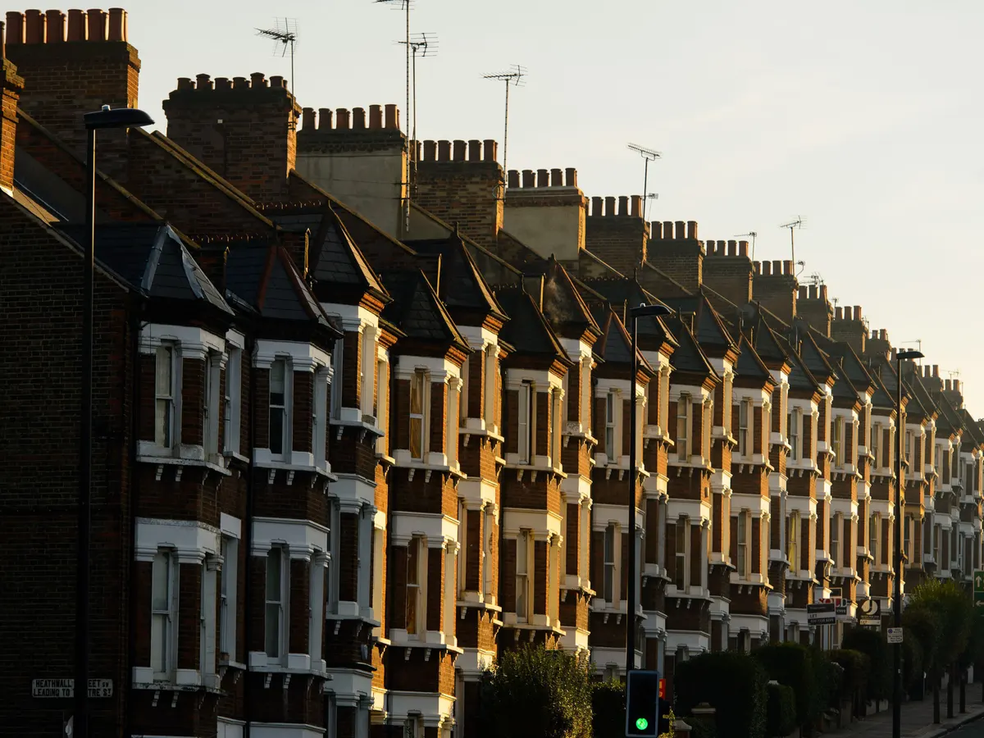
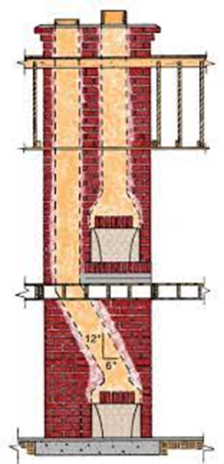

Chimneys & Flues
This meant open fireplaces in bedrooms and chimneys to carry the smoke away

Slide 4
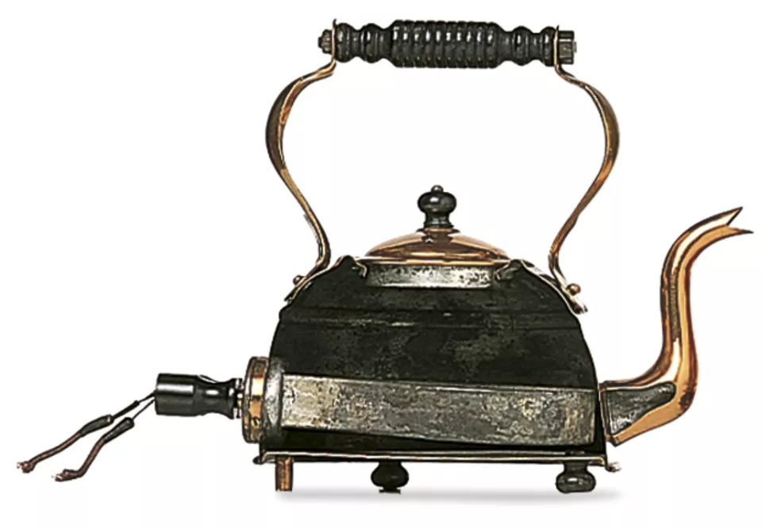
Electricity
By the 1930s new homes in urban areas of Britain were being lit by electricity. It took time for the National Grid to roll out electricity to most of the country, but the number of homes wired up increased from 6% in 1919 to two thirds by the end of the 1930s.
Houses built before 1919 wouldn’t have had electricity fitted as standard during construction, this would have been a later addition (depending on location in the UK).

Slide 5
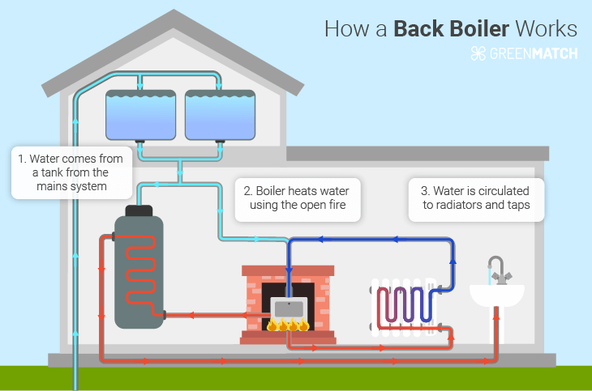
Water
Cold water was brought into a house by a single pipe known as the “rising main” sometimes in older houses this was a lead pipe!
This was connected to a tap and gave people access to fresh water in their homes.
Later this became more complex with more taps being added, as well as tanks and water heaters.

Slide 6
Any questions?

