Slide 1

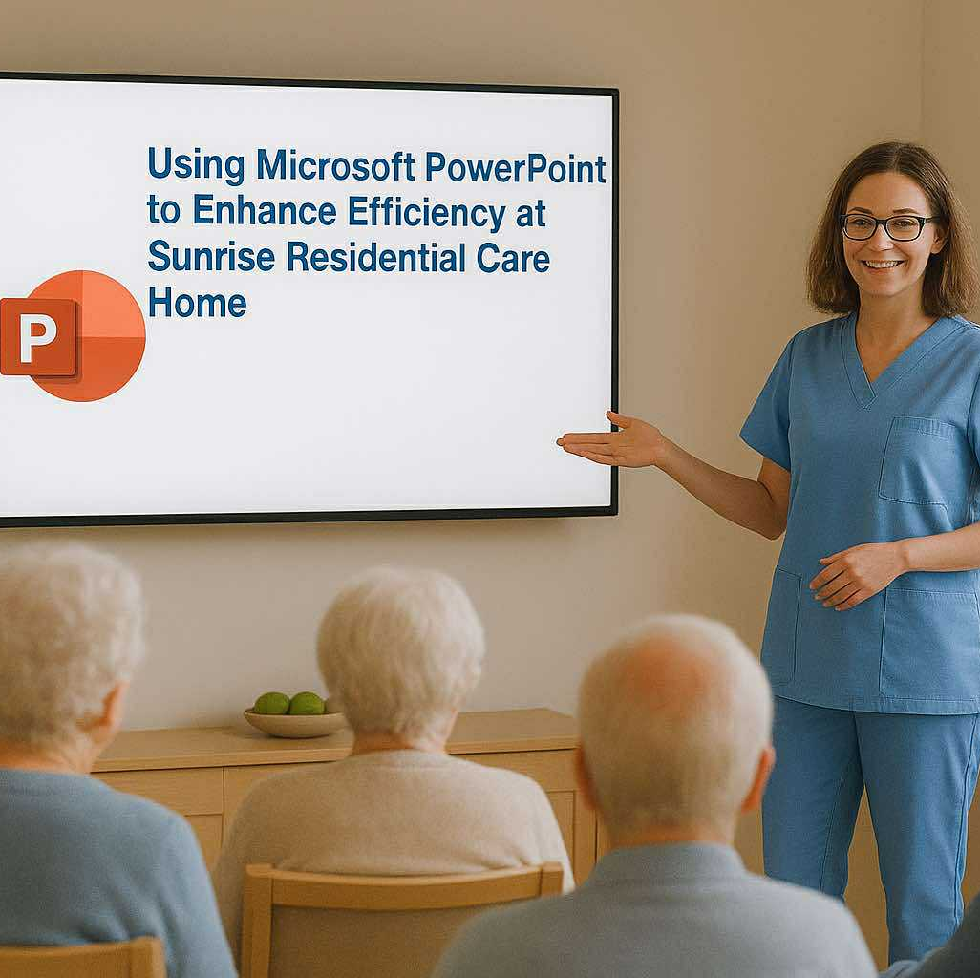
Microsoft PowerPoint
Name: Sanilen Stevens
Student ID: 2508295
Module Name: Digital Skills
Lecturer's Name: Patronella Ganza

Slide 2
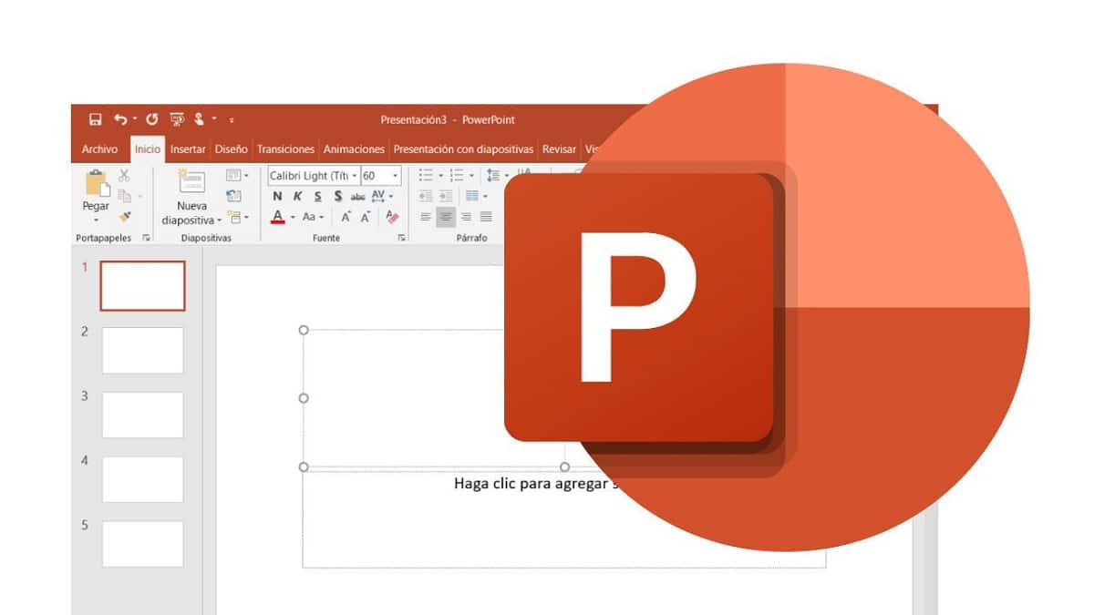

Introduction
Microsoft PowerPoint is a software application
It is used for communication, training and engagement purposes
It support text, images, animations, and charts to enhance understanding
(Microsoft, 2025).

Slide 3
Enhances staff training sessions
Improves communication
Allows easy updates
Supports engagement and understanding
(NHS England, 2025).

Slide 4
Disadvantages of PowerPoint at Sunrise Care Home:
Technical issues
Overuse of slides
Some staff may find it difficult
Requires access to suitable equipment
For security concern – it can be easily copied or shared without permission, especially via smartphone.
(NHS Transformation Directorate, 2025 ; Wang, Heng et al., 2024).

Slide 5
Conclusion:
Microsoft PowerPoint is a valuable tool at Sunrise Care Home
It is an effective tool that improves communication, training, and teamwork in care homes
With proper training, it can significantly improve care quality and professional development
(Microsoft, 2025; NHS England, 2025).

Slide 6
References:
Microsoft (2025) Microsoft PowerPoint: Presentation software. Available at: https://www.microsoft.com/powerpoint (Accessed: 30 October 2025)
NHS England (2023) Digital technology in social care. Available at: https://www.england.nhs.uk/digital-transformation/ (Accessed: 30 October 2025)
NHS Transformation Directorate (2021) Digital Skills in health and care. Available at: https://transform.england.nhs.uk (Accessed: 30 October 2025)
Wang, Heng et al. (2024) ‘Robust Watermarking Against Camera Shooting for PowerPoint Presentation’, IEEE signal processing letters, 31, pp. 1264–1268. Available at: https://doi.org/10.1109/LSP.2024.3393392.

Slide 7


THANK YOU

