Slide 1
Version Control

Slide 2
Topics to be covered..
This week we’ll be looking at:
  Version Control Systems
  How to set up and use a Distributed Version Control System

Slide 3
Quick Recap
Version Control Systems (VCS):
  CVS (Client server system)
  Subversion – CVS successor
  Mercurial
  Clearcase - IBM
  Perforce – Popular VCS
  Visual SourceSafe - Microsoft

Slide 4
Quick Recap
Central to any agile project
Allows multiple programmers to work on same code-base simultaneously
Code written frequently
  Checked in daily (at least)
Visual Studio
  Now has its own version control
  Source Control
  Simple matter of creating a new project and ticking the box to manage the project using source control

Slide 5
Repository
This is the place where all your code gets stored
Version Control system keeps track of all changes made to a set of files (Project)
Version control enables multiple developers to work on the same project concurrently
There are two approaches commonly used to keep track of changes made to a team project:
  Centralised System
  Distributed System

Slide 6
Centralised Systems
Concurrent Versions System (CVS)
  Developed by Dick Grune (1986)
  Latest release – 2008
  CVS uses a Client-Server architecture - revision control system
  Server stores current versions of project & full history
    i.e. history of all changes made during the project-life
  Client connects to the server
    “Check-out” a complete copy of the project
    “Check-in” any changes made to the project
  Client-Server usually connect over a LAN (or internet)
  Can be configured to run on the same machine if used only with local developers

Slide 7
CVS - Terminology
Module
  Single Project
Repository
  Place where modules are stored
Check-out
  Acquisition of latest version of the module
Working Copy
  Currently checked-out files
  Also referred to as working copy, sandbox or workspace
Commit (Check-in)
  Changes made to the working copy are transferred to the repository
Merge
  Update / acquire or merge changes in the repository with the working copy

Slide 8
Distributed Systems
Distributed Revision Control System (DVCS)
  Peer-to-peer approach
  Repository synchronization carried out by exchanging patches from peer-to-peer
  Much faster work flow when not connected to a network
  No need to communicate to central server for many commonly used operations
    Commit / View History / Revert
  Connection to the server only required when sharing changes with others
  Un-hindered private work possible
  DVCS is better for larger projects that employs partly independent developers
    i.e. supports more efficient remote working

Slide 9
Distributed Systems
Distributed Revision Control System (DVCS)
  Cloning
    Complete codebase is mirrored on every developer’s computer
  Initial cloning is slower than CVS
    Because a complete copy of all branches and history gets copied
  Additional storage required to hold complete copy
Open system design
  Supports independent branches
  Relies on merge operations
  Every working copy is effectively a fork
  Each branch is implemented as a working copy
    Merges conducted as patch exchanges across branches

Slide 10
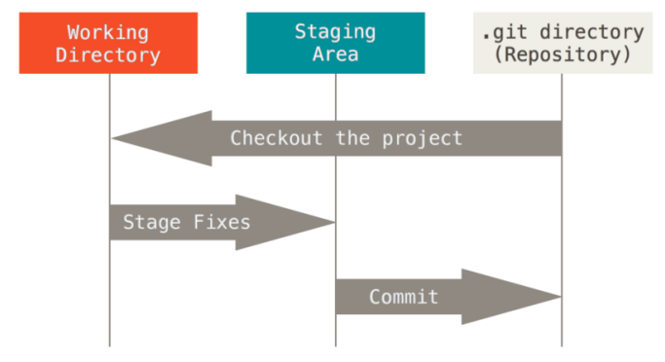
Git Repository
Three states that your files reside in:
  Committed
    Safely stored in your local database (Git Directory)
  Modified
    Files have been changed – but have not been committed to the database yet
  Staged
    You have marked a modified file in its current version to go into your next commit snapshot

Slide 11
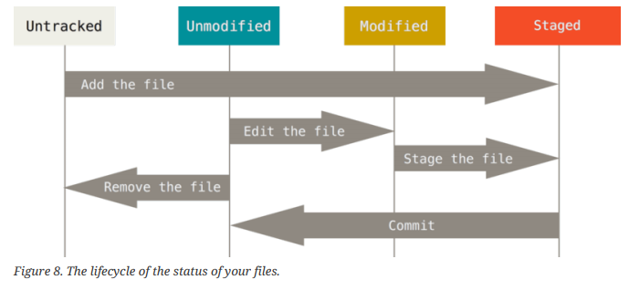
Git Repository
Each file in working directory can be in one of two stages:
  Tracked
    Files that were in the last snapshot – i.e. Git knows about them
    They can be modified, unmodified or staged
  Un-Tracked
    Everything else - i.e. Git doesn’t know about them
    NB> All files are tracked and unmodified when first cloned
      Files become modified when they get changed – before being re-committed

Slide 12
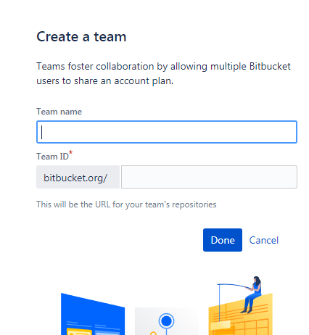
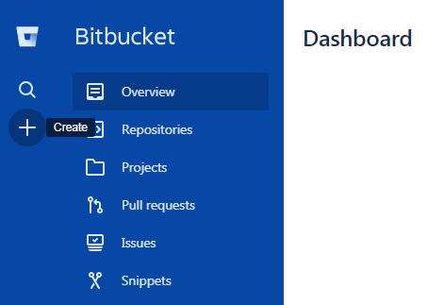
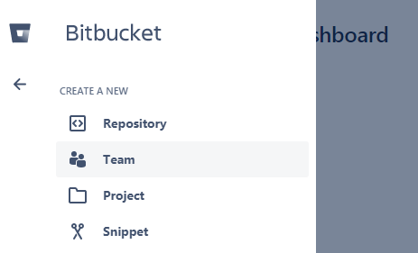
Creating a Team
Prerequisites:
  First create a bitbucket account (it’s free)
    https://bitbucket.org/
  Next create a Team Project

Slide 13
Creating a Repository
Prerequisites:
  Next Add a Repository to this Team
    This is where your working VS Project will be stored
      Its where you’ll check-in any changes made
      And check-out the latest version of the project
  Oops! Omitted the graphic / explanation of how to do this step….

Slide 14
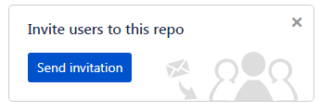
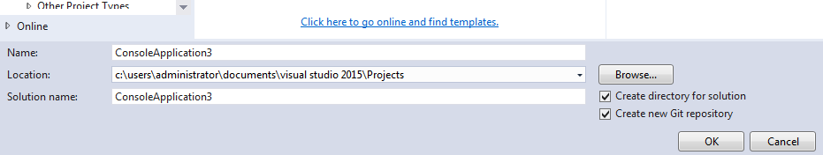
Add Team Members
Add the names of your team members (SEP group) to the Team Project so everyone can work on the same project
Add me to your group:
  AndrewBakerUni
Next you need to create a new Visual Studio project and add it to your repository
  Ensure the – ‘Create new Git repository’ checkbox is selected

Slide 15
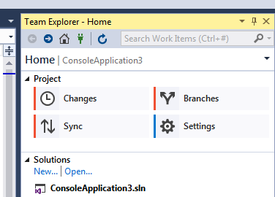
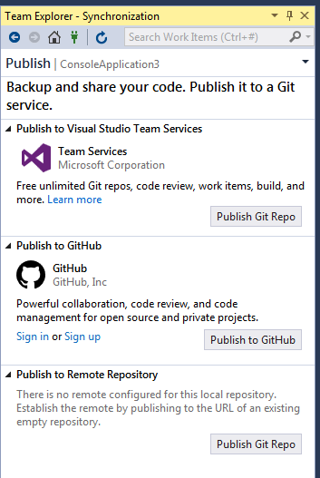

Team Explorer
In visual studio select the Team Explorer TAB
  Sync your project
Publish to a Remote Repository:
  Select Publish Git Repo

Slide 16
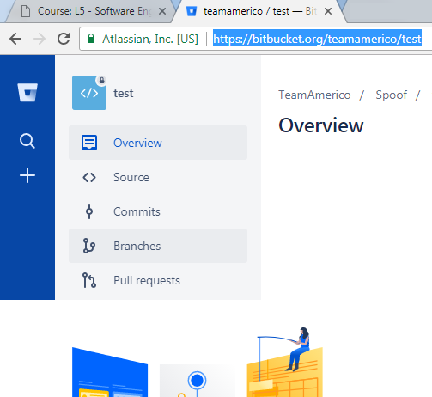
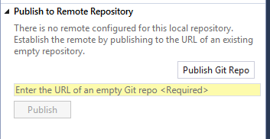


Select a Repository
Copy the full URL to your repository
  You should be able to see the path to your repository in BitBucket when you select a repository:
Enter the URL in the field below (in Team Explorer TAB):

Slide 17
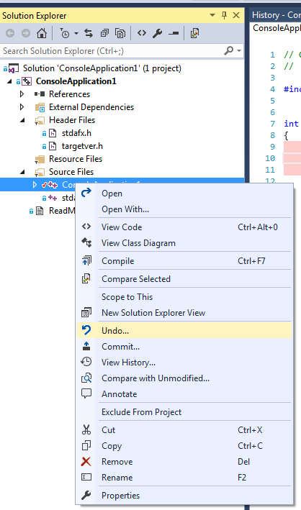
You’re good to go!
Git has recently integrated into Visual Studio
Once you’ve made a change to a file
  Right click the file name in Solution Explorer to access the following VCS features:
Commit - check-in your modified code
  Snapshot of the code gets stored to the repository
  Each snapshot contains a pointer to the previous commit
  This allows you to compare this version with the previous one
Undo – rolls back to a previous version (snapshot)
View History – does what it says on the tin
  View all your previous snapshots

Slide 18
Git Repository
Additional Reading:
  “Pro Git Everything you need to know about Git”, Scott Chacon and Ben Straub, 2nd Edition Apress
download full .pdf:
https://git-scm.com/book/en/v2

