Slide 1
Student Name: FARID LEZAAR
Student Number: 2117388
Module Name: Operating Hotel Facilities (BMIH4006)
Tutor Name: Muhammad Cassamo
Title: Employee Engagement Within Hotel

Slide 2
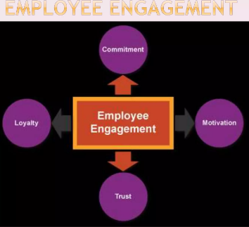
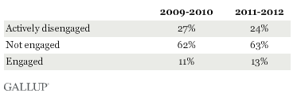
Introduction
Employee engagement : is the emotional dedication that an employee or staff has to the company and its objectives.
This emotional commitment or dedication means that engaged employees care about their work and the company they work for. They put in effort for the company objectives rather than just working for a wage or the next promotion. (Kruse, 2012).
the Gallup study showed that employee engaged in their work globally are only 13%. (Crabtree, 2013)

Slide 3
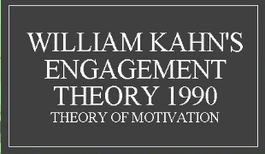
Theory model of employee engagement
Meaningfulness: for example: in article posted on McKinsey & company website has found based on American research that when employees find their work to be meaningful their performance improve by 33% , 75% more committed to their companies, and 49% less likely to leave. (Bromley & al, 2021).
2. Safety: for example: employees are not being spoken from causes that might think they will risk to be fired.
3. Availability: For example, “Many employees get energy from being around colleagues even if they don’t depend on them to complete their task. Working remotely has made it impossible to interact with employee on a regular basis. Leaders need to take the initiative to make sure that workers interact sufficiently to stay motivated and have a purpose in their job. ( the predictive index, 2021)
Meaningfulness
Safety
Availability
(Thompson, 2021)

Slide 4

The importance of employee engagement
Engaged workers increase productivity.(gallup, 2019). According to a Gallup survey, productive employees are 21% more engaged than their competitors.( gallup,2019)
Employees engagement boost guests satisfaction.(gallup.2019) According to Gallup data The most engaged employee are more likely to put up the effort that results in higher production levels.
You will retain your best people.
engagement is a symptom of success. ( Latham, 2015)
According to the Forbes engaged Employees who believe their job matters are more likely to be engaged than those who are productive or easy to deal with. ( Latham, 2015)

Slide 5

Best practice of employee engagement
Inspire your team with meaningful work.
1
Develop human connections with your employees.
2
Build on employee strengths
3
Reward successes.
4
Lead by example.
(Chen, 2022)
For example: on Virgin website state, "If you treat your employees properly, they will be pleased." A happy workers is a proud workers, and a proud workers provides exceptional customer service, which lead to company success..”(virgin incentives)

Slide 6
Data & statistic
Engagement: 70% of engaged employees understand how to meet customer needs.
Productivity: 130% engaged employees work 4-5 days more.
Profitability: 300% engaged employees grow company profits 3 times faster than their competitors.
Stability: employee who are engaged are 87% less likely to leave the company than disengaged employees.
(MacLeod & Clarke, 2009)

Slide 7
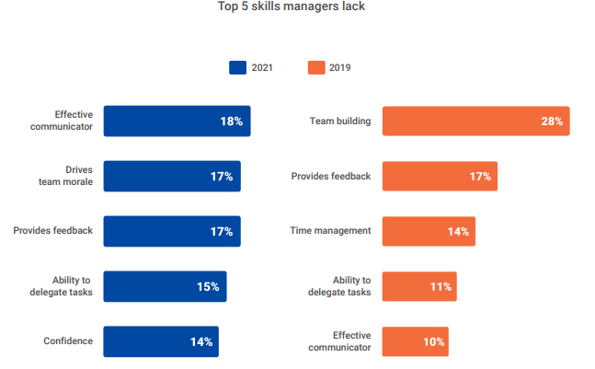
Reasons of Poor employee engagement
LACK OF COMMUNICATION
A recent survey of 1,000 employees' hotels in the U.S. done by Reflective have found that Employees who are engaged are three times more likely to stay at their company if they have regular one to one meetings with their managers. As result managers have the most important role to play when it comes to engaging, growing and retaining engaged staff. (Hoisington,2019)
Disconnect from the mission
Employee engagement is frequently lower when staff members are unaware of the company's mission or aims. According to the data by reflecktive has found that employees who say their organization’s values are “known and understood” are 51 times more likely to be fully engaged. (Hoisington, 2019),
(The predictive index,2021)

Slide 8
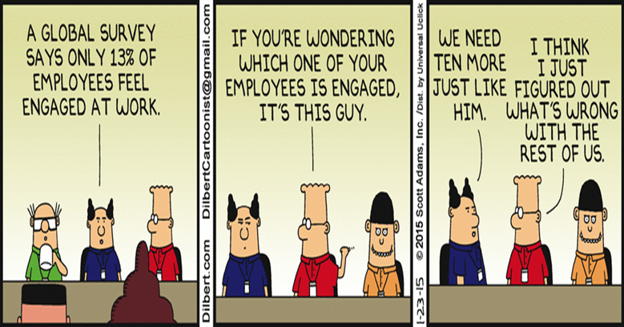
The benefits of employee engagement
Reduced churn: When team members leave, companies have to find, employ, and train replacements. This is a pricey and long process. Employees who are invested in their employment are 87% more likely to stay at them than those who are not. (Georgiev, 2022).
Better teamwork: Employees are more inclined to encourage, value, and trust their teammates when they work in a supportive, trustworthy atmosphere.
Happier customers: Customer satisfaction and staff satisfaction are closely related. It comes as no surprise that visitors or customers are more likely to have positive experiences when they encounter with knowledgeable, motivated and engaged employee.

Slide 9
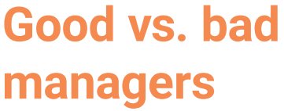
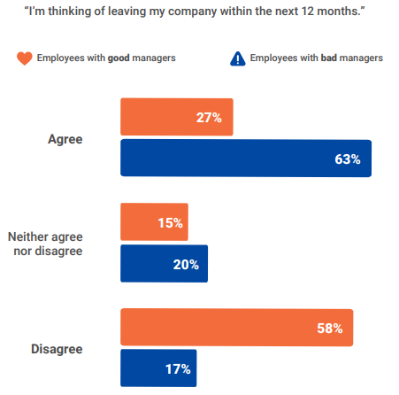
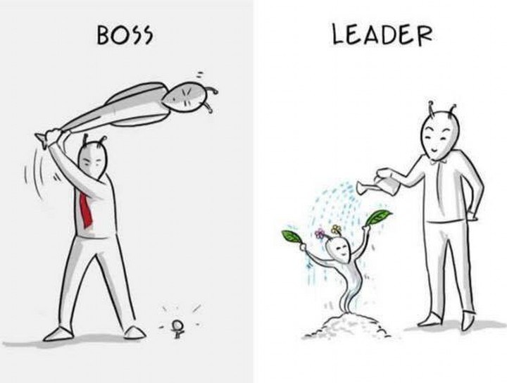
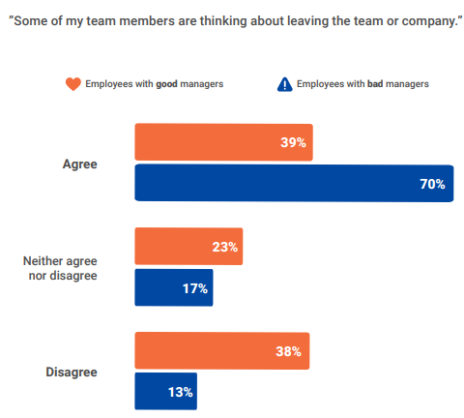
Managers must be and Become a role model and behave in engaging way and remember always that Employees view their organisation from the same perspective in which they view their front-line managers.
(The predictive index, 2021)

Slide 10
Enhancing employee engagement is a continuous endeavour. Your plan for increasing employee engagement should be reviewed and revised often. Keep in mind that what works this year may not work next.
Companies in general and hotels in special they need to pay attention to their employee needs if they want to prevent The Great Resignation, whether it's the freedom to work when and where you want or the ability to take time off and recover.
Conclusion

Slide 11
References
Bromley, T. Lauricella, T. Schaninger, B. (2021) Making work meaningful from the C-suite to the frontline, Available at https://www.mckinsey.com/capabilities/people-and-organizational-performance/our-insights/the-organization-blog/making-work-meaningful-from-the-c-suite-to-the-frontline ( accessed 28-11-2022).
Chen, J, 2022, 18 Employee Engagement Best Practices in 2022, available at https://teambuilding.com/blog/employee-engagement-best-practices , (accessed 28-11-2022).
CRABTREE. S, (2021), Worldwide, 13% of Employees Are Engaged at Work, available at https://news.gallup.com/poll/165269/worldwide-employees-engaged-work.aspx (accessed 01-12-2022).
Gallup,2019, The Evolving Employee Engagement Movement available at https://www.gallup.com/workplace/229424/employee-engagement.aspx (accessed: 27-11.2022)
Hoisington, A, (2019), The ROI of people: Employee engagement key to profitability, Available at https://www.hotelmanagement.net/human-resources/roi-people-employee-engagement-key-to-profitability (accessed 28-11-2022).
Kruse, k, 2012, What Is Employee Engagement, available at https://www.forbes.com/sites/kevinkruse/2012/06/22/employee-engagement-what-and-why/?sh=4ef2a6c7f372 (accessed 27-11-2022).
Latham, A, 2015, 10 Reasons Your Employee Engagement Program Is Hurting Your Company , available at https://www.forbes.com/sites/annlatham/2015/11/01/10-reasons-your-employee-engagement-program-is-hurting-your-company/?sh=3b3c42e9235d , (accessed: 27-11-2022).
Macleod, D. and Clarke, N, (2009). Engaging for success: enhancing performance through employee engagement: a report to government.
The predictive index, (2021), people management report, available https://www.predictiveindex.com/learn/inspire/resources/surveys-reports/people-management-report/ (accessed 29-11-2022)
Thompson, M,( 2012), Employee Engagement Models and Theories, available at https://wethrive.net/employee-engagement/employee-engagement-models-and-theories/ (accessed 28-11-2022).
Virgin, Employee Engagement, available at https://www.virginincentives.com/services/your-employees/employee-engagement/ (accessed 28-11-2022)

