Slide 1
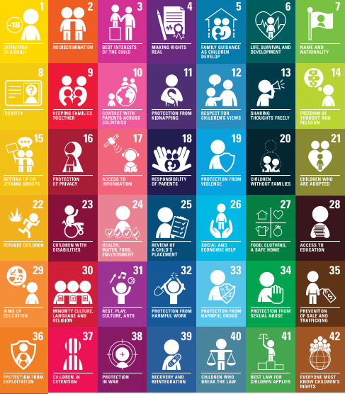
How to keep our children safe ?
’The United Nations Convention on the Rights of the Child 1990 states it is an important agreement by countries who have promised to protect children’s rights. The Convention explains who children are, all their rights, and the responsibilities of governments.’(UNICEF, 2020)
Safeguarding in good practice :
Risk assessments
Site security
Curriculum flexibility
Responsible behaviour
Child protection arrangements.
(Ofsted,2011)
(Image 1, 2020)

Slide 2
School welfare and safety
How do schools keep children safe ?
Responsible behaviour
(Ofsted, 2011)
Site security and risk assessments
(Ofsted, 2011)
Curriculum flexibility
(Ofsted, 2011)
Visitor's to wear badges and sign in and out register book, DBS checks and procedures. Fire safety procedures, automatic lock doors(Department of education, 2019). Risk Assessments to ensure the site of safe to learn.
Promote safeguarding, teach how to stay safe, how to protect themselves from harm and how to take responsibility for their own and others’ safety (Safeguarding in children's education ,Education Act 2002)
Work shops for internet safety
External workshops for sexual education and wellbeing week
(NHS Wales, 2016)
All reported back to the education Welfare officer (EWO) of the school. Their job is to ensure children and young people are being granted a full education (TheSchoolRun, 2021) or report to the Health and safety officer of the school , who ensures a safe learning environment for everyone (Creative Education, 2021) .

Slide 3

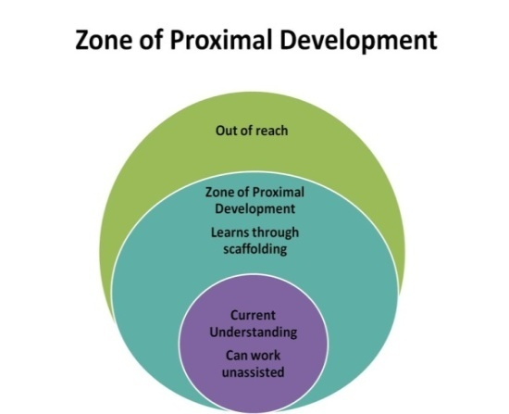
Outside agencies
Support from agencies such as:
Team around the family (TAF) ‘ is a way of bringing people together who can help you and your family really make a difference. ‘ They state that TAF will work with you and make sure you get the help and support you need’ (Family information service Carmarthenshire, 2021)
Social Services Swansea have stated that they provide information that is ‘universal, community and preventative support services to help people make informed choices about their well-being’(Swansea council, 2020).
NSPCC- Work with lots of organisations such as faith groups, schools, hospitals and sports clubs to ’provide is evaluated at different stages and from different perspectives so we can learn what works best and improve our provision’ (NSPCC learning , 2021)
Additional learning needs officer
(ALN )
Speech and language Therapist
CAMHS
PCSO
Who can help ?
Thrive
Police
ELSA
Linked to :
Supporting children and young people can be linked to Vygotsky’s scaffolding of the ‘zone of development’. This shows that ‘children and young people can reach their true potential with correct support from adults.’ (Allen and Gordon, 2011, p. 48)
(Image 3, 2021)
(Image 2, 2015)

Slide 4
References’
Allen, S.A, Gordon, P.G (2011) How children learn 4, Thinking on special educational needs and inclusion, Practical Pre school books: London.
Creativer Education (2021) Health and Safety Officers – Rights and Responsibilities , Available at : Health and Safety Officers – Rights and Responsibilities - Creative Education, (Accessed: 3rd March, 2021).
Department of Education (2019) , School and collage security, Available at : School and college security - GOV.UK (www.gov.uk) (Accessed: 3rd March)
Family information service Carmarthenshire (2021), Team around the family, Available at : Team Around the Family - Carmarthenshire Family Information Service (gov.wales) (Accessed:22nd February,2021).
Image 1 (2020) Available at : The Convention on the Rights of the Child: The children’s version | UNICEF (Accessed:21st February, 2021) .
Image 2 (2015) Available at : unh-ed604 - Lev Vygotsky | Child development theories, Cognitive development, Human growth and development (pinterest.co.uk) (Accessed: 2nd February, 2021)
Image 3 (2021), Available at : Thinking Cartoon - Animation - Art Child Transparent PNG (pnghut.com) (22nd February, 2021)
NHS Wales (2016), A guide for safeguarding children and adults at risk in general practice V.1 ,Available at : Microsoft Word - A guide for Safeguarding Children and Adults at Risk in General Practice September 2016 2.doc (wales.nhs.uk) (Accessed:3rd March, 2021) .
NSPCC learning (2021) Children’s services, Available at : Services for children and families | NSPCC Learning (Acccessed: 3rd March, 2021)
Ofsted (2011), Safeguarding in schools: best practice , Available at : Ofsted publication (bremer.org.uk) (Accessed: 21st February, 2021) .
Safeguarding in children's education, Education Act 2002, C. 1 , Available at : Welsh Government (Accessed: 21st February) .
Swansea council(2020) The Child and Family Information, Advice and Assistance Service, Available at :Swansea - The Child and Family Information, Advice and Assistance Service (Accessed: 22nd February, 2021).
The School Run (2021)What is an Education Welfare Officer? , Available at : What is an Education Welfare Officer? | TheSchoolRun (Accessed : 3rd March , 2021).
UNICEF(2020) The Convention on the Rights of the Child: The children’s version , Available at : The Convention on the Rights of the Child: The children’s version | UNICEF (Accessed:21st February, 2021).

