Slide 1

Hotel International
Image: Diversity & Inclusion at Hilton Brochure
Shaik Ullah- 1705093

Slide 2
Introduction
Hi everyone, for my presentation I will be looking at the Hilton Hotel in Cardiff.
I will be talking about the Political, Economic, Social, Technological, Legal and Environment (PESTLE), and looking at culture and diversity, recruitment and selection, and performance management.

Slide 3
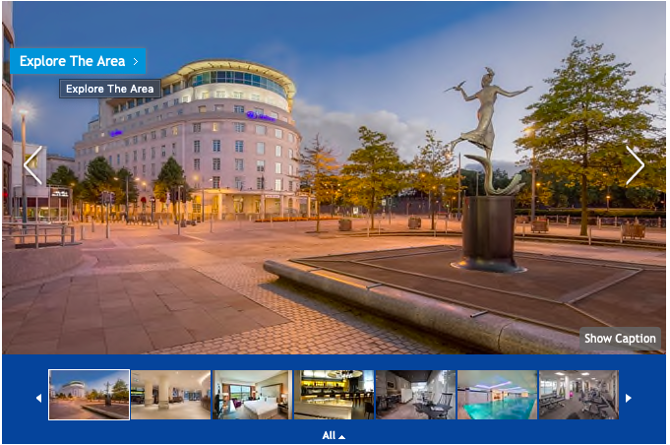
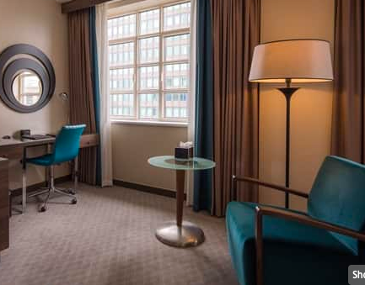
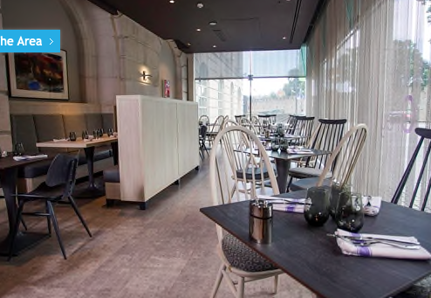
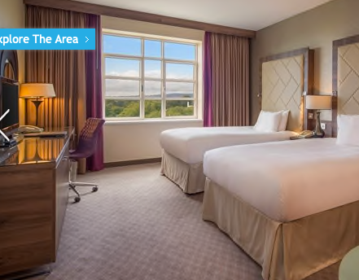
Some shots of the Hilton Hotel (Cardiff).
Screenshots taken from the Cardiff website.
Here is a little video of the Hotel I found on YouTube: https://www.youtube.com/watch?v=bKUG7-lAPUg

Slide 4
Political
With the United Kingdom being one of the biggest countries, its no doubt that the UK will attract many tourists.
However, the government can have a huge impact within the hotel industry and any political changes/steps taken by the government, it will have an affect for the hotel industry.
For example, when a new prime minister has been elected, they may have new ideas, and this can then impact the industry. Even just the political climate i.e. democracy of the country, the security.

Slide 5
Economic
The economic factors can be things such as; inflation, taxation changes, and interests.
If there was supposed to be any economic changes, for example Brexit it can affect the industry and because Britain decided to leave according to IBIS World (2019) 37.1% of the housekeeping staff in the United Kingdom are EU citizens.”
Also, if the currency is going up and down it can affect the vacation spot, so if the UK pound isn’t as strong compared to other places, people may likely want to go somewhere else.

Slide 6
Social
When it comes to booking a hotel, most will want to find a reasonable priced hotel and one of the biggest competition with the hotel industry is Airbnb’s especially within the younger generation.
If someone visits a place and “tourists get good treatment in the community spread the awareness and the social outlook gets changed due to tourism” (Westfordadmin, 2016).
During peak seasons hotels may run out of rooms and when they don’t, the prices may go up a little higher and this can then make someone be put off due to the prices and then make them book an Airbnb due to them being a bit cheaper, and faster.

Slide 7
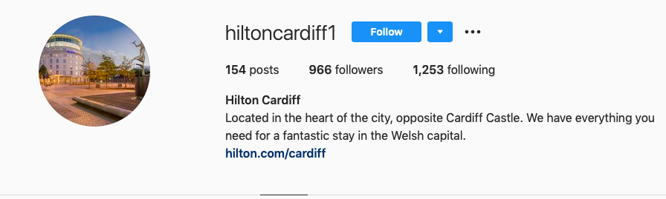
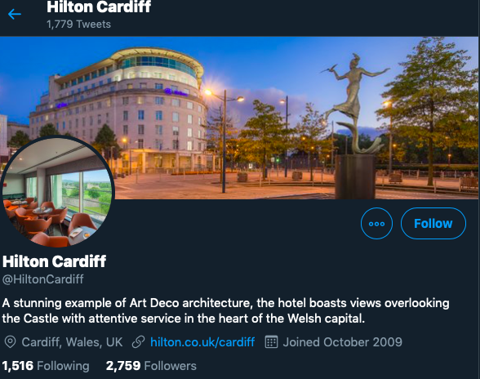
Technological
With technology becoming a huge part of nearly everyone's life, the hotel industry can take advantage of that.
Such as the Hilton in Cardiff have their own twitter and Instagram where they can post pictures, any upcoming events, and keep everyone updated when needed etc.
However, even though it can become an advantage to them, if there is are any negative comments about the hotel it can put customers off when they are searching for hotels to stay at.
Both screenshots of my own

Slide 8
Legal
All hotels need to have laws and regulations, such as rules that can affect the hotel building itself, tourism regulations, health and safety policies etc.
For example,
On the Hilton Cardiff website it shows some of their hotel policies such as; check-in/check-out, family and children, smoking, accessibility and any other details people can contact the hotel and speak to a member of staff.
Due to most hotels having restaurants, serving food/beverages etc. and Hilton Hotel being one of them, it is important that the hotel as their legal duties ensure that their food is being prepared in a hygienic and proper way, no foods being cross contaminated. As Frue, K (2019) states “The establishment needs to be honest about the calories in the good and nutritional ingredients of the dishes.”

Slide 9
Environmental
The environmental factors that can affect the hotel industry are storms, heavy rains or floods, and it is important that hotels can take measures and put them in place, whilst also controlling them on time, and this can then help minimize any troubles and allow them to handle the situations more easier.
The weather can play a huge part when someone wants to travel to places, so it is important that managers and the hotels can price the rooms fairly, even though they cannot control the weather but according to Frue, K (2019) “they must understand the seasonal differences before pricing their rooms.”

Slide 10
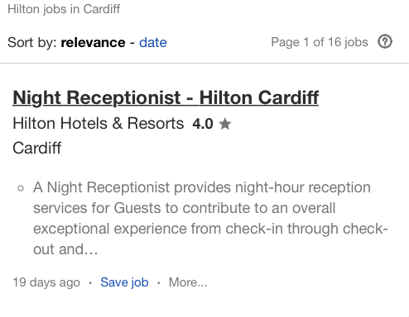
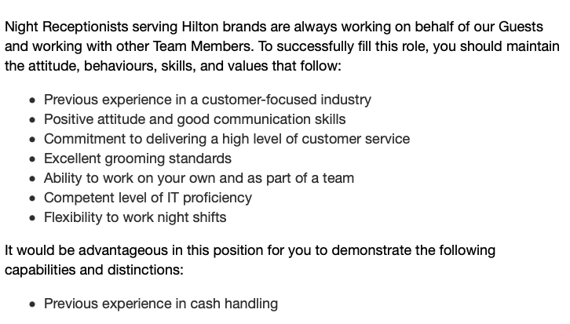
Recruitment and Selection
Within hospitality recruitment it is finding the right person for the job, just like any other jobs. The company can hire their candidates through online applications
For example, the Hilton Hotel in Cardiff can be found within job websites such as ‘Indeed’ and one of the jobs listed was ’night receptionist’ whilst also saying what they will be doing, what the hotel is looking for, what its like to work at the Hilton.
The hotel also has a chatbot that is on their careers site and it and help any candidates through their job application or applying for the job, then setting up an interview/assessment, and making the handoff to the recruiter who will later make an offer.
The importance of having effective recruitment and selection process is that for example, the Hilton Hotel will look for candidates by advertising their job positions and will then provide training for those that have been selected.
The hotel will also hire someone based within their skills and talent or preferences to the experienced candidate because when there is experience there is less training to be done

Slide 11

Culture, Equality and Diversity
Companies are legally required to have certain practices that will make sure that discrimination is being eliminated, and everyone is being treated the same at their workplace. Some of the acts are;
Human Right Acts, Equality Act, and Sex Discrimination Act.
The Hilton Hotel also has a brochure called ’Diversity & Inclusion at Hilton.’ Where it states this:
By having a workplace, that has diversity, different cultures and being equal it allows the hotel to offer variety of skills, ideas into their workplace, and giving their customers different experiences.
For example, staff will have different knowledge about different areas and can share that with their employees or if there is someone who speaks another language it can always come in handy if translating is needed.
Diversity & Inclusion at Hilton, Brochure.

Slide 12
Performance management and Targets achieved
Performance management is the process of ensuring that if there any any set of goals/aims are being met. It can be focusing on the performance of the hotel, certain departments or even an employee.
For example, when the Hilton Hotel in Cardiff had their job application online it said what was needed from the employee, what the hotel is looking for, part/full time, and the other criteria’s. The hotel can advertise their job via websites such as; Indeed, LinkedIn, Newspapers, and these can help them to get a greater audience.
As the Hotel may get a lot of applications through, they also have something called ‘HireVue’ which is a digital interview platform allowing the hotel to interview candidates at once and this can make the hiring process a bit easier for the recruiter.

Slide 13
Reference
IBISWorld (2019) How will Brexit impact the hotels industry? Available at: https://www.ibisworld.com/united-kingdom/market-research-reports/hotels-industry/ (Accessed: 6th March 2020).
Westford University College (2016) Social factors affecting travel industry. Available at: https://mywestford.com/blog/social-factors-that-impact-of-travel-and-tourism-industry/ (Accessed: 6th March 2020).
Hilton Hotel (unknown date) Diversity and Inclusion at Hilton. Available at: https://www.hilton.com/en/corporate/wp-content/uploads/2019/11/20190225_External-Diversity-Brochure.pdf (Accessed: 7th March 2020).
Frue, K (2019) PESTLE Analysis of the Hotel Industry. Available: https://pestleanalysis.com/hotel-industry-pestel-analysis/ (Accessed: 5th March 2020).
Indeed (2020) Night Receptionist- Hilton Cardiff. Available: https://www.indeed.co.uk/viewjob?jk=0c4075f7f89882b6&tk=1e30f2o9j40gt801&from=serp&vjs=3 (7th March 2020).
Solsequi (2018) Hilton Cardiff- Wales. [YouTube]. Available: https://www.youtube.com/watch?v=bKUG7-lAPUg (Accessed: 6th March 2020).

