Slide 1
Digital Skills Module
Week 4

Slide 2
Once you have collected data, what do you do?
Organise and present the data
Summarise the information numerically

Slide 3
Data Representation
Google Sheets

Slide 4
The use of tables
Remember that the objective of tabulation
and the use of graphs and charts is to
summarise information in such a way as to
create a simplified and clear picture of the
data.

Slide 5
Effective tabulation (conventions):
Simplification
Clear layout of figures into rows and columns
Row and column headings
A title for the complete table
The UNITS of the figures (if any ambiguity)
The source of the data
The use of SUMMARY rows and columns

Slide 6
Charts
Histograms
Bar charts
  Simple
  Stacked
  Multiple
Pie charts
Scatter Diagrams

Slide 7
Graphing Numerical Data: The Histogram
A graph of the data in a frequency distribution is called a histogram
The class boundaries (or class midpoints) are shown on the horizontal axis
The vertical axis is either frequency, relative frequency or percentage
Bars of the appropriate heights are used to represent the number of observations within each class

Slide 8
Frequency distribution:
Using Excel
Excel will construct a frequency distribution and plot a histogram if you have suitable input data.
You need the “Data Analysis Add-In” facility
Create a table with 2 columns
Column 1 all the frequency data
Column 2 class intervals (upper end)
Use “Data Analysis> Histograms”
Input Range : all frequency data
Bin range : class data

Slide 9
Bar Charts
The y-axis should start at 0 or comparisons can become distorted
The width of the bars does not matter, but should be similar for each bar
Gaps between the bars emphasise the trends in the data
Can be vertical or horizontal
Bar charts are more useful when you want to highlight the actual data values.

Slide 10
Example:
Country: USA Canada UK France Germany
Export: 700 350 170 210 480
(The figure quoted are given in $10 million)

Slide 11
Bar charts and pie charts
Compound bars allow several sets of data to be presented side-by-side for comparative purposes.
Stacked bars allow two or more sets of related data to be aggregated to show both individual trends and collective trends
Bar charts and pie charts are often used for categorical data
Height of bar or size of pie slice shows the frequency or percentage for each category

Slide 12
Pie Charts
Pie charts use simple data to emphasise differences or similarities.
Six categories of data is the maximum that can realistically be accommodated in a pie-chart.
Pie charts are commonly used to describe data from relative frequency distributions.
Data must first be converted to degrees of a full circle.
Full circle = 360 degrees
Exploded pie charts allow you to emphasise particular elements

Slide 13
Exploded pie chart
Region: North South East West
Sales: 25 10 45 25

Slide 14
Line Graphs
The line graph can be used to illustrate data in two situations.
  Firstly, the line graph is often used to illustrate data that is given over a certain time period.
  Line charts also prove very useful when you are interested in exploring patterns between two different types of data.
  They are also helpful when you have many data points and want to show all of them on one graph.

Slide 15
Line Graphs
Number of employees
Weekly earnings (£) 300 400 500 600 700 800
Company a 2 5 9 12 8 4
Company b 7 14 8 7 3 1

Slide 16
Sales by quarter for Three Sales Territories:

Slide 17
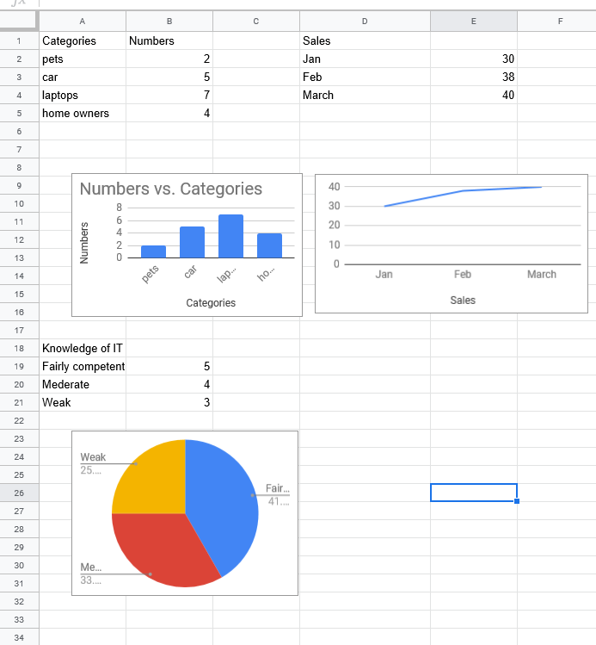
Google sheets

Slide 18
Exercise
Create a graph/ chart based on a question to your fellow students.

Slide 19
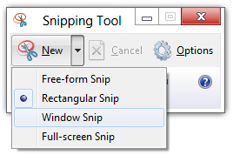
Snipping Tool
Notes:
Sometimes the easiest way to make a copy of something is to take a snapshot of your screen—this is what Snipping Tool does. Use it to save and share news stories, movie reviews, or recipes.
Capture all or part of your PC screen, add notes, save the snip, or email it from the Snipping Tool window. You can capture any of the following types of snips:
Free-form snip. Draw a free-form shape around an object.
Rectangular snip. Drag the cursor around an object to form a rectangle.
Window snip. Select a window, such as a browser window or dialog box, that you want to capture.
Full-screen snip. Capture the entire screen.
After you capture a snip, it's automatically copied to the Snipping Tool window. From there you can annotate, save, or share the snip. The following procedures show how to use Snipping Tool.

Slide 20

Hyper Links
Highlight the words
Insert the hyper link using the icon
Insert the URL

Slide 21
Summary
Insert Images and Hyper links into your Moodle blog
Snipping Tool
Google sheets

