Slide 1
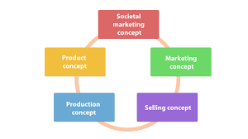
The most effective concept for business in 2025: Societal Concept
Claudiu Sbircea

Slide 2
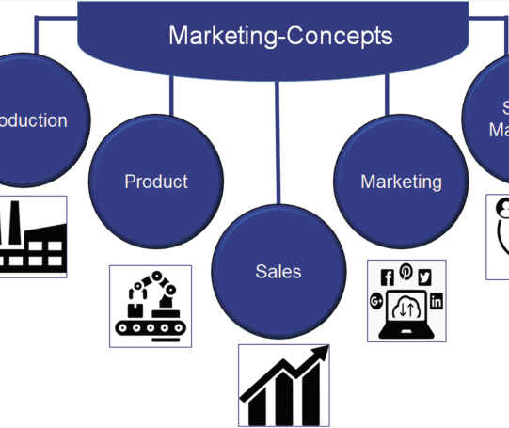
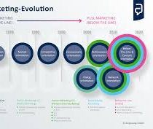

Introduction
Today's marketing concept involves five core approaches: production, product, selling, marketing and social marketing.
These cores represent different ways businesses are trying to satisfy customers and be successful.

Slide 3

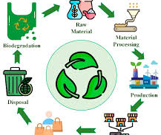

Definition of Societal Concept
The social marketing concept believes that business success depends on creating value that not only satisfies customers but also the public and the world.
Companies should try to satisfy customer needs in a manner that benefits their well-being and healthy planet.

Slide 4

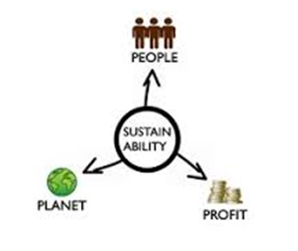
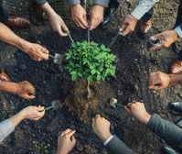
Societal Concept Explanations
The social marketing concept encompasses profit while being responsible to the customer and society.
It encourages companies to think about how their short-term business objectives coincide with long-term social and environmental well-being.

Slide 5
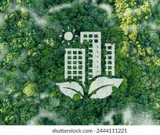

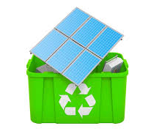
Why it fits for 2025 business?
In 2025, customers will expect brands to demonstrate ethical, sustainable practices with a purpose beyond profit.
The social marketing concept builds trust, brand loyalty and permits long-term organisation growth while being a responsible company.

Slide 6
References
Basha, M. (2023). Impact of artificial intelligence on marketing. East Asian Journal of Multidisciplinary Research, 2(3), 993-1004.
Brenkert, G. G. (2002). Ethical challenges of social marketing. Journal of Public Policy & Marketing, 21(1), 14-25.
Chen, L., Jiang, M., Jia, F., & Liu, G. (2022). Artificial intelligence adoption in business-to-business marketing: toward a conceptual framework. Journal of Business & Industrial Marketing, 37(5), 1025-1044.
Crane, A., & Desmond, J. (2002). Societal marketing and morality. European journal of marketing, 36(5-6), 548-569.
Hermann, E. (2022). Leveraging artificial intelligence in marketing for social good-An ethical perspective. Journal of Business Ethics, 179(1), 43-61.
Kumar, P. (2023). Principles of Marketing. Sultan Chand & Sons.
Kapoor, N. (2021). Principles of Marketing. PHI Learning Pvt. Ltd..
https://eightception.com/societal-marketing-guide/
https://thembains.com/societal-marketing-concept/

