Slide 1


WHY IS PSYCHOLOGY IMOPTANT WHEN WORKING AS A SOCIAL WORKER?
Module: Psychology for Health and Social Care (BMHP4003_BIRM)
University of Wales Trinity Saint Davids
Lecturer: Muhammad Hossain, Rebecca Kavanagh
Student: Zhasmina Krumova Georgieva (2026746)

Slide 2

Intorduction
IMPORTANCE OF PSYCHOLOGY IN SOCIAL WORK
SIGMUND FREUD THEORY
DO PEOPLE STILL RESPECT THEORIES?

Slide 3

PSYCHOLOGY IS IMPORTANT INGREDIENT OF SOCIAL WORK
DEFINITIONS
IMPORTANCE
RELEVANCE
This Photo by Unknown Author is licensed under CC BY-SA

Slide 4
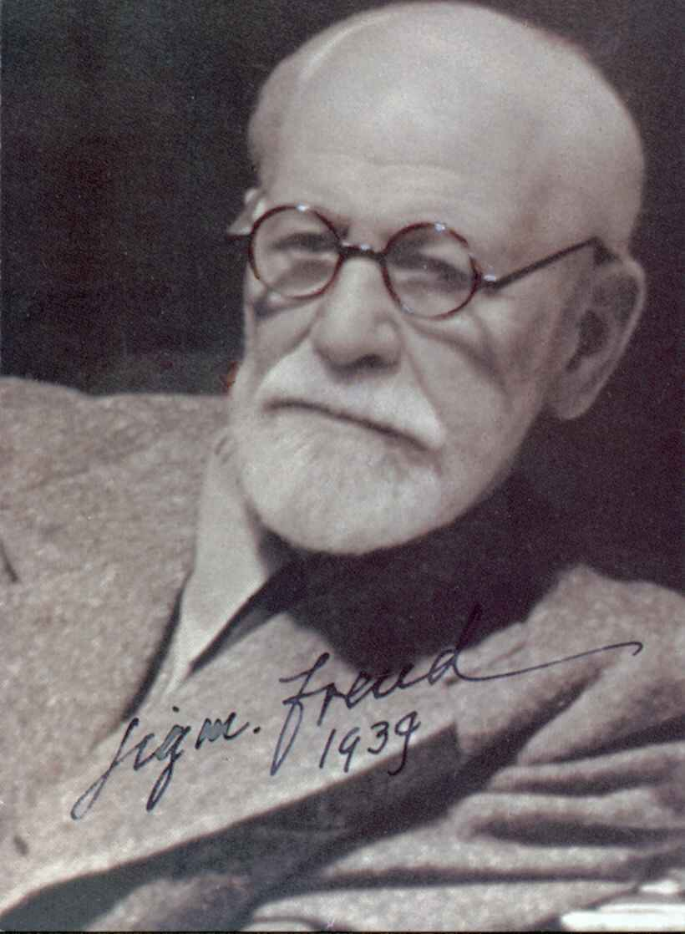
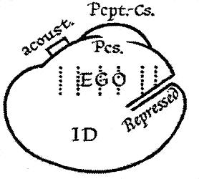
SIGMUND FREUD THEORY
ID
EGO
-SUPEREGO

Slide 5

SUPEREGO
FEELING OF GOOD AND WRONG, PRIDE AND SATISFACTION
THE CONSCIENCE OF THE HUMAN BEING
SUPEREGO MAKES THE PERSON PERFECT

Slide 6

Theories in Modern World

Slide 7
CONCLUSSION
PSYCHOLOGY IS CLOSELY RELATED TO SOCIAL WORK, HELPING TO DETERMINE THE FACTORS THAT AFFECT THE PSYCHE AND BEHAVIOR.
PSYCHOLOGY IS IMPORTANTAS WHEN WORKING AS A SOCIAL WORKER TO BE ABLE TO FIGHT PEOPLE’S INTERNAL RESISTANCES AND MENTAL BARRIERS.

Slide 8
REFERENCE LIST
Goldstein,E., (1995) Ego Psychology and Social Work Practice. 2nd Ed. New York: Third Avenue.
Hicks,L.,McNulty,J.,Faure,R.,(2020)Journal of Personalitu and Social Psychology [journal]Available at: https://reserachgate.net (Accessed: 27th July 2020).
Payne,M., (2020) Modern Social Work Theory. 5th Ed. London: Red Globe Press.
Rennison,N.,(2015) Freud and Psychoanalisis. The Rocket Essential.
Rollins,W.,(2019) Social worker – Client Relationship:Social worker Perspectives[article] Available at: https://doi.org/10.1080/0312407x.2019.1669687 (Accessed:24th Nov 2019).
Sawant,D.V., (2019). Psychology and Social Eork.Think India Journal, 161 – 168. (Accessed: https://thinkindiaquarterly.org/index/think-india/article/view/12414 )
Simon and Schuster, (2019) The EGO and The ID. 1st Ed. Vienna:Clydesdale Press.
Thurschwell,P., (2009) Sigmund Freud. 2nd Ed. London:Routledge.

