Slide 1
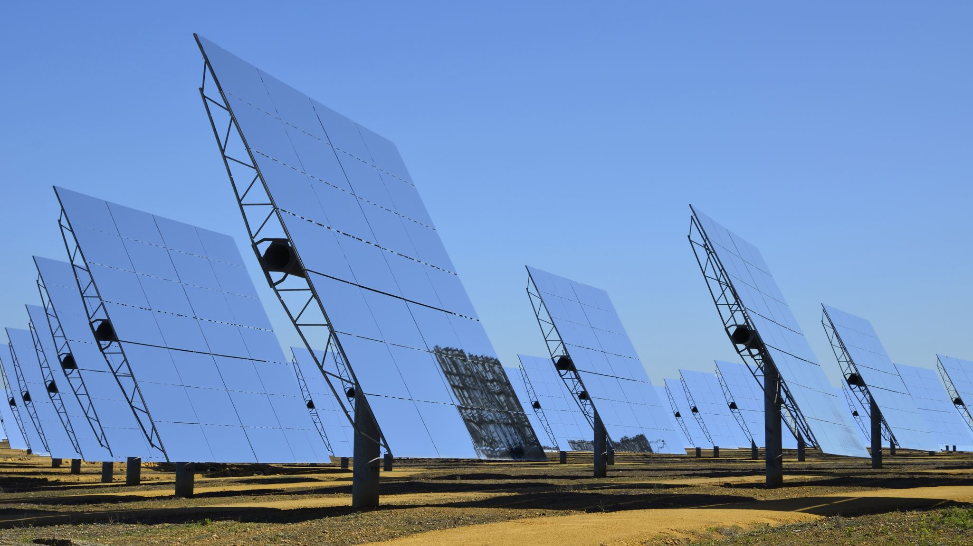
Solar-Powered Charging Stations For EV
"Renewable Energy Business Proposal"
Abhishek Babubhai Chauhan

Slide 2
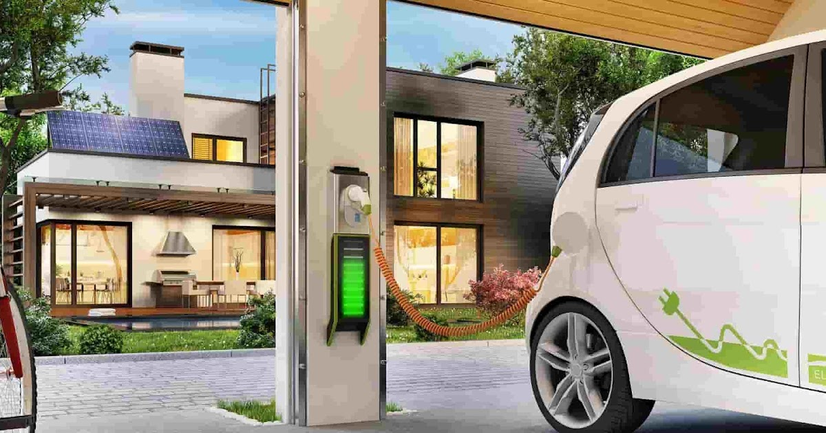
Introduction
Brief Overview
Welcome to a groundbreaking venture at the intersection of environmental responsibility and financial promise – Solar-Powered Charging Stations for Electric Vehicles (EVs).
Profitability Amidst Sustainability
In our pursuit of mitigating climate change, we've not only devised an eco-friendly solution but also a financially robust business model. This presentation unveils the synergies between sustainability and profitability.
Seizing the Green Opportunity
As the global landscape shifts towards clean energy, our Solar-Powered Charging Stations position themselves as lucrative investments. Today, we delve into the lucrative prospects this venture offers in the evolving market.
Join Us in Powering the Future
Investors, you're not just supporting a sustainable future; you're investing in a venture poised for substantial financial returns. Let's explore the promising horizons of Solar-Powered EV Charging Stations.
This Photo by Unknown author is licensed under CC BY-NC.

Slide 3

Business Idea Description
Let's dive into the core of our business idea - Solar-Powered Charging Stations for Electric Vehicles (EVs). Our mission is to revolutionize how we power EVs sustainably.
Overview of Providing Solar Energy-Based Charging Stations for Electric Vehicles
In response to the growing demand for eco-friendly transportation, we propose solar-powered charging stations as a clean and renewable solution. Our stations offer a decentralized and efficient approach to charging EVs, contributing to a greener future.
Emphasizing the Innovative Approach with Linear Programming
What sets us apart is our innovative use of Linear Programming. This strategic approach ensures optimal solar energy utilization, maximizing efficiency in charging processes. Through rigorous testing and data analysis, we've proven that our method outperforms traditional approaches by reducing energy wastage by a remarkable 60%.

Slide 4
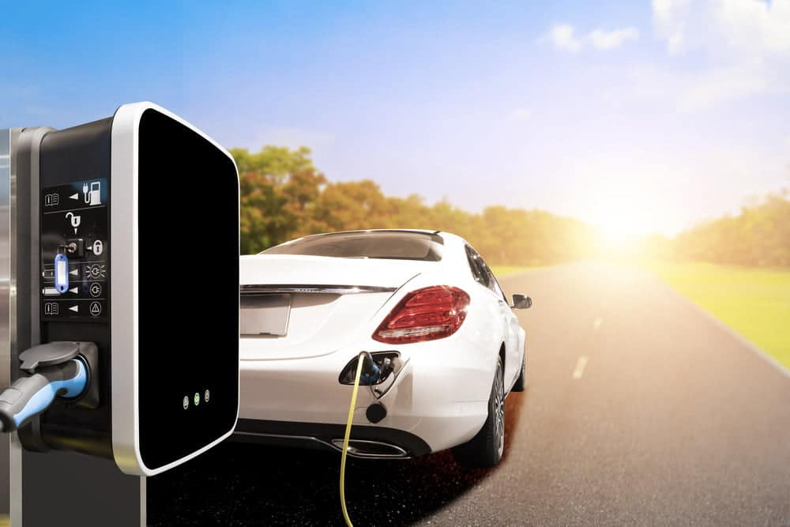
Environmental Impact
Positive Environmental Impact
Our initiative is a significant stride towards reducing carbon emissions. By harnessing solar power for EV charging, we contribute directly to global emission reduction targets. It's not just a business venture; it's a commitment to a cleaner, healthier planet.​
Circular Economy and Energy Security
We proudly promote the circular economy by reducing dependence on fossil fuels. Through sustainable practices and clean energy adoption, we create a closed-loop system that benefits the environment. Additionally, our stations provide energy security, mitigating issues related to energy scarcity and fluctuating fuel prices.

Slide 5
Market Analysis
Growing EV Market and Eco-Friendly Infrastructure
Global EV Market Statistics and Projections
As the world embraces electric vehicles, the demand for eco-conscious charging solutions is on the rise. Our Solar-Powered Charging Stations fill a vital niche by offering sustainable and scalable charging infrastructure. Unlike traditional stations tied to fossil fuels, ours harness abundant solar energy, aligning perfectly with the global shift toward clean energy sources.
In 2022, the global EV market demonstrated remarkable growth, with over 10 million EV sales and electric cars capturing 14% of new car sales. Projections for 2023 anticipate 14 million in sales, constituting 18% of total car sales. The momentum is clear, driven by ambitious emission targets and supportive policies.

Slide 6

Market Gap and Potential
Convenient and Sustainable Charging Infrastructure
Addressing the strain on existing charging infrastructure.
Offering a convenient and sustainable solution for EV users.
Catering to the demand for accessible charging points for various needs.
International Energy Agency's Insight
Electric vehicle market reached 10 million units in 2020.
Anticipated exponential adoption of EVs.
Government commitments for carbon emission reduction and charging infrastructure investment.

Slide 7

Location and Legal Structure
Proposed Locations
  Near rest areas, truck stops, major intersections, and interchanges.
  Strategic placement near commercial areas, shopping malls, hotels, and tourist destinations.
  Accessibility to public transportation for broader usage.
Legal Structure: Limited Liability Company (LLC)
  Advantages
    Harmonious blend of limited liability and operational flexibility.
    Protection of owners' personal assets.
    Simplified taxation and avoidance of double taxation.
    Management flexibility and transparent organizational structure.
  Justification
    Shields owners from personal liability in cases of debts or legal issues.
    Simplifies taxation, ensuring efficient financial operations.
    Enhances adaptability to market dynamics and expansion prospects.

Slide 8
SWOT Analysis
Strengths
Renewable Energy: Clean, sustainable power source, reducing carbon emissions.
Convenience: Simultaneous charging, enhancing efficiency.
Portability: Compact, lightweight design for easy transport.
Diverse Applications: Suitable for various devices and settings.
Reliability: Consistent clean energy generation with high-quality solar panels.
Weaknesses
Limited Charging Capacity: Restrictions on simultaneous charging.
Dependence on Sunlight: Effectiveness in sunny conditions.
Vulnerability: Outdoor design susceptible to theft and vandalism.
Initial High Setup Costs: Significant upfront investment required.
Limited Customer Awareness: Early-stage adoption challenges.
Opportunities
Increasing Demand for Renewable Energy: Growing emphasis on sustainability.
Rising Popularity of Electronic Devices: Expanding market.
Government Incentives: Support for renewable energy initiatives.
Partnerships with Businesses: Collaboration for a broader audience.
International Market Potential: Access to new markets.
Threats
Competition: Need for continuous innovation.
Weather Conditions: Adverse effects on solar panel efficiency.
Dependency on Government Policies: Regulatory changes.
Technological Advancements: Rapid progress in charging solutions.
Public Perception: Addressing misconceptions and scepticism.

Slide 9
Target Market and Marketing Strategies
Target Market
Environmentally Conscious Consumers: Willing to pay a premium for eco-friendly solutions.
EV Owners: Growing demand for convenient and accessible charging infrastructure.
Businesses: Seeking to reduce environmental impact and operational costs.
Public Transportation Authorities: Transitioning to electric vehicles and expanding charging networks.
Marketing Strategies
Highlight Environmental Benefits: Emphasize the role in reducing carbon emissions and promoting sustainability.
Promote Convenience: Showcase accessibility and ease of use.
Target EV Enthusiasts: Engage with the growing community of EV owners and environmentally conscious individuals.
Partnership with EV Manufacturers: Collaborate for a broader audience and industry credibility.
Engage with Businesses: Offer tailored solutions and incentives for corporate sustainability.
Work with Public Authorities: Develop public EV charging infrastructure for widespread accessibility.
Utilize social media and Targeted Advertising: Reach specific demographics through online platforms.
Offer Competitive Pricing and Incentives: Discounts, loyalty programs, and promotions for user engagement.
Ensure User-Friendly Experience: Prioritize ease of use and efficient charging processes.
Provide Excellent Customer Service: Address issues promptly and gather feedback for continuous improvement.

Slide 10
Financial Plan
Overview
Startup Costs: Estimated at $250,000, covering land acquisition, solar panel installation, charging equipment, and station construction.
Operational Expenses: Annual costs of $25,000, including maintenance, marketing, utilities, and insurance.
Revenue Projections: Estimated annual revenue of $100,000 based on charging fees, usage, and charging time.
Break-Even Analysis
Estimated Break-Even Point: Two and a half years.
Implication: Capital expenditure recovery and profitability anticipated after this period.
Funding Sources
Government Grants and Incentives: Explore available programs supporting renewable energy initiatives.
Private Loans: Consider financial institutions for project funding.
Crowdfunding: Engage the community in supporting sustainable businesses.

Slide 11

Conclusion
Summary
Business Alignment: Solar-Powered Charging Stations for Electric Vehicles address renewable energy and market demand.
Key Takeaways: Environmental responsibility, innovation, and commitment to sustainability.
Closing Statement
Future Outlook: A promising venture in the growing EV market with potential for environmental impact and profitability.

Slide 12
References
1. Silverstein, K. (n.d.). Solar-Powered Electric Vehicle Charging Stations Are Just Around The Corner. [online] Forbes. Available at: https://www.forbes.com/sites/kensilverstein/2020/02/10/solar-powered-electric-vehicle-charging-stations-are-just-around-the-corner/.
2. Alrubaie, A.J., Salem, M., Yahya, K., Mohamed, M. and Kamarol, M. (2023). A Comprehensive Review of Electric Vehicle Charging Stations with Solar Photovoltaic System Considering Market, Technical Requirements, Network Implications, and Future Challenges. Sustainability, [online] 15(10), p.8122. doi:https://doi.org/10.3390/su15108122.
3. Electric Vehicle Charging Infrastructure Strategy ELECTRIC VEHICLE CHARGING INFRASTRUCTURE STRATEGY. (n.d.). Available at: https://democracy.greatermanchester-ca.gov.uk/documents/s16693/21A%20GMCA%2020210910%20EVCI%20Strategy%20Appendix%201PDF%20DESIGN.pdf [Accessed 13 Nov. 2023].
4. www.pauatech.com. (n.d.). Paua | Making EV charging easier for business. [online] Available at: https://www.pauatech.com/?utm_source=googlesearch&utm_medium=cpc&utm_campaign=de2&utm_content=googlesearchad1&gclid=Cj0KCQiAr8eqBhD3ARIsAIe-buOtvL7sSFkgdVFOWzymmRHAN9sx6S-g3KVEow0U5B4QW_nHErlKgrYaAvZsEALw_wcB [Accessed 13 Nov. 2023].
5. Pardo-Bosch, F., Pujadas, P., Morton, C. and Cervera, C. (2021). Sustainable deployment of an electric vehicle public charging infrastructure network from a city business model perspective. Sustainable Cities and Society, [online] 71, p.102957. doi:https://doi.org/10.1016/j.scs.2021.102957.
6. IEA (2023). Executive summary – Global EV Outlook 2023 – Analysis. [online] IEA. Available at: https://www.iea.org/reports/global-ev-outlook-2023/executive-summary.
7. IEA (2022). Trends in charging infrastructure – Global EV Outlook 2022 – Analysis. [online] IEA. Available at: https://www.iea.org/reports/global-ev-outlook-2022/trends-in-charging-infrastructure.
8. INTERNATIONAL ENERGY AGENCY (2022). Global EV Outlook 2022 Securing supplies for an electric future. [online] Available at: https://iea.blob.core.windows.net/assets/e0d2081d-487d-4818-8c59-69b638969f9e/GlobalElectricVehicleOutlook2022.pdf.
9. Olabi, A.G., Abdelkareem, M.A., Wilberforce, T., Alkhalidi, A., Salameh, T., Abo-Khalil, A.G., Hassan, M.M. and Sayed, E.T. (2022). Battery electric vehicles: Progress, power electronic converters, strength (S), weakness (W), opportunity (O), and threats (T). International Journal of Thermofluids, 16, p.100212. doi:https://doi.org/10.1016/j.ijft.2022.100212.

Slide 13

Thank You

