Slide 1
2. Collaboration in action: The critical role of teamwork in achieving success
Content page
What is a team?
Examples of ways that the police work as a team
5 stages of team development
Principles of teamwork
How to achieve shared goals by working effectively as a team
Effective teamworking barriers
Example of when teamwork and collaboration went wrong

Slide 2
What is a team?
A team is a group of individuals with complementary abilities who are dedicated to a shared mission, performance objectives, and a collective strategy , for which they hold each other accountable (Katzenbach, 1992).
It’s important as police officers to work as a team as it’s needed to do the job effectively as it’s a continuous part of an officer's life
Good teamworking skills is an important part of being a good police officer as it can help improve decision making, problem solving and increase safety of other officers

Slide 3
Examples of ways that the police work as a team
Call handlers- Call handlers are needed to help police officers respond to situations and emergencies efficiently. They work as a team with the police as they decide if any special units need calling for each situation.
Armed firearms officers- These are officers who deal with critical situations such as counter-terrorism operations.
Dealing with riots- Police officers work as a team to deal with riots by pre planning what’s needed by getting pre information on the scale of the riots. The officers also work as a team as they often need to stand in a line to prevent any escalation of violence and it creates a barrier between any property or people and the rioters

Slide 4
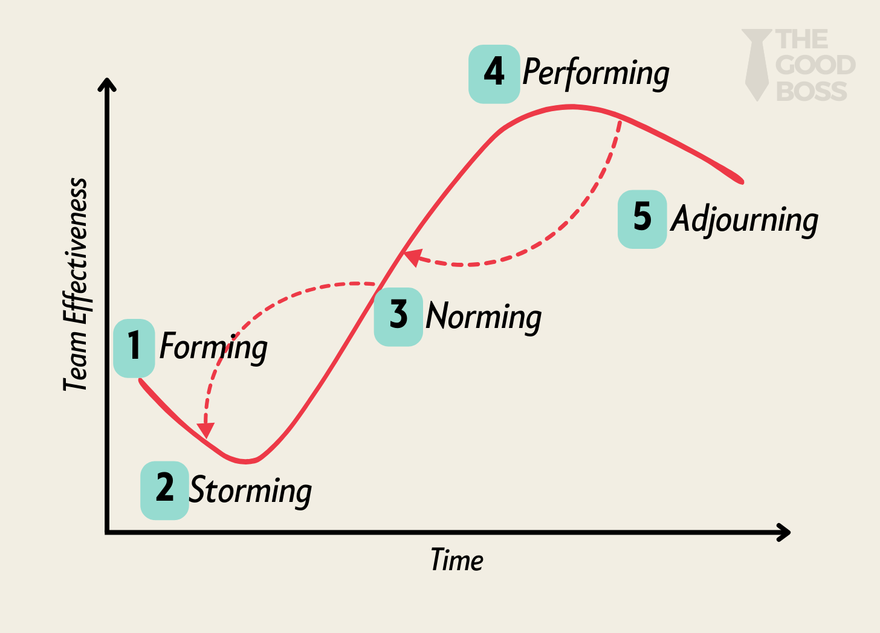
5 stages of team development
Tuckman (1964) created the model to the right which shows the stages that teams go through and how to use it towards improving effective teamwork.
Tuckman stated that new teams could not come together straight away and work smoothly as there was 5 stages of development that a group would need to go through to develop.
The stages were forming; storming; norming and performing before another stage was added later called mourning (Tuckman and Jenson, 1977)

Slide 5
Principles of teamwork and collaboration
One principle of effective teamwork is to embrace diversity. Teams filled with diversity will bring a variety of experiences, perspectives and skills to the group.
There are resources used within the police to embrace diversity for things such as disabilities, gender, religion and race
The police race action plan is an example of one of the plans followed that gives black people better outcomes who get in touch or work for the police (College of policing, 2024).

Slide 6
Further teamworking principles
the function of a team doesn’t work properly if there’s no trust because a lack of trust would mean a lack of effective collaboration and communication (Morita & Burns, 2014).
Another fundamental principle of effective teamwork is to take part in continuous learning as it’s important to move with the times by evolving. This would require individuals of the team to develop and train further on the job to gain any new knowledge or skills needed.
Cook (2021) states that there are over 50 resources available for Police to look at that are under sections such as powers, wellbeing resources, investigation, awareness and legislation.

Slide 7
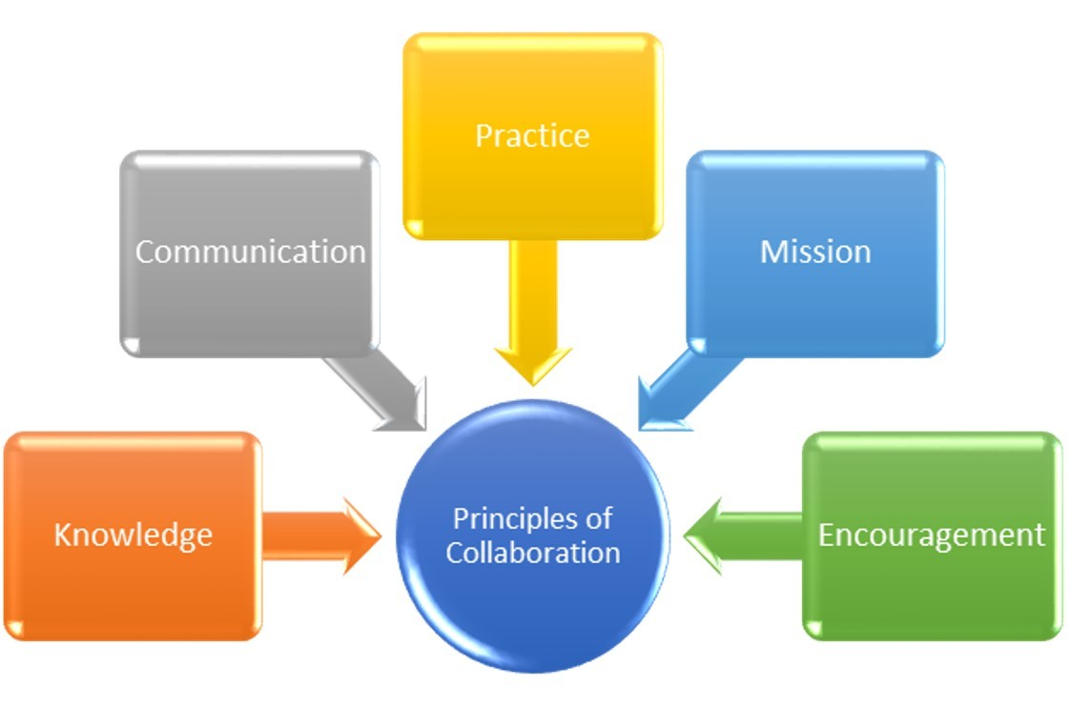
5 Principles of collaboration
Powell (2020) image to the right shows that the 5 principles of collaboration are
Knowledge
Communication
Practice
Mission
Encouragement

Slide 8

How to achieve shared goals by working effectively as a team
This can be done by communicating and collaborating well with other team members by setting goals and aligning individuals to specific responsibilities and value how it will contribute to the team.
Open communication and active listening would allow the team to work effectively by taking on everyone's concerns and ideas.
The Police officers sharing a room with the PSC are there to allow for expeditious responses if reports came in of a missing person (South Wales Police, 2024).

Slide 9

Effective teamworking barriers
Doyle (2008) found a variety of barriers of effective teamworking through his study that looked at facilitators and barriers of nursing that had a multidisciplinary team working with them. Some examples of the barriers found are:
Increased workload
not enough confidence and trust in the other members
constant reorganization
bad communication
roles and responsibilities of team members not acknowledged or appreciated,
not enough resources or time

Slide 10
Example of when teamwork and collaboration went wrong
Ariana Grande concert, Manchester arena attack- This was when a man near the arena had an explosive device whose aim was to kill people. The man exploded the device in the foyer of the arena which ended up killing 22 people including children.
One failure that night was the British transport police as some of them were designated to the foyer room wear the man exploded the device.
Collaboration between services didn’t run effectively as the fire service in Manchester were deployed 2 hours after the event due to them not receiving any communications from the Police (Harvey, 2023).

Slide 11

Research timeline
19 Nov. 24
What is a team
21 Nov. 24
Examples of ways that the police work as a team
22 Nov. 24
5 stages of team development
25 Nov. 24
Principles of teamwork and collaboration
26 Nov. 24
How to achieve shared goals by working effectively as a team
1 Dec. 24
Effective teamworking barriers
4 Dec. 24
Example of when teamworking and collaboration went wrong

Slide 12
Reference list
College of Policing (2024), Police Race Action Plan. Available at https://www.college.police.uk/support-forces/diversity-and-inclusion/action-plan. (Accessed 25/11/24).
Cook, T (2021), CPD resources for response officers. Available at: https://www.college.police.uk/article/cpd-resources-response-officers. (Accessed 25/11/24).
Doyle, J (2008), 'Barriers and facilitators of multidisciplinary team working: a review', Paediatric Nursing 20(2), 26-29.
Harvey, R (2023), Case study: Ariana Grande, Manchester arena attack. Available at:
https://theisrm.org/en/case-study-ariana-grande-manchester-arena-attack. (Accessed 04/12/24).
Katzenbach, J R and Smith, D K (1992), 'Why teams matter', The McKinsey Quarterly (3), McKinsey & Company, Inc
Morita, P P and Burns, C M (2014), 'Trust tokens in team development' Team Performance Management 20(½), 39-64 available at https://www.emerald.com/insight/content/doi/10.1108/TPM-03-2013-0006/full/html. (Accessed 25/11/24).

Slide 13
Powell, M (2020), The 5 Principles of Collaboration. [online] Available at:
https://www.linkedin.com/pulse/5-principles-collaboration-marvin-powell. (Accessed 25/11/24).
South Wales Police (2024), 999/101 Call handlers. Available at:
https://www.south-wales.police.uk/police-forces/south-wales-police/areas/careers/careers/uniformed/public-service-centre-operators/. (Accessed 26/11/24).
Tuckman, B W (1964), 'Personality structure, group composition, and group functioning', Sociometry 27(4), 469-487.
Tuckman, B W and Jensen, M A (1977), 'Stages of small-group development revisited', Group and Organization Studies 2(4), 419-427.

