Slide 1
ECAD5004C
Rachel Wallis / Nerys Defis/Helen Denny
07/03/19

Slide 2
Dyfnder
dealltwriaeth mewn Mathemateg
Depth of understanding in Mathematics

Slide 3
Amcanion y sesiwn
Session objectives
Dadansoddi beth yw ystyr deall mathemateg
Adnabod a dadansoddi ffyrdd o ddatblygu dyfnder dealltwriaeth mewn mathemateg
Analyse what it means to understand mathematics
Identify and analyse ways of developing depth of understanding in mathematics

Slide 4
Sawl nawfed sy mewn un
trydydd ?
Nawr gwethiwch allan:
2/3 ÷ 1/9
How many ninths are there in one third?
Now work out:
2/3 ÷ 1/9

Slide 5
Tasg / Task
Sut ydych yn gwybod eich bod yn deall y cysyniadau hyn?
Sut fyddech yn gwybod os yw plentyn yn deall syniad mathemategol?
How do you know if you understand these concepts?
How would you know if a child understands a mathematical idea?

Slide 6
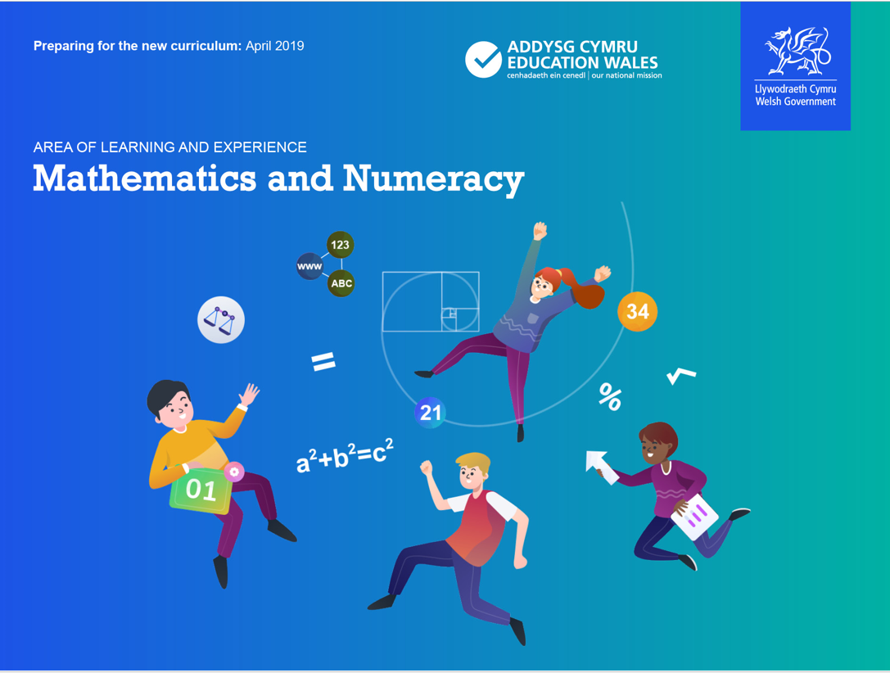
Datblygiadau Diweddaraf
Latest Developments
https://beta.gov.wales/preparing-new-curriculum-update-feb-2019
https://curriculumforwales.gov.wales/2018/09/05/new-animation-how-wales-new-curriculum-and-assessment-arrangements-are-being-built-on-progression/
Notes:
At present there are 6 strands within the KS2 Programme of Study.
The new Mathematics and Numeracy AoLE is focused around 4 “What matters?” i.e. 4 key elements
(See below copied from Slide 7 of above link):
Learners will discover that the number system is used to represent and compare relationships between numbers and quantities.
Learners will come to appreciate how algebra uses symbol systems to express the structures of relationships between numbers, quantities and relations.
Learners will come to understand that geometry focuses on relationships involving properties of shape, space, and position, and that measurement focuses on quantifying phenomena in the physical world.
Learners will see that statistics represent data, probability models chance, and that both support informed inferences and decisions.

Slide 7
Sut mae’n wahanol?
Wedi’i drefnu ar sail pum hyfedredd mathemategol.
Yn rhoi cyfle i ddysgwyr ddefnyddio trinolion a chynrychioli cysyniadau mewn amryw o ffyrdd.
Yn defnyddio berfau fel ‘archwilio’ a ‘deillio’ er mwyn sicrhau cydbwysedd rhwng ‘ehangder’ a ‘dyfnder’.
Notes:
Mae'r cwricwlwm Mathemateg a Rhifedd yn seiliedig ar bum medr mathemategol, a eglurir mewn sleidiau diweddarach, sydd wedi'u defnyddio i lywio'r deilliannau cyflawniad.
Dylai pob dysgwr gael cyfleoedd i ddefnyddio sgiliau trin a thrafod ac i gynrychioli cysyniadau mewn amrywiaeth o ffyrdd, gan gynnwys gosodiadau llafar, concrid, gweledol, digidol a haniaethol.
Defnyddir berfau tebyg i ‘archwilio’ a ‘deillio’ er mwyn sicrhau cydbwysedd addas rhwng 'ehangder' a 'dyfnder'.

Slide 8
Sut mae’n wahanol?
Hyfedreddau mathemategol
Mae’r hyfedreddau rhyngddibynnol a ddefnyddir i ddatblygu’r disgrifiadau o ddysgu yn ganolog i gynnydd ym mhob cam o ddysgu mewn mathemateg. Mae rhifedd yn golygu cymhwyso a chysylltu’r hyfedreddau hyn mewn ystod o gyd-destunau go iawn. Y pum hyfedredd mathemategol yw:
dealltwriaeth cysyniadol
rhuglder
cyfathrebu gyda symbolau
rhesymu rhesymegol
cymhwysedd strategol.
Notes:
Dealltwriaeth gysyniadol: Dylid adeiladu ar gysyniadau a syniadau mathemategol, yn ogystal â'u dyfnhau a'u cysylltu, wrth i'r dysgwyr ymdrin â syniadau mathemategol cynyddol gymhleth. Mae dysgwyr yn arddangos dealltwriaeth gysyniadol drwy allu egluro a mynegi cysyniadau, dod o hyd i enghreifftiau o waith da a gwael, a chynrychioli cysyniadau mewn ffyrdd gwahanol, gan ddefnyddio gosodiadau gwahanol, yn cynnwys rhai llafar, concrid, gweledol, digidol a haniaethol.
Cyfathrebu â symbolau: Dylai'r dysgwyr ddeall bod y symbolau y maent yn eu defnyddio yn osodiadau haniaethol, ac y dylent ddatblygu mwy o hyblygrwydd wrth gymhwyso a thrin amrywiaeth gynyddol o symbolau, gan ddeall confensiynau'r symbolau hynny.
Cymhwysedd strategol (y gallu i greu problemau ar ffurf fathemategol er mwyn eu datrys): Dylai'r dysgwyr ddod yn gynyddol annibynnol wrth gydnabod a chymhwyso'r syniadau a'r strwythurau mathemategol sylfaenol mewn problem, er mwyn gallu ei datrys.
Rhesymu rhesymegol: Wrth i'r dysgwyr ymdrin â chysyniadau cynyddol gymhleth, dylent hefyd feithrin dealltwriaeth o'r cydberthnasau sy'n bodoli oddi mewn i'r cysyniadau hyn, yn ogystal â rhyngddynt. Dylent gymhwyso rhesymu rhesymegol at y cydberthnasau hyn, a gallu eu cyfiawnhau a'u profi. Dylai'r modd y maent yn cyfiawnhau ac yn profi ddod yn gynyddol haniaethol, gan symud oddi wrth esboniadau llafar a gosodiadau gweledol neu ddiriaethol i osodiadau haniaethol, sy'n cynnwys symbolau a chonfensiynau.
Rhuglder: Wrth i'r dysgwyr ymdrin â chysyniadau a chydberthnasau cynyddol gymhleth, ynghyd â'u deall a'u cymhwyso, dylai eu rhuglder wrth gofio ffeithiau, cydberthnasau a thechnegau dyfu, gan olygu bod y ffeithiau, y cydberthnasau a'r technegau a ddysgwyd yn flaenorol yn cael eu sefydlu'n gadarn, ac yn cael eu cofio a'u defnyddio.

Slide 9
How is it different?
    Organised around five mathematical proficiencies.
    Gives learners opportunities to use manipulatives and represent concepts in a variety of ways.
    Use verbs such as ‘explore’ and ‘derive’ to ensure balance between ‘breadth’ and ‘depth’.
Notes:
The Mathematics and Numeracy curriculum is organised around five mathematical proficiencies explained in later slides, which have been used to shape the achievement outcomes.
All learners should have opportunities to use manipulatives and represent a concept in a variety of ways, including verbal, concrete, visual, digital and abstract representations.
Verbs such as ‘explore’ and ‘derive’ are used to ensure a suitable balance between ‘breadth’ and ‘depth’.

Slide 10
How is it different?
Mathematical proficiencies
These inter-dependent proficiencies used in developing the descriptions of learning are central to progression at each stage of mathematics learning. Numeracy involves applying and connecting these proficiencies in a range of real-life contexts. The five mathematical proficiencies are:
conceptual understanding
fluency
communication with symbols
logical reasoning
strategic competence.
Notes:
Conceptual understanding: Mathematical concepts and ideas should be built on, deepened and connected as learners experience increasingly complex mathematical ideas. Learners demonstrate conceptual understanding through being able to explain and express concepts, find examples (or non-examples) and by being able to represent a concept in different ways, flowing between different representations including verbal, concrete, visual, digital and abstract.
Communication with symbols: Learners should understand that the symbols they are using are abstract representations and should develop greater flexibility with the application and manipulation of an increasing range of symbols, understanding the conventions of the symbols they are using.
Strategic competence (formulating problems mathematically in order to solve them): Learners should become increasingly independent in recognising and applying the underlying mathematical structures and ideas within a problem, in order to be able to solve them.
Logical reasoning: As learners experience increasingly complex concepts, they also should develop an understanding of the relationships between and within these concepts. They should apply logical reasoning about these relationships and be able to justify and prove them. Justifications and proof should become increasingly abstract, moving from verbal explanations, visual or concrete representations to abstract representations involving symbols and conventions.
Fluency: As learners experience, understand and apply increasingly complex concepts and relationships, fluency in remembering facts, relationships and techniques should grow, meaning that facts, relationships and techniques learned previously should become firmly established, memorable and usable.

Slide 11
Sut i ddatblygu dealltwriaeth ddofn?
How to develop a deep understanding?
Ystyriwch y ‘Model ar gyfer dealltwriaeth’ er mwyn dadansoddi’r clipiau fideo.
Consider the ‘Model of understanding’ to help you analyse the video clips

Slide 12
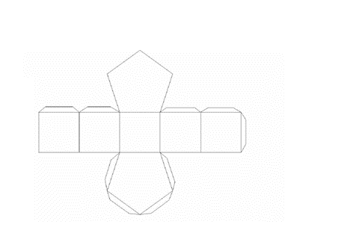
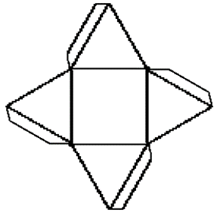
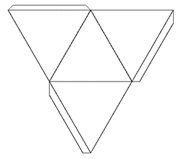

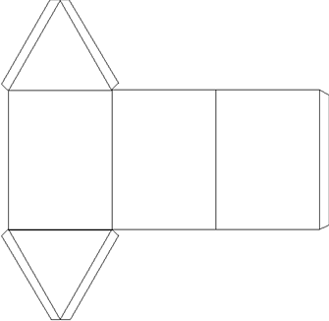
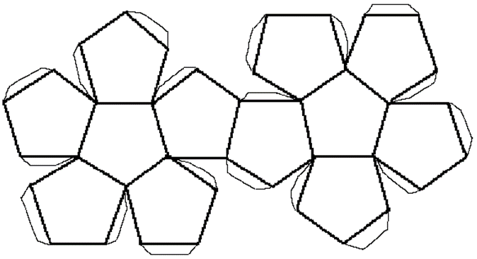
Dyma rwydi rhai siapiau 3D, enwch y siâp 3D y bydd pob rhwyd yn ei wneud:
Here are the nets of some common 3D shapes, give the correct technical name for the 3D shape that each net will make:
Sut allech newid y cwestiwn hwn i ddatblygu dyfnder dealltwriaeth o siapiau 3D?
How could you change this question to develop greater depth of understanding in 3D shapes?

Slide 13
Cyswllt gyda’r Aseiniad
Links to the assignment
Adfyfyria: Sut wyt ti’n sicrhau dyfnder dealltwriaeth o beth a addysgwyd yn yr ysgol PAP?
Bydd argymhellion ar gyfer gwneud cynnydd yn fwy na ‘symund i fyny lefel’, bydd hefyd angen sicrhau dyfnder dealltwriaeth.
Reflect: How do you ensure depth of understanding in what was being taught in your PTE school?
Recommendations for making progress will be more than ‘moving up a level’ it will also need to ensure depth of understanding.

