Slide 1
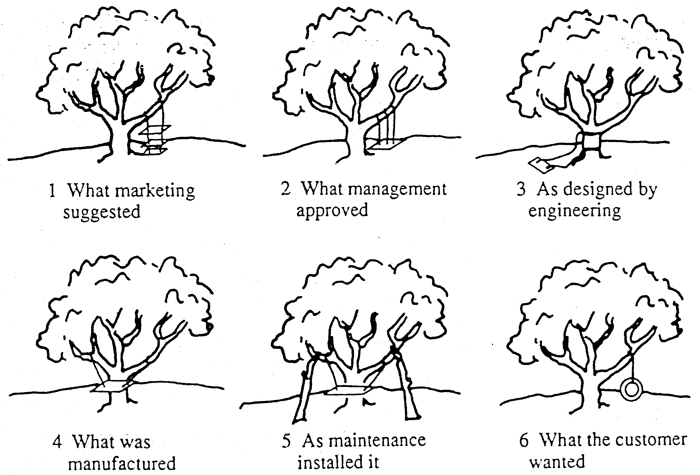
What is “Quality?”

Slide 2
What is “Quality”?
In small groups spend 5 minutes
  Developing a definition for quality
  Identifying the characteristics of quality

Slide 3
The various definitions of quality (Garvin)
The transcendent approach views quality as synonymous with
innate excellence
The manufacturing-based approach assumes quality is all
about making or providing error-free products or services
The user-based approach assumes quality is all about
providing products or services that are fit for their purpose
The product-based approach views quality as a precise &
measurable set of characteristics
The value-based approach defines quality in terms of ‘value’

Slide 4
Quality – a Definition
Quality is consistent conformance to customers’ expectations

Slide 5
Understanding Quality
At its heart, quality is the result of a sequence of activities embodied in a process within the business. The advantage of looking at it in this way is that it becomes possible to map the process and monitor and measure the outputs – and to use this information to identify where and how the process itself can be improved. This kind of thinking is central to the original statistical approaches developed in the early part of the century but it can be applied on a broader scale to explore all the areas where quality is introduced, and to the influences on the process.

Slide 6
Quality is part of our Lives!
Quality is not an option in most walks of life. For example, it would be unthinkable for airline pilots or hospital midwives to aim for anything less than perfection in what they do, and nonsense to think of only trying for an ‘acceptable ‘ level of failure – one plane crash in a hundred or one baby dropped per five hundred deliveries!

Slide 7
Past Perceptions of Quality
Much of the early theory of manufacturing contained terms and concepts such as ‘acceptable quality level’ and an underlying philosophy which assumed mistakes would happen and that things would go wrong. This fed across into the development of services and became part of the underpinning assumptions about operations. Quality was seen as important but the belief was that with complex products and services being delivered via complicated processes there would inevitably be defects and problems which could not be predicted or prevented

Slide 8
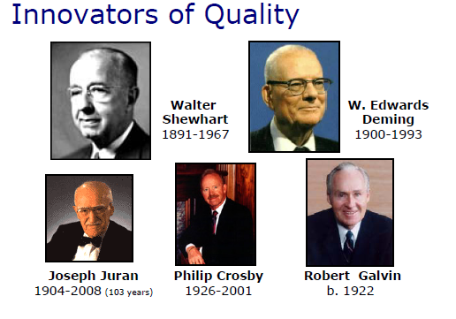

Slide 9
Major writers on Quality: Crosby
Crosby's response to the quality crisis was the principle of "doing it right the first time" (DIRFT). He would also include four major principles:
      the definition of quality is conformance to requirements
      the system of quality is prevention
      the performance standard is zero defects
      the measurement of quality is the price of nonconformance

Slide 10
Major writers on Quality: Deming
The points were first presented in his book Out of the Crisis. (p. 23-24)[
1. Create constancy of purpose toward improvement of product and service, with the aim to become competitive and stay in business, and to provide jobs.
2. Adopt the new philosophy.
3. Cease dependence on inspection to achieve quality. Eliminate the need for inspection on a mass basis by building quality into the product in the first place.
4. End the practice of awarding business on the basis of price tag. Instead, minimize total cost. Move towards a single supplier for any one item, on a long-term relationship of loyalty and trust.
5. Improve constantly and forever the system of production and service, to improve quality and productivity, and thus constantly decrease costs.
6. Institute training on the job.

Slide 11
Major writers on Quality: Deming
7. Institute leadership (see Point 12 and Ch. 8 of "Out of the Crisis"). The aim of supervision should be to help people and machines and gadgets to do a better job. Supervision of management is in need of overhaul, as well as supervision of production workers.
8. Drive out fear, so that everyone may work effectively for the company. (See Ch. 3 of "Out of the Crisis")
9. Break down barriers between departments. People in research, design, sales, and production must work as a team, to foresee problems of production and in use that may be encountered with the product or service.
10. Eliminate slogans, exhortations, and targets for the work force asking for zero defects and new levels of productivity. Such exhortations only create adversarial relationships, as the bulk of the causes of low quality and low productivity belong to the system and thus lie beyond the power of the work force.

Slide 12
Major writers on Quality: Deming
11. a. Eliminate work standards (quotas) on the factory floor. Substitute leadership.
b. Eliminate management by objective. Eliminate management by numbers, numerical goals. Substitute leadership.
12. a. Remove barriers that rob the hourly worker of his right to pride of workmanship. The responsibility of supervisors must be changed from sheer numbers to quality.
b. Remove barriers that rob people in management and in engineering of their right to pride of workmanship. This means, inter alia," abolishment of the annual or merit rating and of management by objective (See Ch. 3 of "Out of the Crisis").
13. Institute a vigorous program of education and self-improvement.
14. Put everybody in the company to work to accomplish the transformation. The transformation is everybody's job.

Slide 13
The Quality Revolution
It would not be an exaggeration to say that there has been a revolution in thinking and practice around the theme of quality. Not only was there an urgent need to address this huge hidden cost, but there was also a great opportunity to deploy improved quality as a source of competitive advantage. In a whole series of industries – motorcycles and cars, consumer electronics, banking and insurance - the competitive landscape was reshaped by companies paying attention to systematic and significant improvements in quality.

Slide 14
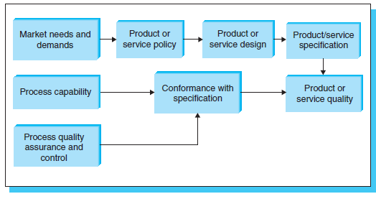
Quality in the Design Process

Slide 15
Manufacturing & Service Quality
Much of the early changes in thinking on quality took place in manufacturing but it soon became clear that the lessons applied equally in services. In many cases, quality is even more important; first, because service contains many tangible components and no-one values poorly cooked or served food or bedrooms which are not cleaned properly. But perceptions of service go beyond this to the overall experience – and the likelihood of returning.

Slide 16
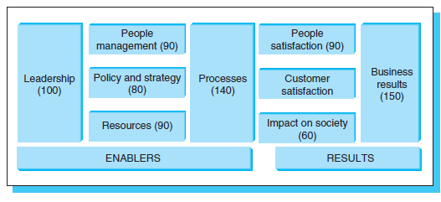
The EFQM Model

Slide 17
The SERVQUAL Methodology
The SERVQUAL questionnaire (Berry, Parasuruman, and Zeithaml) covers these five dimensions using 22 questions
Tangibles - physical appearance
Reliability - dependability, accurate performance
Responsiveness - promptness and helpfulness
Assurance - competence, courtesy, credibility, and security
Empathy - easy access, good communications, and customer understanding

Slide 18
SERVQUAL identifies five gaps between perceptions and expectations
Word of mouth
communications
Personal
needs
Past
experience
Expected service
Gap 5
Perceived
service
Customer
Gap 1
Gap 3
Service
delivery
External
communications
to customers
Management
perceptions of
customer
expectations
Gap 4
Service quality
specifications
Gap 2

Slide 19
SERVQUAL identifies five gaps between perceptions and expectations
Parasuraman et al identified five gaps that can lead to service quality failures. These five gaps are
1. Not understanding the needs of the customers
2. Being unable to translate the needs of the customer into a service design that can address them
3. Being unable to translate the design into service expectations or standards that can be implemented.
4. Being unable to deliver the services in line with specifications
5. Creating expectations that cannot be met (gap between customer’s expectations and actual delivery).

Slide 20
In General There Are ‘Seven Basic Tools’ of Quality Management:
Pareto analysis: this recognises that it is often the case that 80% of failures are due to 20% of problems and therefore tries to find those 20% and solve them first;
Histograms: used to represent this information in visual form;
Cause and effect diagrams: (fishbone charts or Ishikawa diagrams) which are used to identify the effect and work backwards, through symptoms to the root cause of the problem;
Stratification; identifying different levels of problems and symptoms using statistical techniques applied to each layer;
Check sheets; structured lists or frameworks of likely causes which can be worked through systematically. When new issues are found they are added to the list;
Scatter diagrams: used to plot variables against each other and help identify where there is a correlation or other pattern;
Control charts, which use SPC information to start the analytical process off, asking why these errors occur at this time

Slide 21
Quality Circles
The core elements of a QC are simple. It involves a small group (5 -10 people) who gather regularly in the firm's time to examine problems and discuss solutions to quality problems. They are usually drawn from the same area of the factory and participate voluntarily in the circle. The circle is usually chaired by a foreman or deputy and uses SQC methods and problem-solving aids as the basis of their problem solving activity. An important feature, often neglected in considering QCs, is that there is an element of personal development involved, through formal training but also through having the opportunity to exercise individual creativity in contributing to improvements in the area in which participants work.

Slide 22
Continuous Improvement
The underlying principle of continuous improvement is clear and well expressed in a Japanese phrase - ‘best is the enemy of better’. Rather than assuming that a single ‘big hit’ change will deal with the elimination of waste and the causes of defects, CI involves a long-term systematic attack on the problem.

Slide 23
Continuous Improvement
The underlying principle of continuous improvement is clear and well expressed in a Japanese phrase - ‘best is the enemy of better’. Rather than assuming that a single ‘big hit’ change will deal with the elimination of waste and the causes of defects, CI involves a long-term systematic attack on the problem.

Slide 24
Soft factors – gaining
Commitment to TQM;
understanding customer
Requirement, cultural
Change, training,
enthusiasm
Hard factors – SPC
Charts, Ishikawa
Diagrams, Flow diagrams,
other data for
measuring
Constant
Interaction between
Hard, soft, product,
Process factors
Product quality
Providing designs and
Specifications to
customer requirements
Process quality –
The ability to provide
‘right, first time’, cost
effective, speedy and
reliable delivery
requirements
The Total Quality Offering to Customers

Slide 25
Key Points
Quality has moved from being an ‘optional extra’ something you could have if you were prepared to pay for it – to an essential feature of the products and services which we consume. International competitiveness depends not only on price factors but also on non-price factors and quality is the first and most essential of these.

Slide 26
Key Points
Historically quality was a part of what a craftsman would build into what he or she was making. Over time and through processes of industrialisation a separation grew up, in which specialists concerned with design and control of quality took away direct responsibility from the individual. The key development over the past 40 years has been the gradual re-integration of the quality responsibility; these days quality is seen as being ‘everyone’s problem’ not the province of specialists.

Slide 27
Key Points
A key challenge today for the strategic operations manager is to ensure that the design of such products and services – and the management of the operations which go into their creation and delivery - ensures quality. The framework for doing this involves a combination of strategy, tools, procedures, structures and employee involvement and is conveniently grouped under the heading of ‘total quality management’.

Slide 28
Key Points
Central to TQM is employee engagement and developing continuous improvement capability requires establishing and reinforcing a number of key behaviours in the organization including those linked to finding and solving problems in systematic fashion. This also requires extensive investment in training and in creating supporting structures for idea management, reward and recognition and strategic alignment.

Slide 29
Key Points
In many ways the biggest challenge in TQM is not in the components but in their implementation. Evidence shows that although companies recognise the quality imperative they are not always able to respond - or if they do they have difficulties in sustaining such performance for the long haul.

Slide 30
Key Points
There is a wide range of tools to support quality maintenance and improvement including basic and more advanced tools, as well as frameworks like Quality Function deployment (designed to bring customer input to the process) and systematic approaches such as Six Sigma.

Slide 31
  How do we judge quality in products and services?
  Discuss in small groups

Slide 32
Quality Characteristics of Goods & Services
Functionality - how well the product or service does the
job for which it was intended
Appearance - aesthetic appeal, look, feel, sound &
smell of the product or service
Reliability - consistency of product or services
performance over time
Durability - the total useful life of the product or service
Recovery - the ease with which problems with the
product or service can be rectified or resolved
Contact - the nature of the person-to-person contacts
that take place

