Slide 2
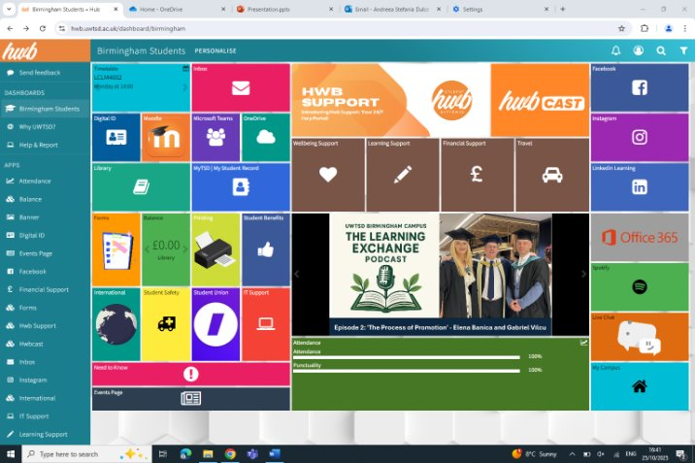
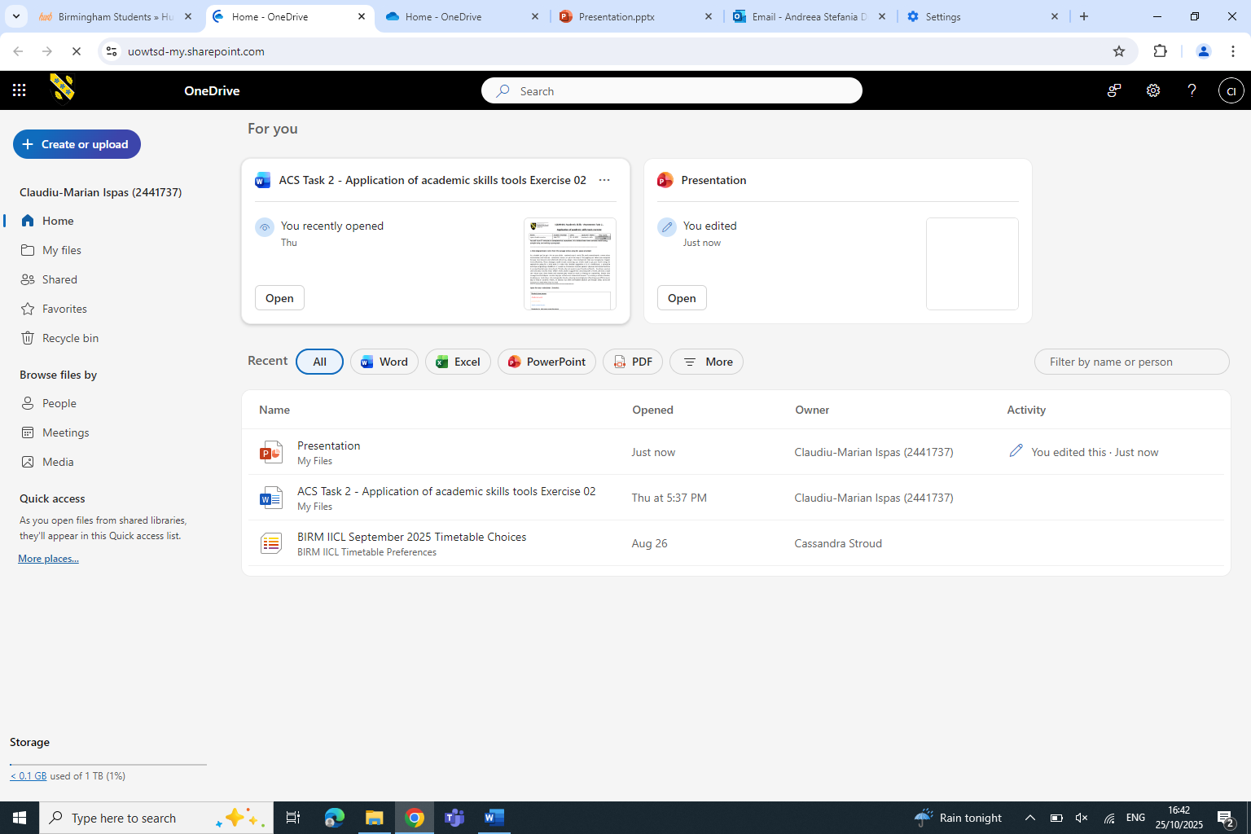
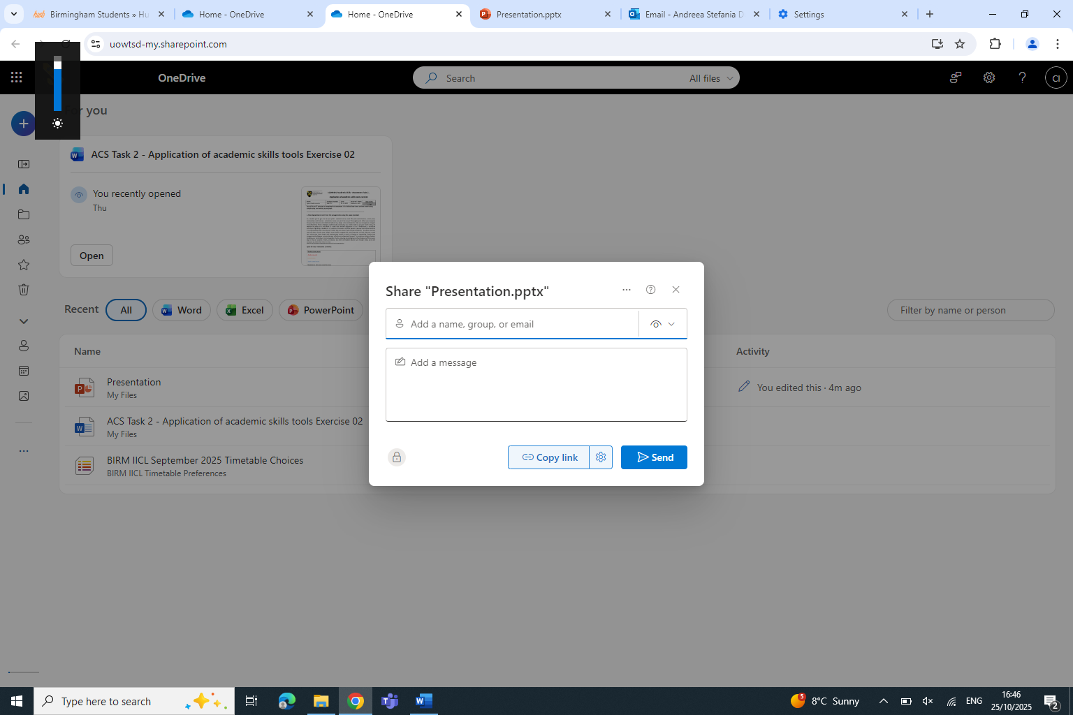
HOW TO SHARE A FILE VIA ONEDRIVE
What you need to do is log in inro uwtsd account by typing g in your student id and your password. Then it will show you a list of app choices you can pick from. To share a file via OneDrive you need to press on the OneDrive app and log in. After you log in it will automatically show you a list of files you have saved.
1 . LOG IN INTO YOUT UWSTD HWB ACCOUNT
CLICK ON THE ONEDRIVE
Next step is to find the file that you would like to share, make sure it is the correct file by checking it before you send it to people . Next to the file it will appear a “share” button press on it. And it will give you more information and instructions
FIND THE FILE YOU WANT TO SHARE
TYPE IN THE NAME OR THE ID NUMBER
After you press on the share button it will ask you the student id of the person you want to send it, after you wrote the student id will give you a choice of persons you need to click on the person you want to send your file to. It will also give you the choice to send the file to multiple people at the same time. Press “cc” and write the the id or the email.
Send it by pressing the send button

