Slide 1

Training session presentation on Elder Abuse in a Residential care home setting.
Student Name : Dilruba Khatun
Student ID Number: 1709434
Module Code : BMHP6009 BIRM
Module Title: Living with Care older person
Lecture Name : Joanne Davies
Assignment Title: Individual poster presentation

Slide 2
Introduction
Defining what is elder abuse.
Care workers recognizing the sign of elder abuse in a care setting like an domiciliary care or residential care homes.
Exploring elder abuse by identifying real life case study in domiciliary care setting or residential care homes.
Analysing current policy that protect elder people from being abuse in an residential care home setting.
Analysing current legislation that protect elder people from being abuse in an residential
Care home setting.
Discussing the theories of ageing which relate to the topic of elder people being abuse in an residential care home setting.
Discussing on how or who to report a elder abuse incident in a residential care home setting.
Recommendation on the awareness of elder people being abuse by introducing the AI within the care prevision.

Slide 3

Define What is Elder abuse.
Defining what is elder abuse in the care sector.
Abuse is defined as negative action or intentionally harming or injuring another person.
Which also mean elder people encounters physical ,sexual or neglect and also financial abuse.
(Tracy ,N 2021)
(NIH, 2020)

Slide 4

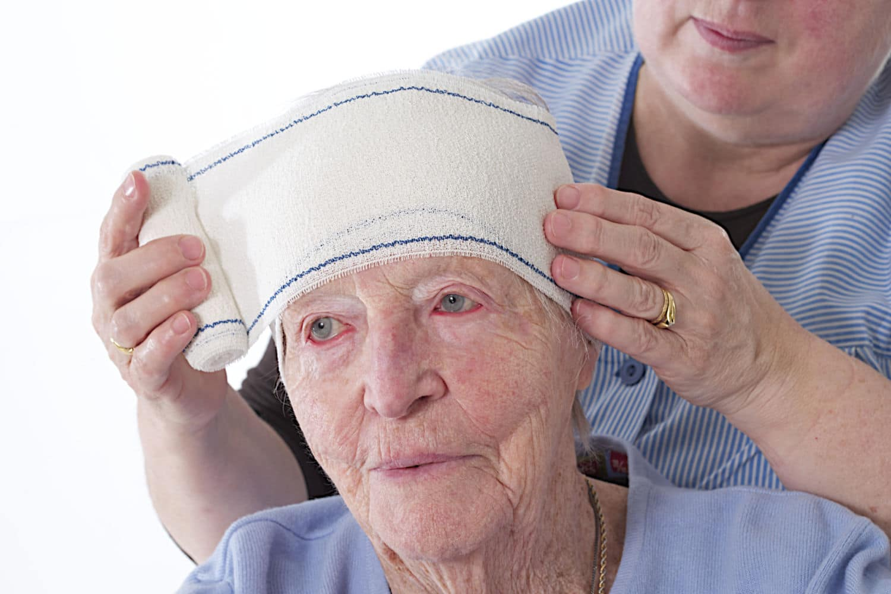
Main point 1
Care workers recognising sign of abuse that the elder people in an residential care home setting.
Elder abuse: spotting the signs and advice for cares
(Hammett , 2019)
(Hammett , 2019)
(Frist aid for life, 2001)

Slide 5


Main point 2
Real life case study on elder people who are being abused in an residential care home setting .
Staff abused women at learning disability unit, finds CQC
(Community care career and current employment , 2020)
(Samuel ,2020)
(Samuel ,2020)

Slide 6

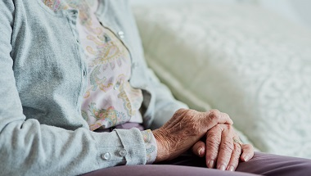
Main point 3
Policy on elder people who are being abused in an residential care home setting.
Staff and visitors can play a vital role in the identification and prevention of abuse and neglect in care homes for adults says NICE, in a draft guideline published today.
03 September 2020
(Nice National institute for health and care excellence , 2021)
(Nice , 2020)
(Nice , 2020)

Slide 7

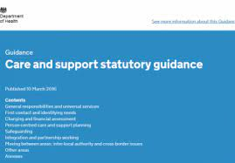

Main point 4
Legislation that are put into place to protect elder people that are being abused in an residential care home setting.
(Welcome to Gov.uk, 2021)
(Gov.uk, 2021)
(Care Quality Commission , 2021)
(The CDP Standard office , 2020)
Health and Social Care Act 2008 (Regulated Activities) Regulations 2014: Regulation 13

Slide 8
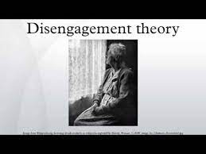


Main point 5
Theories of ageing relating to elder people who have been abuse in an residential care home setting
(White, Raypole, 2020)
(White , Raypole, 2020)
(Lumen, 2020)
Understanding the Cycle of Abuse

Slide 9

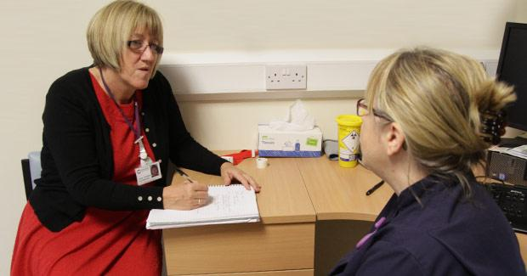

Main point 6
How or who to report an elder abuse in a residential care home setting.
(Bowoman, K (2021)
(The NHS Constitution ,(2020)
(Care quality commission ,(2020)

Slide 10


Main point 7
Recommendation that will protect the elder people from being abuse in an residential care home setting , like introducing the AI that is within the care prevision.
AI in adult social care
(Care Quality Commission , 2021)
(Guidance for unison representative , 2020)

Slide 11
What is Elder abuse
The meaning of Elder abuse in the care sector
(NIH , 2020)
(Tracy ,N 2021)

Slide 12
Sign of abuse recognized by care workers who are looking after elder people in a residential care home setting.
Professional Frist aiders are responsible to recognize elder abuse .
Different sign of abuse that a care might find on an elder abuse body.
Recognizing elder abuse found on the elder people body.
Communicating with the elder person who has been abused.
Tips on Communicating with the elder abuse.
(Hammett , 2019)

Slide 13
Real life case study relating to elder people who are being abuse in a residential care home setting.
4 Staff abused a elder women in the learning disability unite.
The inspection in a health care home
The culture of poor care in a care home.
Small minority staff in a health care home.
(Samuel ,2020)

Slide 14
Policy that is put into place for elder people that are being abused in a residential care home setting.
Staff and visitors play a vital role in a care home on how to identify and prevent any abuse and neglect in adults.
NICE a draft guideline published on 03 September 2020 for a care home.
Executive chief said on this guideline.
Practitioner. and finding perspectives said on this guideline.
(Nice , 2020)

Slide 15
Legislation that is put in to place for elder people who are being abused in a residential care home setting.
Health and Social Care Act 2008 (Regulated Activities) Regulations 2014: Regulation 13
The care Act 2014
Safeguarding venerable Group Act 2006.
(Gov.uk, 2021)
(Handley law , 2015)
(Rushton, 2020)

Slide 16
Theories of ageing which relate to elder people who are being abused in a residential care home setting .
Talking about the disagreement theory
The person centred planning
The Advocacy .
The cycle of abuse theory.
(Lumen, 2020)

Slide 17
Reporting Elder Abuse
Another term for reporting an abuse is called whistle blowing .
Also knowing your company policy on reporting abuse to your team leader or supervisor or your designated officer.
If care worker feel that they are not able to report any abuse because of work related they should go to these following health professions which are
Adult Safeguarding Board.
The CQC.
Emergency control 999 .
Helpline for Elder Abuse.
(Bowoman, K (2021)
(The NHS Constitution ,(2020)
(Care quality commission ,(2020)

Slide 18
Recommendation that can be put into place for elder people who have been abused in a residential care home setting.
Advocacy independent advocates for the older people. This would allow the older people to share concerns this may alert us of elder abuse or prevent it
Camera other IT etc
Person Centred Care Plans
Make sure that the carers are aware of how to report Elder Abuse- who + how
Recommend Staff using pcp .
(Care Quality Commission , 2021)

Slide 19
References
National Institute on Aging, ( 2020) Elder Abuse.
Available at: https://www.nia.nih.gov/health/elder-abuse. ( Accessed : 6the November 2021).
Hammett, (2019) Elder abuse: spotting the signs and advice for cares.
Available at: https://firstaidforlife.org.uk/elder-abuse/ .(Accessed : 5th November 2021).
Award winning Frist Aid Training Tailor to your needs, (2001) First Aid for life.
Available at: https://www.google.com/search?q=first+aid+for+life. (Accessed : 5th November 2021).
Samuel ,M , (2020) Staff abused women at learning disability unit, finds CQC.
Available at: https://www.communitycare.co.uk/2020/09/23/staff-abused-women-learning-disability-unit-finds-cqc
Accessed : 5th November 2021).
Community Care the heart of health and social care , (2020) Community care careers and current employee.
Available at: https://www.google.com/search?q=community+care+the+heart+of+your+social+care+career (Accessed : 5th November 2021).
Rushton, (2020) Legislation and policies that surround safeguarding vulnerable adults.
Available at: https://cpdonline.co.uk/knowledge-base/safeguarding/legislation-and-policies-that-surround-safeguarding-vulnerable-adults/(Accessed: 6th November 2021).

Slide 20
Reference
NICE, (2020) Be aware of the signs of abuse and neglect in adult care homes, says NICE.
Available at: https://www.nice.org.uk/news/article/be-aware-of-the-signs-of-abuse-and-neglect-in-adult-care-homes-says-nice (Accessed : 5th November 2021).
NICE , (2021) The National institute for health and care excellence.
Available at: https://www.google.com/search?q=NICE+Heal+care ( Accessed: 5th November 2021).
Department of health and social care, (2021) Using the Care Act guidance.
Available at: https://www.gov.uk/government/publications/care-act-statutory-guidance/care-and-support-statutory-guidance (Accessed date: 5th November
2021).
Gov.uk ,(2021) Welcome to Gove.uk.
Available at: https://www.google.com/search?q=gov+uk (Accessed: 5th November 2021).
Care Quality Commission ,(2021) Regulation 13: Safeguarding service users from abuse and improper treatment.
Available at: https://www.cqc.org.uk/guidance-providers/regulations-enforcement/regulation-13-safeguarding-service-users-abuse-improper (Accessed: 5th November 2021)
Walsall Healthcare NHS trust, (2021) Supporting staff is key to tackling CQC concern.
Available at: https://www.google.com/search?q=care+quality+commission (Accessed : 5th November 2021).
The CDP Standard office, (2020) Regulation 13: Safeguarding service users from abuse and improper treatment.
Available at: https://www.cqc.org.uk/guidance-providers/regulations-enforcement/regulation-13-safeguarding-service-users-abuse-improper (Accessed: 5th November 2021).

Slide 21
Reference
White, MA, Raypole ,C (2020) Understanding the cycles of abuse.
Available at: https://www.healthline.com/health/relationships/cycle-of-abuse (Accessed : 6th November 20201).
Healthline (2020) Medical information and health advice you can trust.
Available at: https://www.google.com/search?q=healthline (Accessed date: 6th November 20221).
Townbunison, (2021) Use of surveillance in health and care settings: Guidance for UNISON representatives.
Available at: https://www.unison.org.uk/content/uploads/2015/02/TowebUNISON-guidance-on-the-use-of-surveillance-cameras-in-health-and-care-settings2.pdf (Accessed: 6th November 2021).
Care Quality Commission ,(2021) Using cameras or other recording equipment to check somebody's care.
Available at: https://www.cqc.org.uk/contact-us/report-concern/using-cameras-or-other-recording-equipment-check-somebodys-care (Accessed: 6th November 2021).
Best spy camara for nursing home, (2020) Internet eyes.
Available at: https://www.google.com/search?q=camera+other+it+etc+in+care+home (Accessed: 6th November 2021).
Improving end of life care (2021) Improving end of life care /lifespan.
Available at: https://www.google.com/search?q=the+end+%2Ccare (Accessed: 6th November 2021).
Handley law ,(2014) Care Act 2014
Available at: https://handleylaw.co.uk/care-act-2014/ (Accessed: 6th November 2021).

Slide 22
Reference
Tracy ,N (2021) What is abuse ? Define abuse.
Available at: https://www.healthyplace.com/abuse/abuse-information/what-is-abuse-abuse-definition (Accessed: 11th November/2021).
Care quality commission ,(2020) What we do.
Available at: https://www.google.com/search?q=cqc+helpline(Aceesed: 10th November 2021).
The NHS Constitution ,(2020) Call handler emergency medical dispatcher health Career.
Available at: https://www.google.com/search?q=999+call+handler+job+description(Accessed: 10th November 2021).
Bowoman, K (2021) The National Carelines information Now.
Available at: https://www.google.com/search?q=the+nation+care+line (Accessed : 10th November 2021).
The National Careline (2020) Action on Elder Abuse .
Available at: https://www.thenationalcareline.org/AccessingHelp/ActionOnElderAbuse(Accessed : 10th November 2021).
NHS (2020) Call handler/emergency medical dispatcher.
Available at: https://www.healthcareers.nhs.uk/explore-roles/ambulance-service-team/roles-ambulance-service/emergency-medical-dispatchercall-handle (Accessed: 10th November 2021).
The independent regulator of health and social care n England (2021) How we monitor ,inspect and rate.
Available at: https://www.cqc.org.uk/what-we-do (accessed : 10th November 2021).
SCIE (2021) Role and duties of Safeguarding Adults Boards.
Available at: https://www.scie.org.uk/care-act-2014/safeguarding-adults/safeguarding-adults-boards-checklist-and-resources/role-and-duties.asp (Accessed:10th November 2021).

Slide 23
Conclusion
In this assignment regarding this presentation I have learnt about elder abuse and how to deal with the present outcome of the abuse incident. By following Polices and producers like different Act that will protect elder people who have been abused in a care home or a domiciliary care. And importantly the communication you need to provided during any abuse situation that a carer will come across with the elder individual who have been abuse.
The outcome to this presentation was mostly getting the right information on elder abuse people. which there is different literature out there to help elder abuser in a residential care home or domiciliary care.
And finally reaccommodating any service or action to be taken which will allow cares in the care sector to overcome abuse which any elder individual might be suffering in an residential care home or an domiciliary care setting.

Slide 24
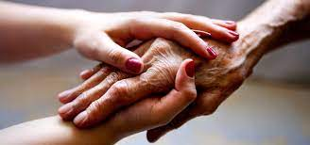
Thank you for listening to my presentation
(Improving end of live care , 2021)

