Slide 1
MBA
Financial Management
Week 5
Financial Ratios (Part 1)
Excel Practice

Slide 2
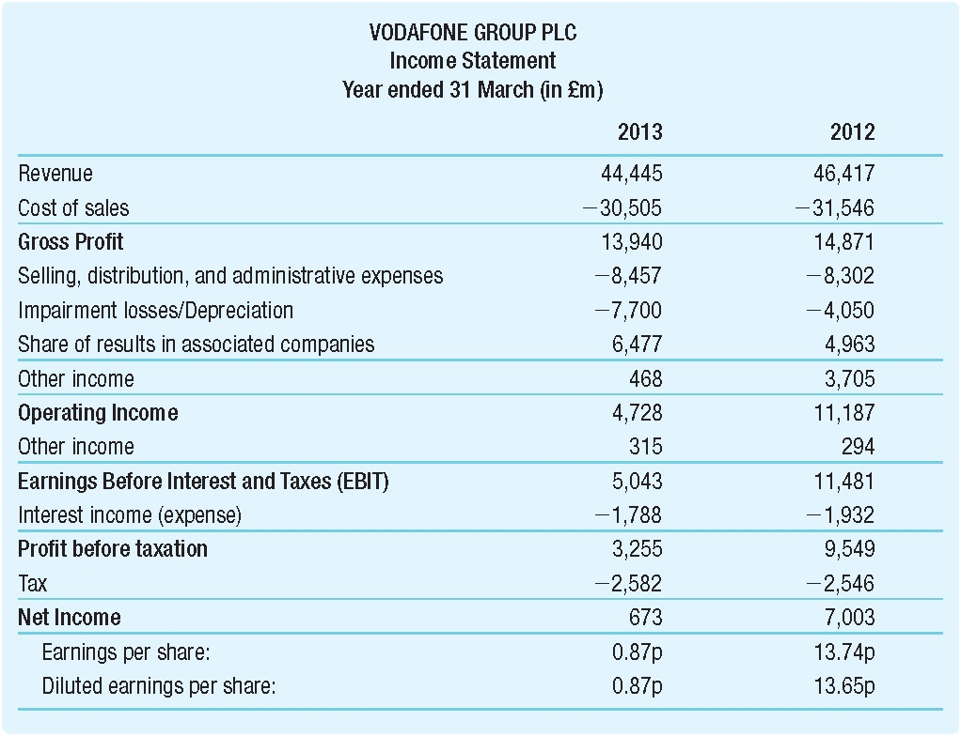
Excel Practice – Create Income Statement
Suppose this is the real-life income statement we are facing.
We notice there are some items unfamiliar to us, like Impairment losses/Depreciation.
Due to companies’ various accounting practices, they may vary from other companies.

Slide 3
Excel Practice – Create Income Statement
No worries, we at first search for these key items, such as Revenue, Cost of Sales, Gross Profit, Operating Income, EBIT, Profit Before Taxation, and Net Income.

Slide 4
Excel Practice – Create Income Statement
When we find these key items, we can collect their corresponding numbers each year.
Open an empty Excel file and put them into it.

Slide 5
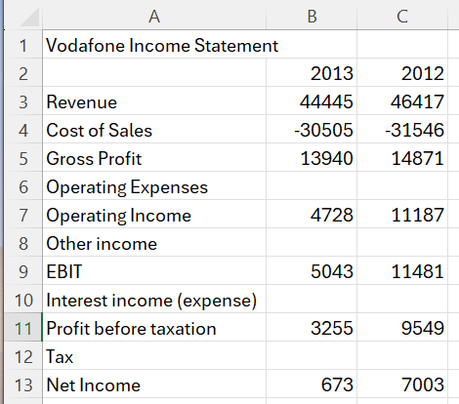
Excel Practice – Create Income Statement
From A1 to C13, we enter these contents, such as the title “Vodafone Income Statement” in A1, the years in B2 and B3, and the information from the real-life income statement in A3 to C13.
You may notice some empty cells. Why?

Slide 6
Excel Practice – Create Income Statement
There are 4 items between Gross Profit and Operating Income, but we only learn that Gross Profit – Operating Expenses = Operating Income.
We need to find a way to simplify “Operating Expenses” (although it may be not accurate and correct).

Slide 7
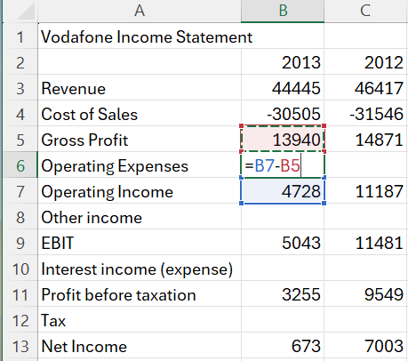
Excel Practice – Create Income Statement
To do so, we directly use Operating Income (4728) minus Gross Profit (13940), and the Excel function is “=B7-B5.”
Don’t forget to press Enter key after you enter a function!

Slide 8
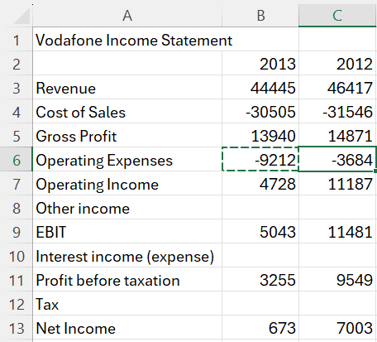
Excel Practice – Create Income Statement
Then, we copy (Ctrl + C) B6 and paste (Ctrl + V) in C6.
Now, we can get the number -9212 and -3684 for Operating Expenses in 2013 and 2012, respectively.
Question: Are we allowed to skip the data collection of Operating Expenses?

Slide 9
Excel Practice – Create Income Statement
Back to the real-life statement. We notice the numbers between Gross Profit (13940) and Operating Income (4728) are -8457, -7700, 6477, and 468.
Can you sum them up and tell me what do you find?

Slide 10
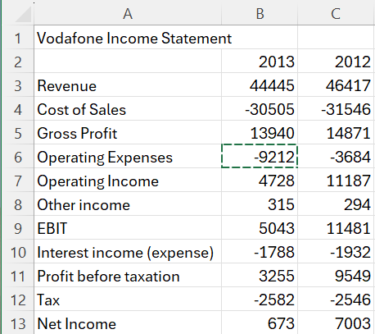
Excel Practice – Create Income Statement
For the rest empty cells, we do the same thing – use the number below the empty cell minus the one above the empty cell.
How can it happen?
Because the calculation of all items in income statement should follow an order – begin from Revenue and end with Net Income.

Slide 11
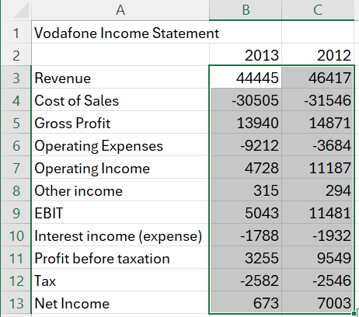
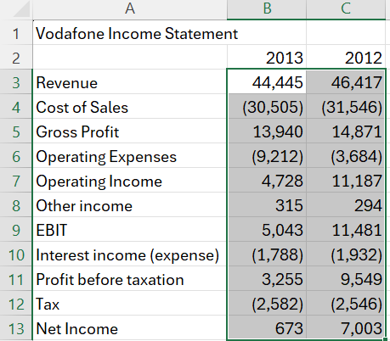
Excel Practice – Create Income Statement
To make this table professional, we need to use a “magic spell,” that is, Format Cells. Select the number area (B3 to C13) and use the spell we learned last week.

Slide 12
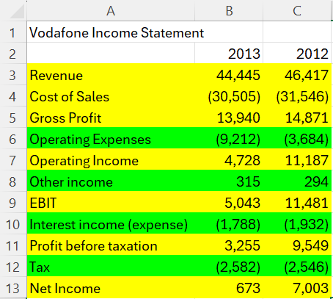
Excel Practice – Create Income Statement
In a nutshell, we need to extract data from the real-life income statement based on these yellow key items and use functions to calculate the green items.
By doing so, we can create a simplified income statement for our data analysis.

Slide 13
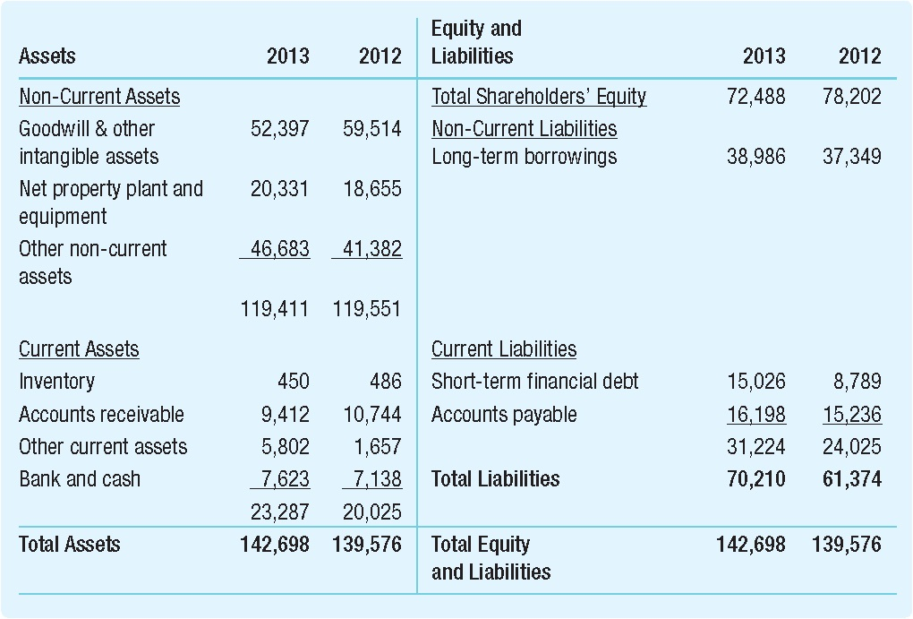
Excel Practice – Create Balance Sheet
We just learned how to create an “easy” income statement. Now, we are creating an “easy” balance sheet.
Suppose we are facing a real-life balance sheet on the left.
Next, we start with Assets side.

Slide 14
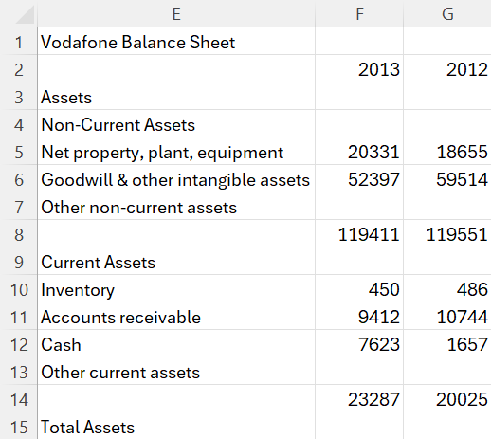
Excel Practice – Create Balance Sheet
We extract key items from the balance sheet on the left and put them in the area E1 to G15.

Slide 15
Excel Practice – Create Balance Sheet
Particularly, we should notice these “blank” items. They show the total amount of a sub-group.

Slide 16
Excel Practice – Create Balance Sheet
For example, “119411” is the sum of all Non-Current Assets in 2013 and “23287” is the sum of Current Assets.
The reason why keeps the name of total amount blank is because of the accounting practice and standard.
Next time when we see empty items, we should know it defines the total amount!

Slide 17
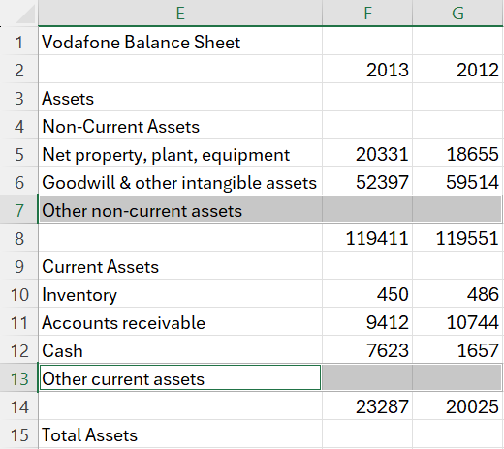
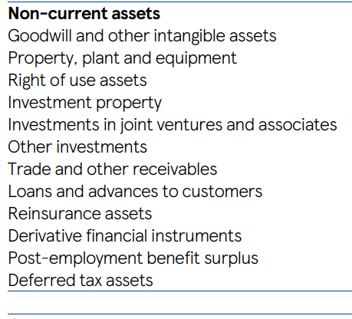
Excel Practice – Create Balance Sheet
Back to Excel, I leave, for example, “Other non-current assets” empty on purpose. There are too many “Others” in real life!

Slide 18
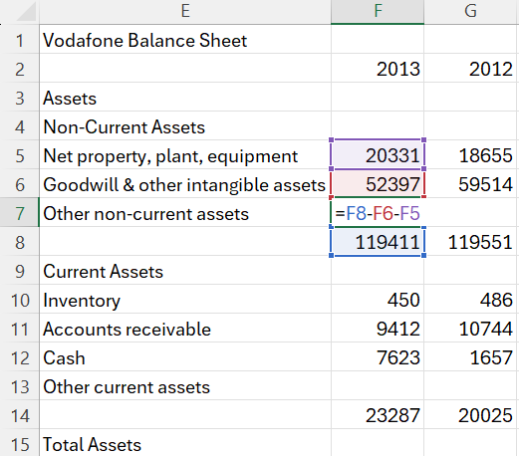
Excel Practice – Create Balance Sheet
Given this, we use a smart way to deal with it.
We use total amount (F8) minus Goodwill (F6) minus Fixed Assets (F5) to calculate Other Non-Current Assets.
Tips: Property, plant, equipment = Fixed Assets

Slide 19
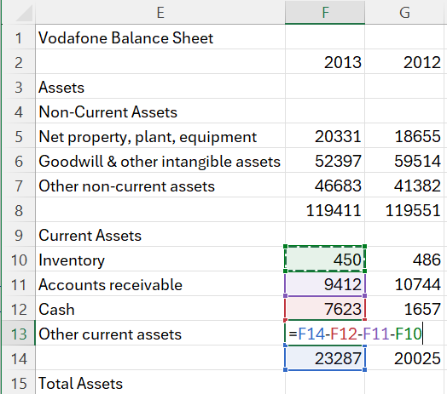
Excel Practice – Create Balance Sheet
For Other Current Assets, we do the similar thing.
We use total amount (F14) minus Cash (F12) minus Account Receivable (F11) minus Inventory (F10).

Slide 20
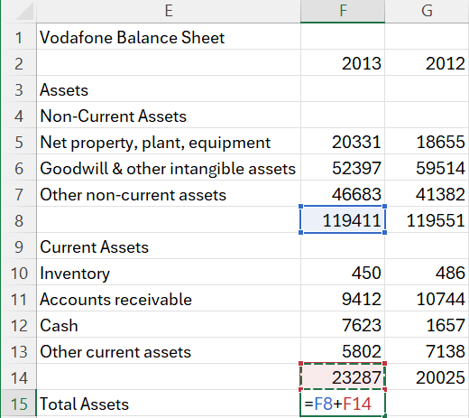
Excel Practice – Create Balance Sheet
The last thing is to calculate Total Assets.
Be careful, lots of real-life balance sheet don’t provide the amount of Total Assets, which means you need to calculate it on your own!

Slide 21
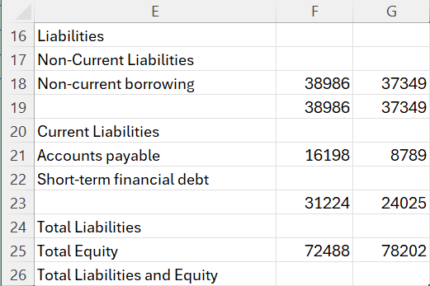
Excel Practice – Create Balance Sheet
Continue our balance sheet. We extract key items from the left table and leave the rest numbers empty.

Slide 22
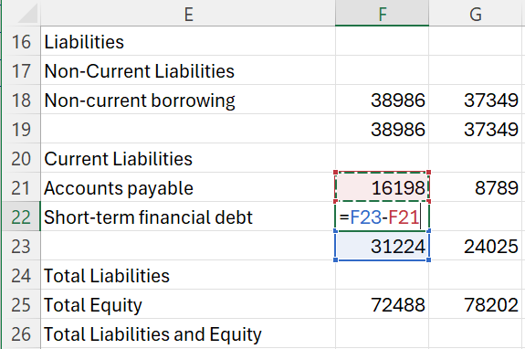
Excel Practice – Create Balance Sheet
The last thing is to calculate Total Assets.
Be careful, lots of real-life balance sheet don’t provide the amount of Total Assets, which means you need to calculate it on your own!

Slide 23
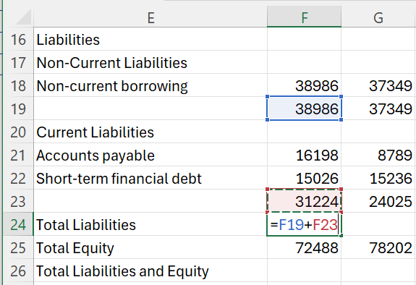
Excel Practice – Create Balance Sheet
The last thing is to calculate Total Assets.
Be careful, lots of real-life balance sheet don’t provide the amount of Total Assets, which means you need to calculate it on your own!

Slide 24
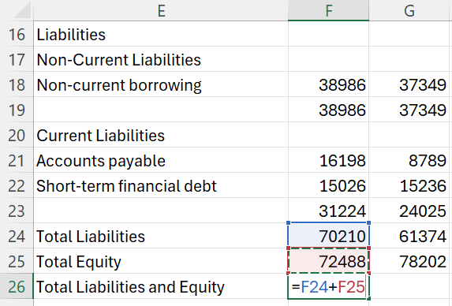
Excel Practice – Create Balance Sheet
The last thing is to calculate Total Assets.
Be careful, lots of real-life balance sheet don’t provide the amount of Total Assets, which means you need to calculate it on your own!

Slide 25
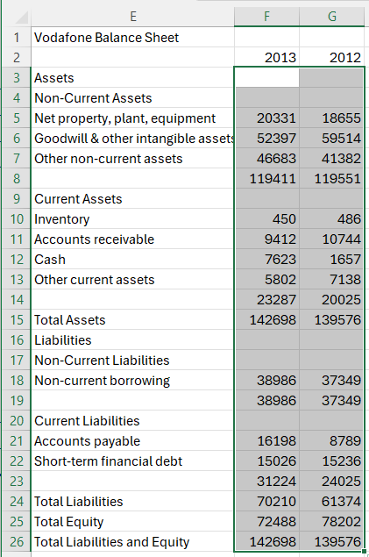
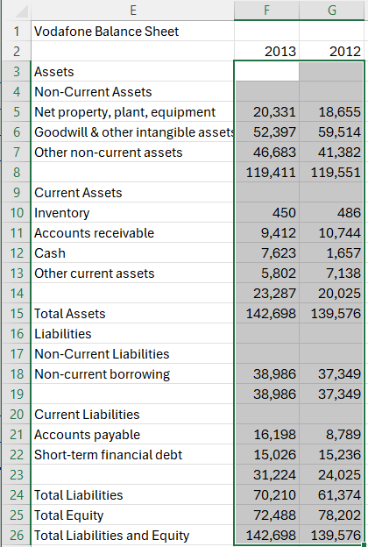
Excel Practice – Create Balance Sheet
The last thing is to calculate Total Assets.
Be careful, lots of real-life balance sheet don’t provide the amount of Total Assets, which means you need to calculate it on your own!

