Slide 1

Working in Teams
Jubli aktar
2128699
Module code: LCHS4005
Module leader:
Opeyemil odejimi

Slide 2
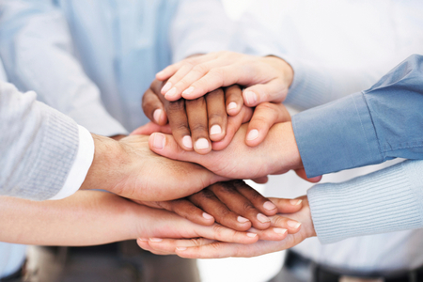
What is Teamwork?
The term "teamwork skills" describes a group of connected skills and abilities that enables individuals to collaborate with people in a planned and empathic manner in a variety of settings, meetings, and projects, stated by (Indeed, 2021).
Group
Formal Groups are teams assembled by an organisation with the aim of completing a particular objective, (S, 2018).
Formal
Work gets done faster
Professional
Person centred care
Holistic care
Support and success together

Slide 3
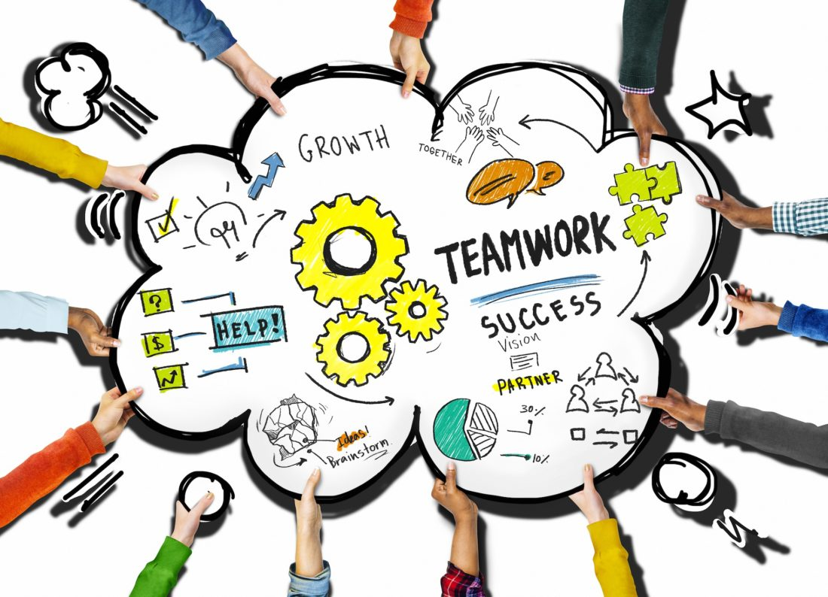
Teamwork within Health and Social Care
Teamwork in the healthcare system can immediately and positively impact patient safety and success. With an increase in founder and the difficulty of care specialty, there is an increasing need for effective teamworks, stated by (Babiker et al., 2014).
The importance?
Teamwork is important because no matter what industry of employment anyone works in, it will nearly always work as part of a team because most organisations have teams in every department and division. Understanding and keeping yourself engaged with team members will help achieve the company's goals. Indeed, (2021) also stated that a “good teamwork also enhances the team's performance, motivation, and employee engagement”.
Teamwork also decreases the chance of unwanted outcomes brought on by errors of the roles and responsibilities and miscommunication with other healthcare providers who are caring for the patient, Babiker et al., (2014) .
( Richter, 2016)

Slide 4

Practical example
Team members should be encouraged to share thoughts with everyone within the group throughout shifts so that there is best outcomes for patients care, express concerns so that nothing in their mind is left out and ask questions in order to brainstorm solutions and raise awareness that might help others. Also, to provide the highest level of patient care and to ensure workplace satisfaction, each team member's strengths and abilities must be used.
Gavin, kara (2006)
Everyone’s skills, background
The project goals
The timeline
What individual roles each member will play
Confident & motivated
Achievement
High moral
Success
Completions
Rewarding
recognition
Stronger leadership
Meetings to avoid conflict
Struggles
Clear duties
Agreements/ disagreement addressed
Less conflict
Storming
Norming
Performing
Forming
Adjourning
Tuckman’s Model

Slide 5
Reference
Indeed (2021) Teamwork skills: Definition, types and tips for improvement, Teamwork Skills: Definition, Types and Tips for Improvement. Indeed Editorial Team. Available at: https://uk.indeed.com/career-advice/career-development/teamwork-skills (Accessed: February 26, 2023).
Babiker, A. et al. (2014) Health Care Professional Development: Working as a team to improve patient care, Sudanese journal of paediatrics. U.S. National Library of Medicine. Available at: https://www.ncbi.nlm.nih.gov/pmc/articles/PMC4949805/ (Accessed: February 26, 2023).
Richter, N. (2016) Office design for Effective Teamwork & Collaboration, Fuze Business Interiors. Available at: https://fuzeinteriors.co.nz/office-design-effective-teamwork/ (Accessed: February 26, 2023).
Gavin, kara (2006) The more doctors interact, the better their patients do, The More Doctors Interact, the Better Their Patients Do. Available at: https://www.michiganmedicine.org/health-lab/more-doctors-interact-better-their-patients-do (Accessed: February 27, 2023).
S, S. (2018) Difference between formal and informal groups (with comparison chart), Key Differences. Available at: https://keydifferences.com/difference-between-formal-and-informal-groups.html (Accessed: March 1, 2023).

