Slide 1
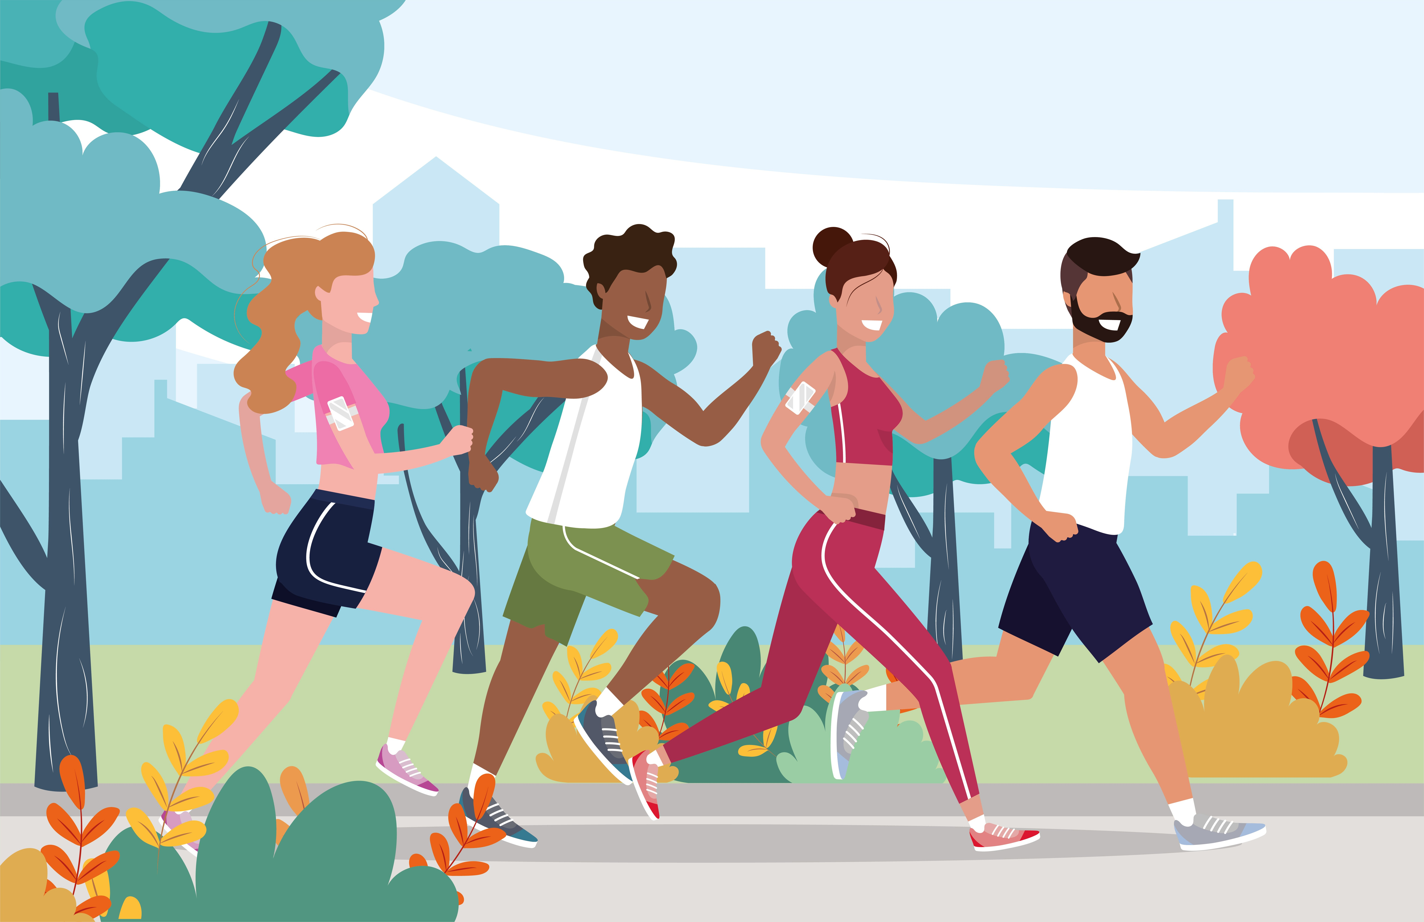
Name: Rezia Razzaque
Student Number: 1711140
Module Name: Practice Based Research
Module Code: LCHS700
Lecturer Name: Zeno Leung
Prevalence of Physical Activity of University Students in Birmingham of The BAME Community
(Vecteezy,2019)

Slide 2
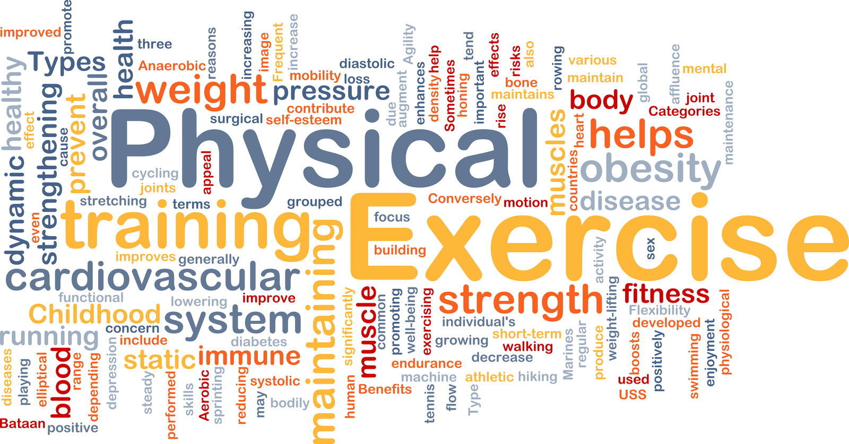
Contents Page
Introduction
Introduction continued
Literature Based background
Rationale
Rationale continues
Proposed Question
Aim and Objectives
Research Design
Ethical Consideration
Implications of Research
Plan of work Gantt Chart

Slide 3
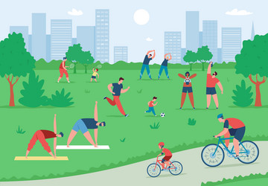
Introduction
The presentation will be looking at the Physical Activity of the BAME community students in Birmingham University.
According to the Office of National Statistics (2011), Black and Asian minority ethnic (BAME) groups comprise approximately 13% of the population in the United Kingdom and are expected to experience a substantial increase in the upcoming decades (WHO, 2022).
Compared to White individuals, those of Asian, Black, and Chinese descent are much more likely to be physically inactive. Additionally, members of these ethnic groups are much less inclined to volunteer in physical activity and reap the rewards that come with it (Sport England, 2020).
(vectostock, 2019)
Notes:
My rsearch based presentation is on the prevelance of Physical Activity of Birmingham students of the BAME community.

Slide 4
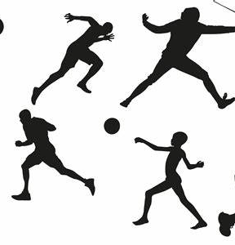
Introduction continued
While activity levels in other ethnic groups stayed similar, Black or Mixed ethnic groups reported a significant decline in the percentage of physically active students in 2019 to 2020 compared with 2018 to 2019 during Covid 19 (Public Health England, 2021).
Currently, 62% of students in England fulfill the recommended 150 minutes of physical activity each week as set forth by the Chief Medical Officer. Only 55.1% of Asians (excluding Chinese) and 56% of Black people, however, meet this threshold (Sport England, 2020).
(clipartix,2020)

Slide 5

Literature Based background
Literature Review: The literature review's objective is to investigate the obstacles and enablers that prevent UK BAME community students from adopting healthy PA lifestyle choices (Mbabazi et al., 2024).
Various factors, including language and cultural challenges as well as beliefs, contribute to the lower levels of physical activity among students from BAME groups (Mental Health Foundation, 2021).
Physical Activity is important and beneficial for people of all ages, it aids in the management and prevention of cancer, heart disease, diabetes, obesity, mental health, cognitive learning, growth and healthy development, and general wellbeing (Mbabazi et al., 2022).

Slide 6

Rationale
Significance of the study:
Universities and local clubs have a really important role to play in providing young students with the opportunity to access physical Activity. It also wants the barriers BAME students face - whether cultural, lack of opportunity or motivation - to be addressed to make getting active an easy choice (bbc, 2020).
Increased socioeconomic and health disparities among Black and Minority Ethnic (BME) populations are a result of inactive lifestyles (Such, E., et al, 2017).

Slide 7
Rationale Continued
In comparison to the UK's general population, BAME Students have been found to have lower levels of physical activity. When it comes to better health outcomes, physical activity has more advantages than negatives (Ingle, 2020).
BAME communities experience health disparities and report worse outcomes from a variety of health treatments.

Slide 8

Proposed Question ?
Why do the Bame Community students have lower levels of Physical activity ?

Slide 9

Aim & Objective
One of the aims and objectives of implementing physical activity for students is enhancing cognitive, motor, and social skills, as well as maintaining optimal metabolic and musculoskeletal health, Additionally, there is a ripple impact on academic achievement (WHO, 2021).
Why culture and ethnicity are important in sports and physical activity (Sport England, 2020)

Slide 10
Aim and Objectives continued
To develop fresh, creative approaches to the design of physical exercise and sports so that a greater number of people may perceive it as something that is appropriate for them, their communities, and individuals who resemble them (Sport England, 2020b)
Speaking about race and culture in the context of physical activity causes a higher level of discomfort, which needs to be addressed to close the ethnicity gap.
Overall activity levels and the notable variations among various ethnic groups
The effect of superimposing various demographic factors on activity levels (Sport England, 2020)

Slide 11

Research Methodology
Cross sectional quantative approuch
Several online surveys and questionnaires will be used to assist in gathering statistics.
Group questionnaires (Sylvia et al., 2014).
Self-report measures, which include activity diaries, recollections.
Online Questionnaire that will be emailed to participants
( FRSPH, M.J.M. et al,2022).

Slide 12

Research Design
Sampling Setting
BAME Postgraduate Students at Birmingham University
White students are excluded.
Number of responses anticipated: 350
All students will get a series of emails with screening questions to help identify the target group
Engaging in voluntary activities
(INFORM, 2020).

Slide 13

Data Collection: A survey will be completed online by participants using a secure platform, providing demographic data and also gender and age.
Informed consent will be considered in the research such as:
The purpose of the study
The advantages and hazards of participating
How much time the study will require
Data Analysis:
Inferential statistics will be used to create conclusions and predictions based on data.
Surveys, observations and experiments, also government census and previous scientific studies using Physical Activity Health Alliance (PAHA) (closer, 2024).

Slide 14
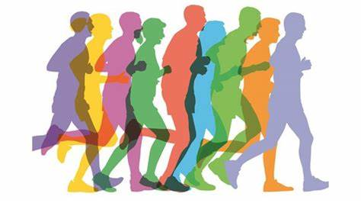
Ethical Consideration
Ethical Consideration: Before beginning any study involving the collecting of human data, an institutional review board (IRB) must receive a research proposal.
The IRB committee will determine if the study's objectives and design adhere to the institution's code of conduct and are ethically appropriate such as:
Racism and discrimination
Mental Health Stigma
Social and economic inequalities
Interpretation of Findings: The results will be helpful in creating culturally appropriate interventions aimed at enhancing physical activity lifestyle choices among BAME students..
(mind, 2020).

Slide 15

Implications of Research: Thinking about how culture and ethnicity influence lifestyle decisions related to physical activity.
Numerous studies have shown how physical activity (PA) influences brain development, which in turn improves wellbeing and cognition (Mandolesi et al., 2018).
Conclusions and Recommendations: The research review will assist in capturing the experiences of BAME students at universities regarding the barriers and benefits of physical engagement. Physical activity must be widely practiced to support behavior adjustment and result in long-lasting improvement. The purpose of this review is to demonstrate the need for further primary, peer-reviewed research on BAME student's experiences with, or views of, the advantages and disadvantages to making good Physical Activity choices.
Sports programs pre-test preparation
Fitness center incentives
Training for physical education courses
Activity tracker or monitor for attendance
(Mbabazi et al., 2024).

Slide 16
Plan of Work Ghant Chart
Week 1 Week 2 Week 3 Week 4 Week5
Quantative approach
Sampling Setting
^{Data Collection}
^{Data Analysis}
^{Ethical Consideration}
^{Interpartation of findings}
^{Implication of Findings}
^{(Sylvia et al., 2014)}

Slide 17
Reference
•Bhandari, P. (2022, December 02). Ethical Considerations in Research | Types & Examples. Scribbr., Available at: https://www.scribbr.com/methodology/research-ethics/ (Accessed 25th Febuary 2024).
bbc (2020). Sport England: Why are children from Black, Asian and ethnic minorities less active? - CBBC Newsround. www.bbc.co.uk. [online] 20 Jan. Available at: https://www.bbc.co.uk/newsround/51281976.(Assessed on 26th Febuary 2024).
Closer (2024). Physical activity measurement: Data collection methods. [online] CLOSER. Available at: https://closer.ac.uk/cross-study-data-guides/physical-activity-measures-guide/data-collection-methods-physical-activity/.(Assessed on 25th February 2024).
Cresswell JW, Cresswell JD. (2017). Research design: qualitative, quantitative and mixed method approaches. (Edn: 5th). Sage Publications Inc: London.(Accessed 25th Febuary 2024).
Creswell, J.W. (2008). Educational Research: Planning, conducting, and evaluating quantitative and qualitative research (3rd ed.). Upper Saddle River: Pearson (Accessed 25th Febuary 2024).
FRSPH, M.J.M., MacGregor, F., Salman, M., Breckon, J., Kunonga, E., Tolchard, B. and Nnyanzi, L., 2022. Exploring the barriers and facilitators to making healthy physical activity lifestyle choices among UK BAME adults during covid-19 pandemic: A study protocol. International Journal of Physical Activity and Health, 1(3), p.1.
Ingle, S. (2020). Sport England warns that BAME people are being ‘excluded and let down’. The Guardian. [online] 26 Jan. Available at: https://www.theguardian.com/sport/2020/jan/26/sport-england-report-bame-people-excluded-let-down. (Assessed on 24th Febuary 2024).
INFORM, N. (2020). Types of exercise. [online] www.nhsinform.scot. Available at: https://www.nhsinform.scot/healthy-living/keeping-active/getting-started/types-of-exercise. (Assessed on 26th Febuary 2024).

Slide 18
Nunez, K. (2019). What You Need to Know About Informed Consent. [online] Healthline. Available at: https://www.healthline.com/health/informed-consent. (Assessed on 26th February 2024).
Mbabazi, J., MacGregor, F., Breckon, J., Tolchard, B., Watson, D., Hogg, J., Kunonga, E., Dorothy Irene Nalweyiso, Teke, J., Dawson, R., George William Kagugube, Salman, M., Richardson, A.S., Misheck Nkhata and Lawrence Achilles Nnyanzi (2024). Exploring the barriers and facilitators to making healthy physical activity lifestyle choices among UK BAME adults during the COVID-19 pandemic: a systematic review of qualitative study. Cogent Public Health, 11(1). doi:https://doi.org/10.1080/27707571.2023.2294518. (assessed on 23rd Febuary 2024).
Maxwell JA. (2012). Qualitative Research Design: An Interactive Approach: 41 (Applied Social Research Methods). Sage Publications Inc: London.(Accessed 25th Febuary 2024).
Mbabazi, J., Kanmodi, K.K., Kunonga, E., Tolchard, B. and Nnyanzi, L.A. (2022). Barriers and Facilitators of Physical Activity. Journal of Health and Allied Sciences NU, 1(2). doi:https://doi.org/10.1055/s-0042-1753561. (Assessed on 23rd Febuary 2023).
Mental Health Foundation (2021). Black, Asian and Minority Ethnic (BAME) Communities. [online] www.mentalhealth.org.uk. Available at: https://www.mentalhealth.org.uk/explore-mental-health/a-z-topics/black-asian-and-minority-ethnic-bame-communities. (Assessed 26th Fabuary 2024).
Physical activity (PA) is defined as any movement of the body made by the skeletal muscles that needs the intake of energy (Caspersen et al., 1985; Dasso, 2019; Mbabazi).
Public Health England (2021). Physical Activity Data tool: Statistical commentary, March 2021. [online] GOV.UK. Available at: https://www.gov.uk/government/statistics/physical-activity-data-tool-march-2021-update/physical-activity-data-tool-statistical-commentary-march-2021. (assessed on 23rdFebuary 2024).

Slide 19
Reference
Koshoedo, S.A., Paul-Ebhohimhen, V.A., Jepson, R.G. and Watson, M.C. (2015). Understanding the complex interplay of barriers to physical activity amongst black and minority ethnic groups in the United Kingdom: a qualitative synthesis using meta-ethnography. BMC Public Health, [online] 15(1). doi:https://doi.org/10.1186/s12889-015-1893-0. (Assessed on 26th February 2024).
Peerbhoy, D., Minou, M. and Stratton, G., 2021. Women, wellbeing and the city: A model of participatory health research exploring physical activity in Black, Asian and minority ethnic communities. Health Education Journal, 80(3), pp.287-299. (Assesed on 26th Febuary 2024).
Silfee, V.J., Haughton, C.F., Jake-Schoffman, D.E., Lopez-Cepero, A., May, C.N., Sreedhara, M., Rosal, M.C. and Lemn, S.C. (2018). Objective measurement of physical activity outcomes in lifestyle interventions among adults: A systematic review. Preventive Medicine Reports, [online] 11(2), pp.74–80. doi:https://doi.org/10.1016/j.pmedr.2018.05.003. (Assessed on 25th Febuary 2024).
Sport England (2020). ‘Sport for all’ highlights ethnicity gap in sport. [online] Sport England. Available at: https://www.sportengland.org/news/sport-for-all. (assessed on 23rdFebuary 2024).

Slide 20
Mandolesi, L., Polverino, A., Montuori, S., Foti, F., Ferraioli, G., Sorrentino, P. and Sorrentino, G. (2018). Effects of physical exercise on cognitive functioning and wellbeing: Biological and psychological benefits. Frontiers in Psychology, [online] 9(9). doi:https://doi.org/10.3389/fpsyg.2018.00509.
Sylvia, L.G., Bernstein, E.E., Hubbard, J.L., Keating, L. and Anderson, E.J. (2014). Practical Guide to Measuring Physical Activity. Journal of the Academy of Nutrition and Dietetics, [online] 114(2), pp.199–208. doi:https://doi.org/10.1016/j.jand.2013.09.018. (Assessed on 24th Febuary 2024).
Such, E., Salway, S., Copeland, R., Haake, S., Domone, S. and Mann, S., 2017. A formative review of physical activity interventions for minority ethnic populations in England. Journal of Public Health, 39(4), pp.e265-e274. (Assessed on 26th Febuary 2024).
World Health Organisation (2022). The Global Status Report on Physical Activity 2022. [online] www.who.int. Available at: https://www.who.int/teams/health-promotion/physical-activity/global-status-report-on-physical-activity-2022. (Assessed on 26th Febuary 2024).
World health organization (2021). WHO reviews effect of physical activity on enhancing academic achievement at school. [online] www.who.int. Available at: https://www.who.int/europe/news/item/17-02-2021-who-reviews-effect-of-physical-activity-on-enhancing-academic-achievement-at-school.(Assessed on 26th February 2024).

